Slide 1
ESLint Setup And Overview
Mobile Developer Fast Track

Slide 2
Introduction
ESLint is a tool for validating Javascript code that you write in the code editor

Slide 3
DEMO

Slide 4
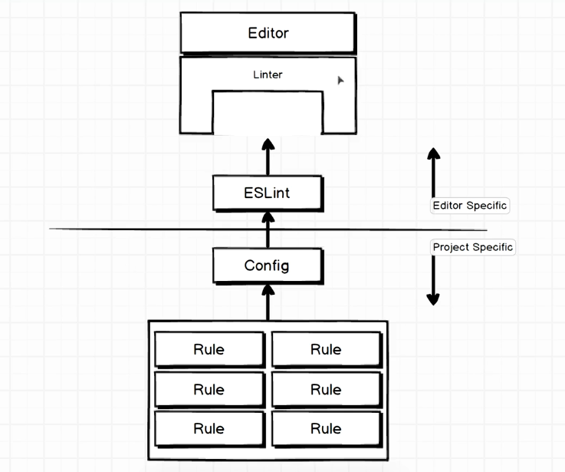
Structure

Slide 5
Explanation
Visual Studio Code has an ecosystem of different packages that we can download and install inside it to enhance the behavior of the editor
One such plugin that we can install is called Linter. Simply Linter, not ESLint

Slide 6
Linter
Linter is some underlying functionality inside of code editor that allows us to plug in different linters.
So ESLint is not the only linting system out there
There are tons of other programming language and many other languages have linters of their own

Slide 7
ESLint
ESLint is the plugin/module that parses our Javascript code and applies some rules to it and tries to validate
It creates the error message to show to the user

Slide 8
Editor and Project Specific
Linter and ESLint are Editor specific settings
You install them once and you can use it forever
On the other side are Project specific settings. You have to install it everytime you create a new project

Slide 9
Config
To set up ESLint on a very specific project, we will add in some amount of configuration (for just that specific project)
The purpose of the config file is to tell ESLint that we want to use some number of rules to validate our Javascript
So when ESLint run for the first time, it does absolutely nothing until we specify some number of rules into it

