Slide 1
ESLint Setup With VSCode
Mobile Developer Fast Track

Slide 2
ESLint
To install ESLint globally, run this script on the command prompt
npm install -g eslint

Slide 3
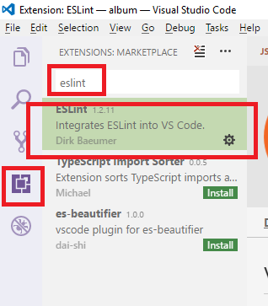
ESLint
To install ESLint in VSCode, click the “Extensions” menu and search for “ESLint”
Install and enable it

Slide 4
Ruleset
To install a React Native ruleset for ESLint, run this script on command prompt
npm install --save-dev eslint-config-rallycoding

Slide 5
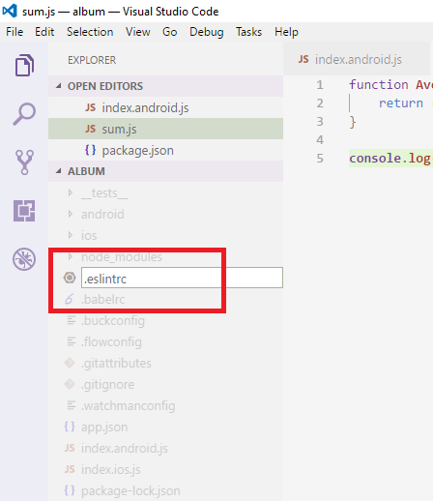
Configure Ruleset Into Project
Open your project in Visual Studio Code
Create a new file named “.eslintrc”

Slide 6
.eslintrc
This file is used to tell ESLint that we want to use the ruleset that we just installed with NPM
Add this code into the .eslintrc file
{
“extends”: “rallycoding”
}

Slide 7
DEMO

