Slide 1
Project Directory Walkthrough
Mobile Developer Fast Track

Slide 2
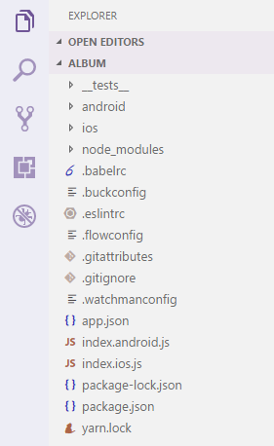
Structure

Slide 3
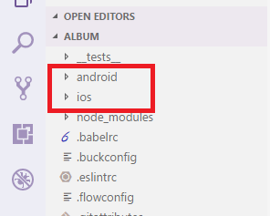
Android & iOS Folder

Slide 4
Android & iOS Folder
Both contains the respective files required to build React Native application on either platform
It’s very rare that we’re ever going to have to deal with the contents of either of these folders
The only time to mess with those project directories is when we want to make a modification to the project on a very low level scale

Slide 5
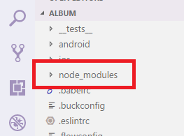
Node Modules Directory

Slide 6
Node Modules Directory
node_modules is where all of our project dependencies are stored
For React Native, there are a tremendous number of dependencies
We’re not going to have to do with that folder at all

Slide 7
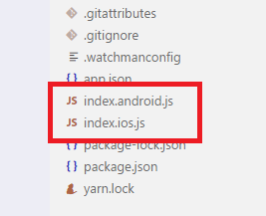
Index JS

Slide 8
Index JS
The 2 files that we’re going to be most concerned with, is index.android.js and index.ios.js files
The 2 files are totally identical
The purpose of these 2 files are to serve as entry points for applications

Slide 9
Index JS
Whenever we built React Native app for Android, the app will execute all of the code inside the index.android.js file first
Likewise when we run the iOS app, it will execute the index.ios.js file first
The 2 files start off as identical but we might customize them over time to better suit the platform

