Slide 1
React VS React Native
Mobile Developer Fast Track

Slide 2
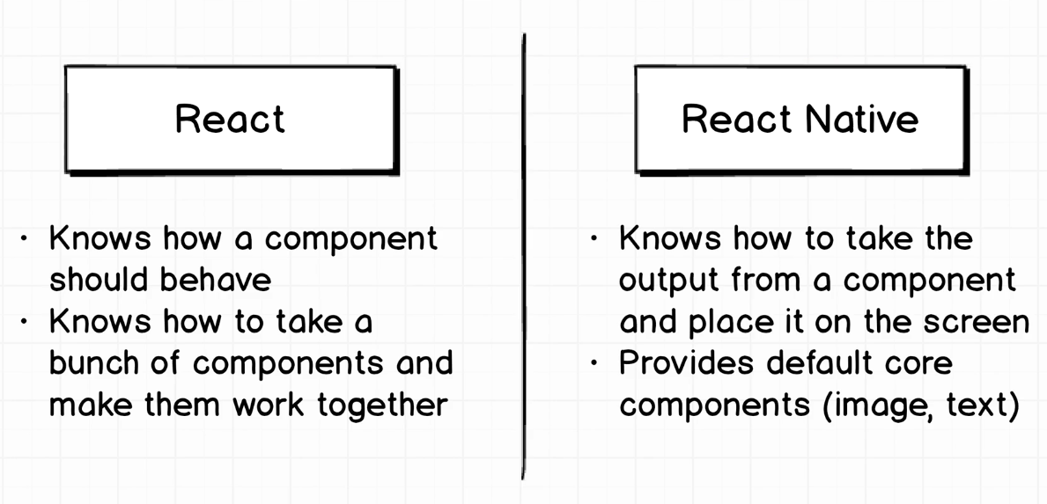
Introduction

Slide 3
Import Statement
Import statement is a part of ES6
ES6 is a new version (improved version) of Javascript
Import statement makes us capable of using the React, React Native, or other libraries that we import, to be used inside our project

