Slide 1
Sourcing Album Data
Mobile Developer Fast Track

Slide 2
Intro
We’ve got our Header complete
We can use it again on future projects whenever we need a header
We’re going to take a lot of components out of this application and use them on future projects
Now we’re ready to move on to the main body of the application

Slide 3
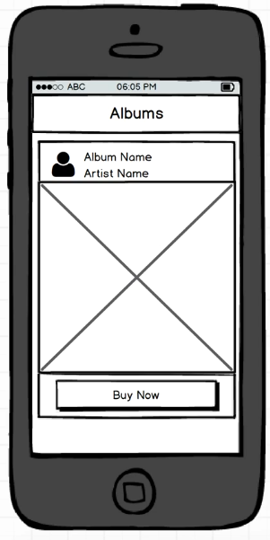
The App
Our App will have a list of Albums to show to the user in the User Interface

Slide 4
The Challenge
How to get a list of albums to show to the user
How are we going to architect our components to show a list of albums (that we’ve retrieved before) to the user

Slide 5
How To Get a List of Albums
We could hardcoded a list of albums in the code base, but it’s not the best flow
It’ll be very hard to update the data

Slide 6
How To Get a List of Albums
The better idea is to get the data from some online endpoint from some API on the internet
There are some music API on the internet such as FreeMusicArchive (https://freemusicarchive.org/api) or MusicGraph (https://developer.musicgraph.com/)

Slide 7
How To Get a List of Albums
After we choose the endpoint that we want to use, the next thing is how to fetch that and show it to the user of our app
So, how to make an HTTP request from the app to the endpoint to get the data, and then how to display it in the app

Slide 8
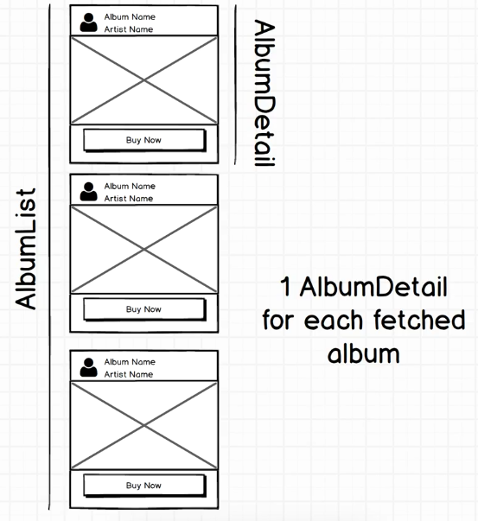
Components Design

