Slide 1
Class Based Components
Mobile Developer Fast Track

Slide 2
Intro
Up until this point, the components that we’ve made referred to as a “Functional Components”
That is they are functions that return some amount of JSX to be displayed on the device

Slide 3
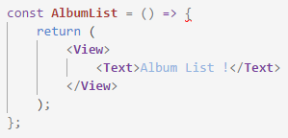
Intro
AlbumList is a functional component
The only rule behind these is that they must return some amount of JSX

Slide 4
Fetching Data
To handle fetching the data, we’re going to use the second type of component, that is “Class-Based Component”

Slide 5
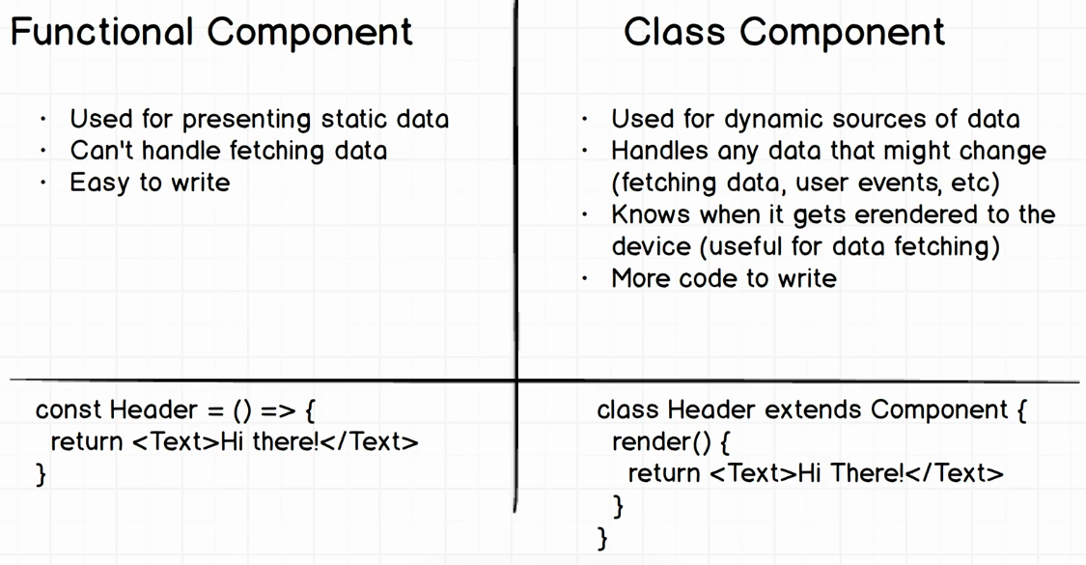
Comparison

