Slide 1
Auth App Introduction
Mobile Developer Fast Track

Slide 2
Introduction
Our last stop was focused on learning more about the styling and building of basic react components
For the next app, we’ll focus on something that is required by nearly every single mobile app
That is Authentication

Slide 3
Authentication
Authentication is the process of signing in and signing out users to the app
We’ll be wiring up authentication using the popular data service, Firebase

Slide 4
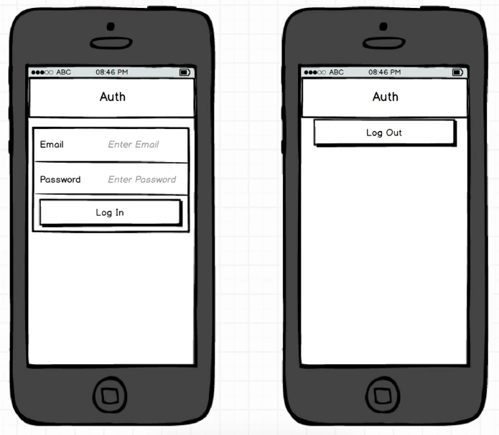
The App

Slide 5
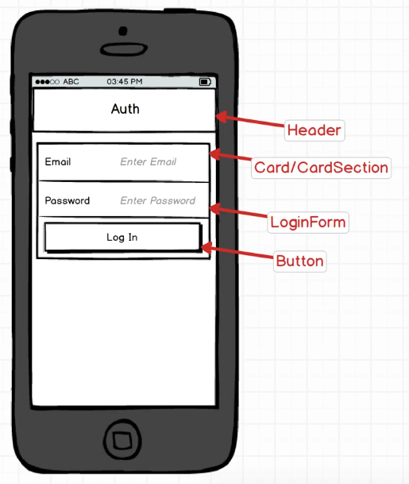
The App

Slide 6
App Challenges
How to use Firebase for authentication
Integrating React with Firebase
Handling user input
Error handling
Spinner

