Slide 1
App Mockup And Approach
Mobile Developer Fast Track

Slide 2
Introduction
The next app that we’re going to be focusing on, is going to be using the Redux Framework
Before we start typing out Redux, we’ll have a quick discussion on the app that we’re going to build

Slide 3
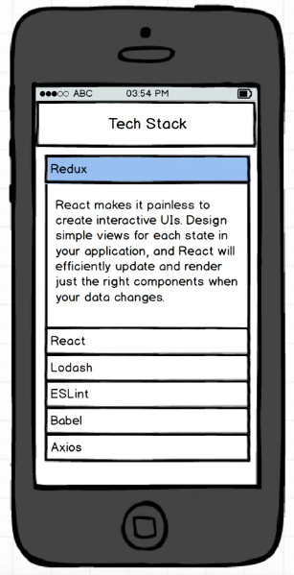
The App
The next app is going to be sort of flashcard-style application
User are presented with a list of topics
Whenever user tap on a topic, that topic section will expend and show a description of that topic

Slide 4
The App
So as this is (the Redux topic in the image beside for example) rendered right now, it’s showing with Redux in a rendered state

Slide 5
The Challenges
We must use Redux to build this app
We have to figure out what Redux is, and figure out how we’re going to apply it to this application

Slide 6
The Challenges
We must figure out a way to render a list of the elements in a performance-conscious manner
Long list of data on mobile devices are notorious for grinding application to a halt
We must figure out a solution to rendering a list of items that may be very very long

Slide 7
The Challenges
We have to figure out animations
Whenever the user taps on a given topic, we’ll have a very smooth animation to display the description of that topic
How to do that with animation API in React Native

