Slide 1
The Basic of Redux
Mobile Developer Fast Track

Slide 2
Introduction
We’re going to spend some time learning more about Redux
We won’t talking about React Native or React
Just Redux

Slide 3
Introduction
To code only Redux, we don’t have to use our code editor and run it on emulator
We can use a tiny little online tools to experiment with Redux code, such as
https://stephengrider.github.io/JSPlaygrounds/

Slide 4
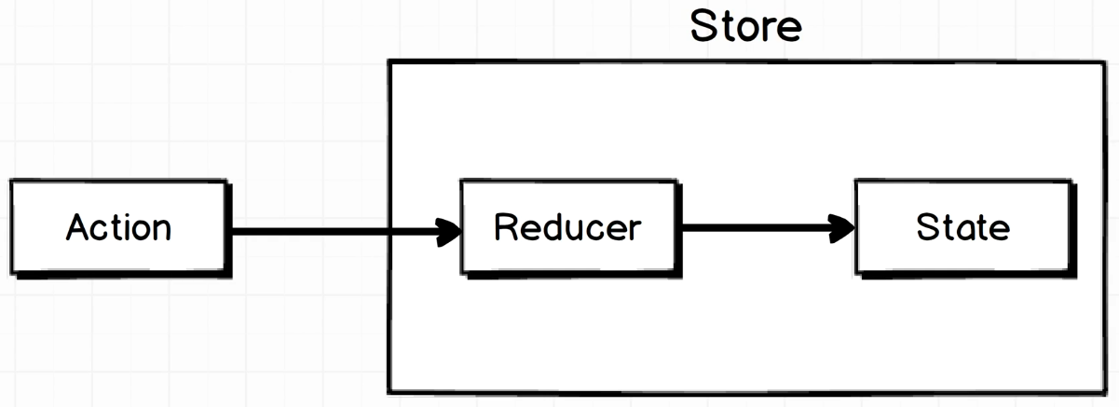
How It Works

Slide 5
How It Works
Redux has a lot of terminology
Sometimes, the terminology obscures the --otherwise-- straightforward concept of Redux
We’ll master the confusing terminology and put a plain English definition to all the different parts of the library

Slide 6
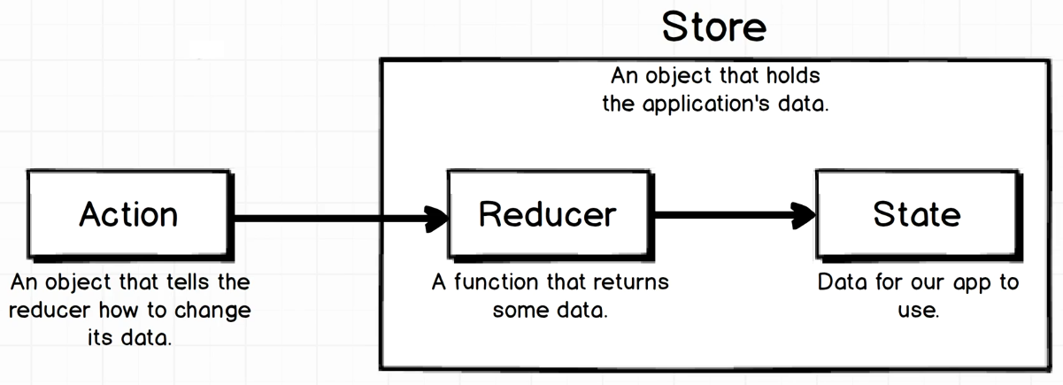
Terminology

Slide 7
Reducer
To make it hard, the term “Reducer” doesn’t reflect any meaning for us at the first sight
A Reducer is a function that produces some amount of data

Slide 8
Action
Action is a plain Javascript object
When we say a “Javascript Object”, it means curly braces {} like an object
It’s a plain Javascript object that tells the Reducer how to modify it’s data

Slide 9
Action
The Action only has 1 requirement
It must have a “type” property

Slide 10
State
State is our application’s data
Everything can be saved here, like a user input from the Input field, or state whether the user have already authenticated, or a list of data, or whatever

Slide 11
Store
The Store is what holds the Reducers in the application State
“Hold” means like just literally it has a reference to the Reducer and the State

Slide 12
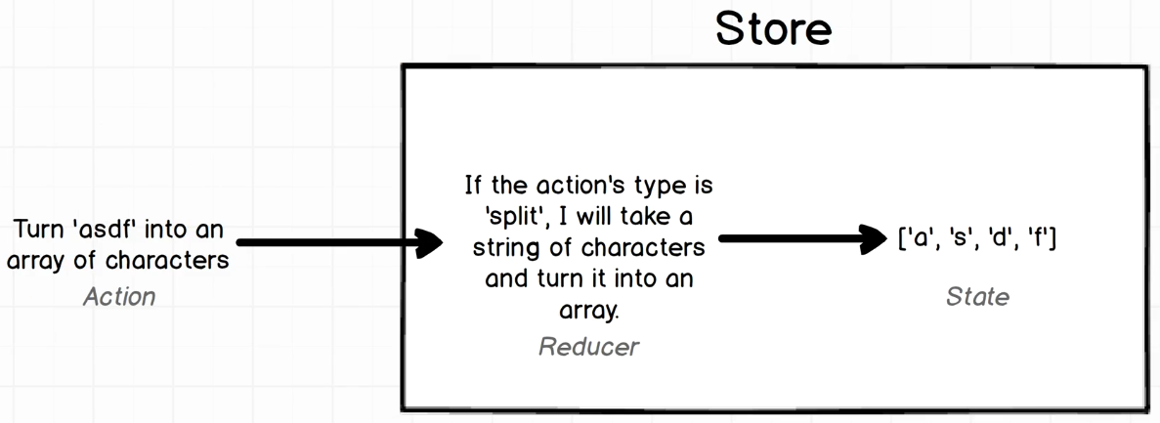
Example of Redux

Slide 13
Example of Redux
Using Redux, we’re going to make a tiny application which will take a string of characters and split it into an array

Slide 14
Example of Redux
To do so, we will first start off with an action
The Action is going to be a plain Javascript object that contain a string of characters and a command to split it up

Slide 15
Example of Redux
We’re going to take that Action and pass it into the Reducer
When the Action goes into the Reducer, the Reducer will take the Action’s command and do something about it
The Reducer then process the Action’s data according to the Action’s command and output it to as a State

