Slide 1
More on Redux
Mobile Developer Fast Track

Slide 2
Introduction
We’ll code our Redux simple app here
https://stephengrider.github.io/JSPlaygrounds/

Slide 3
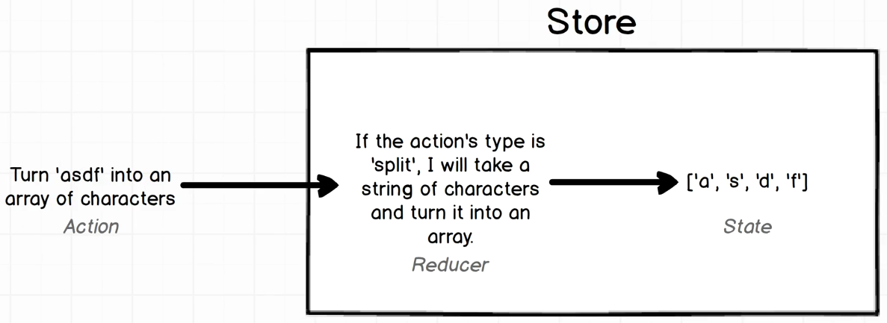
The App

Slide 4
Introduction
JSPlaygrounds is not hooked up to any type of import export system and has direct access to the Redux library

Slide 5
Creating a Store
Remember that Store is an object that holds our application State and Reducer
const store = Redux.createStore();

Slide 6
Creating a Store
Notice that we had an error message
Error: Expected the reducer to be a function.
When we create a Redux Store, it expects us to pass in at least one Reduce (or function)
So remember a Reducer is a function that produces some amount of application State
And clearly it’s expecting us to pass in at least one when we create a Store

Slide 7
Creating a Reducer
const reducer = () => [];
const store = Redux.createStore(reducer);
The Reducer here just a function that return an empty array

Slide 8
Getting The State
Remember that the Store contains our application State and all of our Reducers
And at any point of time, we can ask the Store for it’s current state using getState()
const reducer = () => [];
const store = Redux.createStore(reducer);
store.getState();

Slide 9
The Code
So what the code tell us?
It tell us that by default when we create a redux store and pass a Reducer, the Reducer will be ran
And whatever the Reducer returns, will become the Redux’s Store State

Slide 10
The App

Slide 11
Creating an Action
Action is a plain Javascript object that tells the Reducer that it needs to modify the State that it is producing
So we’ll first create the Action, and then tell the Reducer how to deal with that Action

Slide 12
Creating an Action
The only requirement of an Action is that it has to define a “type” property
The “type” property will always be a string
The purpose of this “type” property is to tell the Reducer to commit a very specific operation/command
const action = { type: 'split_string' };

Slide 13
Creating an Action
We’ll also tell the Reducer which string we want it to split by passing a “payload” property
const action = {
type: 'split_string’,
payload: 'Hello'
};

Slide 14
Linking The Action To The Reducer
Next we’re going to update our Reducer which is up at the top and instructed how to handle the Action
const reducer = () => [];
const store = Redux.createStore(reducer);
store.getState();
const action = { type: 'split_string', payload: 'Hello' };

Slide 15
Linking The Action To The Reducer
Reducers are always called with 2 arguments
The first is the current state that it has produced
And the second is an Action

Slide 16
Linking The Action To The Reducer
const reducer = (state = [], action) => {
if (action.type === 'split_string') {
return action.payload.split(‘’);
}
return state;
};

Slide 17
Linking The Action To The Reducer
The last thing we have to do is to figure out how to tell the Reducer to run that Action
So we want to feed the Action into the Reducer
To do that we use the dispatch() method from the Store
store.dispatch(action);

Slide 18
Final Code
const reducer = (state = [], action) => {
if (action.type === 'split_string') {
return action.payload.split(‘’);
}
return state;
};
const store = Redux.createStore(reducer); store.getState();
const action = { type: 'split_string', payload: 'Hello’ };
store.dispatch(action); store.getState();

