Slide 1
The Theory of ListView
Mobile Developer Fast Track

Slide 2
Introduction
In the previous app (the album app), we have already figured out how to make a list
We did so by using the “map” function to turn a list of data objects into a list of components
That is a fine approach for a small list, but not for a dozen of data

Slide 3
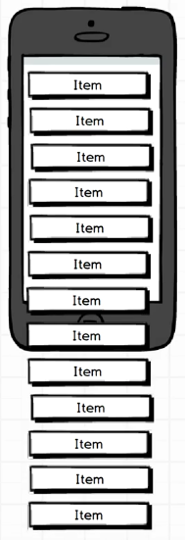
The App
There’s so many items that some number of them is not visible until we scroll down the screen

Slide 4
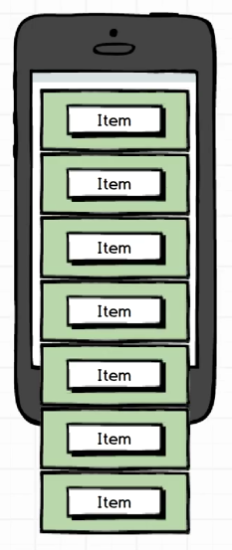
The Previous App (Album)
The model in the left is how we are building a list using the map function
We’ve got an item that’s wrapped in a green box
The white box that says “item” represents a javascript object, like a single album or a single library
The green box around it represents a React component

Slide 5
The Previous App (Album)
With our current approach of rendering list, we take every single item in the list and map it to a component by making a new component for each item
So if we have a list of 100 items, we create 100 components in memory to show every single one of them the instant we create that list

Slide 6
The Problem
The downside is that even if the user can only see, for example, 4 or 5 components on the screen at a time, we still have to render all 100 different items upfront
That 100 components might just sitting there in the memory
That is the source of poor performance, the upfront rendering of a bunch of items and then holding them in memory

Slide 7
The Problem
Mobile devices are traditionally memory constrained
So if we can reduce our memory usage even if just a little bit, is a good thing

Slide 8
The Solution
To address this performance issue, React Native includes a little tool ListView
The ListView is a component that fix this issue of rendering a bunch of items by using a little trick

Slide 9
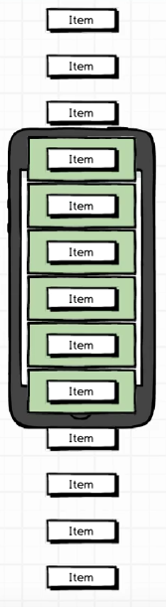
ListView
The ListView works by figuring out what items in the list are visible to user at a given time
And then it creates a single component for only the items that should visible on the screen

Slide 10
ListView
So in this case, instead of creating 100 components for 100 different items, it might only create 6 components for the 6 items that are visible on the screen

Slide 11
ListView
The real magic happens when we scroll through the list
When we scroll the list, ListView watches for any scroll event from the user
The ListView watches for any item that starts to scroll out of view, and move that components to the items that might just comes to the screen

Slide 12
ListView
So the idea here is that as a user scrolls around, the ListView is reusing the same components over and over again
It’s just swapping out the data that sits inside of them

Slide 13
Conclusion
Basically, in practice, the way that the ListView works is to take only a subset of the total list at any given time, and only render that subset

