Slide 1
Introduction To Redux Thunk
Mobile Developer Fast Track

Slide 2
Introduction
In the last section we realize that there is a little bit of issue with our piece of Auth State
There are some piece of Auth State that can only be updated after we make an asynchronous request

Slide 3
Introduction
Until this time, we’ve always been writing Action Creators in a Synchronous nature
We call them and they instantly return an Action
This won’t work in our case now because we want to authenticate a user by making a request to Firebase
The Action can be returned/dispatched AFTER our request to Firebase completed (which will absolutely take some times)

Slide 4
Introducing Redux Thunk
Redux Thunk is used to handle any type of asynchronous Action Creator
Redux Thunk can be used to handle any type of AJAX request or any long-running process you can imagine

Slide 5
Introducing Redux Thunk
Redux Thunk is an npm module, so you have to install it first by running
npm install --save redux-thunk

Slide 6
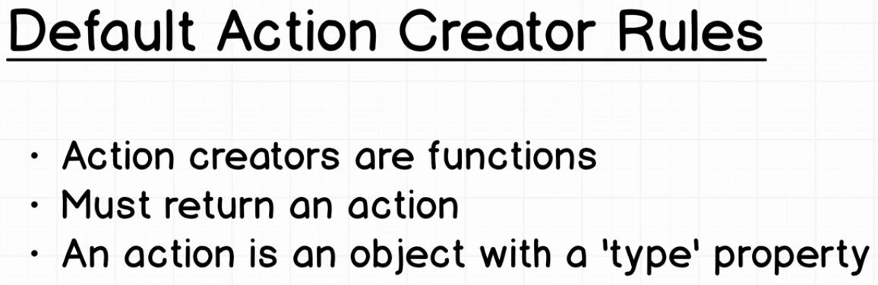
Default Action Creator

Slide 7
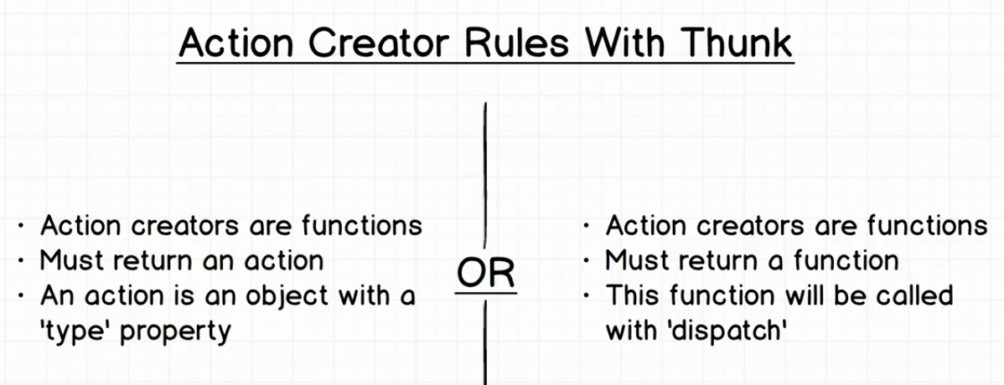
Action Creator With Thunk

