Slide 1
App Challenges
Mobile Developer Fast Track

Slide 2
Introduction
After all the app that we made, there’s one important things that we don’t handle yet
That is Navigation
The ability for a user to move around to different pages in our app
They can see different content as they navigate around

Slide 3
Initialization
Create a new React Native App by running a command
react-native init manager

Slide 4
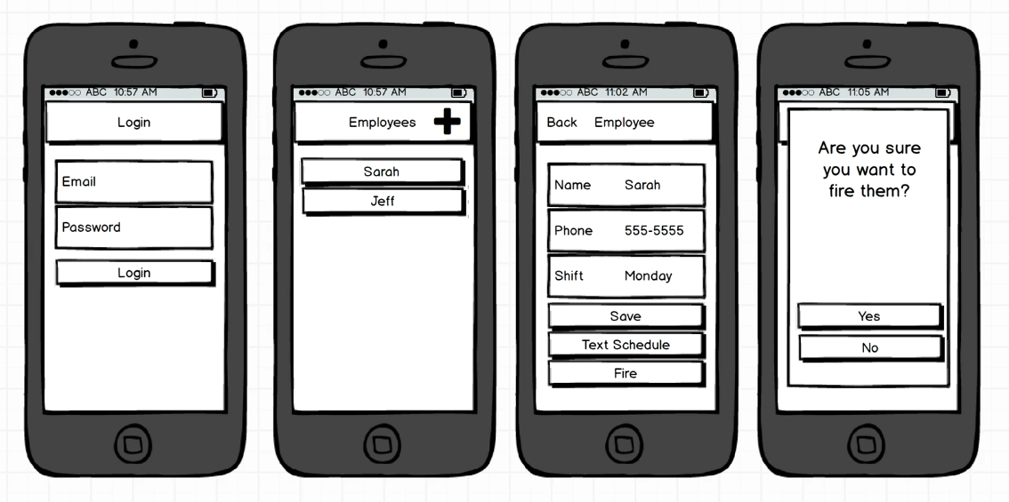
The Mockup

Slide 5
The Idea
The idea behind this app is that a manager of a small business can add their employees
We can then schedule a work shift and then text that schedule to that particular employee
And we can fire a particular employee and delete their data from the database

Slide 6
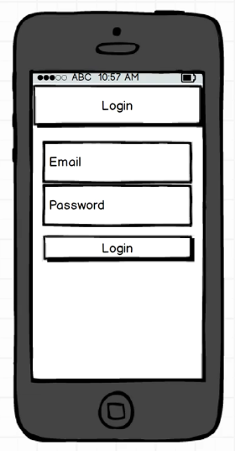
Login Screen
Like before, we’re going to tackle the Authentication here
Login screen is going to be just like the one that we made previously
A user has to enter an email and password
We’re going to use the same trick of not separating a signup screen

Slide 7
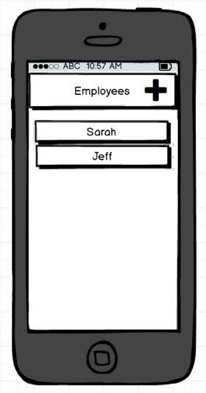
Employee List Screen
It will display a list of all different employees that they have
This list screen is going to start off as empty
By default user does not have any employee
Only after they start adding employees will they be able to see them on the list

Slide 8
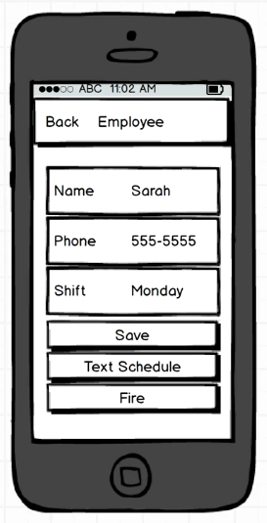
Create-Edit Screen
This screen has a dual purpose
It will be used for both creating and editing existing employee

Slide 9
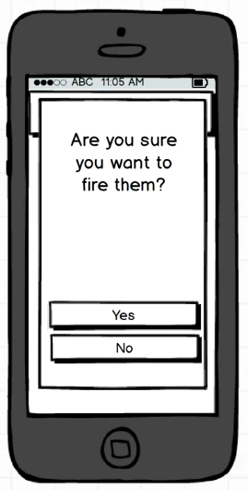
Pop Up Screen
If the managers decide that they want to remove an employee, we’re going to show a big modal message
It will make sure if they still want to do the request (to fire the employee)

