Slide 1
App Challenges
Mobile Developer Fast Track

Slide 2
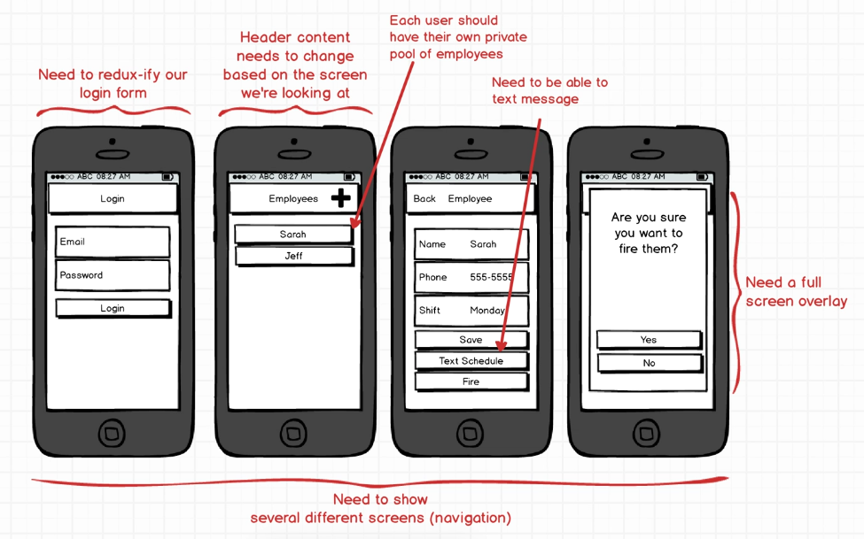
The Challenges

Slide 3
Login Form
We’ve already made a login form previously
But that was a stand alone React component that have no basis of Redux
Do we have to make changes to the login form to suit how Redux works?

Slide 4
Navigation
This app will have a different screen
How do we navigate between them?

Slide 5
Header
It looks like, over time, we’ve got an ever changing Header on every screen
And for some screen, the header will contain a back button
That button will take the user to the previous screen
So clearly there’s some further customization of the headers required
Managing that header like that, in React Native, is a little bit harder

Slide 6
Data
Each users who install the app should have their own private list of employee
We need to figure out however we saved the data, we need to make sure that we’ve got a good layer of security there
We have to make sure that different users can’t see each other’s employees and modify them in any way

Slide 7
Intent
We need to interface with the phone, somehow, to be able to send a text message
One of the big feature in the app is that after an employee gets a shift set, we need to be able to interface with the phone to send a text message

Slide 8
Modal
We need, like, a big full screen overlay like a modal popup
Something to prompt a user and ask user to confirm something

Slide 9
Modal
Android and iOS devices have some default confirm message that we could use
And we can style to make a nicer-looking mod

