Slide 1
Login Form In A Redux World
Mobile Developer Fast Track

Slide 2
Introduction
In the previous section, we have 4 separate pieces of state inside the Login Form

Slide 3
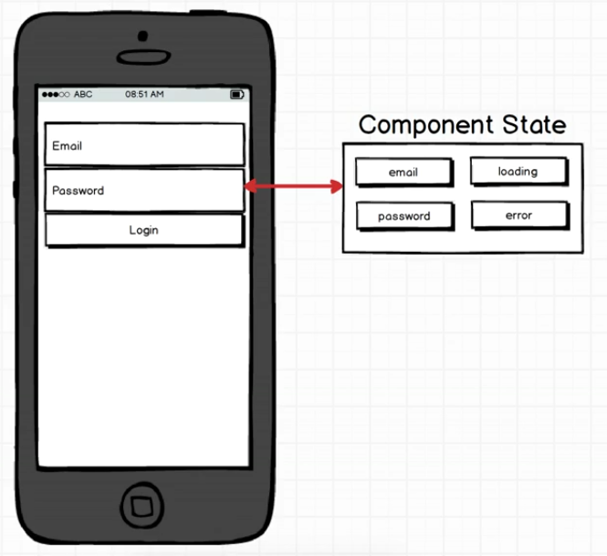
Introduction

Slide 4
Introduction
Now the question is, should we modify this thing to work in a Redux world
The answer is “not really”
In the previous app we have proven that we can make a React Native app without Redux

Slide 5
Introduction
But if we want to make a more complex app (like we’ll be doing up next), we’re going to find that by using Redux, it’ll make our life easier
By keeping track of everything

Slide 6
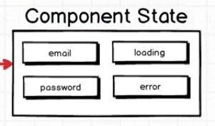
Introduction
In this section we’ll move the Login Form’s component level state and hold them at the application state level (Redux level)

Slide 7
Introduction
As we start to bring Redux into our application, we’re going to move components like the Login Form
We’ll move that from a very intelligent component that know how to manage all the things (state), into a very simple component that behave like a template component
A template that just take some amount of data and display it with some amount of JSX
We’ll pull out as much logic in keeping track of state as possible, away from the component level and push it to Redux instead

Slide 8
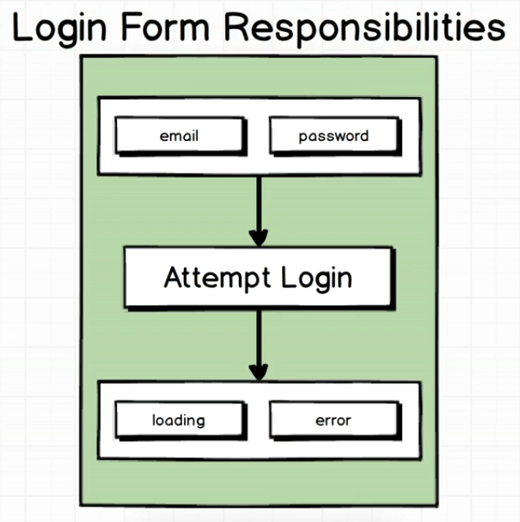
The Old Login Form

Slide 9
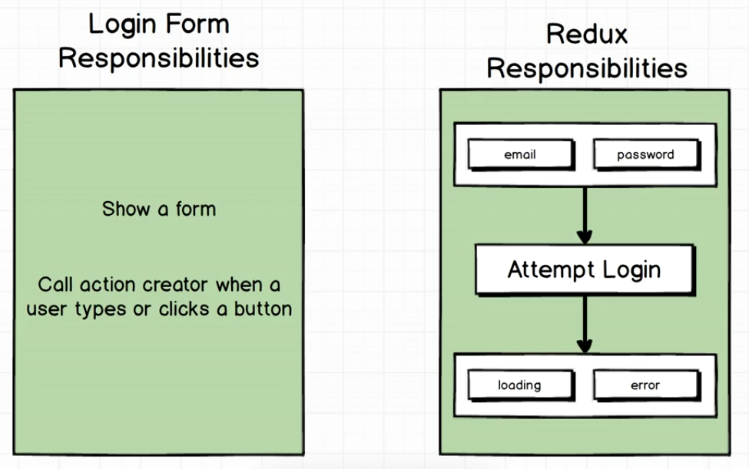
The New Login Form

Slide 10
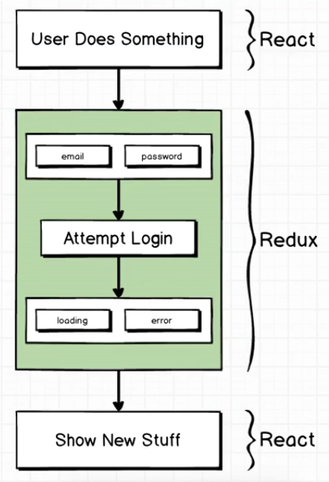
The New Login Form

Slide 11
The New Login Form
React is just showing something on the screen and watching for user events
Redux is about keeping track of the state of the app and deciding how to interpret or handle these events that are coming into the app

