Slide 1
Immutable State
Mobile Developer Fast Track

Slide 2
Introduction
As we’ve learned, whatever value we returned from the reducer will end up as our application state
So, in the reducer, we need to somehow update our state object and then return it
The question is, how do we update our state object inside the reducer?

Slide 3
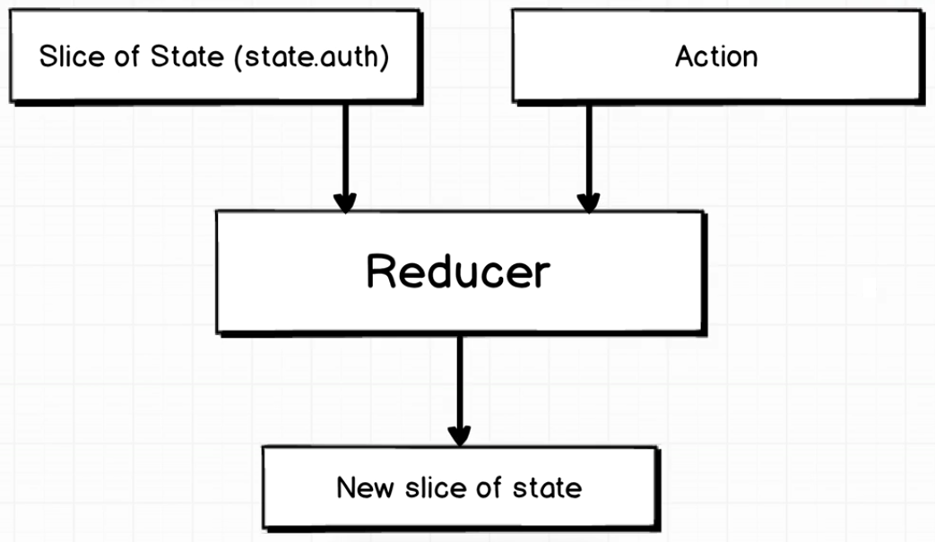
Processing The State

Slide 4
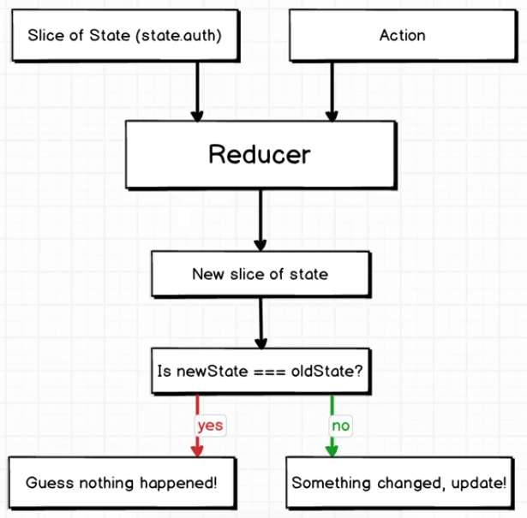
The Actual Process

Slide 5
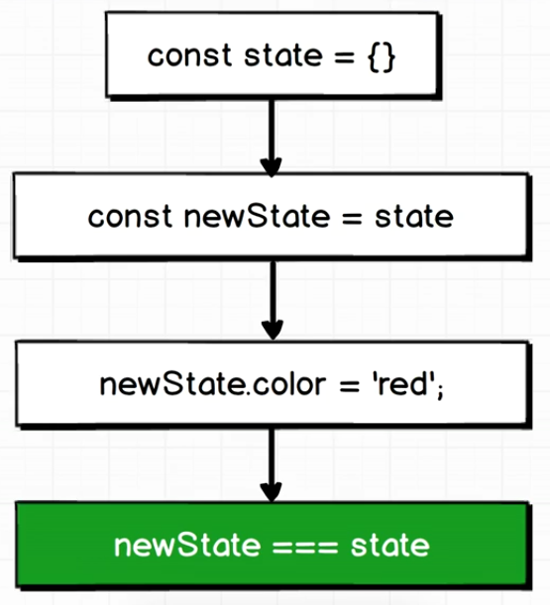
The Problem

Slide 6
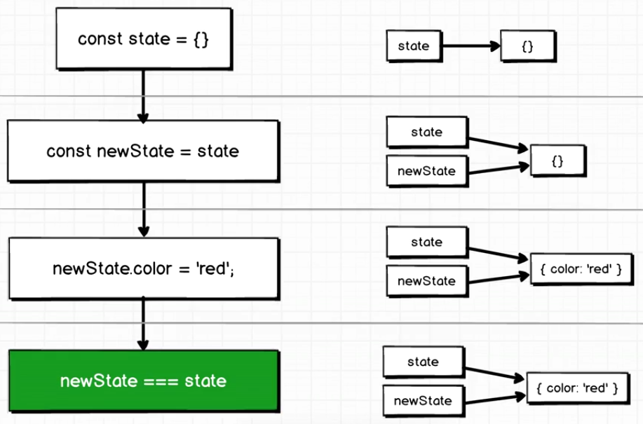
Explanation

