Slide 1
Synchronous VS Asynchronous Action Creators
Mobile Developer Fast Track

Slide 2
Introduction
As the state that we made until now, our auth reducer maybe need to maintain some other state beyond just the email and password

Slide 3
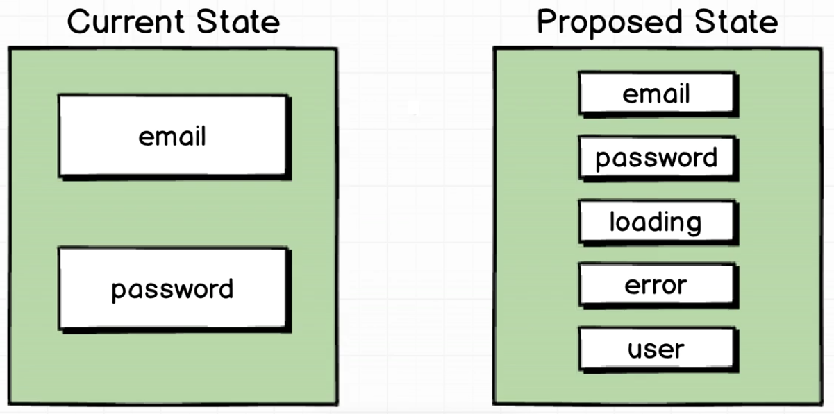
Auth State

Slide 4
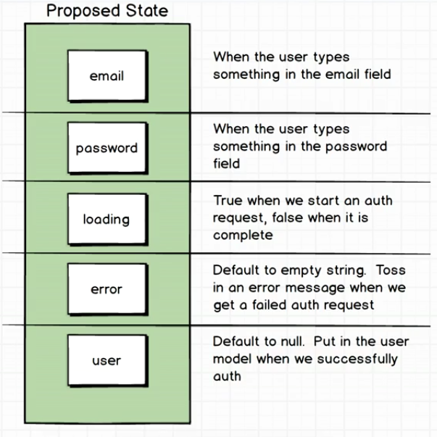
Time To Update

Slide 5
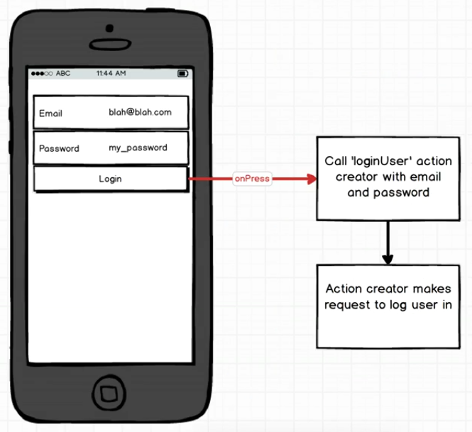
The Problem

Slide 6
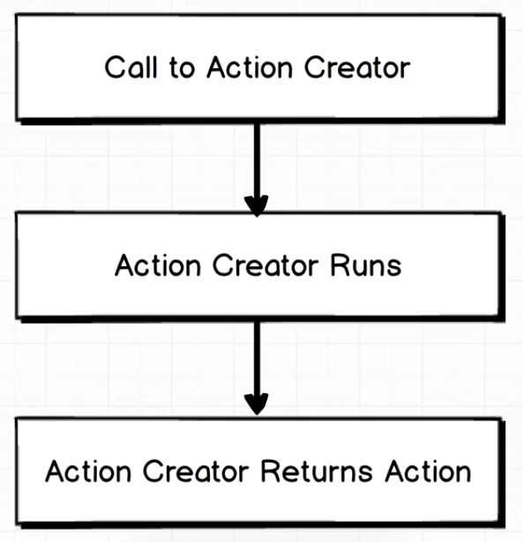
How Action Creator Works

Slide 7
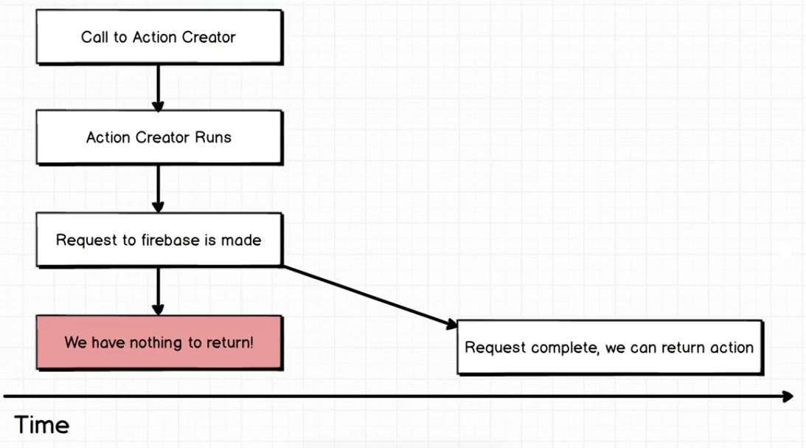
The Problem

Slide 8
Summary
The problem here is that we’ve been writing Synchronous action creator that instantly return an action
But in this case we need to write an Asynchronous action creator that will return an action at some point in the future

