Slide 1
Dealing With Navigation
Mobile Developer Fast Track

Slide 2
Introduction
Our login form is now fully Reduxify
Now we have a better hand on handling Redux in general
We can move on to the next are of the app

Slide 3
Introduction
Right now we can put an email and password and log in or sign up using that
But once the user signed in, we’re not actually doing anything
That’s what we want to start working on
We’re going to start working on the realm of Navigation in React Native

Slide 4
Navigation In React
Navigation with React Native is a little bit of a tricky subject
While in the React world, it has a “de-facto” standard of navigation with the React Router library
So ReactJS have a very clear directions on how to pull off navigation on the web

Slide 5
Navigation In React Native
On the other hand, React Native doesn’t really have an absolute solution for navigation
There’s not a single, community-accepted, standard-library, solution for navigation

Slide 6
Navigation In React Native
So we’re going to be using one possible solution for navigation
It means that there are different solutions for navigation out there that you can use too
The navigation solution that we’re going to use is a library called React-Native-Router-Flux

Slide 7
React Native Router Flux
To install it, run the command
npm install --save react-native-router-flux

Slide 8
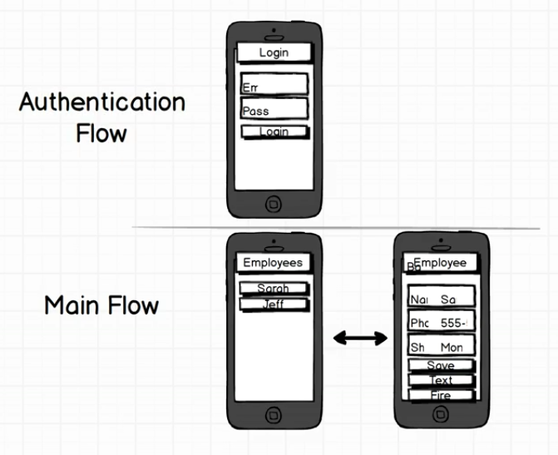
Navigation Schema

Slide 9
The Scene
This routing library has an idea of what is called a Scene
A Scene is how we organize a distinct page that the user can navigate to
A Scene is a component that we’re going to import from the React Native Router Flux library

Slide 10
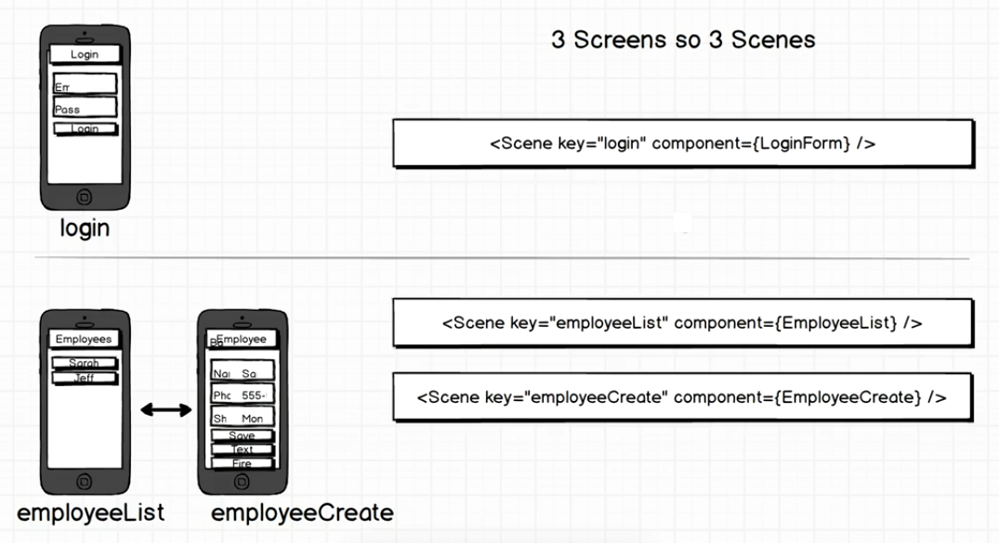
The Scene

Slide 11
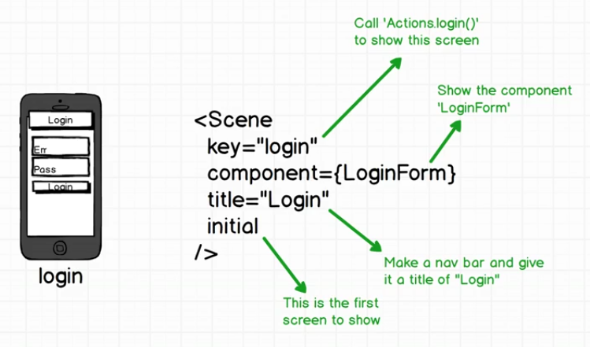
The Scene

