Slide 1
Grouping Scenes With Bucket
Mobile Developer Fast Track

Slide 2
Introduction
When we navigate user around with the Action (from React Native Router Flux library), we get one “free” feature
That is in the new Scene, we have a “back” button sitting on the top-left of our header

Slide 3
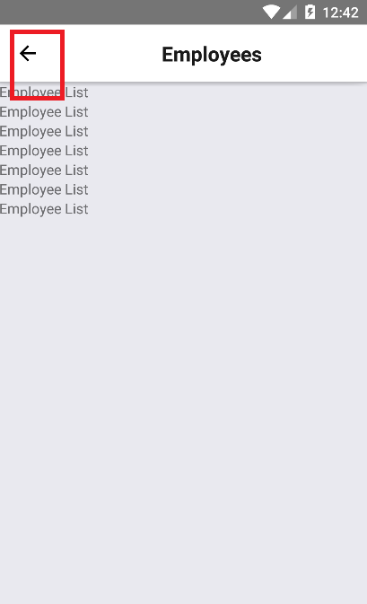
Introduction

Slide 4
Introduction
Certainly this is a great feature
We don’t have to code anything to tell the component that if user hit the “back” button, we should manually send back user to the previous screen
Everything has been done for us by the React Native Router Flux

Slide 5
The Problem
The problem is, we don’t need this feature in our “home page”
After the user logged in and redirected into our “home page”, we don’t want the user to be able to hit the “back” button and sent back to the Login Form
It’ll be one big design flaw

Slide 6
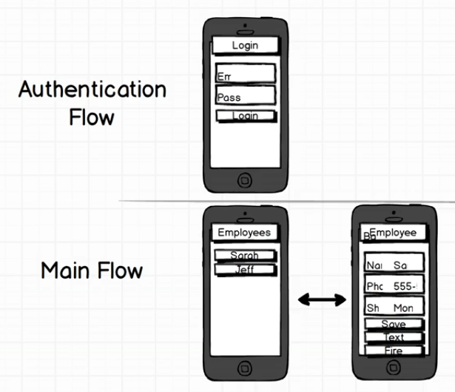
Scenes Grouping

Slide 7
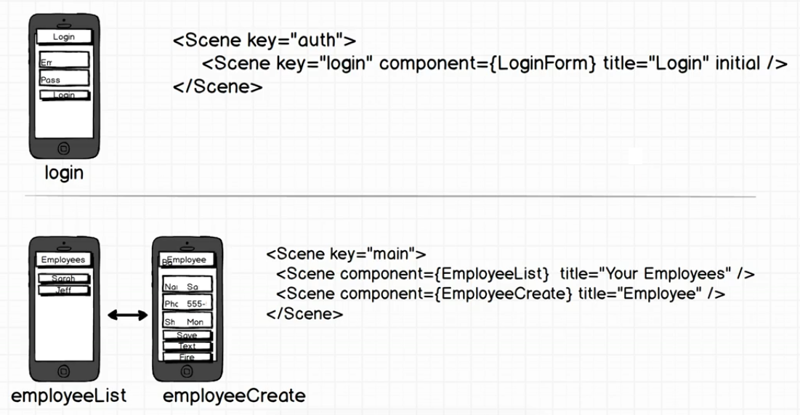
Scenes Bucket

Slide 8
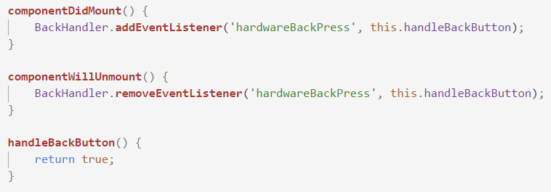
Android’s Back Button
And for handling the hardware back button in Android, you can use the BackHandler component
https://facebook.github.io/react-native/docs/backhandler.html

