Slide 1
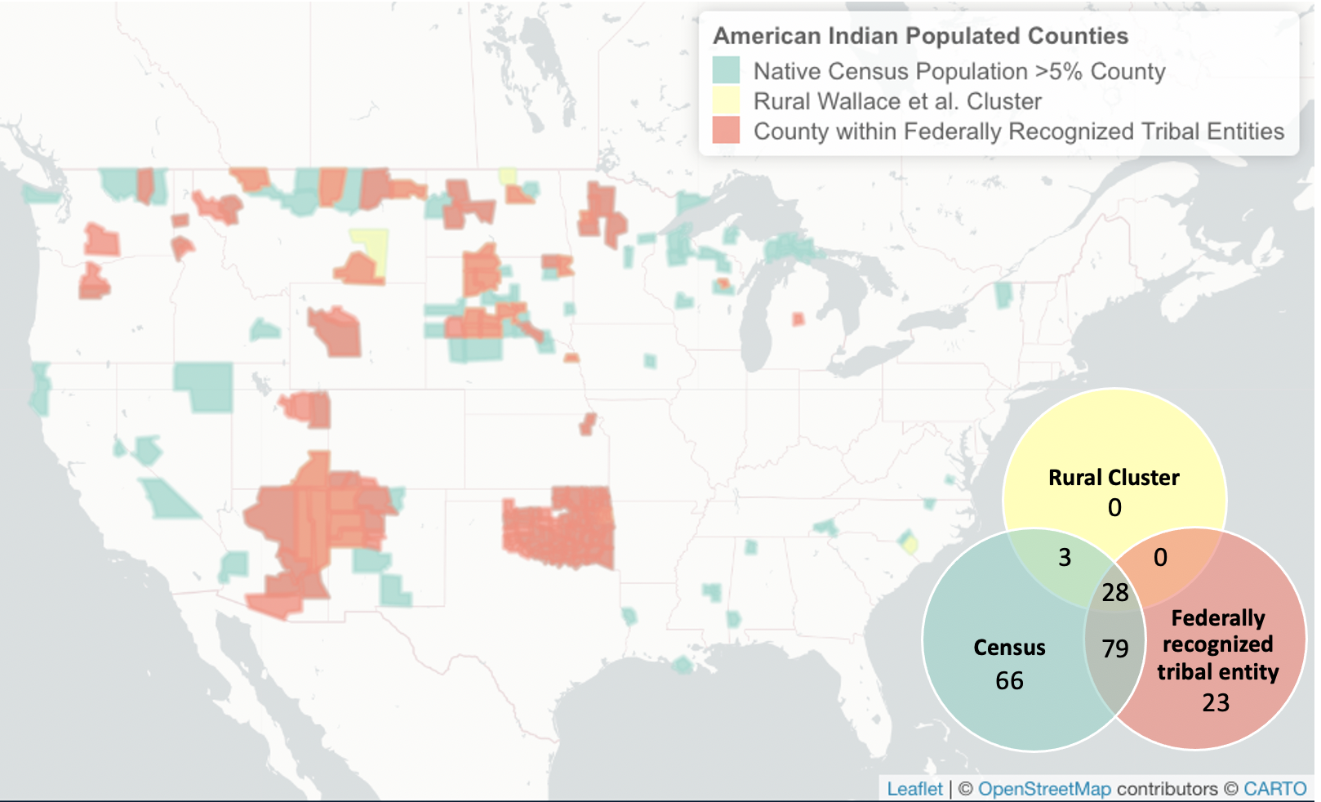
Notes:
Figure 1

Slide 2
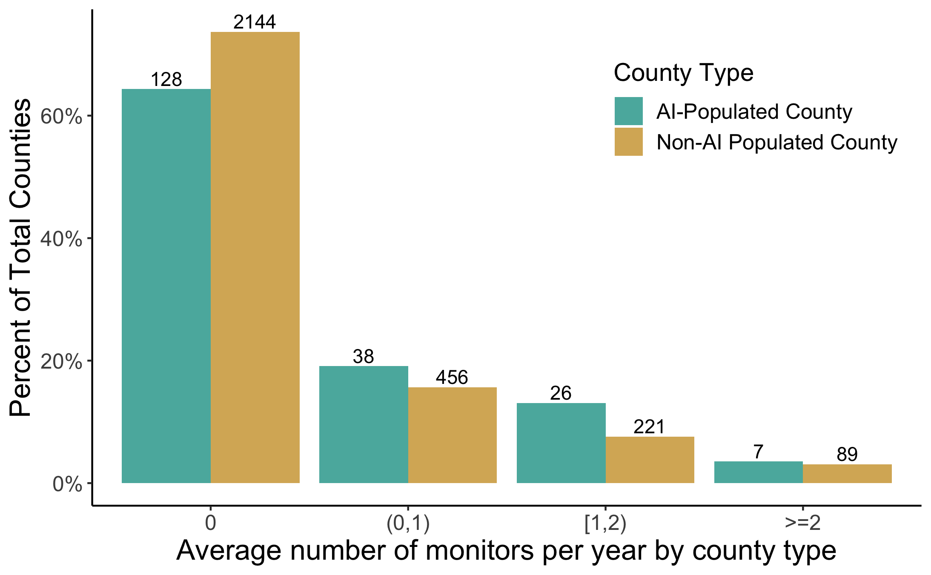
Notes:
Figure 2

Slide 3
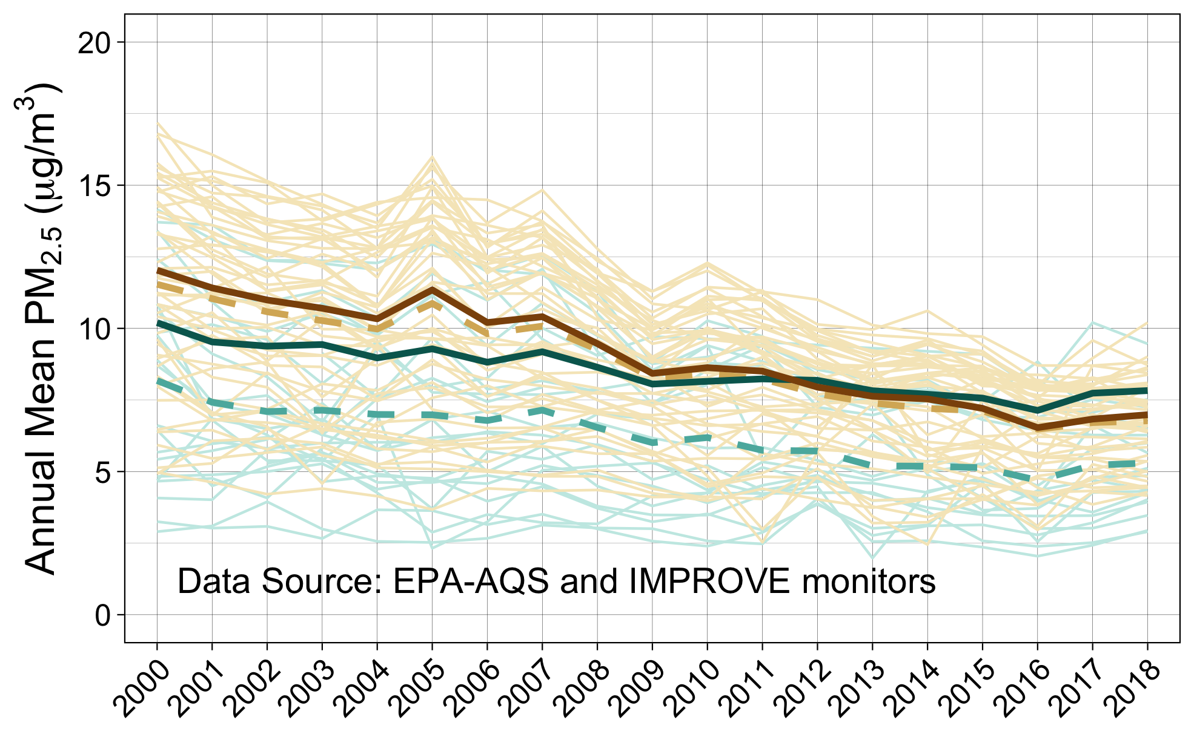
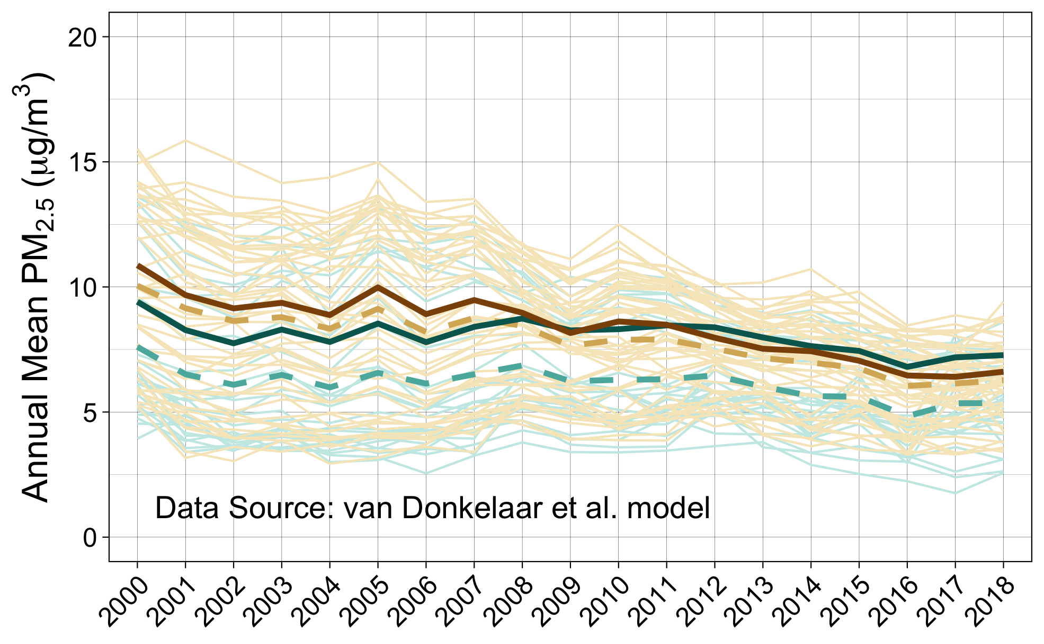
Non-AI-populated counties
AI-populated counties
Non-AI-populated counties
AI-populated counties
Observed Annual Means by State
Observed Annual Means by State
Observed Annual Means by State
Observed Annual Means by State
Observed Annual Means (All States)
Observed Annual Means (All States)
Observed Annual Means (All States)
Observed Annual Means (All States)
Estimated Annual Means (Model 4)
Estimated Annual Means (Model 4)
Estimated Annual Means (Model 4)
Estimated Annual Means (Model 4)
Notes:
Figure 3

Slide 4
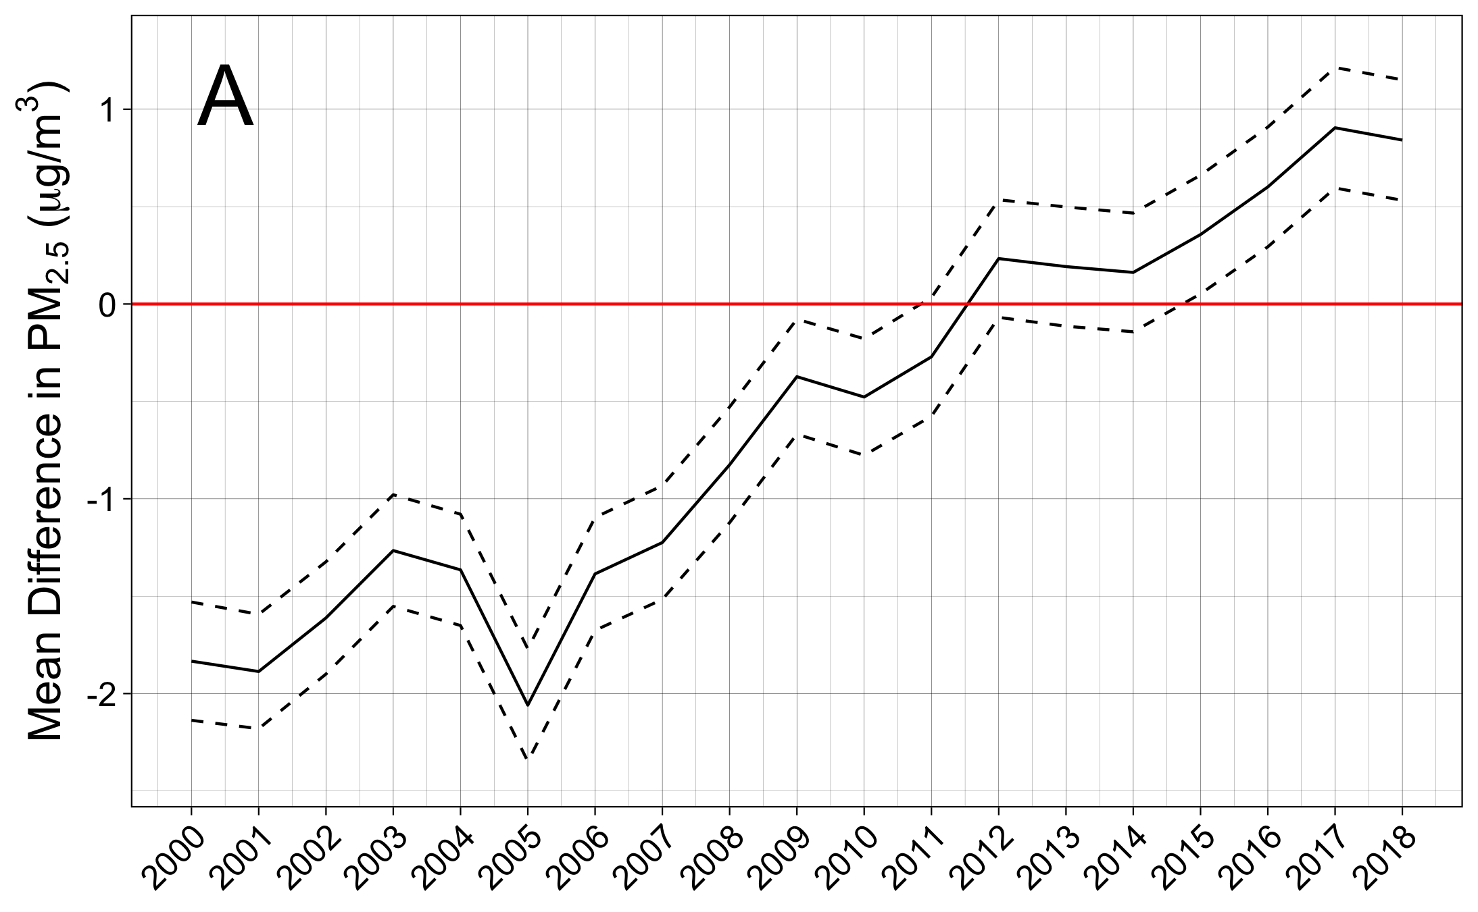
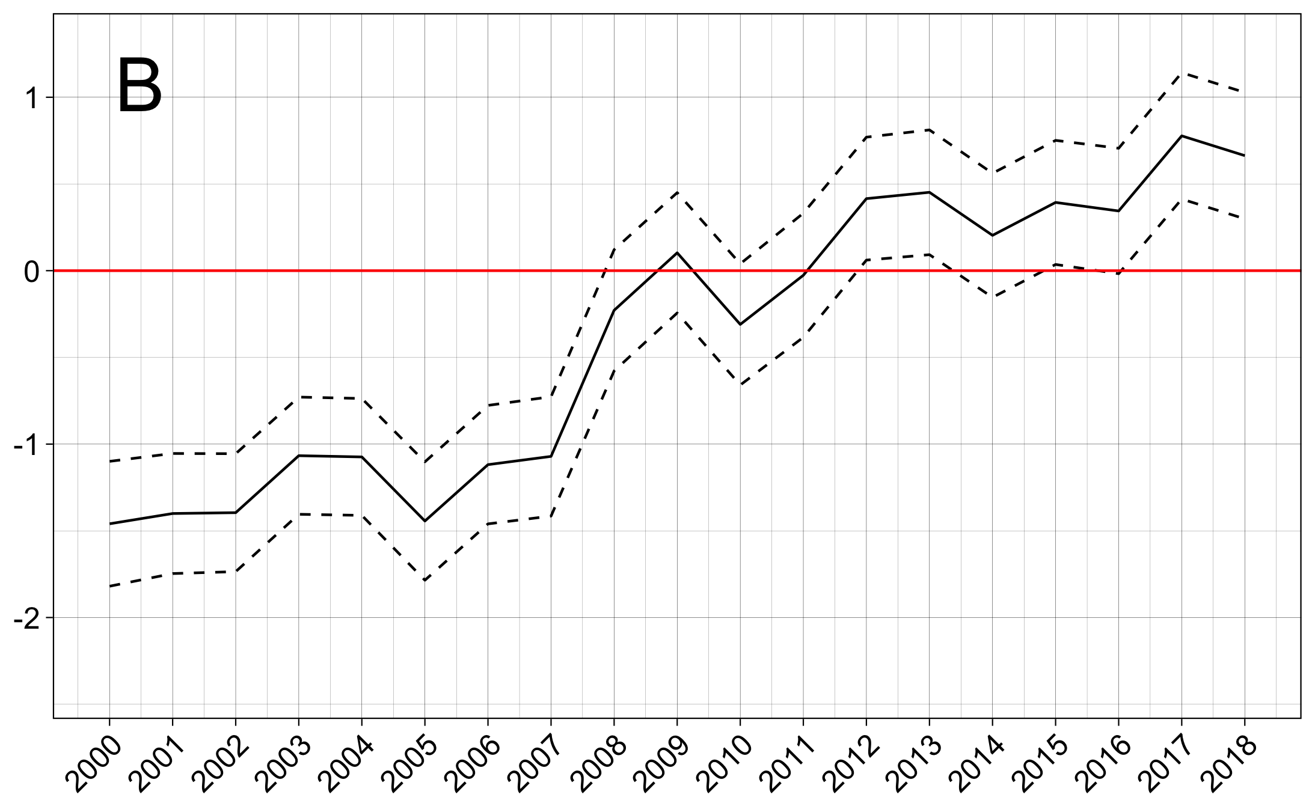
Notes:
Figure 4 (alt edit) KEEP THIS ONE FOR FINAL PAPER

Slide 5
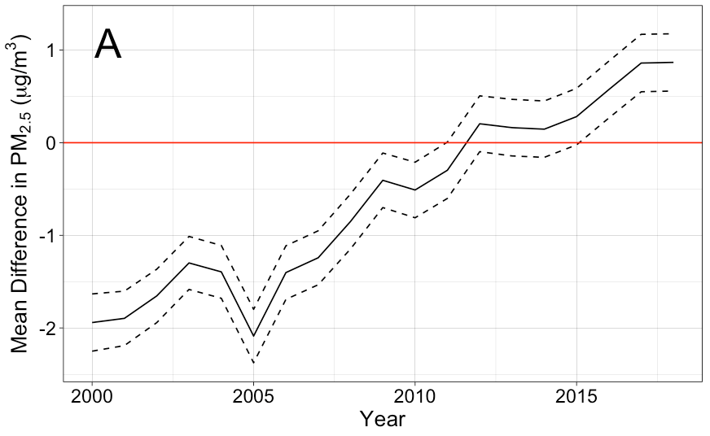
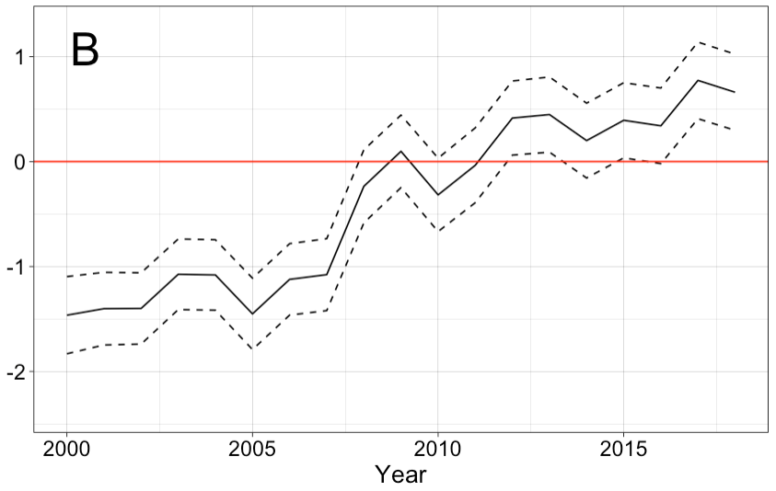
Notes:
Figure 4

Slide 6
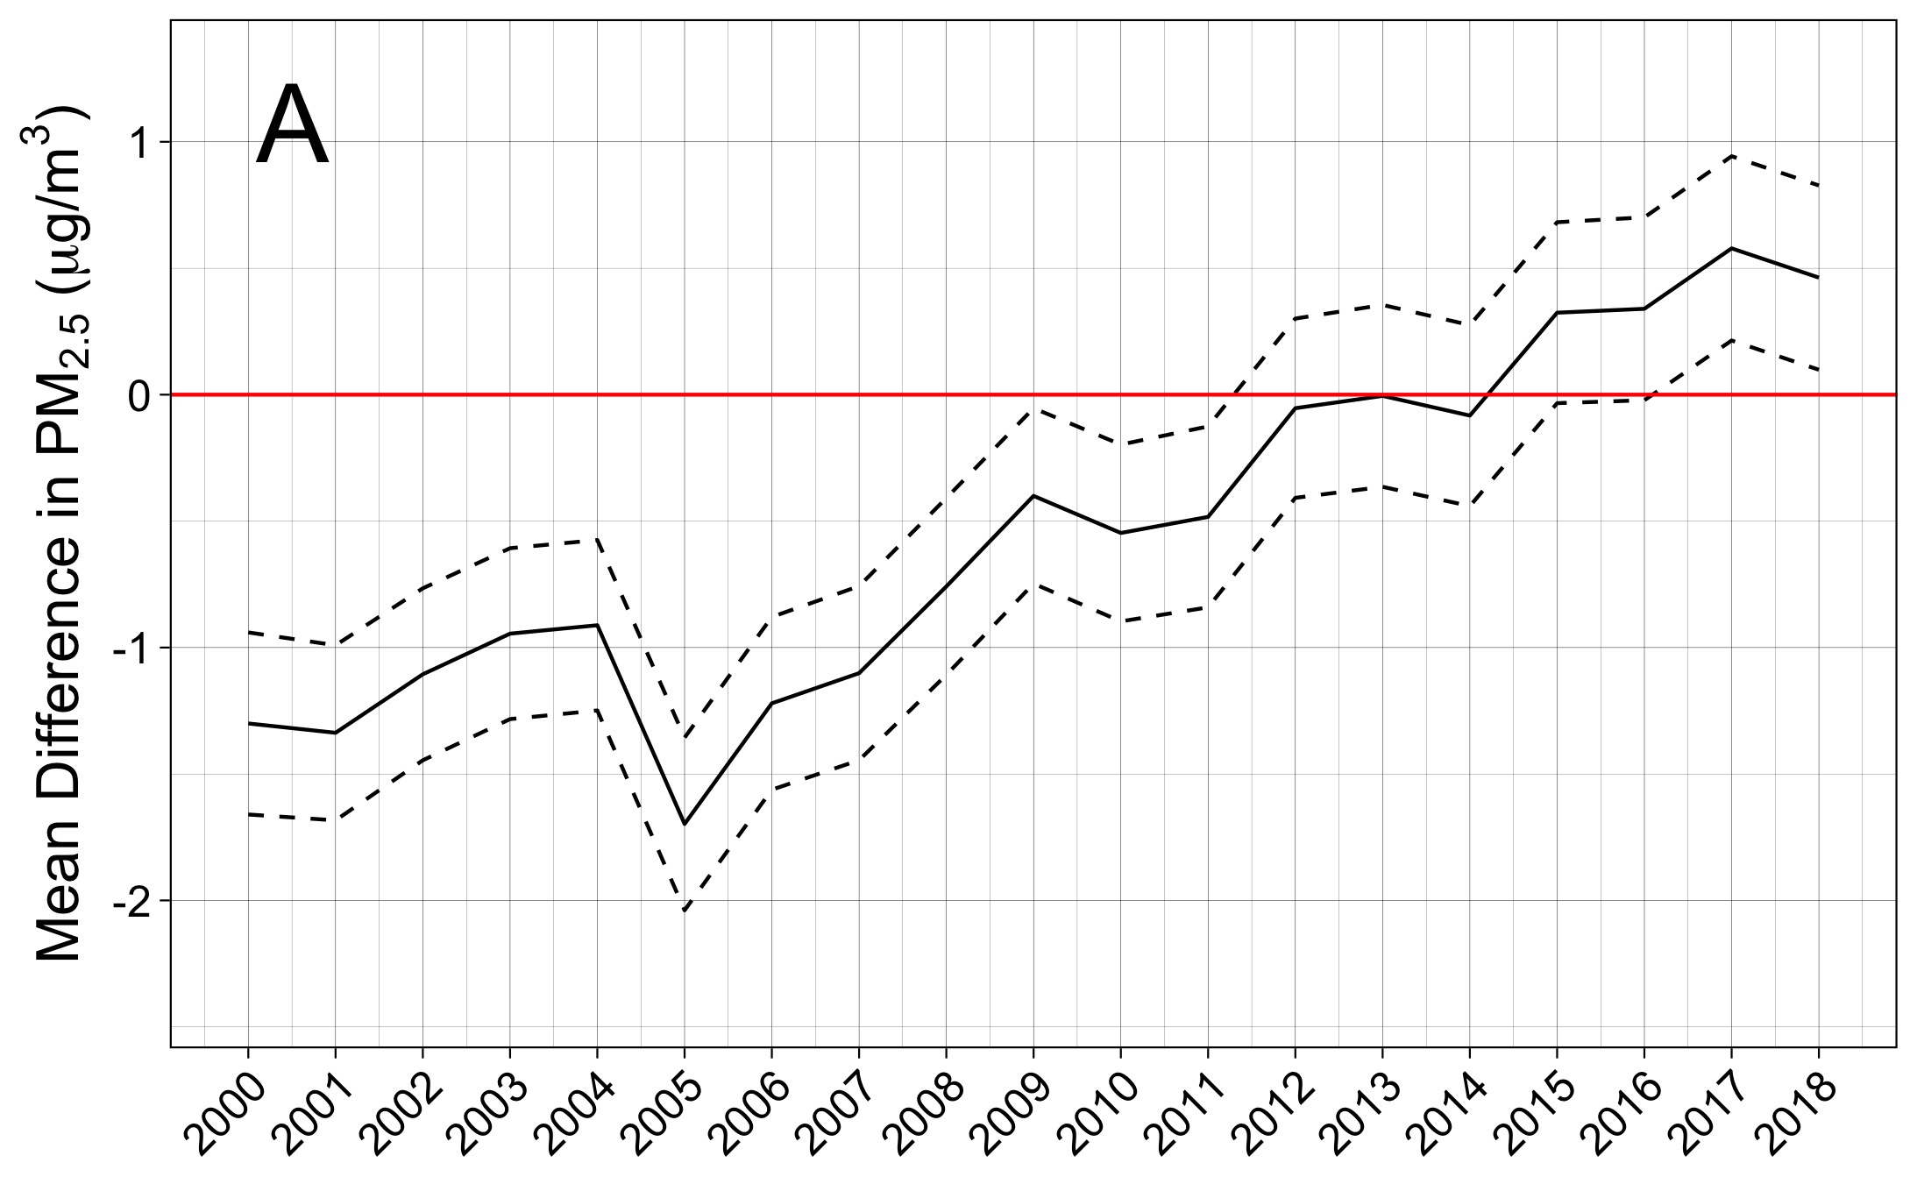
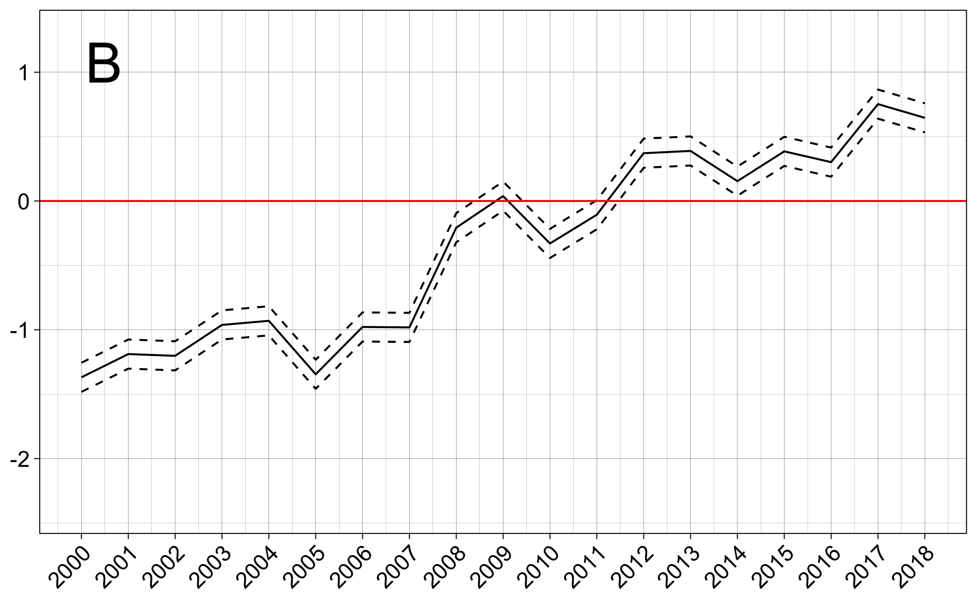
Notes:
InterX plots for supplement

