Slide 1
A Corpus for Dimensional Sentiment Classification on YouTube Streaming Service
Ching-Wen Hsu, Chun-Lin Chou, Hsuan Liu and Jheng-Long Wu
Department of Big Data Management, Soochow University, Taipei, Taiwan

Slide 2
CONTENTS
1
Introduction
4
Methodology
2
Motivation
5
Experiment
3
Related Work
6
Conclusion

Slide 3
Introduction
Habitual
Discussable
People viewing habits have shifted from TV to online social media platforms.
YouTube provides a discussion function for audiences to express their opinion.
Why we use
YouTube?
Shareability
Omnipresent
Videos themselves are highly shareable, and thus become a fast and effective way to convey ideas.
People can watch videos at anytime and anywhere.

Slide 4
Motivation
Present ways to tract video performance
How do we analyze video performance ?
1. average view duration.
2. browsing history.
3. variance in audience’s demographics.
Comments themselves are useful
Analyze audience’s comments through multi-dimensional sentiment indicators.
Help YouTuber create improved content
give YouTubers a sense of its popularity.
see what resonates with their audience.
discover audience emotional ups and downs.

Slide 5
Related Work
The purpose of analyzing YouTube’s comments
Clustering comments to classify video categories (Leung et al., 2009).
01
Social media reflect public views
methods deal with text-based classification tasks
02
03
Using Amazon’s comments to determine audience’s preference
(Bhatt et al., 2015).
Fine-tuned with Bidirectional Encoder Representations from the Transformers (BERT) model using comments.
(Sun et al. 2019)

Slide 6
Methodology
Comment
Collection
Sentiment
Indicators
Data
Labeling
Text
Preprocessing
Text
Classification
Three indicators for
analyzing comments
YouTuber preference
Video preferences
Excitement level
Three experts annotate sentiment indicators .
TF-IDF
word-embedding
RandomForest
Xgboost
SVM
FastText
BERT
25 channels
125 videos
12,500 comments

Slide 7



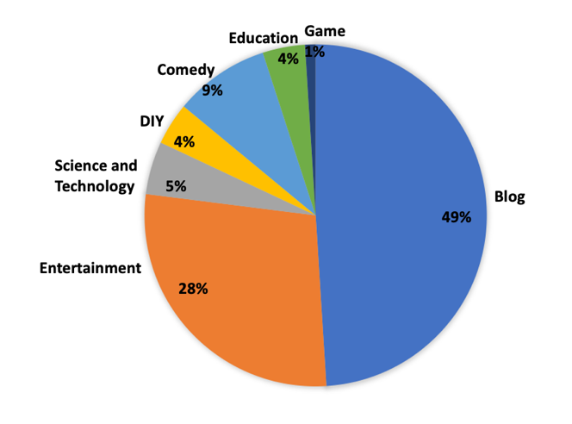
Comment Collection
Channels
videos
Comments
Subscribe number over 100, 000
Highly popular or controversial.
A total of 25 channels.
selection video duration 2019/01/01-2021/02/31
filter top 5 videos through viewing number.
A total of 125 videos.
randomly remain 100 pieces of comments from each videos
A total of 12,500 comments

Slide 8





Sentiment Indicators
YouTuber Preference
Non-Relative Comments towards YouTubers
comments do not contain YouTuber's name or affairs.
STEP
1
Like
Comments Collection
Relative Comments towards YouTubers
STEP
2
Neutral
Unlike

Slide 9
Sentiment Indicators
Video Preference
Non-Relative Comments towards Videos
comments do not contain video content or talk about YouTuber’s affairs.
STEP
1
Like
Comments Collection
Relative Comments towards Videos
STEP
2
Neutral
Unlike

Slide 10
Sentiment Indicators
Excitement Level
Hyper
excited
Fairly
excited
Slightly
excited
Excited
Barely
excited
No emoji
One type of emoji
Looks nice
Speak confidently and contain two types of emojis
Emojis are highly repetitive or over three types emojis
You are beautiful 😊
A lot of rhetoric and a series of emojis
👍🏻I used to go to hukilau. It was so comfortable and awesome 😂
I am appreciate that they could understand what I'm saying🤣🤣🤣
I love everything you said and subscribe your channel immediately ❤️❤️❤️❤️❤️❤️❤️❤️

Slide 11

Sentiment Indicators
Hyper
excited
I love everything you said and subscribe your channel immediately ❤️❤️❤️❤️❤️❤️❤️❤️
A lot of rhetoric and a series of emojis
Fairly
excited
Emojis are highly repetitive or over three types emojis
I am appreciate that they could understand what I'm saying🤣🤣🤣
Speak confidently and contain two types of emojis
👍🏻I used to go to hukilau. It was so comfortable and awesome 😂
Excited
Slightly
excited
One type of emoji
You are beautiful 😊
Barely
excited
No emoji
Looks nice

Slide 12

Data Labeling
label the audience’s comments independently according to three indicators
watching videos before labeling comments is required
annotation guideline
watching
videos
annotation
agreement
eliminate
non-relative comments
Three annotator
using the majority decision to filter out inconsistent labels.
advertisements.
comments not using Mandarin.
comments that post links to external web pages.

Slide 13
Annotation agreement scores
Excitement
level
0.393
Video preference
0.459
YouTuber preference
0.584
0.2
0.4
0.6
Fleiss's Kappa
Fair agreement
Moderate agreement
Substantial agreement
Video preference
0.726
YouTuber preference
0.852
Excitement
level
0.90
0.7
0.8
0.9
Cronbach's alpha
Acceptable
Good
Excellent

Slide 14
Text Processing
Machine Learning
Deep Learning
BERT
TF-IDF
pre-trained
word
embedding
pre-trained
tokens
Input
text
Model training & evaluation
Convert emojis to text
Establish a user-defined dictionary
Word tokenization using CKIP

Slide 15
Text Classification
Text Classification
Classification Tasks
BERT-based classifiers
M1: bert-base-multilingual-cased
M2: distilbert-base-multilingual-cased
Machine learning-based classifiers
M3: RandomForest + TFIDF
M4: Xgboost + TFIDF
M5: SVM + TFIDF
Deep learning-based classifiers
M6: FastText + Word embedding
T1: Audience’s sentiment toward YouTubers.
T2: Audience’s sentiment towards videos.
T3: Audience’s emotional ups and downs.

Slide 16
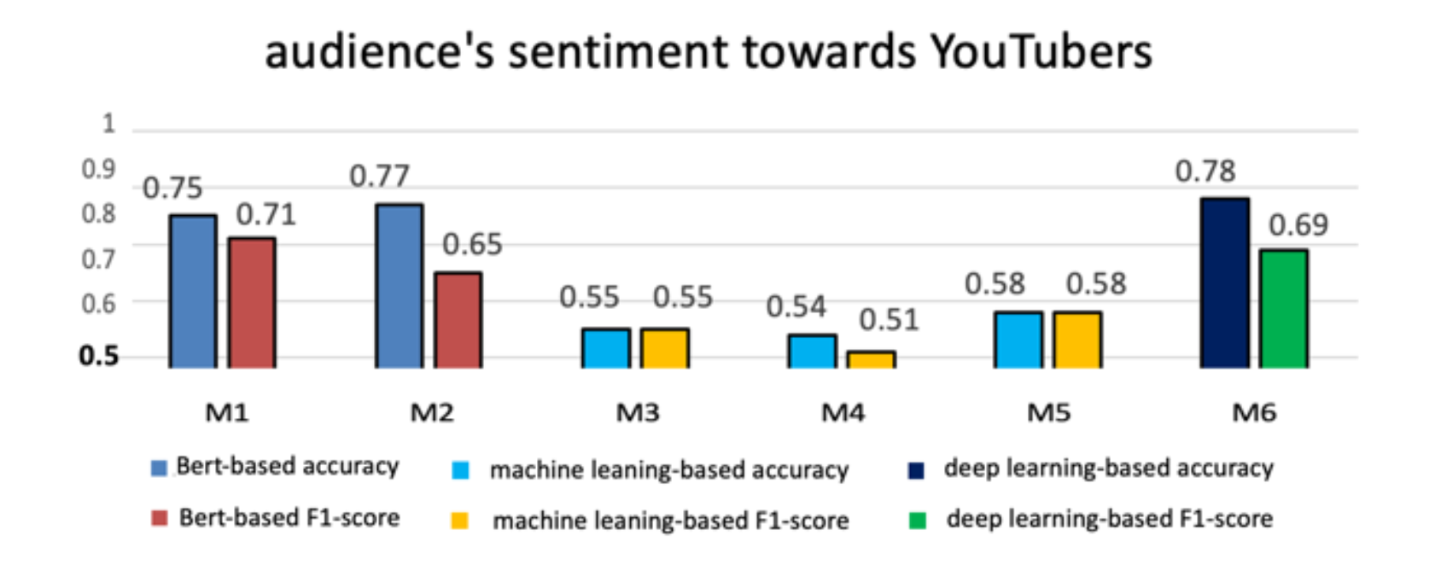
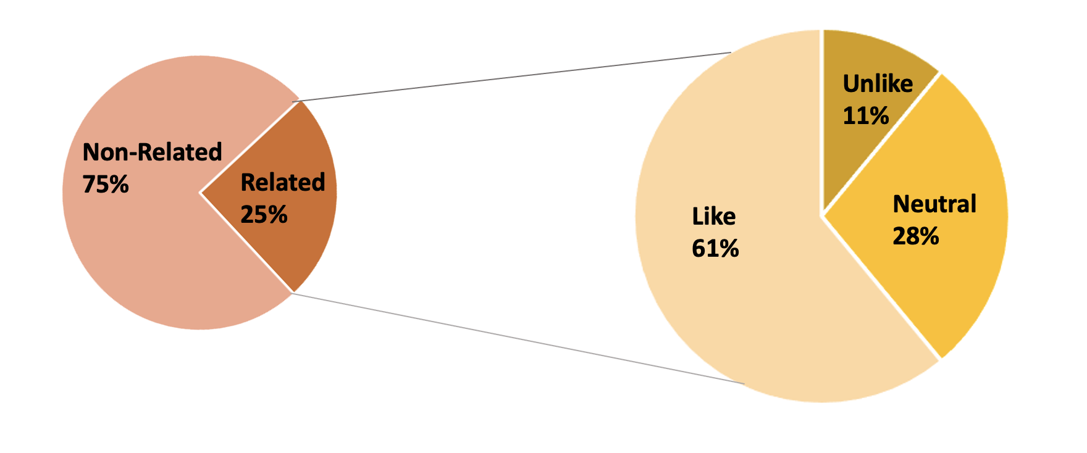


Experiment
T1 : Audience’s sentiment toward YouTubers
Data Distribution
Experiment
Result
Over half of the audience present a positive attitude towards YouTubers.
BERT-based classifiers and deep learning-based classifier have similar performance.

Slide 17
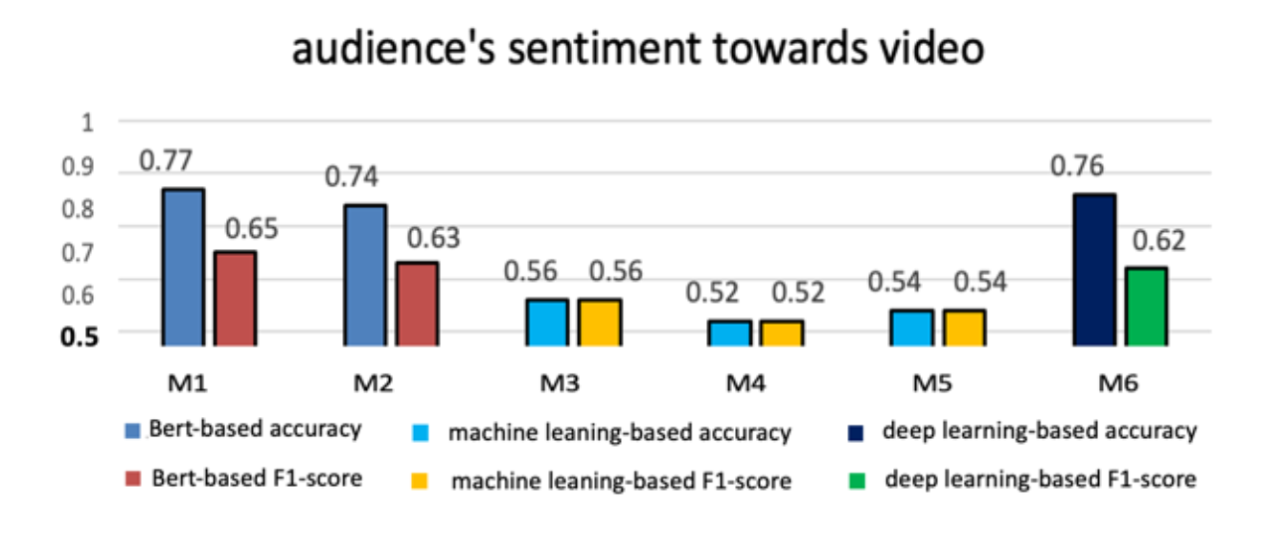
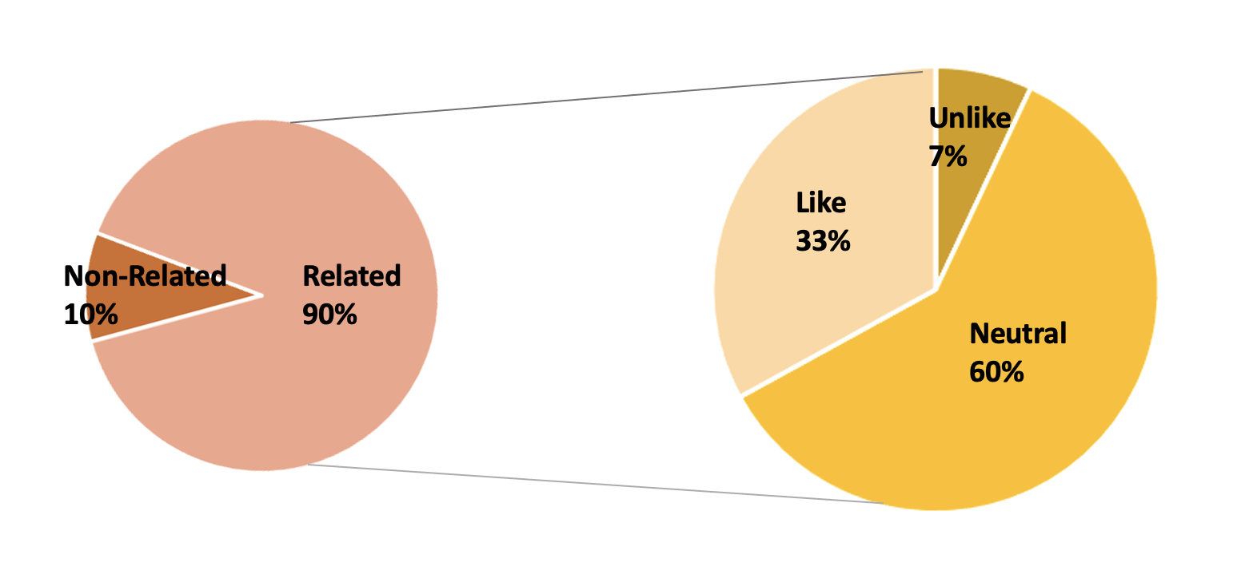
Experiment
T2 : Audience’s sentiment towards videos
Data Distribution
Experiment
Result
Machine learning-based models achieve the same score in accuracy and F1-score.
The accuracy of BERT and deep learning- based methods is 10% higher than their F1-score.
Although 90% comments have relationship with videos’ content,
most people do not present their personal positions.

Slide 18
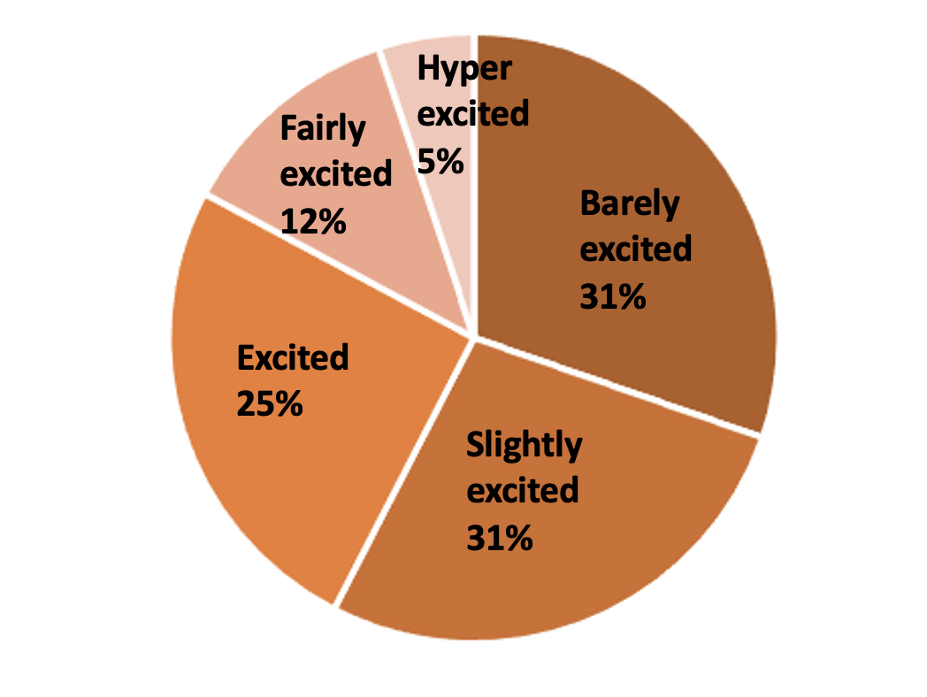
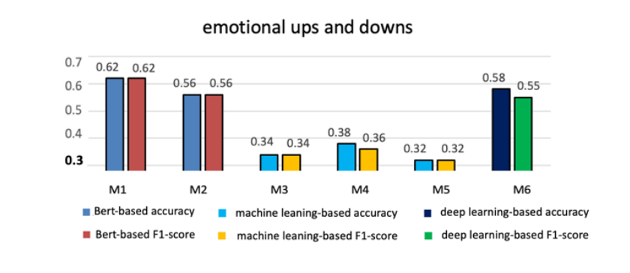
Experiment
T3 : Audience’s emotional ups and downs
Data Distribution
Experiment
Result
The performance of machine learning-based classifiers reduce significantly.
Multi-dimensional tasks are more suitable to be analyzed by BERT-based classifiers and deep learning-based classifier.
While Barely excited and Slightly excited account for the majority, some audience also express their extremely emotion.

Slide 19
Conclusion
Within three sentiment detection tasks, machine learning-based classifiers perform the worst.
The majority of comments are related to videos’ content; only few of them have relevant with YouTubers.
1
3
Result
2
4
BERT slightly outperforms other models in three tasks according to the F1-score.
Whatever comments, people not frequently showing negative or even animosity attitude as their opinion.

Slide 20
The end

