Slide 1
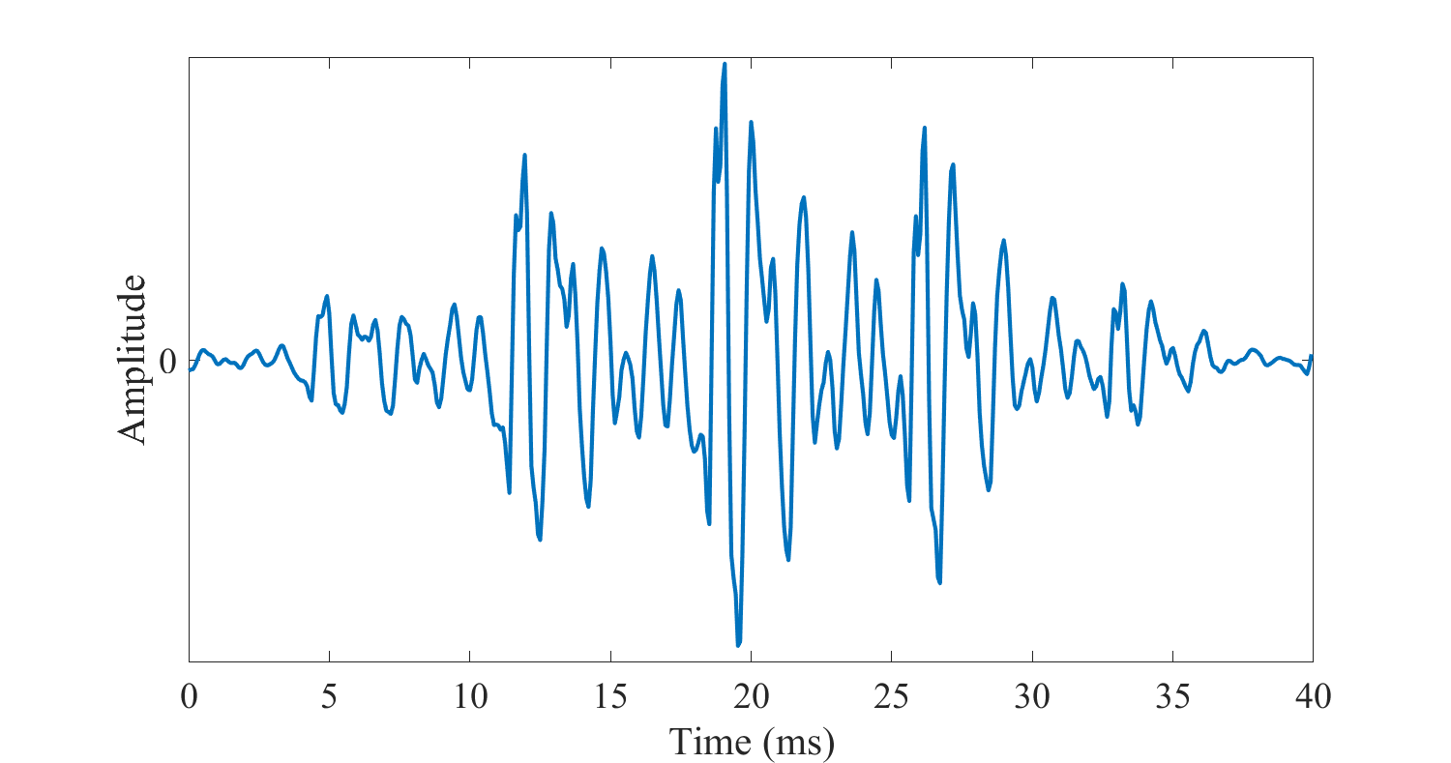
Feature Extraction
Y
th ih s ih z s p iy ch
Acoustic Models
Pronouncing Dictionary
Sequence of Acoustic Vectors
this is speech
W
Language Model
P(W) . P(Y|W)

Slide 2
Feature Extraction
Y
th ih s ih z s p iy ch
Acoustic Models
Pronouncing Dictionary
Sequence of Acoustic Vectors
this is speech
W
Language Model
P(W) . P(Y|W)

Slide 4
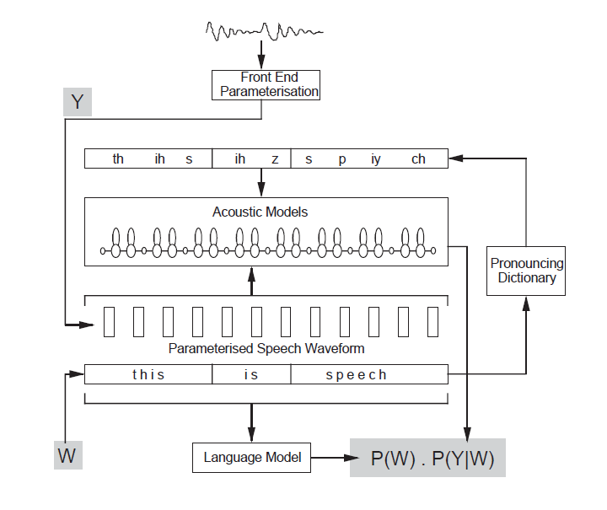

Slide 5
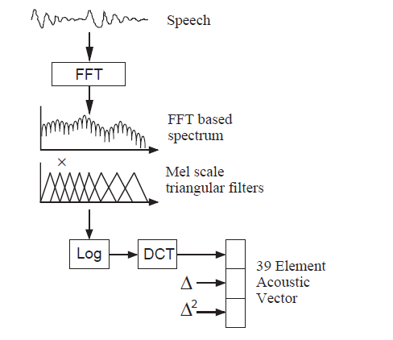

Slide 6
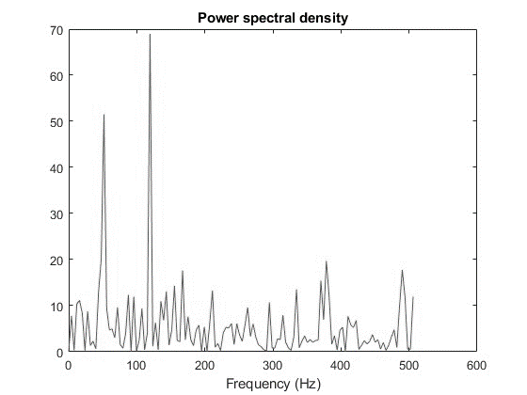
Speech
Signal
FFT
X
FFT Based Spectrum
Mel Scale Triangular Filters
Log
DCT
Acoustic
Vector

Slide 7
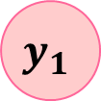
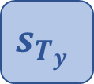
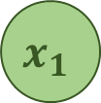
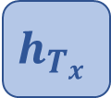
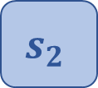
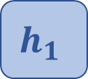
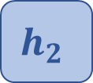
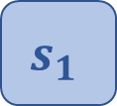

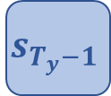


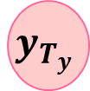
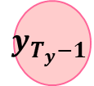
$$y_{1}$$
$$y_{2}$$
$$y_{T_{y}−1}$$
$$y_{T_{y}}$$
Fixed-Length
Summary
Vector c
$$s_{1}$$
$$s_{2}$$
$$s_{T_{y}−1}$$
$$s_{T_{y}}$$
$$h_{1}$$
$$h_{2}$$
$$h_{T_{x}}$$
$$x_{1}$$
$$x_{2}$$
$$x_{T_{x}}$$

Slide 8
$$y_{1}$$
$$y_{2}$$
$$y_{T_{y}−1}$$
$$y_{T_{y}}$$
Fixed-Length
Summary
Vector c
$$s_{1}$$
$$s_{2}$$
$$s_{T_{y}−1}$$
$$s_{T_{y}}$$
$$h_{1}$$
$$h_{2}$$
$$h_{T_{x}}$$
$$x_{1}$$
$$x_{2}$$
$$x_{T_{x}}$$

Slide 9
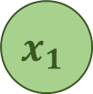


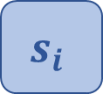
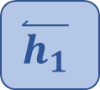
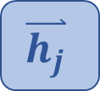




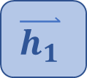
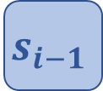
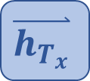

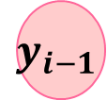

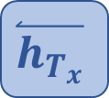
$$y_{i−1}$$
$$y_{i}$$
- - -
$$s_{i−1}$$
$$s_{i}$$
- - -
$$c_{i}$$
Attention Model
$$α_{i,1}$$
$$α_{i,T}$$
$$α_{i,j}$$
$$\overset{⃑}{h_{1}}$$
$$\overset{⃑}{h_{j}}$$
- - -
$$\overset{⃑}{h_{T_{x}}}$$
- - -
$$\overset{⃐}{h_{1}}$$
- - -
$$\overset{⃐}{h_{j}}$$
- - -
$$\overset{⃐}{h_{T_{x}}}$$
$$x_{1}$$
$$x_{2}$$
$$x_{T_{x}}$$

Slide 10
Speech Signal from the driver
Automatic Speech Recognition Unit
Text
Text Classifier Unit
Automated Dispatcher Actions

Slide 11
Decoder
Feed Forward
Encoder
Feed Forward
Encoder-Decoder Attention
Self Attention
Self Attention

Slide 12
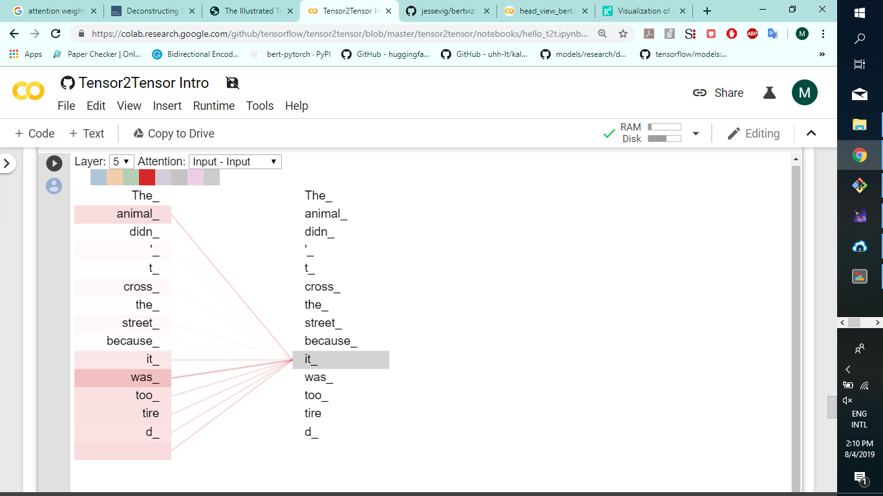

Slide 13
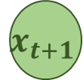
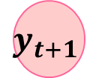

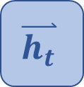

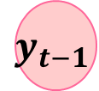


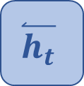
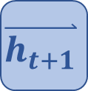
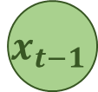

Output Layer
$$y_{t−1}$$
$$y_{t}$$
$$y_{t+1}$$
$$\overset{⃑}{h_{t−1}}$$
$$\overset{⃑}{h_{t}}$$
$$\overset{⃑}{h_{t+1}}$$
- - -
Forward Layer
- - -
$$\overset{⃐}{h_{t−1}}$$
$$\overset{⃐}{h_{t}}$$
$$\overset{⃐}{h_{t+1}}$$
Backward Layer
- - -
- - -
Input Layer
$$x_{t−1}$$
$$x_{t}$$
$$x_{t+1}$$

Slide 14
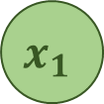
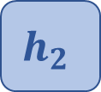



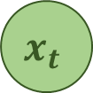


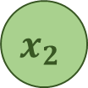
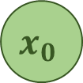




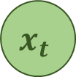
$$y_{t}$$
$$y_{0}$$
$$y_{1}$$
$$y_{2}$$
$$y_{t}$$
$$h_{t}$$
=
$$h_{0}$$
$$h_{1}$$
$$h_{2}$$
$$h_{t}$$
$$x_{t}$$
$$x_{0}$$
$$x_{1}$$
$$x_{2}$$
- - -
$$x_{t}$$

Slide 15
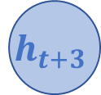



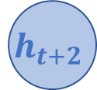

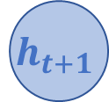

$$r_{t}$$
$$r_{t+1}$$
$$r_{t+2}$$
$$r_{t+3}$$
Row Conv Layer
$$h_{t}$$
$$h_{t+1}$$
$$h_{t+2}$$
$$h_{t+3}$$
Recurrent Layer

