Slide 1
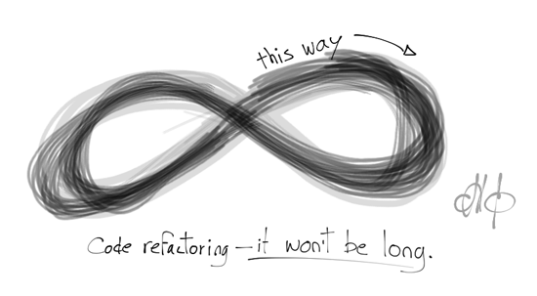
Refactoring Combat
Team ∞ Infiniti
by
Maggie Hewitt Alejandro Marchini Paul Francis Brian To

Slide 2
Agenda
Combat Design
Combat Implementation
Metrics
Refactor Guidelines
Refactor Proposal
Refactored Design
Benefits and Principles
Refactor Implementation
Limitations

Slide 3
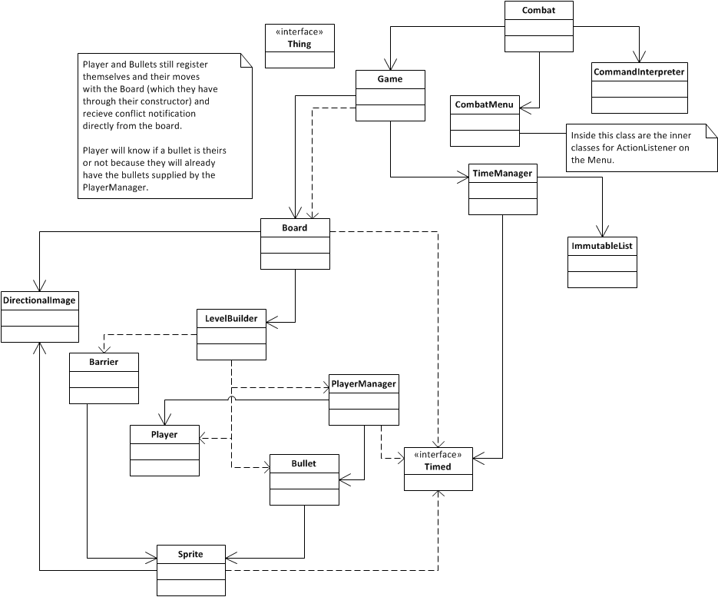
Original Given Design

Slide 4
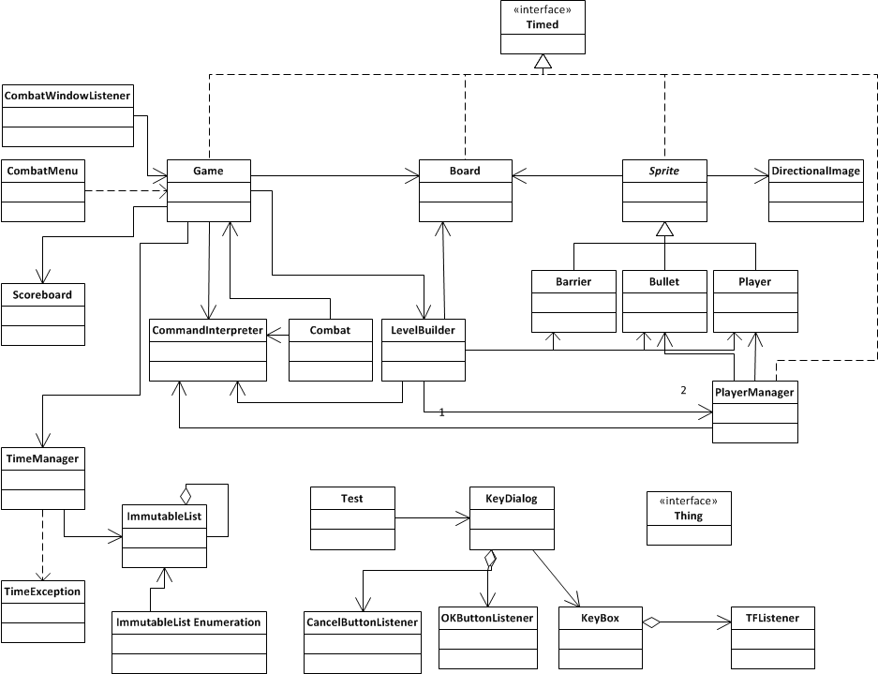
Original Actual Design

Slide 5
Factors that guided our refactoring activity
What features need to be added?
Level Creator, Dynamic loader, Key selector
What bugs currently exist?
Bullet bounce and shadow
Barrier hop
Code Metrics
Complexity and function attributes
Implementation mismatch to design
Incomplete Design Patterns
Unused Classes and Misleading class names
Documentation
Sequence diagrams
CRC
Unnecessary Threads

Slide 6
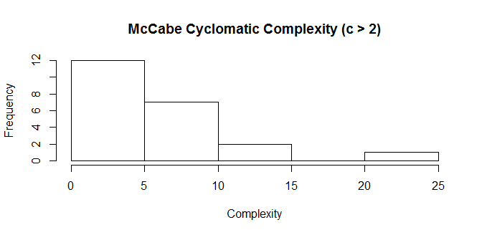
Metrics
High Cyclomatic Complexity
conflict (Bullet) and move (PlayerManager)
keyPressed (CommandInterpeter)
PlayerManager constructor contributed to parameters/method

Slide 7
Initial Refactoring Ideas
Patterns they claimed
Proxy
State
Command
Patterns for refactoring
Observer - Game, PlayerManager
Builder - Level Builder, Game
Things that are Retained
The tick threaded mechanism
ScoreBoard, DirectionalImage, Sprite, Player & bullet movement functions
CommandInterpreter, Board, CombatMenu,Barrier
Throw away the "Thing" & "ImmutableList"

Slide 8
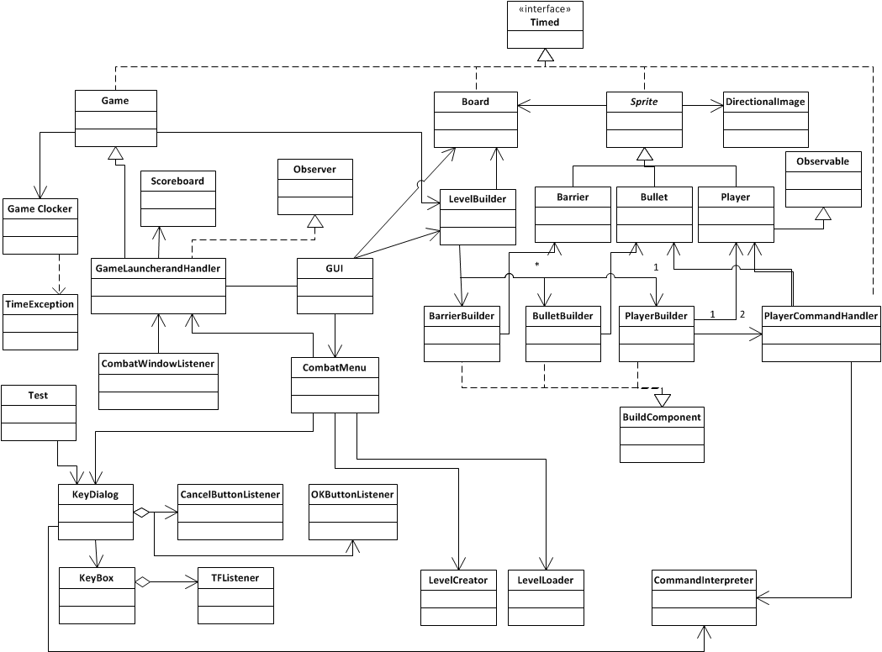
Final Refactored Design

Slide 9
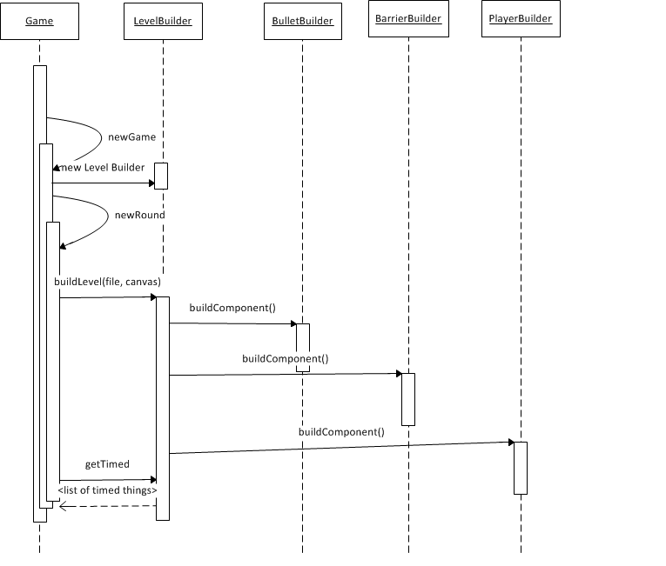
New Level Building

Slide 10
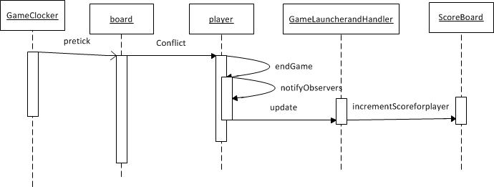
Scoreboard Update sequence

Slide 11
Benefits and Principles
Principles
Model View Controller
Enforcement of Law of Demeter
Separation of Concerns
Patterns Justification
Observer Pattern
Eliminated need of Game and PlayerManager Threads. Should increase performance
Should avoid concurrency Issues
easy maintenance
Builder pattern
Included to match what the actual design intended to do
Load levels without barriers
To accommodate game expansion
adding AI tanks, Defensive barriers, landscape...

Slide 12
Refactor Implementation
Removal of unused methods and classes
Renaming Classes
Implementing the Key selection for player Inputs
Conflict method in Bullet refactoring
PlayerManager parameter Modification

Slide 13
Limitations
Player creation and setup still uses player indices
Still clunky
Hard to modify because of having to explicitly deal with two cases

Slide 14

Questions???

Slide 15
Changes and Benefits
Class Name | Description of Changes | Benefits
GUI | Creation of class. | Jpanel, board container creation and everything related to view are centralized in one location.
Level Creator Level Loader | Creation of class. | New implementation to accommodate requirements
Scoreboard | No longer communicates with Game. Communicates with Combat/Game Control | Game no longer acts as a poltergeist, pushing information to Combat/Game Control.
Player Command Handler/ Player Manager | Player Manager renamed to Player Command Handler Added Observable behaviour to notify observers | Decreases violations of the Law of Demeter
Thing | Deleted. | Unnecessary. Provides no functionality

Slide 16
Changes and Benefits
GameLauncherandHangler | Combat renamed to GameLauncherandHandle | Extends game functaionalities and implements observers Reduced coupling to game Eliminated thread
Player | Extends observable | Eliminated thread
Bullet, PlayerManager | Refactoring of conflict and the constructor | Reduce complexity and parameter/method in metrics
Immutable List | Deleted | Unneccesary and inappropriate

