Slide 1
Your presentation must:
* [ ] Be at least 8-10 min. long
* [ ] Describe the core message or hypothesis for your project.
* [ ] Describe the questions you and your group found interesting, and what motivated you to answer them
* [ ] Summarize where and how you found the data you used to answer these questions
* [ ] Describe the data exploration and cleanup process (accompanied by your Jupyter Notebook)
* [ ] Describe the analysis process (accompanied by your Jupyter Notebook)
* [ ] Summarize your conclusions. This should include a numerical summary (i.e., what data did your analysis yield), as well as visualizations of that summary (plots of the final analysis data)
* [ ] Discuss the implications of your findings. This is where you get to have an open-ended discussion about what your findings "mean".
* [ ] Tell a good story! Storytelling through data analysis is no different than in literature. Find your narrative and use your analysis and visualization skills to highlight conflict and resolution in your data.

Slide 2

Maggie L Kevin H Rob S

Slide 3
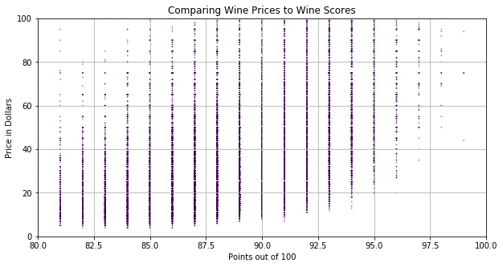
Finding The “Best” Wines
Looking at the outliers
Top Left
Bottom Right

Slide 4
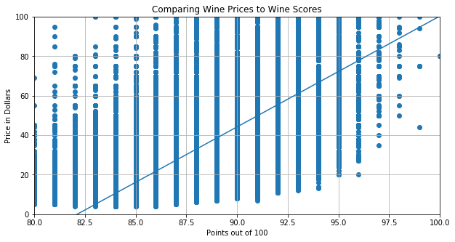
So much data… Is the a correlation though?

Slide 5
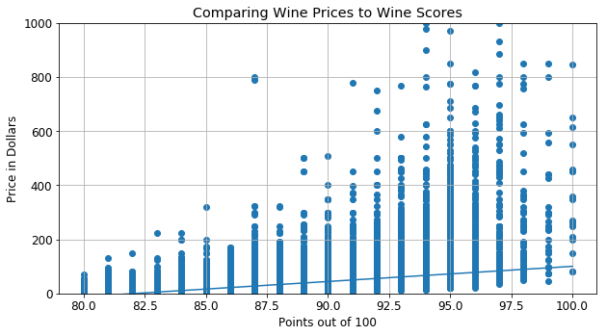
More Expensive, Better Tasting?
Slope: 5.6
R squared: .17
P value = 0.0

Slide 6
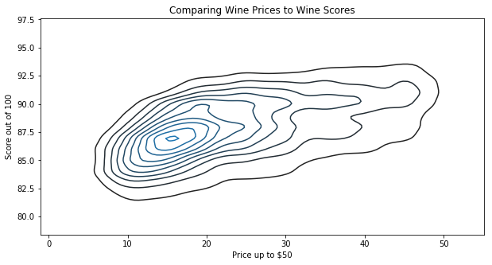
Density of Price and Points

Slide 7
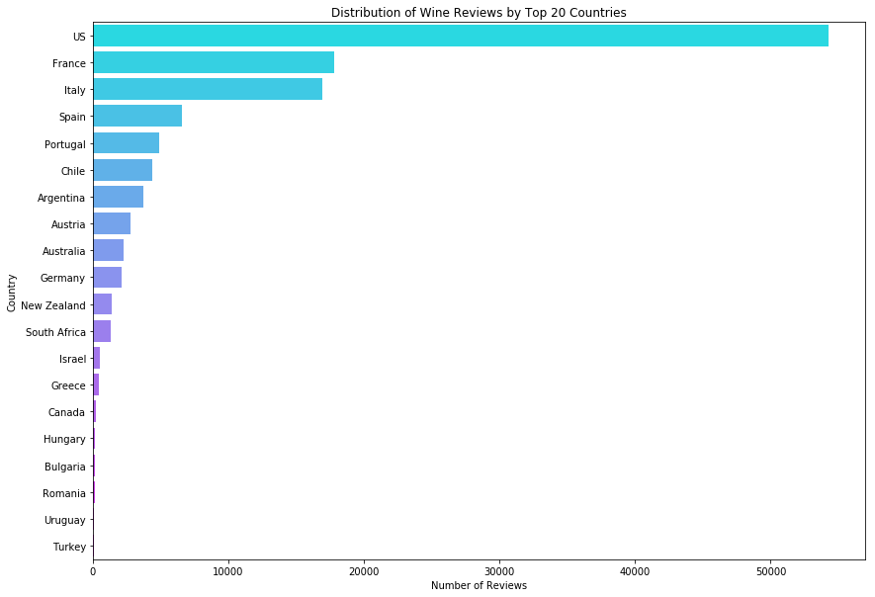
Distribution of Wine Reviews by Top 20 Countries

Slide 8
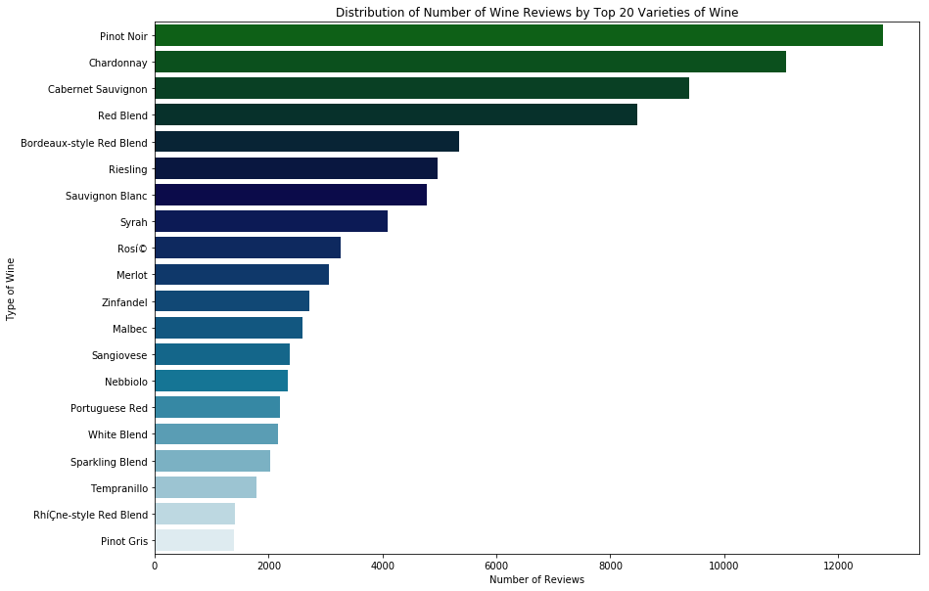
Distribution of Number of Wine Reviews by Top 20 Varieties of Wine

Slide 9
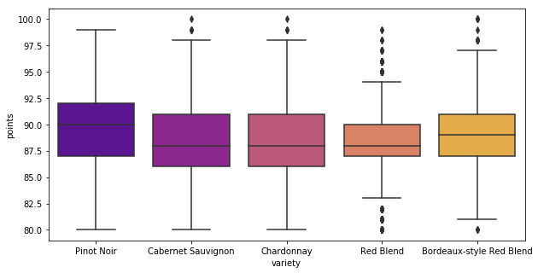
Consistent Consistency

Slide 10
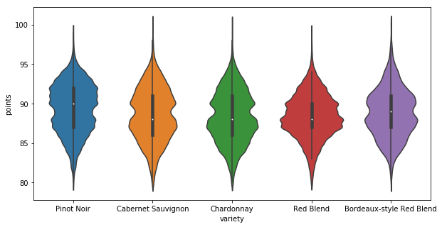
Music To My Ears

Slide 11
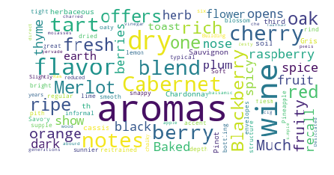

Slide 12
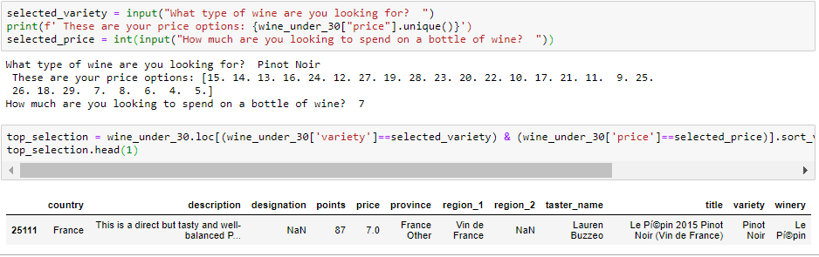
Wine Reconmendation
Input desired variety and price
Output highest rated wine

