Slide 1

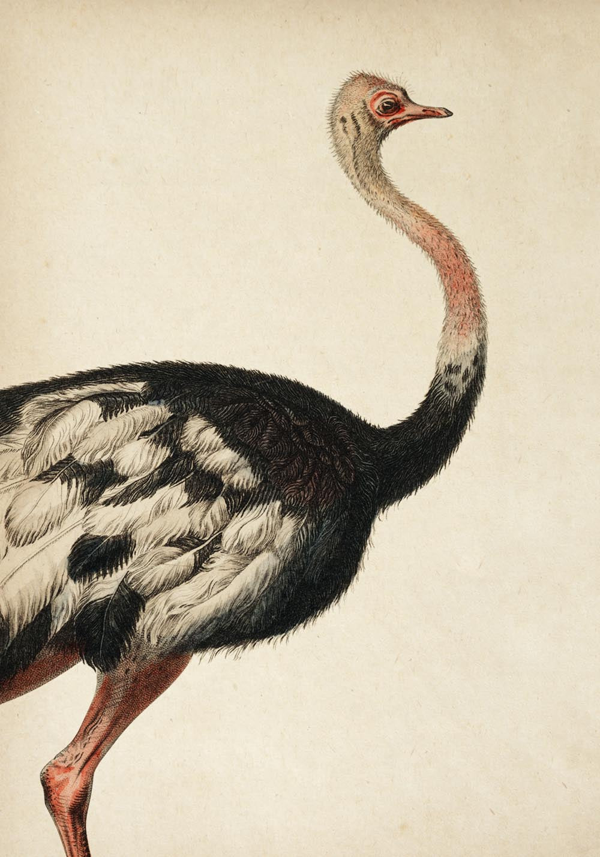
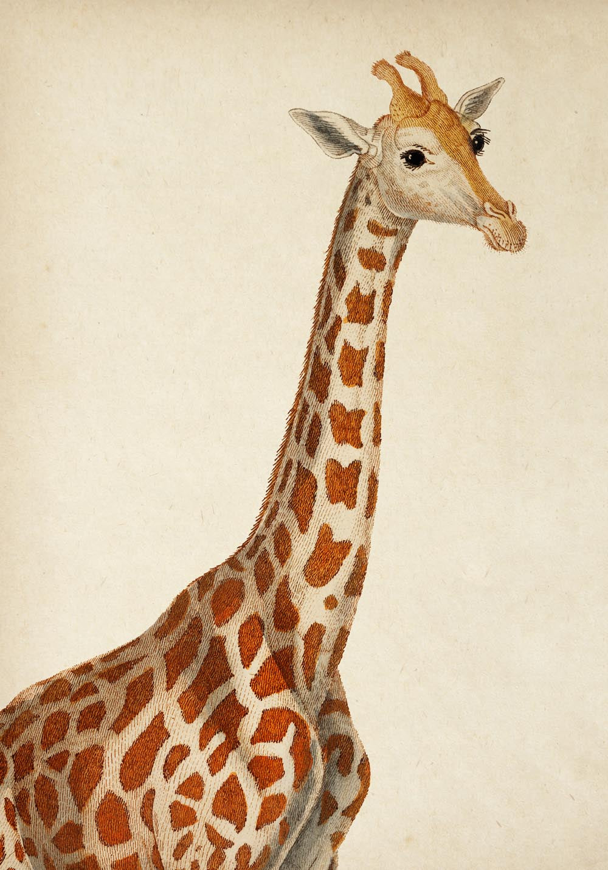
ROCK PAPER SCISSORS
Animal Poster Set
Ostrich and giraffe fine art prints
Collected vintage animal wall art
SET
SIZE
PAPER
PRICE
2 prints
8 x 10 in
Fine art paper
$26
Retail package front / 8x10 paper format
SKU CGW10116-8X

