Slide 1
Book1
File created on: 10/17/23 1:37:19 PM EDT

Slide 2
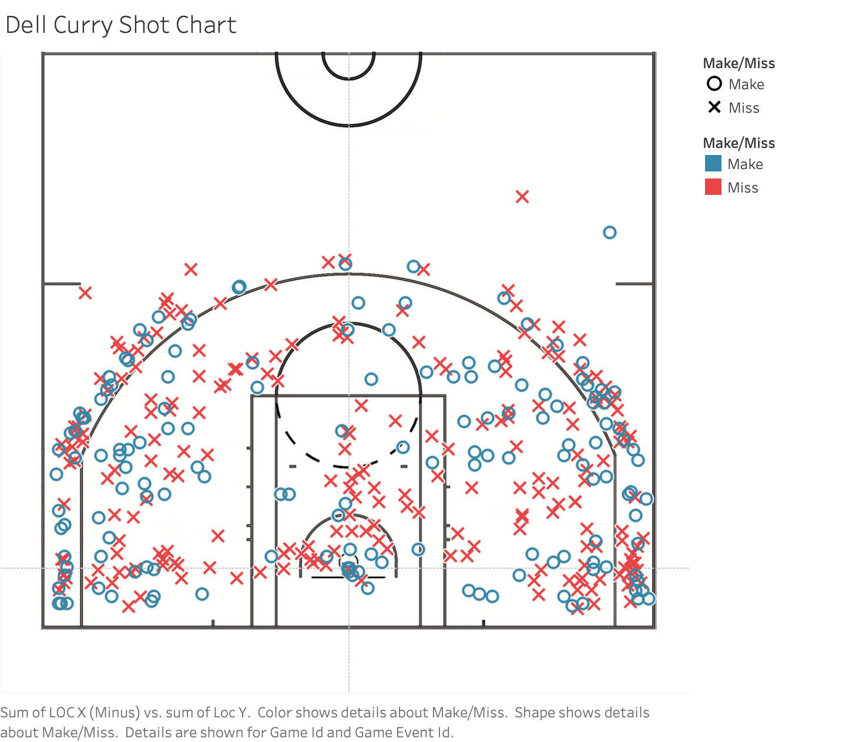

Slide 3


Slide 4
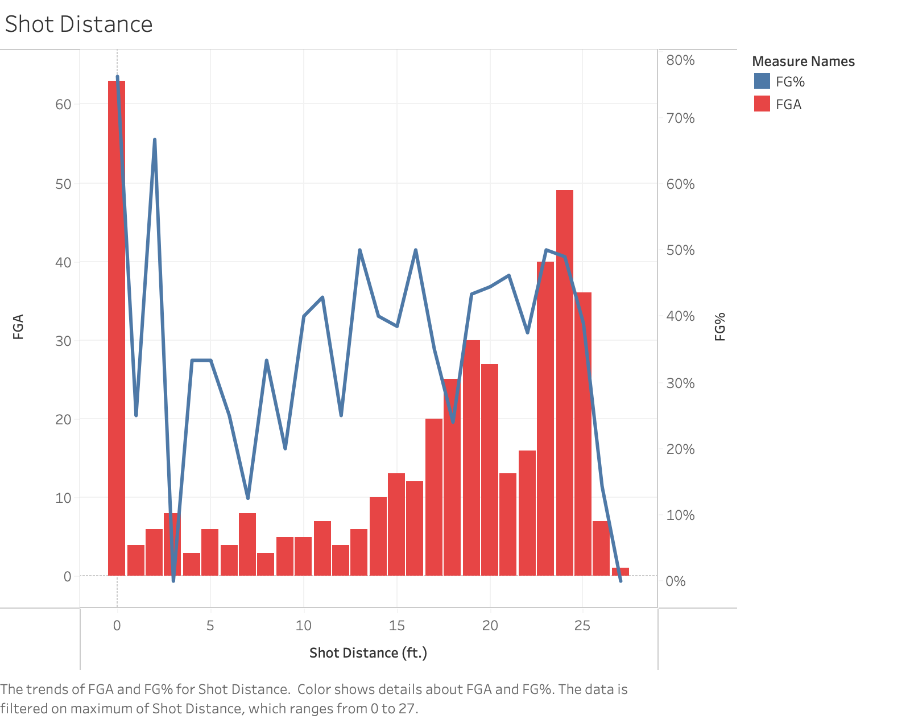

Slide 5
