Slide 1
Steph_Curry_Dashboard
File created on: 10/17/23 12:45:41 PM EDT

Slide 2
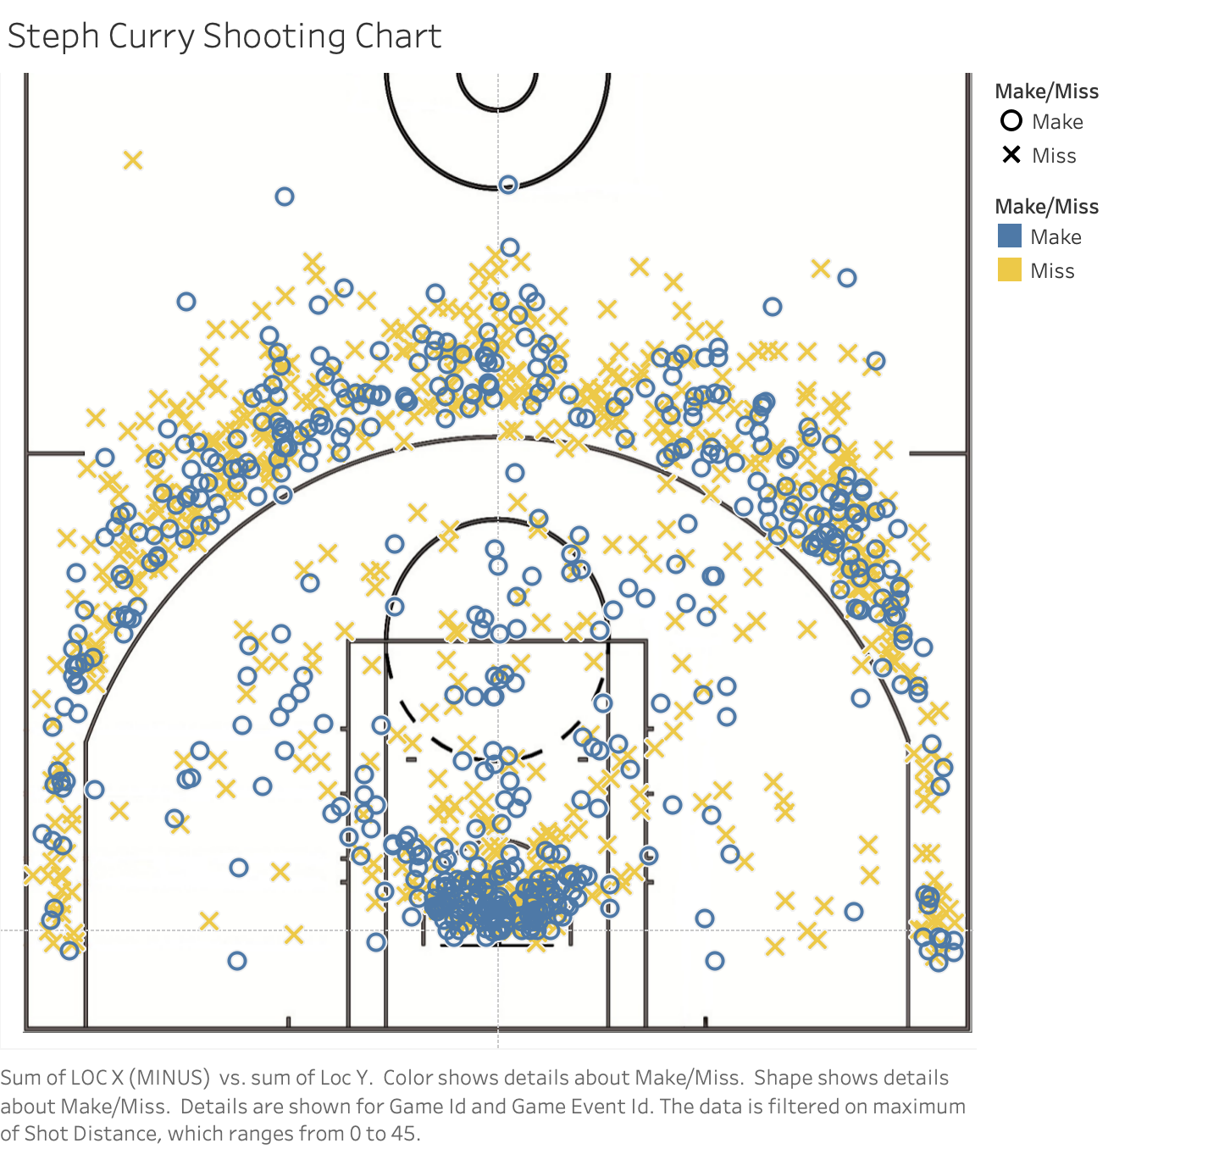

Slide 3
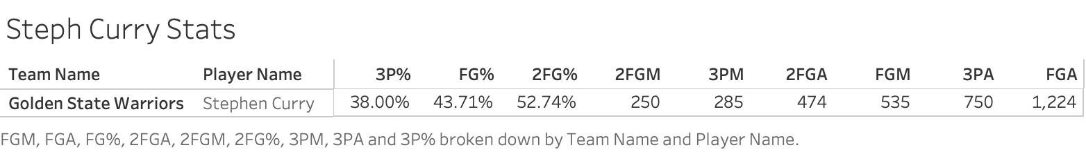

Slide 4
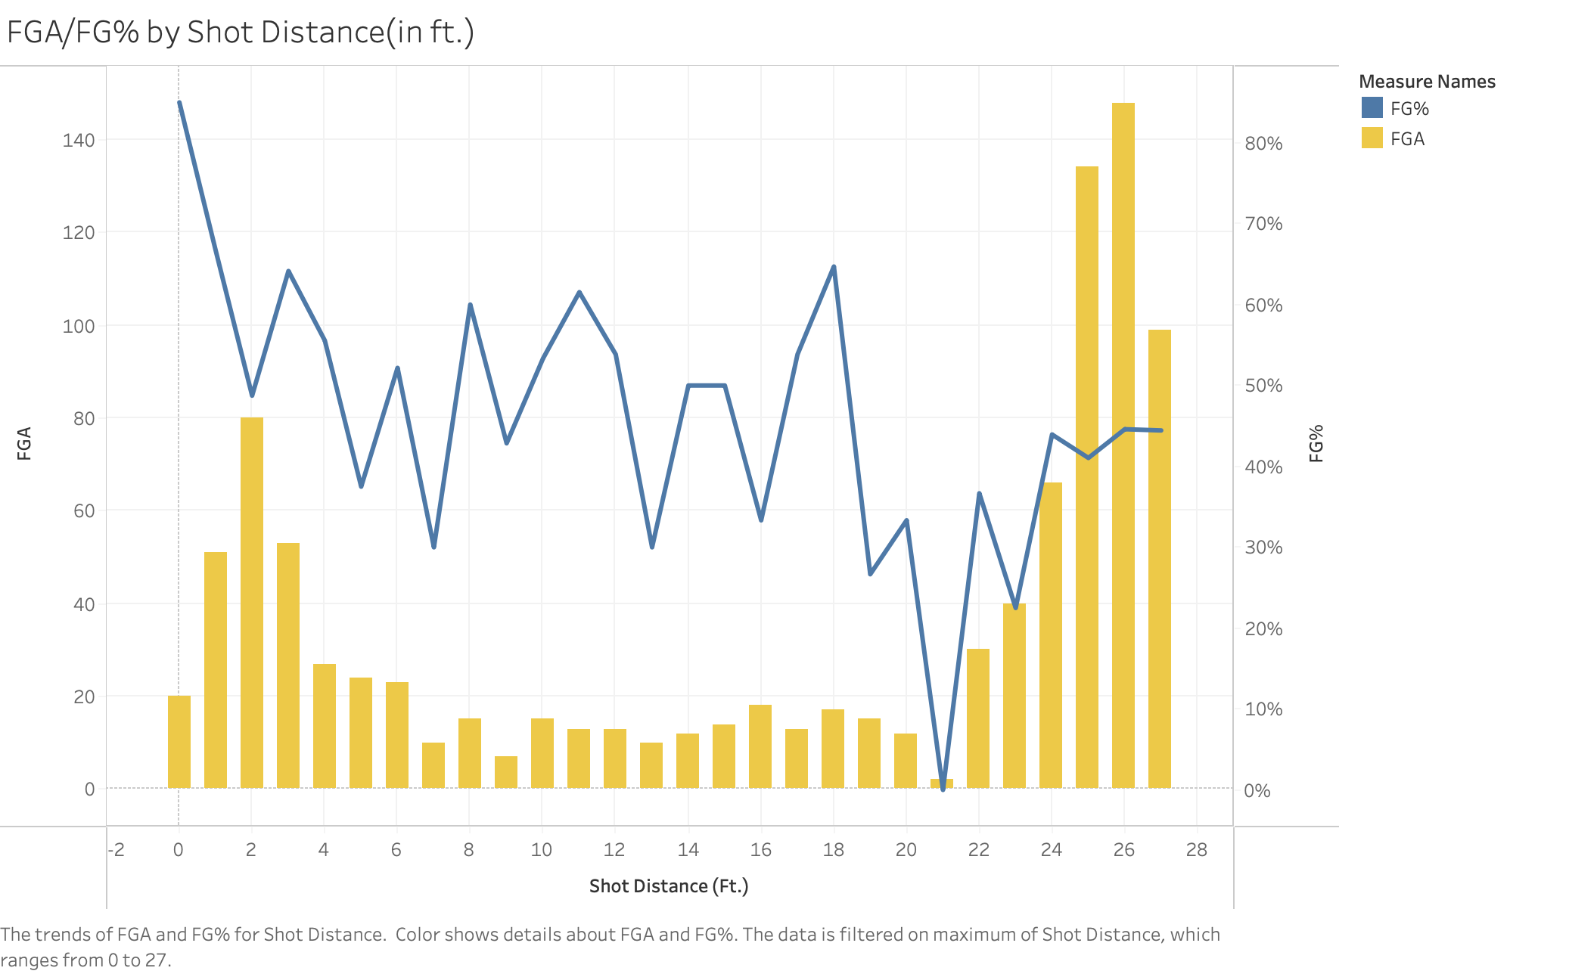

Slide 5
