Slide 1

Final Presentation
Team 1

Slide 2
01
Introduction
02
How we solve
contents
03
Experimental framework
04
Result and conclusion

Slide 3
About us
-------- TEAM 1 --------
Mingjun Liu
Simeng Wang
Guiming Xu
Ning Zhang

Slide 4
About Dataset
We choose the kaggle dataset Home Credit Default Risk.
From home credit companies with a predictive borrower risk program.
Aim at people who do not have loan record and credit record, using other related information, like transactional information, to predict clients' repayment abilities.

Slide 5
About Dataset
application_train/test.csv：The main table, divided into training sets and test sets, contains main personal information of customers
bureau.csv： All loan records kept by counseling company
bureau_balance.csv： Monthly balance of the above loan records
POS_CASH_balance.csv：Customer's cash on the home credit loan and the monthly consumption of the pos machine
credit_card_balance.csv： Customer's monthly balance on home credit
previous_application.csv：Customer loan application record before home credit
installments_payments.csv：Customer loan repayment history before home credit

Slide 6
How we solve
01
02
03
Load data:
Read all csv files and save as the format of dataframe
Preprocess:
Integrate and connect information for each sample.
One-hot encoding.
Model:
Build the LightGBM algorithm;
Kfold cross validation .

Slide 7
Experimental framework
1
Decision Tree
Decision tree algorithm is a very common prediction method.
The decision tree algorithm represents a mapping relationship between object attributes and object values. Each node in the tree represents an object, and each forked path represents a possible attribute value.

Slide 8
Experimental framework
2
LightGBM
LightGBM is a gradient boosting framework that uses tree based learning algorithms. It is designed to be distributed and efficient with the following advantages:
Faster training speed and higher efficiency
Lower memory usage
Better accuracy
Parallel and GPU learning supported
Capable of handling large-scale data

Slide 9
Experimental framework
3
Cross-validation
kfold: The k-fold cross-validation is to use 1/k of the training set as test set, each model is trained k times, tested k times, the error rate is average of k times, and finally the model Mi with the smallest average rate is selected.
Limited dataset
Ensure a better performance

Slide 10
Experimental framework
4
Metrics-AUC
AUC = area under the curve. Usually the curve here refers to the Receiver operating characteristic (ROC).
Accuracy of prediction.

Slide 11
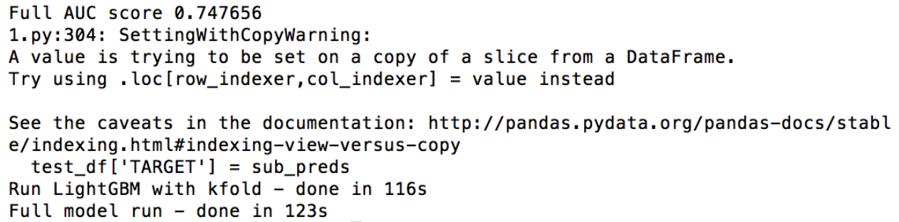
Results
AUC on all dataset is 0.748.

Slide 12
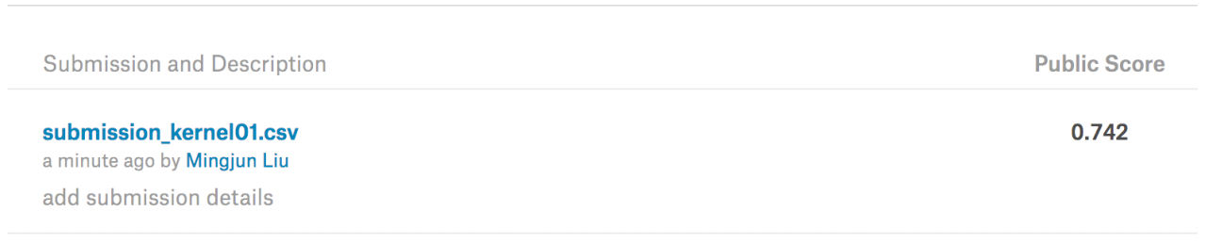
Results
AUC on all dataset is 0.748.
Get a score of 0.742 on kaggle.

Slide 13
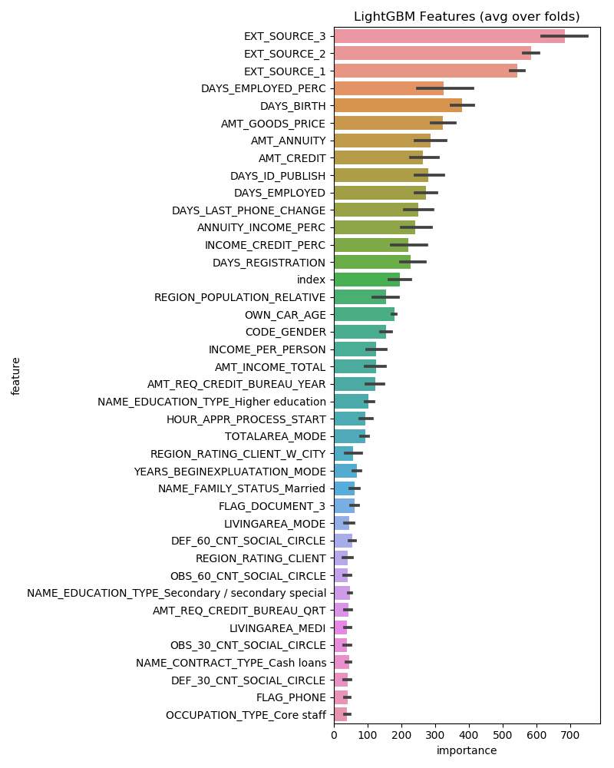
Results
With the data obtained by Kfold, we used the results of LightGBM training to get the importance of each feature, which may help further algorithm optimization.
For example, we can select the above-mentioned more important features to form a new data set, which means feature selection.

Slide 14
Conclusion
1
What we learned?
The general process of data cleaning such as missing value processing and one-hot encoding.
2
What we learned?
Process the data with kfold to verify the accuracy of the model and concept of LightGBM.
3
Where is the code?
https://github.com/maggiewang1222/MachineLearing-Group1
4
What is the main challenge?
When using Bayesian optimization algorithm for parameter adjustment, the calculation is too large and computer crashes!

Slide 15
Questions?

Slide 16
Thank you

