Slide 1
Improving Image Segmentation with Edge Detection and Filters
Jing Lin & Maggie Wu

Slide 2
Motivation
Unclear edge definition

Slide 3
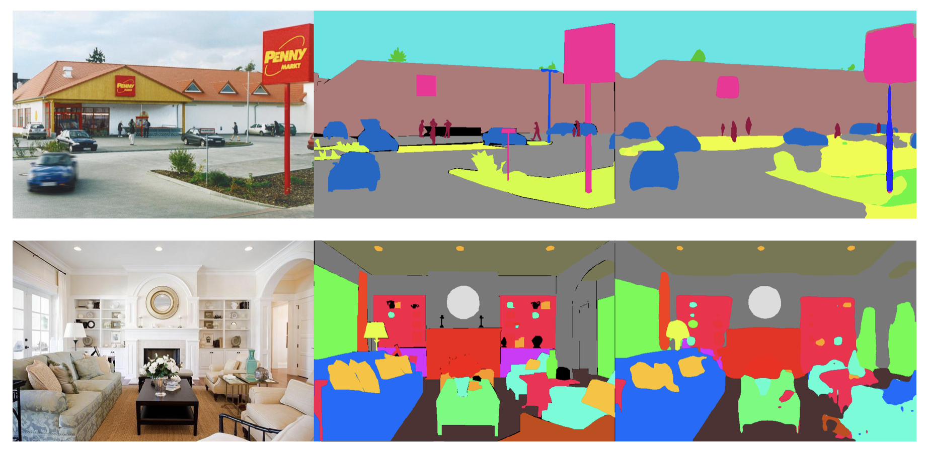
Motivation
Unclear edge definition

Slide 4
Motivation
Unclear edge definition

Slide 5
Motivation
Unclear edge definition

Slide 6
Motivation
Unclear edge definition

Slide 7
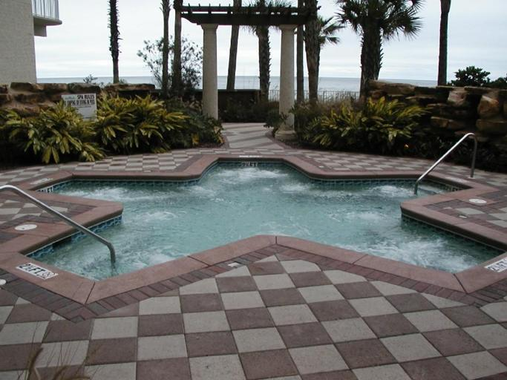
Approaches

Slide 8
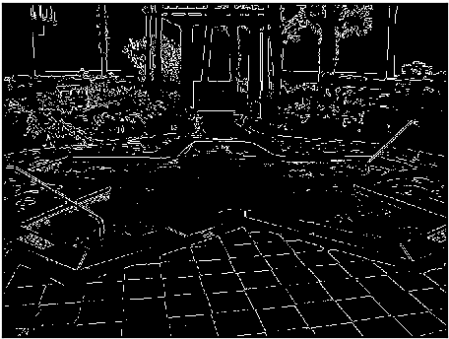

Approaches
Edge Detection

Slide 9

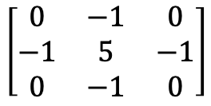
Approaches
Edge Detection
Sharpen Filter
$$\left[\begin{matrix}0 & −1 & 0 \\ −1 & 5 & −1 \\ 0 & −1 & 0\end{matrix}\right]$$

Slide 10
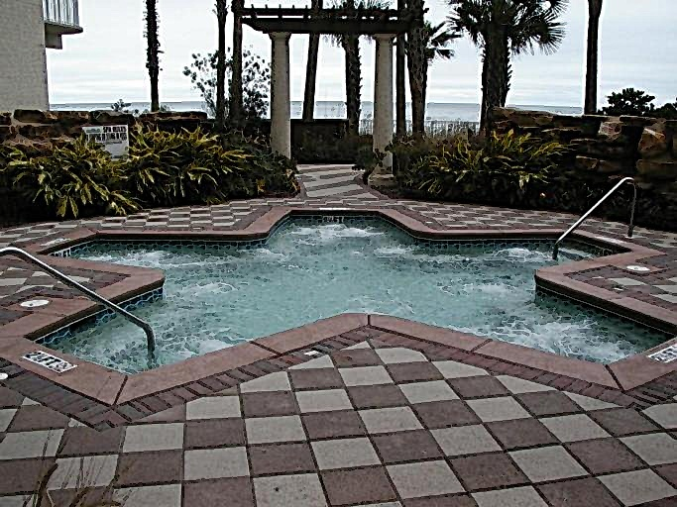
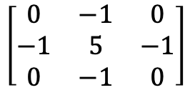
Approaches
Edge Detection
Sharpen Filter
$$\left[\begin{matrix}0 & −1 & 0 \\ −1 & 5 & −1 \\ 0 & −1 & 0\end{matrix}\right]$$
Combined Technique
$$\left[\begin{matrix}0 & −1 & 0 \\ −1 & 5 & −1 \\ 0 & −1 & 0\end{matrix}\right]$$

Slide 11
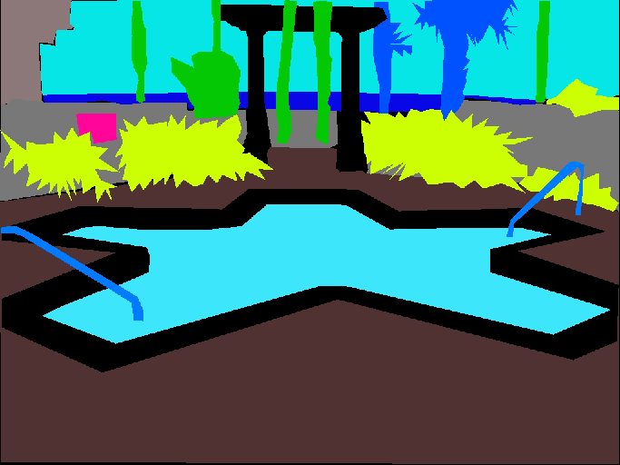
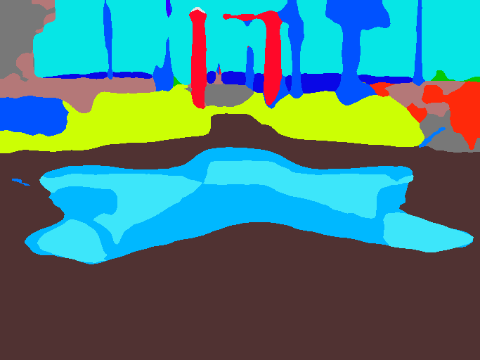
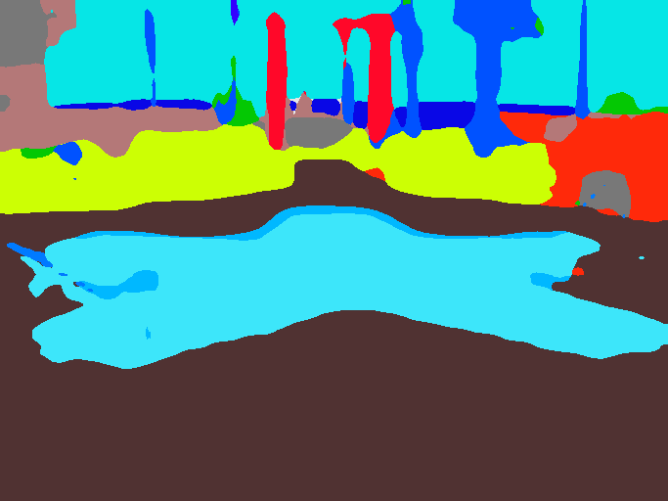
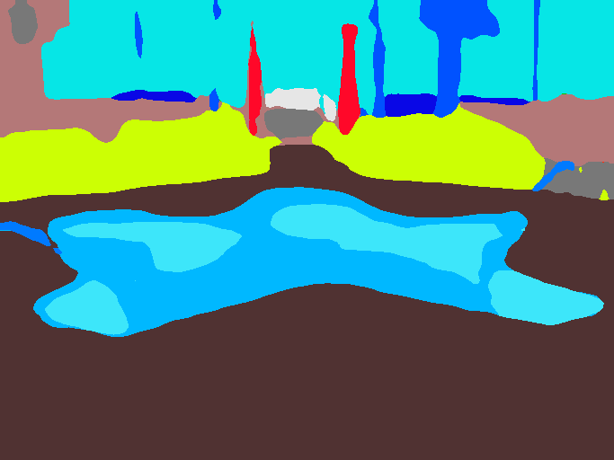
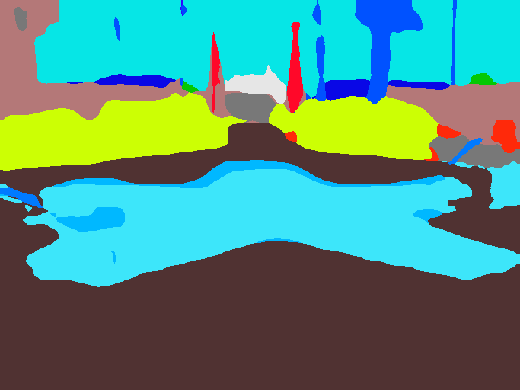
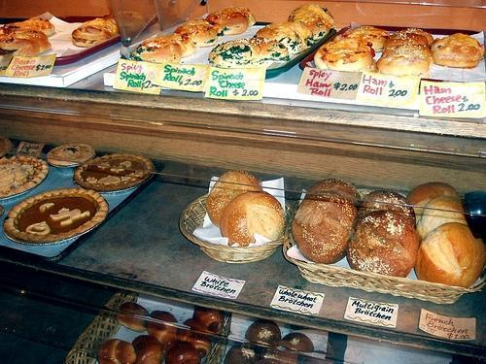
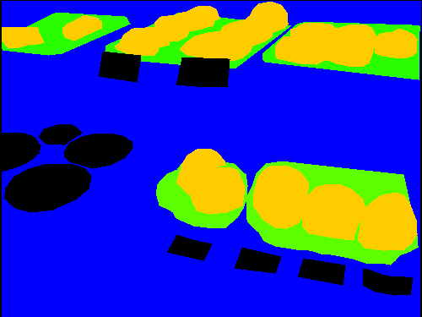
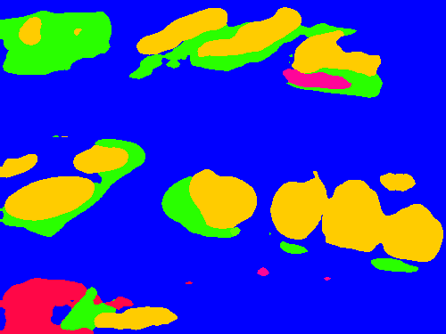
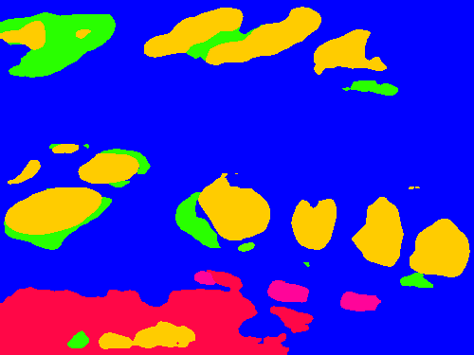
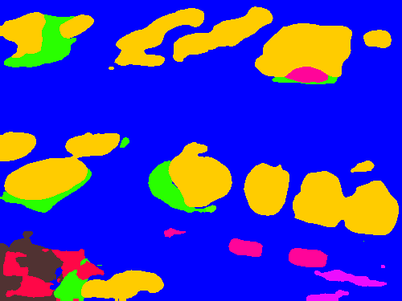
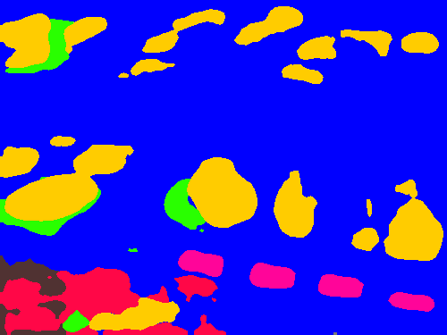
Results & Discussion
Images | Original | Ground Truth | Baseline | Edge Detection | Filter | Edge Detection + Filter
Pool
Bread

Slide 12
Results & Discussion
Images | Original | Ground Truth | Baseline | Edge Detection | Filter | Edge Detection + Filter
Pool
Bread

Slide 13
Results & Discussion
Images | Original | Ground Truth | Baseline | Edge Detection | Filter | Edge Detection + Filter
Pool
Bread

Slide 14
Contributions
Jing
Parse scene segmentation via NN on AWS
Implement filter technique
Maggie
Implement edge detection technique
Provide error analysis

