Slide 1

心理状态等的刻画方法

Slide 2
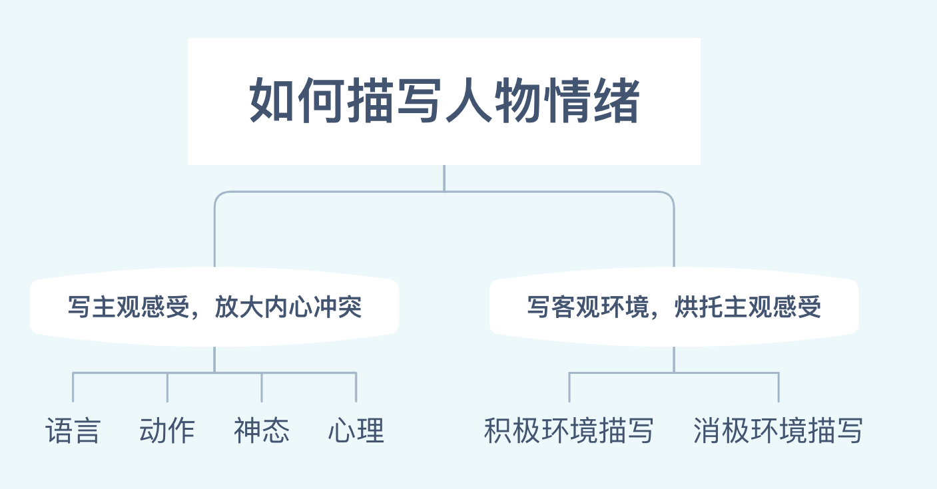

Slide 3
Examples from literary works…

Slide 4
心理活动描写
Mary felt her spirits sink even lower. 玛丽觉得她的情绪更低落了。
Mary felt a wave of anger sweep over her. 玛丽感到一阵愤怒。
神态描写
Mary felt her cheeks flush. 玛丽感到面颊发红。
When he saw the light from Mary’s candle, his eyes widened even further, but the crying stopped.
当他看到玛丽的蜡烛发出的光时，他的眼睛睁得更大了，但是哭声停止了。

Slide 5
动作描写
He scowled (怒视), slamming the door behind him.
他怒气冲冲，摔门而去。
She fumbled (摸索) for the key, [her heart beating faster than a galloping horse]. 她摸索着找钥匙，心跳得比一匹疾驰的马还快。
Taking a deep breath, Mary pushed open the door and stepped inside.
玛丽深吸了一口气，推开门走了进去。
She swallowed hard and stepped into a huge room.
她使劲咽了一下口水，走进一个大房间。

Slide 6
环境+心理活动描写
The rain began again that night. It beat against the window, [waking Mary up]. She listened as the wind howled around the house and down the chimney. She tried but could not get back to sleep. “Stupid wind!” she thought.
那天晚上又开始下雨了。雨拍打着窗户，把玛丽吵醒了。她听着风在房子周围呼啸，从烟囱里呼啸而下。她想睡，但还是睡不着。“愚蠢的风！”她想。

Slide 7
主观心理感受描写

Slide 8
No.1 开心
普通版：He was happy.
进阶版:
动作描写：
Tears of happiness ________ _______ Susan’s ________. (沿着脸颊奔流而下)
She ________ _______ ______ ________. (落下开心的泪水)
I beamed at (笑容满面) him, “Welcome back, ...”
He grinned with delight (咧嘴开心地笑) when he saw us.
神态描写：
Her eyes _______________________________________. (闪烁着快乐的光芒)
Her face _______ _______ with pleasure.（容光焕发）
Her smile _______ _______ the whole room. （她的笑容照亮了整个房间。）
The smile on her face ________ _______ _____ _________. (像钻石一样闪耀)
He cast us a glance, with his face wearing a broad/wide/radiant/warm smile.（她看向我们，面带灿烂/温暖的笑容。）
Her eyes brimmed over (溢满) with warm excited tears. （热泪盈眶）
poured down
cheeks
shed tears of joy
shone/glittered/sparkled /twinkled with joy
lit up
lit up
shone like a diamond

Slide 9
No.1 开心
心理描写：
A wild joy ________ _______ ______ him. (极度的开心控制／占据了他)
Joy _______ ______ inside her. (她心中涌起喜悦。)
Hearing this, everybody ______ ________ _______ _______. (欣喜若狂)
Her heart was pounding/beating with excitement. （砰砰直跳）
When his mother kissed him on the cheek, it seemed as if the baby were on the top of the world. (小婴儿开心极了。)
A ripple of excitement ran through them. (一阵阵激动声穿过他们。)
took hold of
welled up
was wild with joy

Slide 10
No.2 悲伤
普通版：He was sad.
进阶版：
动作描写：
She ________, hiding her face in her hands. (她掩面啜泣。)
He _______ ______ _____________. (失望地叹了口气。)
He struggled to _____________________________________________ his tears. (抑制泪水)
He stood silently, tears rolling down his cheeks.
Her hands were trembling. She was on the verge of tears. (快要哭了)
When he embraced me with his arms open wide, I felt my throat choke with sob/tightened. (当他张开双臂拥抱我时，我觉得自己喉头哽咽。)
sobbed
sighed with disappointment
fight back/swallow against/hold back/choke back

Slide 11
No.2 悲伤
神态描写：
The news ________ a cloud of gloom over his face. (蒙上了一层忧郁的阴影)
They sat there with gloomy looks on their faces. (带着一脸忧郁。)
His eyes brimmed with tears of sorrow. (他的眼里噙满了悲伤的泪水。)
心理描写：
My heart seemed to ____________ (tear). (心都要撕碎了)
Upon hearing the bad news, she ______________________________________
__________________ (感到被一股悲伤控制／淹没／压倒) and couldn’t help
crying bitterly.
Grief comes in waves. (悲伤如潮水一般涌来。)
A ripple/wave of sadness welled up inside him. (涌起阵阵悲伤)
cast
be torn
felt seized/engulfed/overwhelmed/overcome
by a burst of sadness

Slide 12
No.3 紧张／害怕
普通版：He was nervous.
进阶版：
动作+神态描写：
At the sight of the fierce wolf, I felt so scared that ____ ________ _________ and _____ ________ _______ ________. (喉咙发紧，膝盖发软)
I said nervously, my voice ___________ (tremble) a bit.
With ____ ________ ______ (砰砰跳的心脏) and _______, _______ ________ (冰冷潮湿的手掌), I felt faint.
I _______ ______ _______ (因害怕而僵住), too scared to move an inch.
Her face turned ________ (苍白的) and stood there ___________(舌头打结的).
She was choked by fear. 她因恐惧而窒息。
Her heart beat so violently that she felt nearly suffocated (窒息). 她的心跳得厉害，几乎窒息而死。
my throat tightened
my knees felt weak
trembling
a pounding heart
cold moist palms
froze with terror
pale
【tongue-tied】

Slide 13
No.3 紧张／害怕
心理+神态描写：
Her face turned pale, feeling like sitting ____ _______ _____ ________. (如坐针毡。)
Fear slowly crept upon her. 恐惧慢慢地爬上她的心头。
A flood of fear welled up in him. / Fear flooded over (淹没) him.
I felt that the blood in my body froze rapidly because of the terrible sight.
I was seized by a sudden impulse (冲动) to run.
Standing in the classroom, I became increasingly nervous and could feel my heart beating wildly. (感到心跳加速)
on pins and needles

Slide 14
No.4 愤怒
普通版：He was angry.
进阶版：
动作描写：
He stamped his foot in anger (气得直跺脚) and ran out of the room in a burst of anger.
He was breathing fire and fury.
His voice trembled with anger/rage.
Filled with anger/fury, Tom was unable to utter a single word.
He clenched his fists.
He glared at me with burning eyes.
My voice sounds like a growling, angry bear.
She threw the invitation on the table with annoyance, murmuring...
气得说不出话
我的声音听起来像一只怒吼的熊。
怒气冲冲地跑出房间
声音因生气而颤抖
满腔怒火
恼怒地把…扔开
握紧拳头
怒气冲冲地瞪着我

Slide 15
No.4 愤怒
神态描写：
His face clouded with anger. 他气得脸色阴沉。
心理描写：
He could hardly/scarcely contain his rage. 他几乎控制不住怒火。
Anger engulfed/swallowed (吞噬) him like a wild beast.

Slide 16
No.5 感动
神态、心理描写：
Tears __________ her eyes (热泪盈眶), she offered her heartfelt gratitude.
All those present to listen to her sad story ____ ________ to tears. (感动得流泪)
Touched deeply/immensely, we… 被深深感动, 我们…
With tears streaming down her face, she... 泪水顺着她的脸颊流了下来, …
filling
were moved

Slide 17
客观环境烘托心理变化

Slide 18
No.1 使用生动的形容词 （积极&消极）
【关于风的形容词】
积极形容词：gentle/soft 轻柔的, warm 温暖的, pleasant 令人愉悦的
消极形容词：icy/freezing 冰冷的, strong/violent 猛烈的, dreadful可怕的, howling 呼啸的, biting 刺骨的, bone-chilling/ bone-piercing 刺骨的
e.g. a gentle warm breeze 温和的暖风
an icy howling wind 刺骨的狂风
【关于雨的形容词】
积极形容词：gentle/light 小的, pleasant 令人愉悦的
消极形容词：icy/freezing 冰冷的, heavy, dreadful 可怕的
【关于雪的形容词】
积极形容词：feathery 鹅毛般的, tiny 极小的, pure/clean干净的纯洁的
消极形容词：icy/freezing 冰冷的, heavy, dreadful可怕的
e.g. the pure feathery snowflakes 鹅毛般纯洁的雪花

Slide 19
No.1 使用生动的形容词 （积极&消极）
【关于星星的形容词】
积极形容词：lovely, little, sparkling/shining/glowing/twinkling 亮闪闪的
消极形容词：pale/faint 暗淡的, starless没有星星的
e.g. the few pale stars 零零散散的暗淡的星星
dark starless night 昏暗的没有星星的夜晚
【关于太阳/阳光的形容词】
积极的形容词：warm, amber-like 像琥珀一样的, dazzling 耀眼的
消极的形容词：burning/scorching火辣辣的, scalding炙热的
e.g. the warm amber-like sunshine 温暖的琥珀色的阳光
Tip1：使用两个或者三个并列的形容词来描写自然景物，效果会更好。

Slide 20
No.2 使用恰当的动词 （积极&消极）
关于风的动词：
howl 嚎叫, blow 吹, whip 鞭打, sting 刺痛, kiss 亲吻
关于雨的动词：
beat against…拍打, crash against…击打, pour down倾盆
关于雪的动词：
dance 跳舞, float/fall/drift 飘落, melt away 融化, blanket 裹住, cover 覆盖
关于星星的动词：
shine/sparkle/twinkle闪耀, wink/blink眨眼睛, hide躲藏, decorate装饰, dot点缀
关于太阳、阳光的动词：
come out出来, rise升起, set落下, kiss亲吻, flood in 照射进来, be bathed in沐浴在

Slide 21
举个例子～
积极环境描写：
The pure feathery snowflakes were dancing gracefully in the air.
Morning sunshine flooded in through the open curtains.
The scenery along the journey is just like a breath-taking landscape painting.
Clusters (群，簇) of stars decorated the vast sky like sparkling jewels.
Stars winked at me in a darkening sky.
The breeze (微风) gently kissed her cheeks.
The beach was bathed in the amber-like sunshine.
The sky was dotted with sparkling stars.
消极环境描写：
The icy wind started howling, cutting my face like a sharp knife/ stinging my face.
The dreadful rain was beating wildly against the windows.
Wind and rain now whipped the house.
A heavy silence blanketed the room.
Tip2：可以添加相应的修饰语来修饰动词，如副词、介词短语或非谓语动词。
Tip3：巧用修辞手法—明喻、暗喻、拟人

Slide 22
结语：人物心理综合刻画技巧
Techniques:
刻画人物动作、语言、神态、心理活动；
描写积极、消极环境。
Tips:
多用两个以上并列形容词；
多用修饰语来修饰动词，如副词、介词、非谓语动词；
巧用修辞手法，如明喻、暗喻、拟人、反衬等。
Notice:
人物情绪、客观环境勿着墨过多，不可宣兵夺主，妨碍情节发展

Slide 23
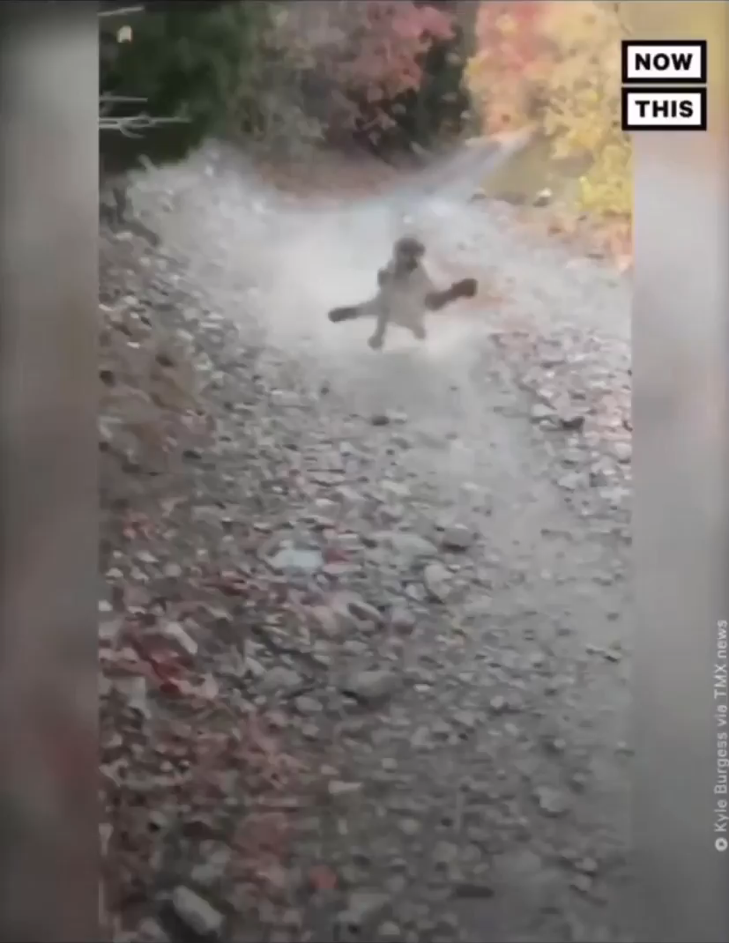
Mac was leisurely jogging in the mountains on a Saturday morning when he accidentally entered the territory of a female lion and irritated her…
Describe his emotions!
As the fierce beast growled furiously at him, Mac’s heart beat so violently that he felt nearly suffocated (窒息的). 1) 被一种想要逃跑的冲动所支配，他加快了步伐，想要甩掉狮子，却是徒劳。2) 哦天哪！我肯定是要死在这儿了！”他想道。视线所及，除了道路旁繁茂的 (lush) 枫树，空无一人，但他现在毫无心情欣赏风景。3) Mac鼓起勇气，开始向狮子猛烈地吼叫，但是这只狮子似乎太锲而不舍了。4) 他每退后一步，就感到膝盖又软了一点。

Slide 24
1) 被一种想要逃跑的冲动所支配，他加快了步伐，想要甩掉狮子，却是徒劳。
2) 哦天哪！我肯定是要死在这儿了！”他想道。视线所及，除了道路旁繁茂的 (lush) 枫树，空无一人，但他现在毫无心情欣赏风景。
3) Mac鼓起勇气，开始向狮子猛烈地吼叫，但是这只狮子似乎太锲而不舍了。
4) 他每退后一步，就感到膝盖又软了一点。
1) Seized by a sudden impulse to run, he accelerated his pace in an attempt to get rid of the lion but in vain.
2) “Oh gosh! I must die here!” he thought. There was no one in sight except lush (茂盛的) maple trees along the path, but he had no mood for that now.
3) Plucking up his courage, Mac started to roar at the lion violently, but the lion seemed too persistent.
4) With every step he took back, he could feel his knees weakened a bit.

