Slide 1

体态与外貌的描写方法

Slide 2
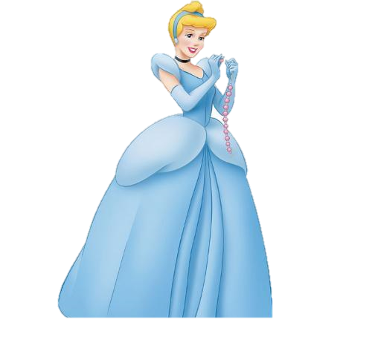
Guess who she is
She wears a beautiful blue dress to a ball.
She is a girl with blonde hair.
Cinderella
She has a pair of crystal shoes.
She has
an evil stepmother.
Her clothes are dirty and old.
Who is she?
A character from classics

Slide 3
Now, we are going to…
observe sentences from classics
try to write about a person by using what we have learned
learn how to write about appearance from classics

Slide 4

1. How many sentences are used
to introduce a character?
2. which aspects of appearnce are
talked about?
1. He was about medium height, strongly built, and probably in his mid-thirties. - Jane Eyre
2. She had grey hair and quick, bright eyes and had a handkerchief tied over her head. She was wearing gardening gloves and held a knife. –David Copperfield
3. I remember him as if it were yesterday. A tall nut-brown man with broken nails and a white scar across one cheek. - Treasure Island
4. He was a tall, broad-chested man with a red face. His eyebrows are very black which made him look short-tempered. –Treasure Island
5.He was a lad eighteen or nineteen years of age, small in stature, with irregular but delicate features, and of a constitution (体格) apparently weakly. –The Red and the Black
6. The boy had huge, dark eyes that seemed too big for his thin, pale face –The Secret Garden
7. She wore a brown sailor hat, and beneath the hat were two braids of very red hair, which ran almost all the way down her back. -Anne of Green Gables

Slide 5
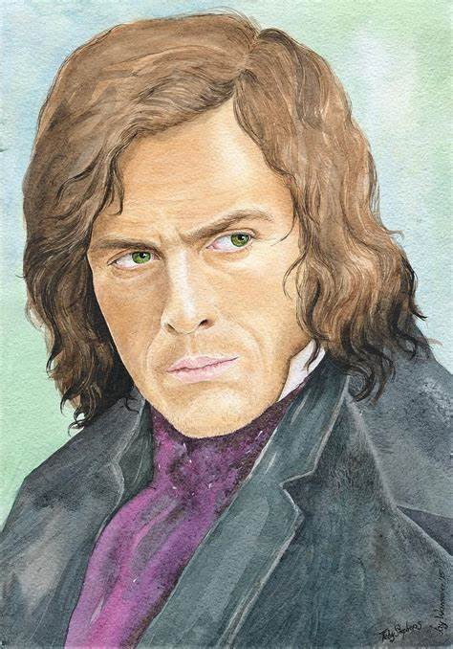
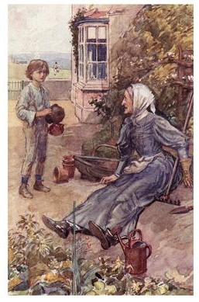
2. Which aspects of appearance are talked about?
1. He was about medium height, strongly built, and probably in his mid-thirties. - Jane Eyre
Betsey
2. She had grey hair and quick, bright eyes and had a handkerchief tied over her head. She was wearing gardening gloves and held a knife. –David Copperfield
Mr. Rochester
height
eyes
build
age
tools
hair
a special feature

Slide 6
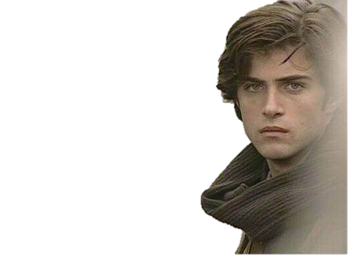
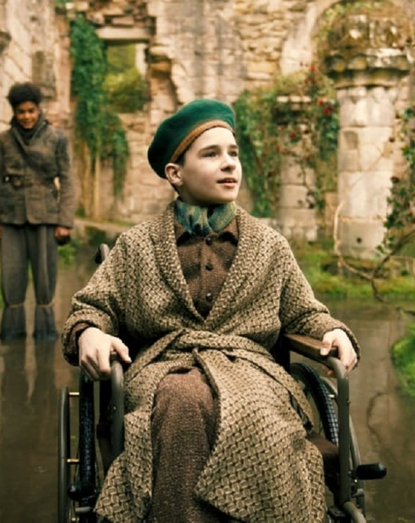
2. Which aspects of appearance are talked about?
5.He was a lad eighteen or nineteen years of age, small in stature, with irregular but delicate features, and of a constitution (体格) apparently weakly. –The Red and the Black
age
a special feature
build
6. The boy had huge, dark eyes that seemed too big for his thin, pale face –The Secret Garden
Julien
face
a special feature
eyes

Slide 7
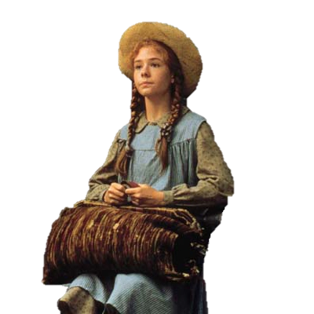
2. Which aspects of appearance are talked about?
7. She wore a brown sailor hat, and beneath the hat were two braids of very red hair, which ran almost all the way down her back.
-Anne of Green Gables
braids
red hair
A special feature
hat

Slide 8
Appearance
5
other features
chest/hand/scar/clothes...
4
face
cheek/eyebrow/eye/skin colour...
3
hair
colour/style/hat
2
age
1
height
build

Slide 9
More Expressions
Age
Toddler
Child
Teenager/youngster
Middle-aged
Senior/old

Slide 10
More Expressions
Height
small in stature
tall/short
broad/narrow-chested
slim/thin/fat/plump
strongly built/ well-built
square-shouldered
Height
体格小
宽阔/窄窄的胸膛
丰腴的

Slide 11
More Expressions
braid
straight/curly/thick
bald
low/high hairline
red/blonde/brunette
…
hair

Slide 12
More Expressions
bright/huge/dark/watery eyes
thin/pale/red face
double chin/rosy cheeks
fair/dark skin/
even teeth
thick/black eyebrow
hooked/flat/freckled nose
水汪汪的眼睛
瘦削/苍白的/红红的脸庞
双下巴/红润的双颊
白皙的/深色的皮肤
Face
整齐的牙齿
鹰钩鼻/塌鼻梁

Slide 13
More Expressions
broken nails
white cotton trousers
a white scar
long-sleeved dress
high heels
long fingers
other
features
red tie
thick bellied
a light brown suit
well-dressed
toothless smile
light freckles

Slide 14
Exercise

Slide 15
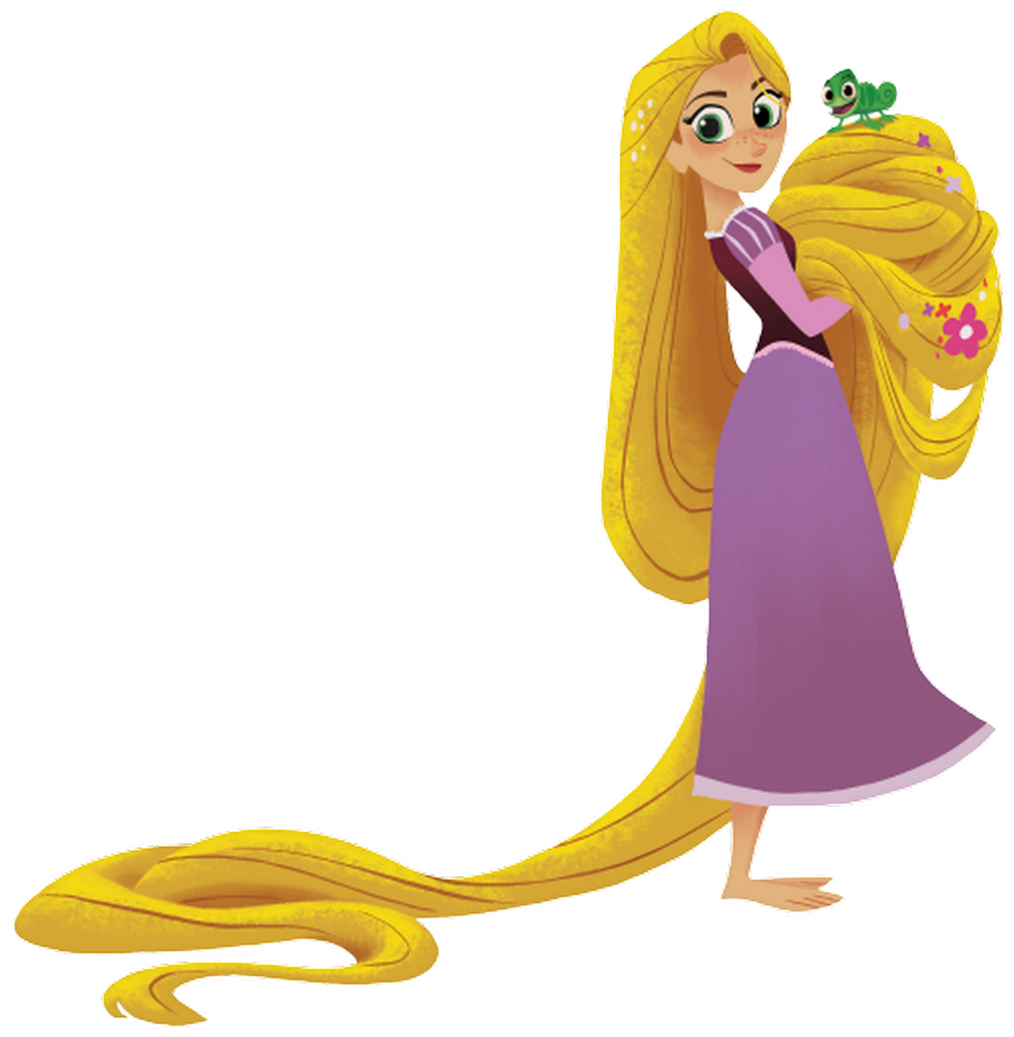
Exercise 1 Observe the picture of Rapunzel and fill in the blanks
____________
1
_____________________
2
_________________
3
____________________
4
________________________
5
_____________________
6

Slide 16

Exercise 1
Exercise 1 Observe the picture of Rapunzel and fill in the blanks
Rapunzel is a very 1________________ __________________________with 2______________, ________________, 3________________________, 4.________________________and 5. ______________________ around her nose. 6. She is famously known for_______________________, which is_________________________________.
18岁美少女
1
皮肤白皙/双颊红润
2
绿色的大眼睛
3
棕色的眉毛
4
鼻子附近有淡淡的雀斑
5
最出名的是近70英尺长的金发
6

Slide 17
Exercise 1 Observe the picture of Rapunzel and fill in the blanks
Rapunzel is a very 1________________ __________________________with 2______________, ________________, 3________________________, 4.________________________and 5. ______________________ around her nose. 6. She is famously known for_______________________, which is_________________________________.
18岁美少女
beautiful 18-year
1
old young woman
皮肤白皙/双颊红润
fair skin
rosy cheeks
2
large green eyes
绿色的大眼睛
3
brown eyebrows
light freckles
棕色的眉毛
4
鼻子附近有淡淡的雀斑
her long blonde hair
5
roughly around 70 feet in length
最出名的是近70英尺长的金发
6

Slide 18
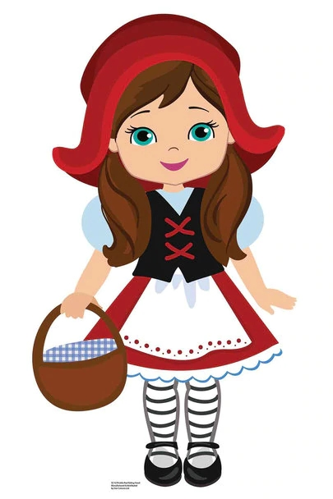
Exercise 2—observe and use your own words to introduce Little Red Riding Hood, you should tell how she has
got the name (appearance + a special feature).
Little Red Riding Hood
Once upon a time, _______________________________________________________________________________________________________________________________________________________________________________________________________________

Slide 19
Exercise 2—observe and use your own words to introduce Little Red Riding Hood, you should tell how she has
got the name (appearance + a special feature).
Little Red Riding Hood
红色有帽子的斗篷（cloak）
Once upon a time, there was a smiley little girl with big green eyes and brunette hair. She liked to wear a red dress with a red cloak which had a hood, so everyone in the village called her Little Red Riding Hood.
绿色的大眼睛
带着笑容
褐色的头发
红裙子

Slide 20



Review: We have…
written about Rapunzel and Little Red Riding Hood
read some examples from classics
observed several aspects to write about appearance

