Slide 1

神态与情感的表达方法

Slide 2

happy
sad
afraid
nervous
angry
surprised
thankful
moved
tired
satisfied
目录
Can you write down the expressions of emotions for the mind-map?

Slide 3



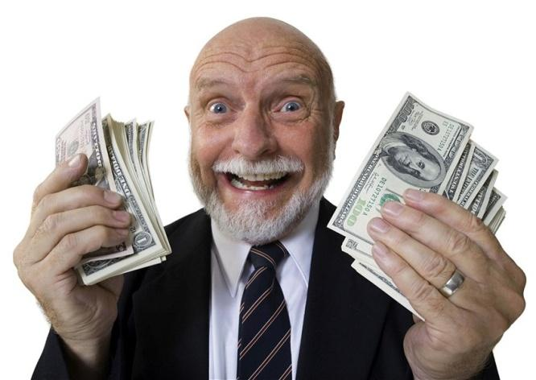


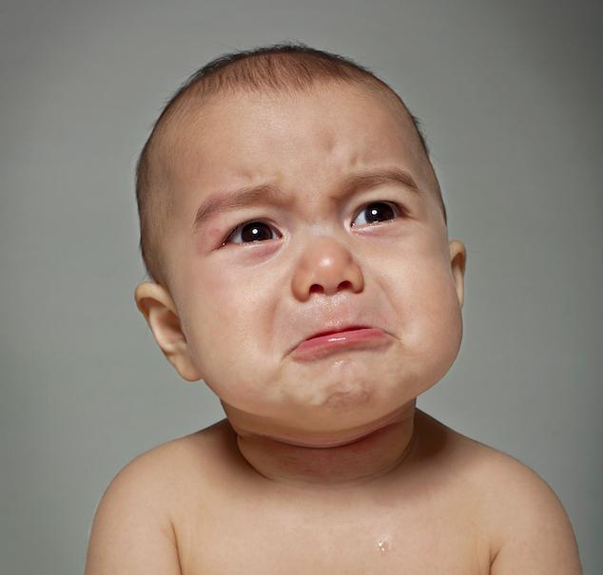

How do you feel?

Slide 4
Mind-map：Emotions
1.happy: happy,delighted,cheerful,excited/exciting, thrilled, shout with joy
2.sad: sad, heart-broken,upset, disappointed, depressed/frustrated,
sorrowful, desperate, tears streaming
down one’s cheek(泪流满面)…
3.afraid: afraid, scared, frightened, fearful, palms are sweating(手心出汗)…
▲情感形容词的后缀常有：
-ed(人，感到...的),
-ing(物，令人..的),
-ful/-less(人/物,...的)

Slide 5
Mind-map：Emotions
4.nervous:
nervous, anxious,worried, stressed,stressful(令人有压力的)
5.angry:
angry,mad,bad-temered,lose one's temper(发火),
  burn with anger(怒火中烧)
6.surprised:
surprised/surprising, amazed/amazing,astonished/shocked(震惊的)

Slide 6
7.thankful: thankful,grateful, thank sb for
8.moved: moved/moving, touched/touching
9.tired: tired, exhausted
10.satisfied: satisfied, pleased,content
11.relaxed: relaxed, take it easy, relieved

Slide 7
12.hopeful：hopeful,with hope in one's eyes,hopeless(无希望的)
13.determined: determined,firm, have a will/ have a strong mind(意志坚定)
14.quiet：quiet, silent,calm
15.brave:brave,fearless,couragoushopeful型：hopeful,with hope in one's eyes,hopeless(无希望的)

Slide 8
情感描写技巧
1.be/feel/become +adj. (系表结构)
2.Feeling+adj，主+谓+宾 (非谓语短语，作原因/伴随状语)
3.adj+adj, 主+谓+宾（形容词短语，作原因/伴随状语）
4.形容词+ly→副词（修饰动词/形容词/副词/介词短语/句子）5.with+n.（介词短语，作原因/伴随状语）

Slide 9
技巧1. be/feel/become +adj. (系表结构)
1. 他又高兴又甜蜜。
He _________________ and sweet.
was very happy
2. 听到那个坏消息，她很伤心。
Hearing the bad news, she ________________.
felt very sad
3. 天黑了，她非常担心她儿子的安全,情不自禁哭了。
she ______________________about her son's safety
when it was dark, and couldn't help crying.
felt very worried

Slide 10
技巧 2. Feeling+adj，主+谓+宾 (非谓语短语,作原因/伴随状语)
1. 他感到很激动，立刻拿出手机，迫不及待地告诉他的朋友这次经历。
_________________, he took out his phone atonce, eager to tell his friends the experience.
Feeling excited
2. 她不开心地继续赶路，不久就在路上遇到一位老人。
she went on her way,_______________, and soon met an old man on the road.
feeling upset
3. 王鹏坐在空荡荡的饭店里面，感到非常沮丧。
Wang Peng sat in his empty restaurant, _____________________.
feeling very frustrated/depressed

Slide 11
技巧 3. adj, 主+谓+宾（形容词短语，作原因/伴随状语）
1. 吓坏了，埃利和我尝试了所有我们知道的防御熊的行动。
_________________, Elli and I tried all the bear defense actions we knew.
Frighted/Terrified
2. 我们终于到达了目的地，又累又饿.
tired and hungry
We finally arrived at our destination，______________．
3. 难过但不恐惧，他决定要改变这一切。
Heartbroken but fearless
_______________________________,he decided to turn everything around.

Slide 12
技巧 4. 形容词+ly→副词（修饰动词/形容词/副词/介词短语/句子）
1.他高兴地笑了，露出了一排洁白整齐的牙齿。
He _____________, revealing a row of white and even teeth.
smiled happily
2.幸运地,在安东尼13岁时我已经教过他缝纫, 那时他还在崇拜我.
Luckily/Fortunately
______________, I had taught Anthony to sew when he was 13, when he still respected me.

Slide 13
技巧 5. with/in+n.（介词短语）
如 in surprise/amazement,with joy/tears/ worry(忧虑)
1.她惊奇地看着我。
She looked at me ________________.
in amazement
2. “但是我知道他刚才就在那儿。”露茜说，眼里带着泪水。
with tears
" But I know he was, " said Lucy, ___________ in her eyes .

