Slide 1
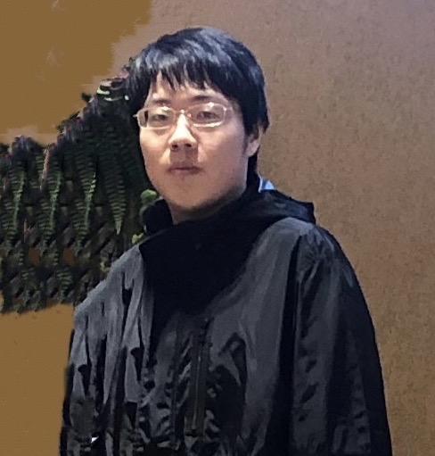
Quantum States with Sp(2N),
SU(2N) and G2 symmetries
Congjun Wu (吴从军)
Department of Physics, Westlake University
Zhi-Qiang Gao, C. Wu, arXiv: 2010.14126
Zhi-Qiang Gao, C. Wu arxiv: 2411.08107….
D. Wang, Y. Li, Z. Cai, Z. Zhou, Y. Wang, C. Wu, Phys. Rev. Lett. 112, 156403 (2014).
C. Wu, J. P. Hu, and S. C. Zhang, Phys. Rev. Lett. 91, 186402 (2003).
C. Wu, Phys. Rev. Lett. 95, 266404 (2005),
C. Wu, Mod. Phys. Lett. B 20, 1707 (2006) (brief review).
高志强，PKU → Berkeley
Fudan, Dec 2, 2024

Slide 2
Collaborators
Zhi-qiang Gao (Berkeley)
Shenglong Xu (Texas A&M)
Da Wang (UCSD→ Nanjing Univ.)
Yu Wang, Zhi-Chao Zhou (Wuhan Univ.)
Collaborators on earlier works: S. C. Zhang (Stanford), J. P. Hu (Purdue), S. Chen and Y. P. Wang (IOP, CAS).
Acknowledgments: A. L. Fetter(Stanford), E. Fradkin (UIUC), T. L. Ho (OSU), Z. Q. Ma (CAS), J. Hirsch, D. Arovas (UCSD), Y. Takahashi (Kyoto Univ.), F. Zhou (UBC)

Slide 3
SO(5)/Sp(4), SO(7), and G2
High symmetry fermion systems
SU(N) Hubbard
Model
Quartetting

Slide 4
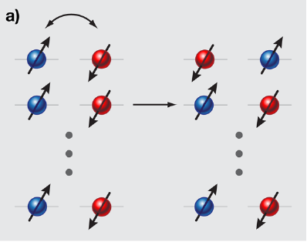


Large S in transition metal oxides - classic
Large spin magnitude from Hund’s coupling.
Inter-site coupling: exchange a single pair.
1/S-effect: $ΔS_{z}=±1$
Bilinear exchange dominates
$$\frac{t^{2}}{U}{\vec{S}}_{i}⋅{\vec{S}}_{j}+\frac{t^{4}}{U^{3}}({\vec{S}}_{i}⋅{\vec{S}}_{j})^{2}+...$$
C. Wu, Physics 3, 92 (2010).
C. Wu, Nature Physics 8, 784 (2012) (News and Views).

Slide 5
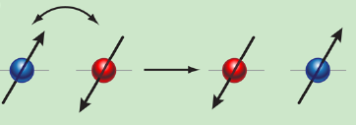

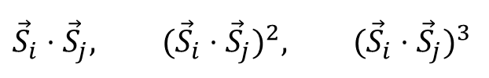
Cold fermions: large N enhanced fluctuations!
Large-hyperfine-spin as a whole object (no ionization).
$$ΔS_{z}=±1,±2,...±S$$
One step of super-exchange can completely overturn spin config.
Bilinear, bi-qudratic, bi-cubic terms, etc., are all at equal importance.
$${\vec{S}}_{i}⋅{\vec{S}}_{j}, ({\vec{S}}_{i}⋅{\vec{S}}_{j})^{2}, ({\vec{S}}_{i}⋅{\vec{S}}_{j})^{3}$$
5

Slide 6














Two views of a quartet -- weights
Solid: SU(2) (1D lattice)
A high rank spinor Rep. of a small group.
Off-diagonal operator: (fluctuation)
$$S_{±}$$
$$S_{±}$$
$$S_{±}$$
$$S_{z}$$
$$S_{±}$$
-3/2
-1/2
1/2
3/2
Cold fermions Sp(4)/SO(5) (2D lattice)
The fundamental spinor Rep of a large group.
Much more off-diagonal operators.
$$m_{2}$$
$${π_{1}}_{±}$$
$${π_{4}}_{±}$$
$$m_{1}$$
$${π_{2}}_{±}$$
$${π_{2}}_{±}$$
$${π_{3}}_{±}$$
$${π_{1}}_{±},{π_{2}}_{±},{π_{3}}_{±},{π_{4}}_{±}$$
$${π_{1}}_{±}$$

Slide 7
SU(2N), Sp(2N) (2N=2S+1)
Large S
Large N
Alkaline-earth fermions: 2N equivalent components
Alkali fermions: spin-dependent interactions; SU(2N) symmetry is not generic.
The next high symmetry: symplectic symmetry
SU(2N) → Sp(2N)
Good properties under time-reversal transformation.

Slide 8
SO(5)/Sp(4), SO(7), and G2
High symmetry fermion systems
SU(N) Hubbard
Model
Quatetting

Slide 9
Spin-3/2: Hidden symmetry!
Spin 3/2 atoms: ¹³²Cs, ⁹Be, ¹³⁵Ba, ¹³⁷Ba, ²⁰¹Hg.
Sp(4) (SO(5)) without fine tuning regardless of dimensionality, particle density, and lattice geometry!
Sp(4) in spin 3/2 systems ←→ SU(2) in spin ½ systems
SU(4) symmetry ←→ spin-independent interactions
High symmetries: unification of competing orders; description of strong fluctuations, etc.
C. Wu et al. Phys. Rev. Lett. 91, 186402 (2003).
Notes:
These systems are indeed very special, because it contains a hidden and generic symmetry.
In additional to the obvious spin SU(2) symmetry, we will show it has an hidden SO(5) symmetry,
or isomorphically Sp(4) symmetry in it. This SO(5) symmetry is robust, and free of fine tuning.
It is exact in the continuum model with the s-wave scattering interactions,
and it is also exact in the lattice-Hubbard model, regardless the dimensionality,
Lattice geometry, impurity potentials.
The cold atomic spin 3/2 systems are very different from high spin transition metal compounds,
in which three electrons coupled by Hund’s rule to form a spin 3/2 object.
However, the inter-site coupling is still mediated by the virtual hopping of
a single electron. Thus these systems only have the SU(2) symmetry, and
there are no hidden symmetry.
Before I move on, let me emphasis that this SO(5) symmetry I am talking about
is qualitatively different from the SO(5) theory of high Tc superconductivity.
Only the name of the symmetry group is the same, the physics is quite different.

Slide 10
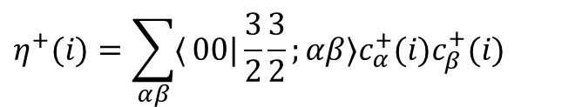
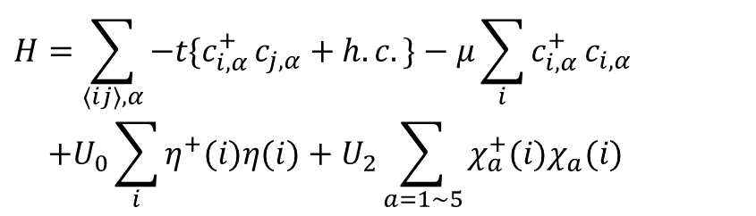




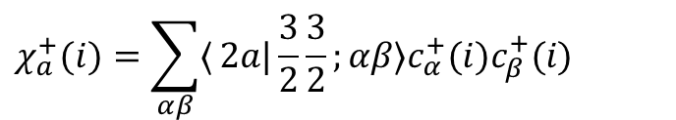
Spin-3/2 Hubbard model in optical lattices
$$H=\sum_{⟨ij⟩,α}{−t\{c_{i,α}^{+}}c_{j,α}+h.​c.\}−μ\sum_{i}{c_{i,α}^{+}}c_{i,α} \\ +U_{0}\sum_{i}{η_{ }^{+}(i)η(i)}+U_{2}\sum_{a=1\sim 5}{χ_{a}^{+}(i)χ_{a}(i)}$$
$$\left|\frac{3}{2}\right\rangle$$
$$\left|\frac{1}{2}\right\rangle$$
$$\left|−\frac{1}{2}\right\rangle$$
$$\left|−\frac{3}{2}\right\rangle$$
Fermi statistics: F_{tot}=0, 2 allowed; F_{tot}=1, 3 forbidden.
$$η^{+}(i)=\sum_{αβ}{⟨}00|\frac{3}{2}\frac{3}{2};αβ⟩c_{α}^{+}(i)c_{β}^{+}(i)$$
singlet:
$$χ_{a}^{+}(i)=\sum_{αβ}{⟨}2a|\frac{3}{2}\frac{3}{2};αβ⟩c_{α}^{+}(i)c_{β}^{+}(i)$$
quintet:
Exact Sp(4), or, SO(5), for arbitrary values of t, μ, U0, U2 and lattice geometry.
Notes:
40”
Now let us look at the lattice system. Within the reasonable experimental parameters,
The single bond Hubbard model is valid.
The hopping term, the chemical potential term. Similarly to the continuum model,
We have two independent Hubbard repulsions, the on-site singlet and on-site quintet
channel interactins..

Slide 11











What is Sp(4)(SO(5)) group?
$$n_{5}$$
SU(2) (SO(3)) group.
3-vector: x, y, z; 3-generator:
$$L_{12}, L_{23}, L_{31}.$$
2-spinor:
$$\left|↑\right\rangle , \left|↓\right\rangle$$
$$n_{3}, n_{4}$$
Sp(4)(SO(5)) group.
$$n_{1}, n_{2}$$
5-vector:
$$n_{1},n_{2},n_{3},n_{4},n_{5}$$
10-generator:
$$L_{ab} (1≤a<b≤5)$$
4-spinor:
$$\left|\frac{3}{2}\right\rangle$$
$$\left|\frac{1}{2}\right\rangle$$
$$\left|−\frac{1}{2}\right\rangle$$
$$\left|−\frac{3}{2}\right\rangle$$
What quantities correspond to 5-vector and 10-generator？
Notes:
Now let me briefly explain what is SO(5) group. SO(5) group describes
the rotation in a real 5-dim space. The axis n1 to n5 are orthogonal
to each other, which form the vector representation of this group.
It contains 10 generators. Each geneator Lab is responsible for
the rotation in ab plane.
SO(5)’s spinor Rep is 4-dimensional. The four spin
components just form the SO(5) spinor.
Rigorously speaking, spinors are Rep of the SO(5)’s covering
Group called Sp(4). The relation between SO(5) and Sp(4) is similar
to the relation between SO(3) and SU(2).

Slide 12
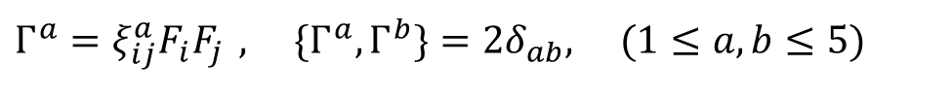
spin-3/2 algebra
Degrees of freedom: 4²=16=1+3+5+7.
1 density + 3 spin operators are incomplete.
rank: 0
1
2
3
Spin-quadrupole (rank-2 tensors) form five-Γ matrices (5-vector) .
$$Γ^{a}=ξ_{ij}^{a}F_{i}F_{j} , \{Γ^{a},Γ^{b}\}=2δ_{ab}, (1≤a,b≤5)$$
Notes:
Now we construct the SO(5) algebra. We have four spin components, thus
we have 16 bi-linears One density and three spin operators are not enough.
We need high order symmetric spin tensors. The rank-2 tensor has five degrees
of freedom, rank-3 has 7 degrees of freedoom. 1+3+5+7=16, this is a complete set.
The rank-2 tensors are often denoted as spin-nematics matrices.
They anticommute with each other, and form a basis for the five Dirac matrices.
They are SO(5) vectors.

Slide 13
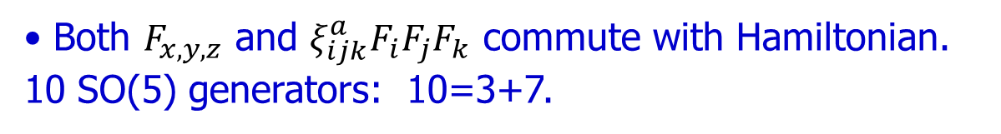
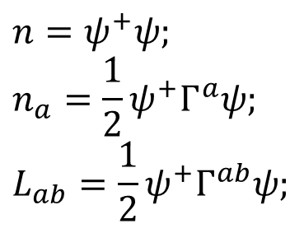
Hidden conserved quantities: spin-octupoles
Both $F_{x,y,z}$ and $ξ_{ijk}^{a}F_{i}F_{j}F_{k}$commute with Hamiltonian. 10 SO(5) generators: 10=3+7.
7 spin-octupole operators are the hidden conserved quantities.
SO(5): 1 scalar + 5 vectors + 10 generators = 16
Time Reversal
1 density:
5 spin-quadrupole:
3 spins + 7 spin-octupole:
$$n=ψ^{+}ψ; \\ n_{a}=\frac{1}{2}ψ^{+}Γ^{a}ψ; \\ L_{ab}=\frac{1}{2}ψ^{+}Γ^{ab}ψ;$$
even
even
odd
Notes:
On the other hand, the three spin operators and seven cubit spin operators form the SO(5)
Generators. They commute with the Hamiltonian. These seven cubic spin operators are
the hidden conserved quantities, just like the Rugne-Lenz vectors.
In short, the p-h bilinears can be classified into SO(5) scalar, vectors, and
generators. The SO(5) vectors are just spin-nematics. The 10 generators
either carry spin 1 or spin 3. We can see this SO(5) symmetry purely lies
in the particle-hole channel. In comparison in the high Tc, the SO(5) symmetry
there involves both particle-hole and particle-particle channel.

Slide 14






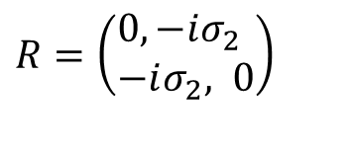



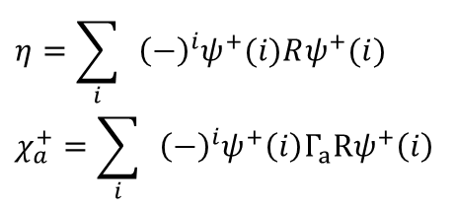
SO(8) algebra = ${SO}_{A}$(7)+7-vector
quintet pairing
singlet pairing
$$V_{a}=$$
SO（5）: spin+spin octupole
5-vector (spin quadrupole)
$$η=\sum_{i}{ }{\left(−\right)}^{i}ψ^{+}(i)Rψ^{+}(i)$$
$$χ_{a}^{+}=\sum_{i}{ }{\left(−\right)}^{i}ψ^{+}\left(i\right)Γ_{a}Rψ^{+}\left(i\right)$$
$$s_{ }\text{: }η_{ }^{+}$$
$$−$$
$$d_{yz}:χ_{3}^{+}$$
$$d_{\text{xy}}: χ_{1}^{+}$$
$$d_{3z^{2}−r^{2}}\text{: }χ_{4}^{+}$$
$$i$$
$$R=\left(\begin{aligned}&0,−iσ_{2} \\ &−iσ_{2}, 0\end{aligned}\right)$$
$$d_{xz}:χ_{2}^{+}$$
$$i$$
$$d_{x^{2}−y^{2}}:χ_{5}^{+}$$
$$i$$
Notes:
Now let us look at the quintet-channel interaction more carefully.
We organize them into polar basis in analogy to the polar wf of the
d-orbits in the QC.
As we mentioned before, they also form a SO(5) vector.
They span a 5-d sphere. We start from the North pole, we can arrive at
any point by SO(5) rotation. However, we can only move within
a sub-manifold on the sphere, thus the SO(5) symmetry is indeed
more general and it include SU(2) as its subgroup.
In short, …….

Slide 15
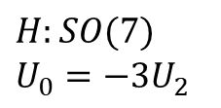

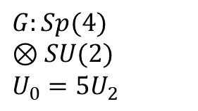
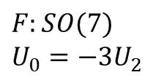
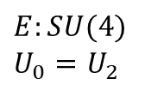

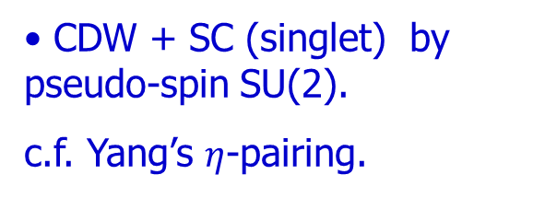
Unify AF, SC, CDW with exact symmetries
Higher symms in bipartite lattice and half-filling.
$$U_{2}$$
$$E:SU(4) \\ U_{0}=U_{2}$$
$$F:SO(7) \\ U_{0}=−3U_{2}$$
AF (5-spin quadrupole)+SC (singlet) ← SO(7)
B: 5-AFM
A: 10-AFM
C: 2- singlet SC
CDW + SC (singlet) by pseudo-spin SU(2).
c.f. Yang’s $η$-pairing.
$$U_{0}$$
$$G:Sp(4)⊗SU(2) \\ U_{0}=5U_{2}$$
$$H:SO(7) \\ U_{0}=−3U_{2}$$
AF (10-spin+spin octupole) +SC (10-quintet) + CDW by the 21D adjoint rep. of SO(7).
D: 1- CDW

Slide 16
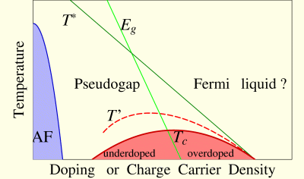
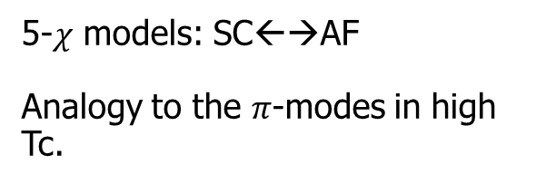



“Unifications” – power of the group theory
Pseudo-spin SO(3=2+1)/SU(2) symm. →
SC (singlet)+CDW – C. N. Yang, S. C. Zhang.
Approx. SO(5=2+3) symm. → SC (d-wave singlet) + AFM – Zhang, and Demler.
Exact SO(7=2+5) → SC + AFM (5-spin quadrupole).
$$[χ_{a}^{+},Δ]=AF_{a}$$
$$\left[H,χ_{a}^{±}\right]=∓Δμχ_{a}^{±}$$
5-$χ$ models: SC←→AF
Analogy to the $π$-modes in high Tc.
$$H(χ_{a}^{+}\left|G_{SC}\right\rangle )=[E_{G}+Δμ](χ_{a}^{+}\left|G_{SC}\right\rangle )$$

Slide 17






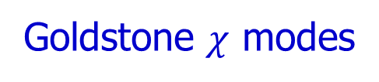
Grand Unification of 21 orders (adjoint of SO(7))
AF (DW 10-spin/spin-octupole) + SC (5-quintet cplx) + CDW
$${ O}_{AF,ab}, Δ_{q,a}=O_{0a}+iO_{a6}, { O}_{CDW}=O_{06}$$
$${ [M}_{ab},O_{cd}]=i(δ_{ac}O_{bd}+δ_{bd}O_{ac}−δ_{ad}O_{bc}−δ_{bc}O_{ad})$$
10 Goldstone modes: $SO(7)/[SO\left(5\right)⊗SO(2)]$
Pseudo-Goldstone mode in the quintet SC state $|Δ_{q,b}⟩$
$e^{i{{(c}^{∗}χ}_{a}^{+}+cχ_{a})}\left|Δ_{b}\right\rangle$ → ${|O}_{AF,ab}⟩(a≠b)$ or $\left|CDW\right\rangle (a=b)$
|CDW$⟩$
$$……$$
$$[χ_{a}^{+},Δ_{q,b}]=O_{AF,ab}$$
$${|O}_{AF,ab}⟩$$
Goldstone $χ$ modes
$$e^{i{{(c}^{∗}χ}_{a}^{+}+cχ_{a})}$$
$$|Δ_{q,b}⟩$$

Slide 18

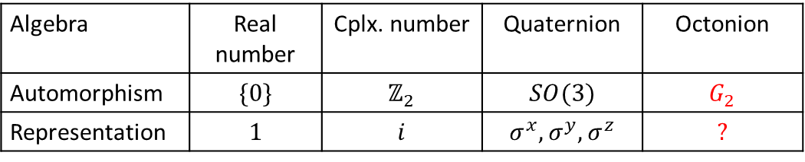
Why $G_{2}$?
The smallest exceptional Lie group
Automorphism of the non-associative algebra: octonion
Algebra | Real number | Cplx. number | Quaternion | Octonion
Automorphism | $$\{0\}$$ | $$ℤ_{2}$$ | $$SO(3)$$ | $$G_{2}$$
Representation | $$1$$ | $$i$$ | $$σ^{x},σ^{y},σ^{z}$$ | $$?$$
Widely studied in high energy physics and quantum Hall physics
No 4-fermion lattice realization
M. Günaydin, S. V. Ketov NPB 467, 215; Y. Hu, C. L. Kane, PRL 120, 066801
Z.-Q. Gao, CW, arXiv: 2010.14126

Slide 19



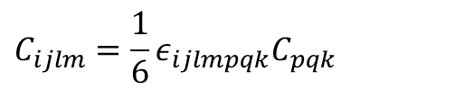
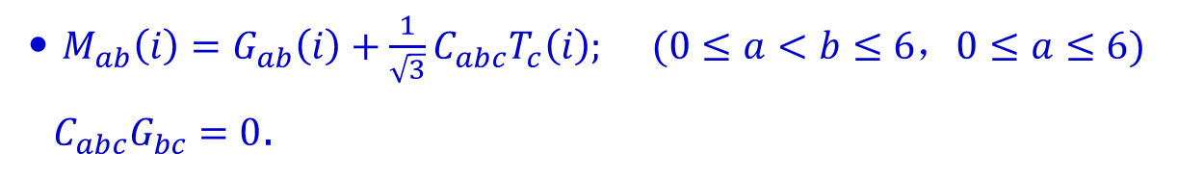
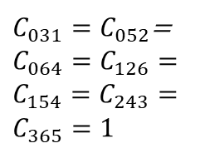
Octonion and $G_{2}$
$$e_{a}e_{b}=−δ_{ab}+C_{abc}e_{c}$$
$C_{031}=C_{052}$=
$$C_{064}=C_{126}=$$
$$C_{154}=C_{243}=$$
$$C_{365}=1$$
$$C_{ijk}C_{lmk}=δ_{il}δ_{jm}−δ_{im}δ_{jl }+C_{ijlm}$$
$$C_{ijlm}=\frac{1}{6}ε_{ijlmpqk}C_{pqk}$$
Non-associative: $\left[e_{a},\left[e_{b},e_{c}\right]\right]+\left[e_{b},\left[e_{c},e_{a}\right]\right]+\left[e_{c},\left[e_{a},e_{b}\right]\right]=C_{abcd}e_{d}$
$M_{ab}\left(i\right)=G_{ab}\left(i\right)+\frac{1}{\sqrt{3}}C_{abc}T_{c}\left(i\right); (0≤a<b≤6，0≤a≤6)$
$C_{abc}G_{bc}=0$.
$G_{ab}\left(i\right)=\frac{2}{3}M_{ab}\left(i\right)+\frac{1}{6}C_{abcd}M_{cd}\left(i\right); T_{a}\left(i\right)=\frac{1}{2\sqrt{3}}C_{abc}M_{bc}\left(i\right).$

Slide 20

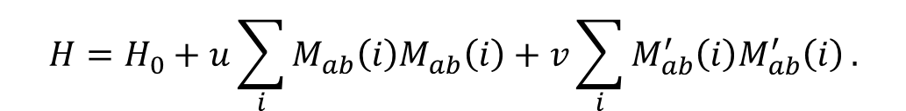

G2, SO(7)-A, SO(7)-B
Z. Gao, C. Wu, arxiv:201014126
$SO_{B}(7)$: $M_{ab}^{′}\left(i\right)=G_{ab}+\frac{1}{\sqrt{3}}C_{abc}T_{c}^{′}\left(i\right); T_{a}^{′}+iV_{a}^{′}=e^{i\frac{2}{3}π}(T_{a}+iV_{a})$
$$H=H_{0}+u\sum_{i}{M_{ab}\left(i\right)M_{ab}\left(i\right)}+v\sum_{i}{M_{ab}^{′}\left(i\right)M_{ab}^{′}\left(i\right)}.$$
$$M_{ab}^{′}\left(i\right)M_{ab}^{′}\left(i\right)=C_{abcd}M_{ab}\left(i\right)M_{cd}\left(i\right)$$
$χ_{0}\left(i\right)$ maps generators of $SO{\left(7\right)}_{A}$ ←→ $SO{\left(7\right)}_{B}$
$χ_{0}\left(i\right)=e^{−i\frac{π}{4}sgn⁡(i)}ψ_{\frac{3}{2}}\left(i\right)+e^{i\frac{π}{4}sgn⁡(i)}ψ_{\frac{3}{2}}^{+}(i)$.
$${χ_{0}M}_{ab}^{ }\left(i\right)χ_{0}=M_{ab}^{′}\left(i\right)$$

Slide 21
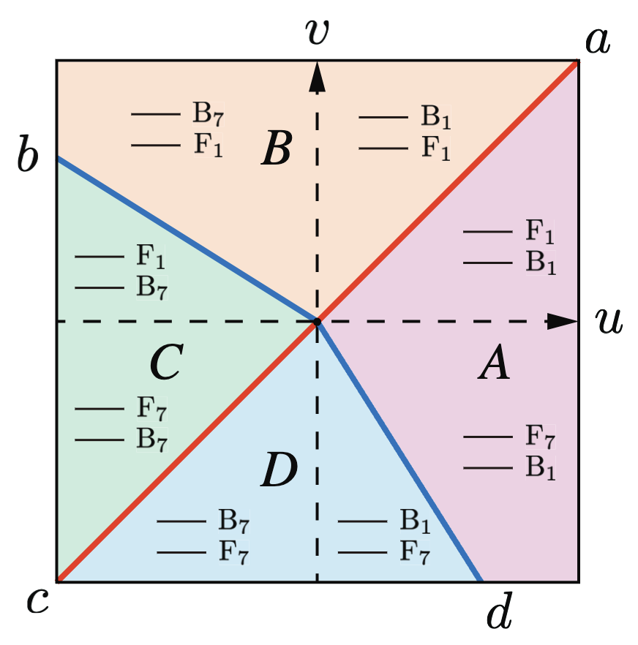
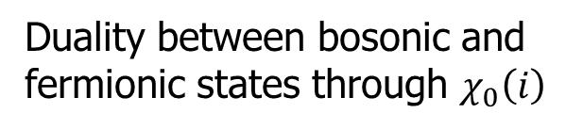



Z.-Q. Gao, CW,
arXiv: 2010.14126
Self duality
Single-site problem.
16d Hilbert space for spin-3/2 fermion on each site.
16 = 1d bosonic singlet (B1)
+ 1d fermionic singlet (F1)
+ 7d bosonic vector (B7)
+ 7d fermionic vector (F7).
$$SO_{B}(7)$$
$$SO_{A}(7)$$
Duality between bosonic and fermionic states through $χ_{0}\left(i\right)$
level spectra of two lowest states
Self-duality at $u=v$ (red line).

Slide 22







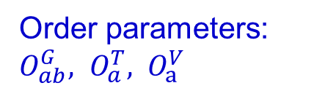
SU(3) and 𝑆𝑈(2)×𝑈(1) gauge theory
Order parameters: $O_{ab}^{G}, O_{a}^{T}, O_{a}^{V}$
Z. Gao, C. Wu, arxiv:201014126
In $A$ and $B$ regions $G_{2}$ / $SU(3)∼S^{6}$
$$SO_{B}(7)$$
$$O(i)=\hat{h}(cosθO_{a}^{V}\left(i\right)−sinθO_{a}^{V}\left(i\right))$$
Nambu spinor $ψ\left(i\right)=(ψ_{σ},ψ_{σ}^{T})$
$$SO_{A}(7)$$
Diagonal $O_{4}\left(i\right): ψ_{SU(3)}=U(i,t){\left(ψ_{\frac{1}{2}},ψ_{−\frac{1}{2}},ψ_{\frac{3}{2}}^{+}\right)}^{T}$
$A_{μ}(x,t)={P({U^{+}\left(i,t\right)}^{ }∂_{μ}}^{ }U(i,t))P$
${SO}_{A}\left(7\right):$ $ψ_{SU(4)}={U^{ }\left(i,t\right)}^{ }{\left(ψ_{\frac{1}{2}},ψ_{−\frac{1}{2}}, ψ_{\frac{3}{2}}^{+}, { ψ}_{−\frac{3}{2}}^{+}\right)}^{T}$
${SO}_{B}\left(7\right):$ $ψ_{SU(4)}={U^{ }\left(i,t\right)}^{ }{\left(ψ_{−\frac{1}{2}},ψ_{\frac{1}{2}}^{ }{, ψ_{\frac{3}{2}},ψ}_{−\frac{3}{2}}^{+}\right)}^{T}$

Slide 23
SO(5)/Sp(4), SO(7), and G2
High symmetry fermion systems
SU(N) Hubbard
Model
Quartetting

Slide 24
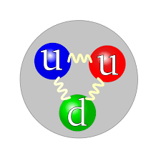
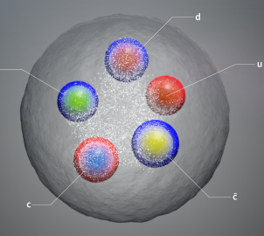
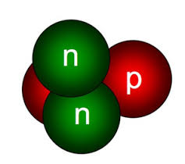
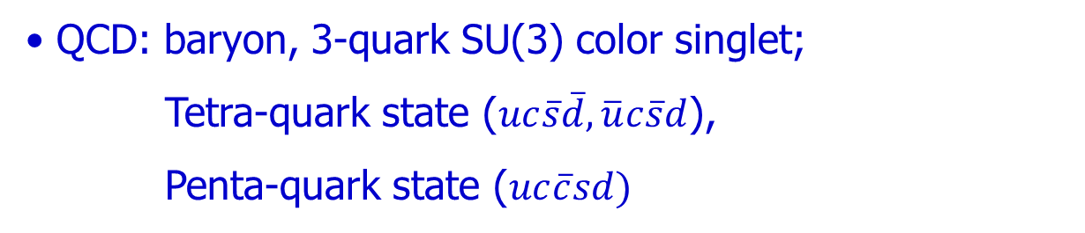
Multi-particle states
blue
red
green
Nuclear Physics: $α$-particle, spin and isospin singlet
QCD: baryon, 3-quark SU(3) color singlet;
Tetra-quark state ($uc\overline{s}\overline{d}, \overline{u}c\overline{s}d$),
Penta-quark state ($uc\overline{c}sd)$
Condensed matter: Biexcitons

Slide 25
Many-body physics of multi-particle order
Difficulty: lack of a BCS-type well-controlled mean field theory.
4-fermion counter-part of Cooper pairing
Field theoretical method beyond mean-field theory in 1+1D
CW, Phys. Rev. Lett. 95, 266404 (2005).
Variational wavefunction method
P. Li, K. Jiang, J. P. Hu, arxiv:220913905.
R. Liu, W. Wang, and X. Cui, PRL 131,193401(2023)
Notes:
Second, spin 3/2 systems can exhibit quartetting order.
It means that four particles with all spin components form
a bound state and then condense. This is a four-fermion counterpart
to the Cooper pairing.
Taking into account the extensive study of Feshbach resonance, it
is reasonable to expect that the quartetting order is one possible
focus for the future research.

Slide 26
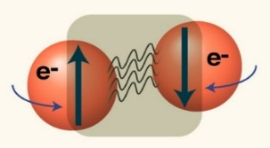




1+1D Renormalization group study
$$g_{2}$$
SU(4)
Phase A: Luttinger liquid, spin-charge separation.
$$g_{0}=g_{2}$$
C: Singlet pairing
A
Two spin gap phases: (B) quartetting, (C) pairing.
$$g_{0}$$
$$g_{0}≈3g_{2}$$
B: Quartetting
Ising duality between (B) and (C).
SU(4)
CW, Phys. Rev. Lett. 95, 266404 (2005).
Notes:
Here we present the one loop RG phase diagram. First, I confess that this is not
the phase diagram from the raw data. The raw data should be drawn in terms
of the geology coupling constant. Here I translate it back in terms of the
s-wave singlet and quintet channel coupling constant. Then the physics is more clear.
First the charge sector remains gapless and decouples with the spin sectors as usual.
In the spin sector, we find three phases. Phase A is the Luttinger liquid phase,
it is controlled by this black dot, the non-interacting fixed point.
In this phase, everything is gapless. It exhibits a spin-spin-charge separation.
It is because the spin degrees of freedom can be classified into
SO(5) vector and tensor channels. In principle, there exists two different spin velocities.
Phase B is controlled by the strong coupling fixed point in the infinity as marked by the red line,
and a spin gap opens. Late we will show it is the quartetting phase.
Similarly, phase C is also controlled by the another strong coupling fixed point in the infinity
as marked by the blue line. It is related to the pairing phase.
Now let us translate it into the more physical phase diagram using the coupling constants
in the particle-particle singlet and quintet channels.
The LL phase lies in the repulsive interaction region where g2<g0.
The quartetting phase lies in the regime where attractive interactions dominates.
The singlet paring phase is also interesting, it even survives in the purely repulsive interaction
Regime. This is similar to the high Tc, we can have Cooper pairs in the repulsive interaction regime.

Slide 27

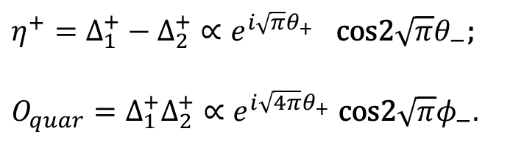

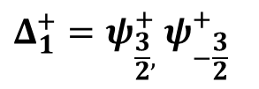
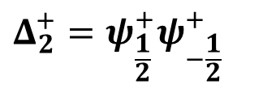
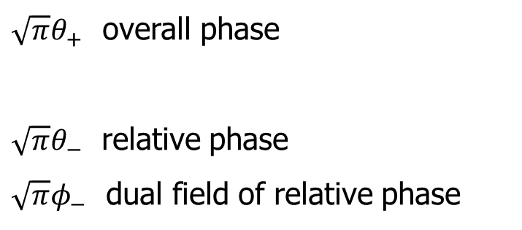
Two-band model: pairing v.s. Quartetting
Phase locking:
$$η^{+}=Δ_{1}^{+}−Δ_{2}^{+}∝e^{i\sqrt{π}θ_{+}} \text{cos}\text{2}\sqrt{π}θ_{−}\text{; }$$
$$O_{quar}=Δ_{1}^{+}Δ_{2}^{+}∝e^{i\sqrt{4π}θ_{+}} \text{cos}\text{2}\sqrt{π}φ_{−}.$$
$$Δ_{1}^{+}=ψ_{\frac{3}{2}, }^{+}ψ_{−\frac{3}{2}}^{+}$$
$\sqrt{π}θ_{+}$ overall phase
$\sqrt{π}θ_{−}$ relative phase
$\sqrt{π}φ_{−}$ dual field of relative phase
$$Δ_{2}^{+}=ψ_{\frac{1}{2}}^{+}ψ_{−\frac{1}{2}}^{+}$$
$θ_{+}=\frac{θ_{1}+θ_{2}}{2},$ $θ_{−}=θ_{1}−θ_{2}$
$φ_{+}=φ_{1}+φ_{2},$ $φ_{−}=(φ_{1}−φ_{2})/2$
Notes:
The competition between quartetting and pairing can be mapped to
a phase locking problem of two-component superfludity. This
Two component superfluidity was first studied by Prof. Leggett.
One component is the pairing between 3/2,-3/2; the other one is pairing
between ½, -1/2. The pairing operator can be written as two parts. It
contains one overall phase in the charge channel theta_c, and a
relative phase theta_v, which is a variable in the spin channel .
The quartetting order contains the overal phase theta_c, but
it also contains. The dual field phi_v to the relative phase.
The overal phase theta_c is always powerlaw fluctuating, and does
play a role in the transition. On the other hand, it is the relative phase that controls the
transition. The effective Hamiltonian to describe this competition is a sine-Gordon theory in the
relative phase channel. It contains cosine terms of both relative phase and its dual
field. If the coefficient lamba_1 is larger than lambda_2, then the relative phase is locked, pairing order;
Otherwise, the dual field is locked, it is the quartetting order.
This phase transition can be mapped to two majorana fermions with different masses.
One fermions is always gapped, the other one is gapless at lamda_1=lambda_2, which is
The critical point.

Slide 28


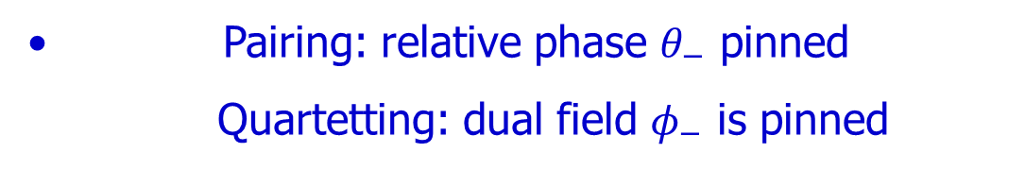
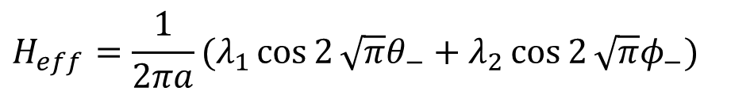
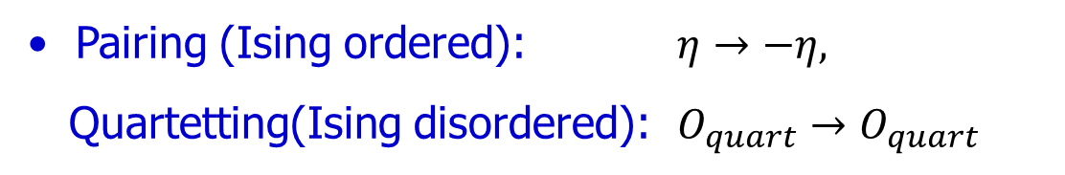

Ising transition: relative phase $θ_{−}$
$$H_{eff}=\frac{1}{2πa}(λ_{1}\cos{2}\sqrt{π}θ_{−}+λ_{2}\cos{2}\sqrt{π}φ_{−})$$
Pairing: relative phase $θ_{−}$ pinned
Quartetting: dual field $φ_{−}$ is pinned
$$λ_{1}>λ_{2}$$
$$λ_{1}<λ_{2}$$
Ising transition: two Majorana fermions with masses.
$$λ_{1}±λ_{2}$$
Pairing (Ising ordered): $η→−η,$
Quartetting(Ising disordered): $O_{quart}→O_{quart}$
Notes:
The competition between quartetting and pairing can be mapped to
a phase locking problem of two-component superfludity. This
Two component superfluidity was first studied by Prof. Leggett.
One component is the pairing between 3/2,-3/2; the other one is pairing
between ½, -1/2. The pairing operator can be written as two parts. It
contains one overall phase in the charge channel theta_c, and a
relative phase theta_v, which is a variable in the spin channel .
The quartetting order contains the overal phase theta_c, but
it also contains. The dual field phi_v to the relative phase.
The overal phase theta_c is always powerlaw fluctuating, and does
play a role in the transition. On the other hand, it is the relative phase that controls the
transition. The effective Hamiltonian to describe this competition is a sine-Gordon theory in the
relative phase channel. It contains cosine terms of both relative phase and its dual
field. If the coefficient lamba_1 is larger than lambda_2, then the relative phase is locked, pairing order;
Otherwise, the dual field is locked, it is the quartetting order.
This phase transition can be mapped to two majorana fermions with different masses.
One fermions is always gapped, the other one is gapless at lamda_1=lambda_2, which is
The critical point.

Slide 29
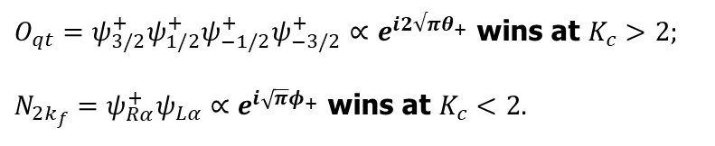
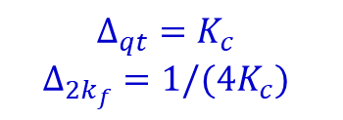
The quartetting phase – superfluid v.s. normal
Quartetting superfluidity v.s. 2k_{f}-CDW.
$$O_{qt}=ψ_{3/2}^{+}ψ_{1/2}^{+}ψ_{−1/2}^{+}ψ_{−3/2}^{+}∝e^{i2√πθ_{+}} \text{wins} \text{at} K_{c}>2;$$
$$N_{2k_{f}}=ψ_{Rα}^{+}ψ_{Lα}∝e^{i\sqrt{π}φ_{+}} \text{wins} \text{at} K_{c}<2.$$
$$Δ_{qt}=K_{c}$$
$$Δ_{2k_{f}}={1/(4K}_{c})$$
K_{c}: the Luttinger parameter in the charge channel.
Notes:
Now let us look at the quartetting phase.
In phase B, there are two competing orders, the quartetting superfluidity and the 2kf charge density wave order.
If we check the periodicity of the 2kf cdw, it is just the density wave of quartets.
So in this phase, four fermions first form quartets, then the quartets can either undergo
superfluid instability or charge density wave instablity.
Because the charge sector is gappless, both orders are power law fluctuating.
The superfluid order wins over the CDW order at Kc>2.
Check Ogatta, Shiba.

Slide 30
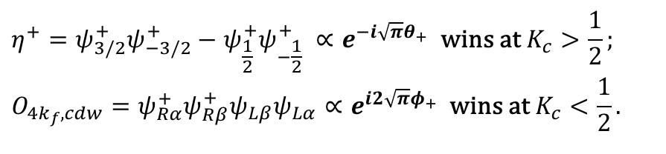
The singlet pairing phase
SU(4)
Singlet pairing superfluidity v.s 4k_{f}-CDW.
singlet pairing
$$η^{+}=ψ_{3/2}^{+}ψ_{−3/2}^{+}−ψ_{\frac{1}{2}}^{+}ψ_{−\frac{1}{2}}^{+} ∝e^{−i\sqrt{π}θ_{+}} \text{wins} \text{at} K_{c}>\frac{1}{2}; \\ O_{4k_{f},cdw}=ψ_{Rα}^{+}ψ_{Rβ}^{+}ψ_{Lβ}ψ_{Lα}∝e^{i2\sqrt{π}φ_{+}} \text{wins} \text{at} K_{c}<\frac{1}{2}.$$
Quartetting
Possibility of pairing with purely repulsive interactions
Notes:
Similarly in the phase C, two particles first form Cooper pairs, and
Coopers can undergo superfluidity or CDW instablities.
Both of them are also powerlaw fluctuating. The superfluid instability
dominates over the cdw at Kc>1/2.
Check Ogatta, Shiba.

Slide 31
Color magnetism
The SU(2) singlet: 2 sites.
The uniform SU(4) singlet: 4 sites.
baryon
The staggered SU’(4) singlet: 2 sites.
meson
Notes:
These two different SU(4) have dramatically different properties.
For the first SU(4), we need 4-particles in a plaquette to form a singlet.
It is a baryon like state, there is no site and bond spin orders, only
Plaquette order.
On the other hand, the second staggered SU(4) model. We only need two particles
to form a singlet. It is a meson-like state.

Slide 32



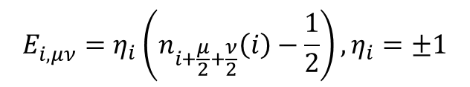
3D SU(4) resonant plaquette model
High order gauge theory (c.f. fracton theory)
n=1(occupied), =0(unoccupied).
Rank-2
E-field:
$$E_{i,μν}^{ }=η_{i}\left(n_{i+\frac{μ}{2}+\frac{ν}{2}}\left(i\right)−\frac{1}{2}\right), η_{i}=±1$$
$\left[E_{i,μν}, A_{j,ρσ}\right]=iδ_{ij}(δ_{μρ}δ_{νσ}+δ_{μσ}δ_{νρ}$)
$$H_{t}=−t (cos\left(∇_{z}A_{xy}−∇_{x}A_{yz}\right)+cos\left(∇_{x}A_{yz}−∇_{y}A_{zx}\right)+cos\left(∇_{y}A_{zx}−∇_{z}A_{xy}\right))$$
$$A_{μν }^{ }→A_{μν }^{ }+∇_{μ}∇_{ν}f$$
${∂_{x}^{ }∂_{y}E}_{i,xy }^{ }+{∂_{y}^{ }∂_{z}E}_{i,yz }^{ }$+${∂_{z}^{ }∂_{x}E}_{i,zx }^{ }=ρ_{i}=5η_{i}$
C.K. Xu, CW, Phys. Rev. B 77, 134449 (2008).
R. N. Nandkishore, M. Hermele, Ann. Rev. Cond. Matt. Phys. 10, 295 (2019)
Notes:
Now let us look at the 2D phase diagram. At the staggered SU(4) point where J2=0,
the QMC simulations conclude that the ground state is Neel ordered.
However, for general values of J2, the phase structure is an extremely difficult problem.
Even QMC has sign problem, there is no conclusive answer yet.
Let us look at the Kugel-Komskii SU(4) point, there is an exact diagonalization
on 4*4 lattice, they conjectured that the ground state exhibits the plaqutte order.
As I mentioned before, the plaquette order is an order of 4 sites, no bond order.
Their result is interesting but still no conclusive.
Now we speculate the general phase structure. Between the Neel order, which is a
Site order, and the plaquette order, there might be a dimer ordered phase.
Different from the usual spin ½ systems, the dimer here can be either singlet or quintet,
So there might be magneticly ordered dimer state.

Slide 33
SO(5)/Sp(4), SO(7), and G2
High symmetry fermion systems
SU(N) Hubbard
Model
Quartetting

Slide 34
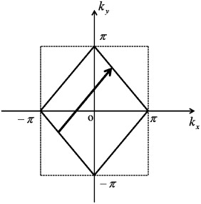






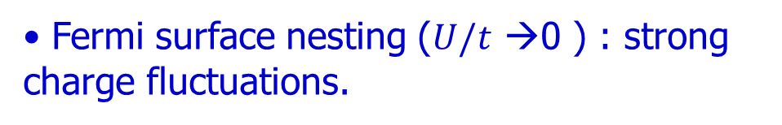

Two pictures: Slater v.s. Mott (half-filling)
$${\vec{Q}=(π,π)}^{ }$$
Fermi surface nesting ($U/t$ →0 ) : strong charge fluctuations.
$${\vec{Q}}^{ }$$
$${\vec{σ}}^{ }$$
$${\vec{σ}}^{ }$$
$${\vec{Q}}^{ }$$
$${Δ∝te^{−\sqrt{t/U }}}^{ }$$
Local moments ($U/t$ →$∞^{ }$) : AFM super-exchange.
$${H=J∑{\vec{S}}_{i}⋅{\vec{S}}_{j}}^{ }$$

Slide 35
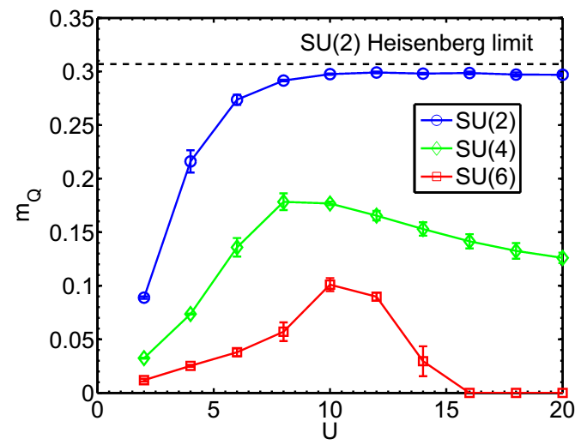

SU(2) v.s. SU(N) Hubbard models
SU(2): Neel order, crossover, no transition
Determinant QMC.
J. Hirsch, 1985.
Large-N for Hubbard models: difficult for analytic studies
Enhanced spin fluctuations → New quantum phase transitions
Suppressed charge gap → $N→∞,Δ→0 ,$ another route to non-Fermi liquid?

Slide 36
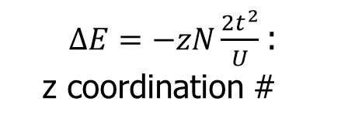
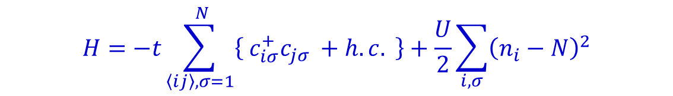
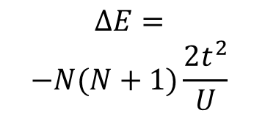
Half-filled SU(2N) Hubbard model
$${H=−t\sum_{〈ij〉,σ=1}^{ N}{\left\{ \right.c_{iσ}^{+}c_{jσ}}}^{ }+h.c.\left. \right\}+\frac{U}{2}\sum_{i,σ}^{ }{{\left(n_{i}−N\right)}^{2}}$$
Atomic limit t=0.
Neel state unfavorable as N increases.
${ΔE=−zN\frac{{2t}^{2}}{U}}^{ }$:
z coordination #
classic-Neel
$${\begin{aligned}ΔE= \\ −N(N+1)\frac{2t^{2}}{U}\end{aligned}}^{ }$$
SU(2N) singlet

Slide 37






SU(6): quantum phase transitions
Magnetism suppressed as Mottness grows
Mott-Heisenberg
Slater: Q(${π,π}^{ }$)
$U^{∗}$
dimer Q(${π,0}^{ }$)
$U_{c}^{ }$
Single-particle gap $Δ_{c}^{ }$
D. Wang, Lei Wang, CW, PRB 100, 115155(2019).
D. Wang, Y. Li, Z. Cai, Z. Zhou, Y. Wang, CW, PRL. 112, 156403 (2014).
Notes:
This is a representative result: the magnetic Neel ordering for the SU(4) and SU(6) Hubbard models through QMC simulations. The blue line is the SU(2) case for comparison which shows a monotonic increase as increasing U. This changes for the SU(4) and SU(6), the Neel orders are non-monotonic with U. In particular, for the SU(6) case, the Neel order first increases with U, and then it becomes to drop after U/t>10 as Mottness grows. Finally it is suppressed to zero at U around 15. After than the system enters to a dimerized phase. It clearly shows a phase transition from the Slater to the Mott region, which is absent in the SU(2) case.

Slide 38





Single-particle gap softened as increasing N
Hole’s band width ${W∼2zNt}^{ }$.
$${Δ_{sg}=\frac{U−W}{2}∝\#−\#N}^{ }$$

Slide 39



How do interaction effects scale with N (fixed U, n/N)?
$${H=−t\sum_{〈ij〉,σ=1}^{ N}{\left\{ \right.c_{iσ}^{+}c_{i+1,σ}}}^{ }+h.c.\left. \right\}+\frac{U}{2}\sum_{i,σ}^{ }{{\left(n_{i}−\frac{N}{2}\right)}^{2}}$$
Half-filling (particle density per component)
${\frac{n}{N}=\frac{1}{2}, k}_{f}^{ }=π/2$
Large U limit: Mottness
# of virtual hopping processes scales with ${(\frac{N}{2})}^{2}$
softening of the Mottness → $\frac{{ΔE}_{k}^{ }}{N}≈−Nt^{2}/U$
Small U limit: itinerancy
inter-component collision # scales with $N^{2}$
enhancement of collisions → $\frac{{ΔE}_{U}^{ }}{N}≈\left(N−1\right)U$
Notes:
Now we address an important question: How do interaction effects scale with N with a fixed U? Here we fix at half-filling, and the particle density scales with N. In the large U limit, the system is in the Mott insulating states. The number of virtual hopping processes scales as N^2, hence, the Mottness is softened as enlarging N. If we start with a small U nearly in the itinerant regime. Increasing N enhances inter-particle collisions, which enhances interaction effect.

Slide 40



Convergence of itinerancy and locality
Relative band width:
$W_{R}^{ }=〈E_{K}〉/〈E_{k}^{U=0}〉$=1 (free), 0 (infinite U)
U/t=0.5→ 19
weak coupling: enhancement of collision as ${N→∞}^{ }$
1D SU(N)
strong coupling:
softening of Mottness
N=
A universal limit at ${N→∞}^{ }$? $\lim_{u→0}\lim_{N→∞}{W_{R}(N,u)≠W_{R} (N, u=0){ }}⁡$
Notes:
We check the above picture via QMC simulations for the 1D SU(N) Hubbard model, for which N can reach values of 14. It shows a tendency of convergence of itinerancy and locality as N goes large. We define the relative band width, which is the kinetic energy expectation value divided by that of the non-interacting case.
For free system, the relative band width equals 1, and if U is infinity, the relative band width equals 0.
Hence it can reflect the correlation effect. Different lines represent a fixed U as increasing N. U takes values from weak interacting region to strong interacting region.
For the strong interaction case, the relative band width is very small, which is a reflection of Mottness. The band width is due to virtual hopping. The Mottness is softened and band width increases as large N. On the contrary, if we start with a small U at the order of band width, the band width decreases as increasing N in the weak interaction side.
The relative band width seems to approach a limit from opposite directions. A question is that if it means an interacting limit at large N? And we feel that it is a signature of the convergence of itinerancy and locality.

Slide 41



The AF structure factor
Opposite dependences of ${S(π)}^{ }$on N from the strong (local moment) and weak (itinerancy) interaction regimes.
$${\begin{aligned}U=15, \\ β=30\end{aligned}}^{ }$$

Slide 42
SO(5)/Sp(4), SO(7), and G2
High symmetry fermion systems
SU(N) Hubbard
Model
Quartetting

Slide 43
Alice string and SO(4) Cheshire charge
Wu, Hu, Zhang, arxiv 2005
Entanglement: particle and half-quantum vortex loop!
Notes:
Most atoms have hyperfine spin multiplets. Here spin means the total spin of the atom,
including the electron spin and the nuclear spin. I will follow the convention in atomic
physics. I use F to denote the total spin of the atom.
The cold atomic high spin systems are different from the high spin
condensed matter systems. In many transition metal oxide, several
electrons can be combined by Hund’s rule to form a high spin object.
However, the intersite coupling is still mediated by the virtual hopping
of a single electron. In contrast, in the cold atomic systems, each
atom carries high spin.
The study of cold atomic high spin system was pioneered by Jason about 10 years ago.
A lot of important progress has been made in this field. For example, there is already
extensive research on spin-1 bosons such as Na, Rb, including the spinor condensation,
and the more interesting spin nematic phase in the Mott insulating state in optical lattices.
On the other hand, high spin fermionic systems are also interesting.
In this talk, I will focus on the simplest high spin fermionic system—
spin 3/2 fermions.

Slide 44
g₂<0: s-wave quintet (S_{pair}=2) pairing
BCS theory: polar condensation; order parameter forms an SO(5) vector.
R: charge conjugation matrix
Ho and Yip, PRL 82, 247 (1999); Wu, Hu and Zhang, 2005.
d: spin channel
Notes:
When the interaction in the quintet channel is negative, we have quintet Cooper pairing.
Within BCS theory, the ground state is a polar state, in other words, no spin polarization.
As we explained before, they form an SO(5) vector,
can be parameterized by an amplitude, a phase, and a 5-d unit vector to represent the
This problem was discussed by J. Ho before, but he did not
notice this SO(5) symmetry. Now we have more interesting results.

Slide 45
Superfluids with spin: half-quantum vortex (HQV)
Z₂ gauge symmetry
-disclination of as a HQV.
remains singly valued.
d is not a rigorous vector, but a directionless director.
Fundamental group of the manifold.
Notes:
Superfluid with spin degrees of freedom can support half-quantum vortex.
It is because of a Z2 symmetry, if we change d to –d, and also theta by pi,
the order parameter does not change. In other word, d is not a vector but a director.
HQV is actually a pi disclination of the d-vector. As we wind around the vortex core,
d only rotate pi, also the phase winds at pi, thus the order parameter is still
singlely valued.
Formally, the Goldstone manifold for d is a
Hemisphere called RP4. RP4 contains a non-contractable loop. More formally,
The fundamental group of RP4 is Z2, this allows a line defect of pi disclination.

Slide 46
HQV as Alice string (³He-A phase)
A particle flips the sign of its spin after it encircles HQV.
Triplet Cooper pairing.
Configuration space U(1)
McGraw, PRD, 1994.
Notes:
1:30
The HQV has an interesting property called Alice string behavior.
When a particle encircles vortex core adiabatically, its spin flips sign.
Let us look at He-3 A phase as a simple example. He3-A is similar to what we
Discussed above, but the d-vector lives in hemisphere of S^2.
Let us creat a pi disclination. We assume at the starting point, the d-vector
is along the z direction. As we move around the vortex, we can rotate the
d-vector pi degree around any axis in the xy plane, say the n-axis.
Thus the configuration space of HQV can map to the U(1) circle of xy plane.
For a particle with spin encircles the vortex, since the rotation angle is only pi.
Thus spin up goes to spin down, and spin down goes to spin up up a U(1) phase.
This U(1) phase is determined by alpha angle of the n-axis.
The phenomion is not surprise, because the spin rotatinon symmetry is already broken.
It is just the ordinary U(1) Berry phase.

Slide 47
A pair of HQV or HQV loop
SO(3)→SO(2)
Phase state.
McGraw, PRD, 1994.
Notes:
1:30
The HQV has an interesting property called Alice string behavior.
When a particle encircles vortex core adiabatically, its spin flips sign.
Let us look at He-3 A phase as a simple example. He3-A is similar to what we
Discussed above, but the d-vector lives in hemisphere of S^2.
Let us creat a pi disclination. We assume at the starting point, the d-vector
is along the z direction. As we move around the vortex, we can rotate the
d-vector pi degree around any axis in the xy plane, say the n-axis.
Thus the configuration space of HQV can map to the U(1) circle of xy plane.
For a particle with spin encircle the vortex, since the rotation angle is only pi.
Thus spin up goes to spin down, and spin down goes to spin up up a U(1) phase.
This U(1) phase is determined by alpha angle of the n-axis.
The phenomion is not surprise, because the spin rotatinon symmetry is already broken.
It is just the ordinary U(1) Berry phase.

Slide 48
SO(2) Cheshire charge (³He-A)
HQV pair or loop can carry spin quantum number.
For each phase state, SO(2) symmetry is only broken in a finite region, so it should be dynamically restored.
Cheshire charge state (S_{z}) v.s phase state.
McGraw, PRD, 1994.
Notes:
An even more interesting concept is Cheshire charge. It means a pair of half-quantum vortex
and anti-vortex pair or a vortex loop can carry spin quantum number called Cheshire charge.
Let us start with an order ground state, the d-vector lies along the z-direction.
There is an SO(2) symmetry around the z-axis.
Now we introduce a HQV pair or loop.
Faraway from the vortex, the orientation of d-vector does not change.
The configuration of the vortex pair is also U(1), is determined by the axis n,
around with the d-vector is rotated by pi.
We call it as phase state.
For each phase state alpha, SO(2) symmetry only breaks in a finite region close to the vortex loop,
Thus it should be dynamically restored in quantum mechanics.
We do liner superposition by the Fourier transformation to form the
Cheshire charge eigenstate, Here charge means Sz.
For example, a zero charge state is just an average of the phase state.

Slide 49
Spin conservation by Cheshire charge (³He-A)
Initial state: particle spin up and HQV loop zero charge.
Final state: particle spin down and HQV loop charge 1.
•
Still Abelian. No entanglement!
McGraw, PRD, 1994.
Notes:
Let us we study the spin transport process. We assume the initial state is a spin up
particle with a zero charge vortex loop. After a particle passing the vortex loop,
Its spin still flips. Spin up goes to spin down, and the spin conservation is realized
by exciting cheshire charge, the vortex loop gains spin-1.
Let us look at it more carefully at the algebra. We expand the charge eigenstate
In terms of the phase state. For each configuration of alpha, the finial state are
With a different phase, after the liner-superposition, the finial state of vortex loop
Is an excited state carrying Cheshire charge.
This is indeed interesting. However, both the final and initial state are product
state. No entaglement! It is not useful for quantum computation.

Slide 50
Quintet pairing as a non-Abelian generalization
HQV configuration space , SU(2) instead of U(1).
equator:
Notes:
Let us move to our main interest about quintet pairing as a non-Abelian generalization.
In this case, the configuration space of a pi-disclination is SU(2).
D is a 5 dimensional d-vector. We set up a frame e1,2,3,4,5.
At the starting point, we assume d//e4. We can rotate d-vector around any axis in the
Equator, which is a S3 phere spaned by e1,2,3,5, and S^3 is group space for SU(2).

Slide 51
SU(2) Berry phase
After a particle moves around HQV, or passes a HQV loop:
Notes:
Now we move a particle around HQV, or through a HQ loop.
3/2,-3/2→ goes to ½, -1/2.
The transformation exhibits SU(2) Berry phase.
W can be any SU(2) matrix, which is determined by n vector on the S^3 sphere.

Slide 52
Non-Abelian Cheshire charge
Construct SO(4) Cheshire charge state for a HQV pair (loop) through S³ harmonic functions.
SO(5) → SO(4)
Zero charge state.
Notes:
Similarly, we can introduce SO(4) Cheshire charge eigenstates for HQV loop or pairs
by introducing Fourier transformation to the phase state.
Let me skip the detail. These T’s are SO(4) quantum numbers, Y are harmonic functions
on S^3 sphere.
The simplest case, the zero charge state is just an average of on the phase state.

Slide 53
Entanglement through non-Abelian Cheshire charge!
SO(4) spin conservation. For simplicity, only is shown.
Entanglement between the particle and HQV loop!
Notes:
Now we move a particle through HQV loop which is Cheshire charge eigenstate.
Amazingly, quantum entanglement is generated in the finial state to ensure the
SO(4) spin conservation.
For example, the initial state, particle with Sz=3/2, HQV with zero charge.
The final state is an entangled state determined by the SO(4) C-G coefficentl.
Thus it is useful for topogolical quantum computation.

Slide 54

More details

Slide 55


Triality and supersymmetry in (1+1)D
Z.-Q. Gao, CW,
arXiv: 2411.08107
Duality between $SO{\left(7\right)}_{A}$ and $SO{\left(7\right)}_{B}$ becomes triality among three $SO(7)$ symmetries.
Supersymmetric tri-critical Ising CFT as multi-critical point between Gross-Neveu phases related by triality.

Slide 56


Lattice reminiscence in (1+1)D
Supersymmetry $→$ Degeneracy between bosonic and fermionic states
Triality $→$ Duality
Z.-Q. Gao, CW,
arXiv: 2411.08107

