Slide 1
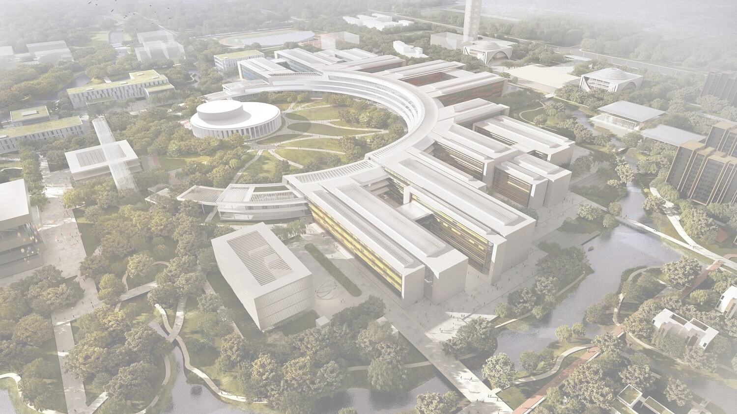

WESTLAKE UNIVERSITY · SCHOOL OF SCIENCE
2025–2026 Scholarship Evaluation Presentation
Higher-Dimensional Topological Quantum Matter & Non-Abelian Quantum Geometry
Junwen Zhao · Physics · 2022
School of Science, Westlake University · 13 Oct 2026

Slide 2
Overview
PROFILE
RESEARCH I
Incompressible Quantum Hall Liquid on the Four-Dimensional Sphere
RESEARCH II
Second-Chern Bounds in Non-Abelian Quantum Geometry
Overall Performance
WESTLAKE UNIVERSITY · SCHOOL OF SCIENCE
2

Slide 3
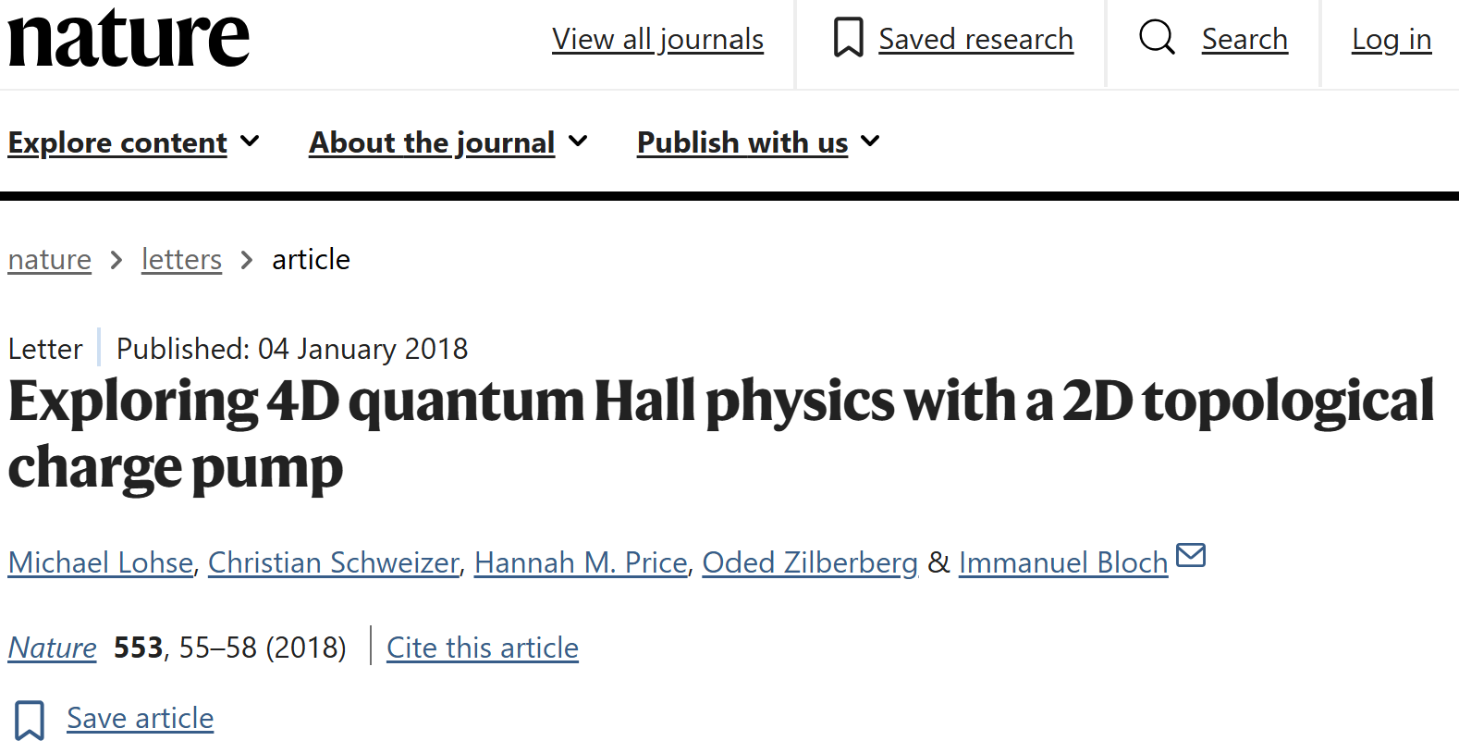
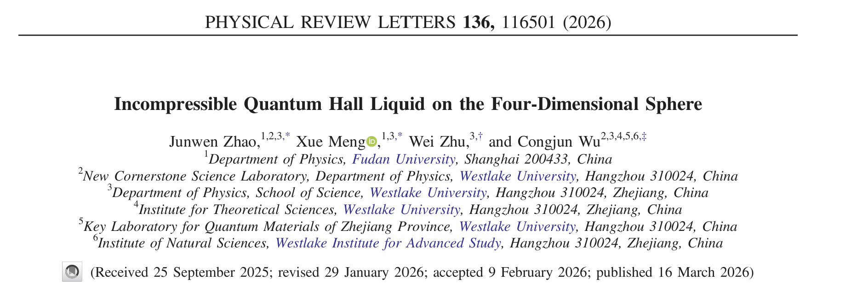
Four dimensional fractional quantum hall effect
RESEARCH
Take Home message
The work extends the conceptual framework of the fractional quantum Hall effect beyond two dimensions.
Lohse et al., Nature 553, 55 (2018);
Zilberberg et al., Nature 553, 59 (2018);
Bouhiron et al., Science 384, 223 (2024).
• From 2D to 4D: generalizing Laughlin’s fractional quantum Hall paradigm
• From wave function to Hamiltonian: establishing a microscopic interacting theory.
• From concept to phase: demonstrating signatures of an incompressible quantum liquid.
• Broader impact: revealing new possibilities for strongly correlated topological matter beyond 2D.
Co-first author (listed first)
From 2D topological liquids to higher-dimensional many-body physics
WESTLAKE UNIVERSITY · SCHOOL OF SCIENCE

Slide 4
Contribution
CONTRIBUTION
MY CONTRIBUTION
Xue Meng’s CONTRIBUTION
Theory & Analytical Framework
Built the 4D Haldane pseudopotential framework
Identified the SO(5) irreducible interaction channels
Constructed the parent Hamiltonian for the 4D
Laughlin-type state
Derived key analytical expressions and SO(5) CG coefficients
Contributed to physical interpretation and manuscript writing
Performed exact diagonalization calculations.
Cross-checked key theoretical formulas and
analytical derivations.
Analyzed the many-body spectra and
numerical results.
Contributed to the physical interpretation
and manuscript preparation.
Zhao: theory & analytics · Meng: exact-diagonalization numerics
WESTLAKE UNIVERSITY · SCHOOL OF SCIENCE

Slide 5
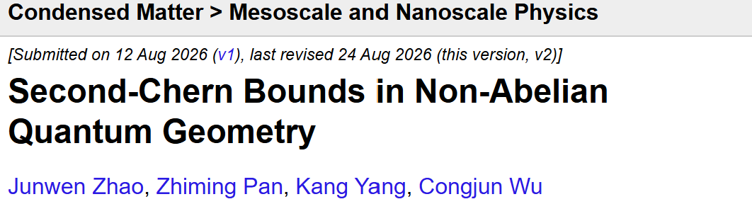
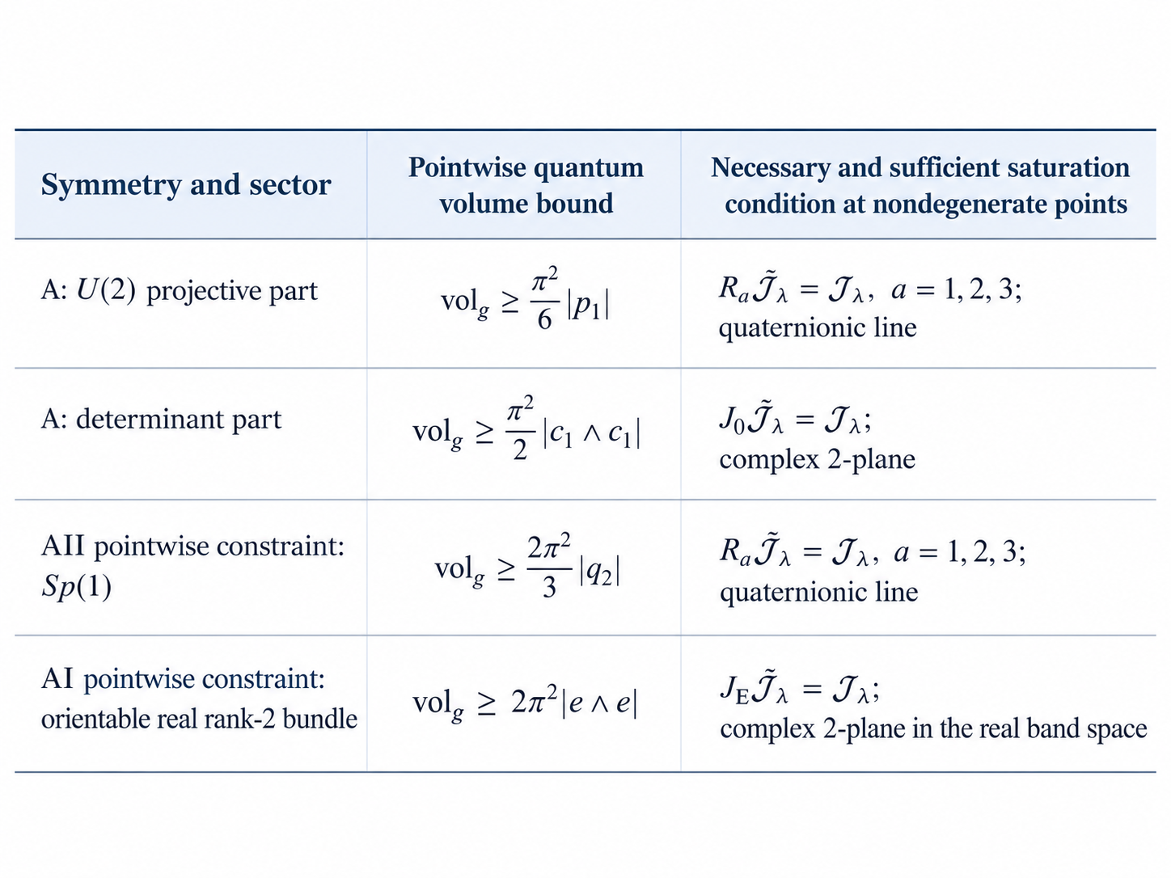
Second-Chern Bounds in Non-Abelian Quantum Geometry
STRUCTURE
Problem: Can quantum geometry constrain topology beyond 2D?
Idea: Extend the geometry–topology relation from Chern bands to 4D non-Abelian systems.
Result: Derive a geometric bound connecting the quantum metric to the second Chern number.
Meaning: Reveal a higher-dimensional “ideal-band” geometry
Proposed the original research idea.
Obtained the core theoretical bound.
Developed the physical and geometric interpretation.
Deeply involved in discussions and manuscript writing.
MY CONTRIBUTION
WESTLAKE UNIVERSITY · SCHOOL OF SCIENCE

Slide 6
Overall Performance
PROFILE
Study performance
Research performance
GPA: 3.82
40 credits completed
Research proposal, mid-term evaluation, and qualifying examination all completed
Junwen Zhao, Xue Meng, Wei Zhu, and Congjun Wu, Phys. Rev. Lett. 136, 116501 (2026).
Junwen Zhao, Zhiming Pan, Kang Yang, and Congjun Wu,arXiv:2608.12221 (2026).
Xue Meng, Junwen Zhao, Wei Zhu, and Congjun Wu,Physics Letters A 580, 131488 (2026).
Community service
Overall Qualities
Conference Volunteer, Five-University Joint Physics PhD Forum, Westlake University (2025)
Westlake · SJTU · Nanjing · ShanghaiTech · SUSTech
Active in academic discussions and collaborative activities; strong teamwork and responsibility.
Maintain regular physical exercise and pursue balanced personal development.
WESTLAKE UNIVERSITY · SCHOOL OF SCIENCE

Slide 7
Summary
SUMMARY
RIGOR
ORIGINALITY
CONTINUITY
Built the analytical framework for 4D fractional quantum Hall states.
Proposed the Second-Chern research project and obtained the core theoretical bound.
Developed a focused research line in higher-dimensional quantum hall physics.
Future
Explore quantum geometry, topology, and strongly correlated states beyond two dimensions.
Thank you!
WESTLAKE UNIVERSITY · SCHOOL OF SCIENCE
7

