Slide 1
Quantum chaos, Black holes and
Sachdev-Ye-Kitaev (SYK) models
Jinwu Ye
Mississippi State University
Outline:
I. An intuitive introduction at AdS/CFT, SYK models
and its possible gravity dual
Two approaches to quantum chaos in SYK models
and black holes:
II Quantum information scramblings by
Out of Time ordered Correlation (OTOC), 1/N expansion
III. Random matrix theory (RMT)
Contrast OTOC with RMT
Possible experimental realizations and detections
VI. Summary and Perspectives

Slide 2
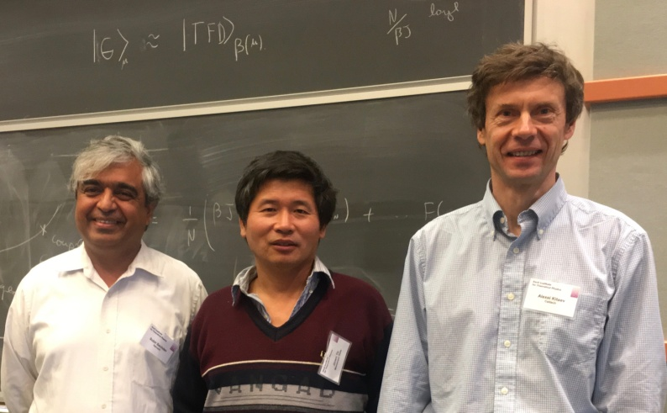
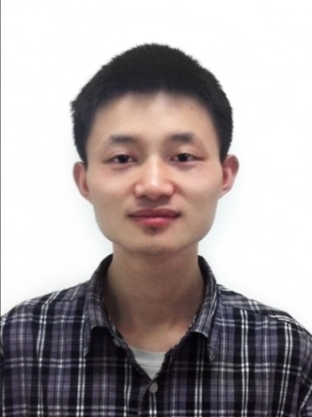

Ph.D. 2020:
Sun
SYK
Ph.D. 2016 Yu
My Research is supported by
AFOSR FA9550-16-1-0412
at KITP, NSF PHY-1748958

Slide 3
My group’s recent works on SYK models:
1. Photon Berry phases, Instantons, Quantum chaos and quantum analog of Kolmogorov-Arnold-Moser (KAM) theorem in the U(1)/Z_2 Dicke models
Yi-Xiang Yu, Jinwu Ye and CunLin Zhang,
arXiv:1903.02947.
2. Two indices Sachdev-Ye-Kitaev model
Jinwu Ye, ArXiv:1809.0667, v2
3. A new universal ratio in Random Matrix Theory and quantum analog of Kolmogorov-Arnold-Moser theorem in Type-I and Type-II hybrid SYK models
ArXiv:1809.07577, v2
Yi-Xiang Yu, Fadi Sun, Jinwu Ye and W.M. Liu,
submitted to PRL, to be submitted to PRB
Classifications of quantum chaos in the colored Sachdev-Ye-Kitaev models, Fadi Sun，Yi-Xiang Yu, Jinwu Ye and W.M Liu，
Phys. Rev. D 101, 026009 (2020).
5. Periodic Table of SYK and supersymmetric SYK，
Fadi Sun and Jinwu Ye, Phys. Rev. Lett. 124, 244101 (2020).
arXiv:1905.07694

Slide 4
I.Overview on physics at different scales
Quantum gravity
Cosmology
Astrophysics
General Relativity
Gravity
Quantum Black-holes
String (M) Theory ???
Extra-dimensions
Emergent Space-Time
Symmetry and symmetry breaking at different
energy (or length ) scales +Topological orders
Elementary particle physics
Quantum Mechanics
Quantum Field Theory
Atomic physics, quantum optics
Quantum information and
Quantum computing
Condensed matter physics
Entanglement ！
2d conformal field theory
CFT at any other d
Gravity/Gauge ( AdS/CFT)
Supersymmetric Yang-Millis (SYM), 1998-
Sachdev-Ye-Kitaev (SYK), 2015-

Slide 5
A. Gravity/Gauge ( ) duality
Gauge
Theory
Electricity/Magnetism duality
Boundary value of the bulk
gravity theory acts as the
Source of the QFT on the boundary
CFT
Gravity in AdS space
A emergent (synthetic )
space dimension
GR=RG
Supersymmetric Yang-Mills (SYM)
J. Maldacena, 1998
Type IIB string theory on
Self-dual
D3 brane

Slide 6
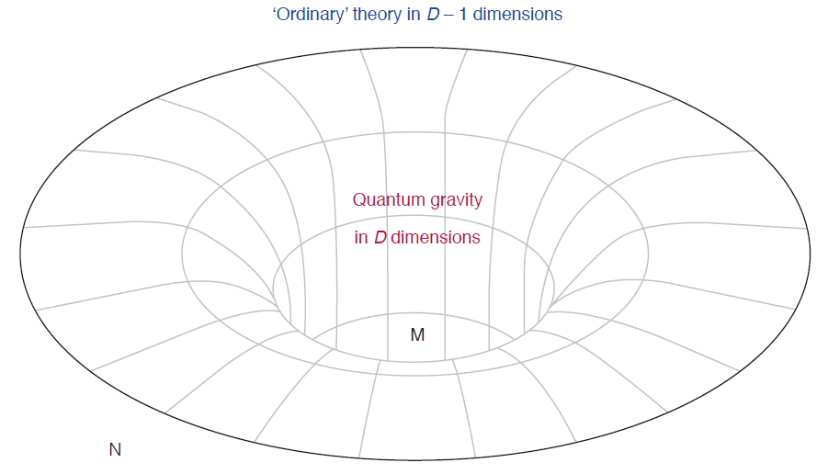
Electricity/Magnetism duality
CFT in flat space such as SYK model
Fixed Minkowski space time
at the boundary N
Fluctuating space-time
in the bulk M
Emergent space-time
( gravity ) from the
boundary
N
E. Witten, Symmetry and emergence， Nature Physics， 14,116–119 (2018)
P.W. Anderson: More is different: emergent phenomena

Slide 7
Correspondence
Operator contents of CFT
Fluctuating gauge fields in the bulk
at a fixed boundary value
Quantum gravity:
Fluctuating spacetime in the bulk
at a fixed boundary value
What about the discrete anti-unitary or unitary symmetries such as in the boundary ?
which was recently addressed in
Boundary: Fadi Sun and Jinwu Ye, Phys. Rev. Lett. 124, 244101 (2020).
Periodic Table of SYK and supersymmetric SYK，
Bulk: Douglas Stanford, Edward Witten, JT Gravity and the Ensembles of Random Matrix Theory， arXiv:1907.03363,

Slide 8
Supersymmetric Yang-Mills (SYM)
1998
String tension
String length
String coupling constant
Planck length
Common Radius of the
************
Sachdev-Ye-Kitaev (SYK) model
2015-
Quantum Spin liquid
2d AdS Black holes
dilaton
2d JT gravity ????

Slide 9
If SYK model is indeed a boundary theory
of a bulk quantum gravity which contains
a black hole
Then one can do experiments on SYK models on
the basement to study quantum black holes.
That could be the simplest way to study quantum
Black holes !
Hard to experiments with black holes !

Slide 10
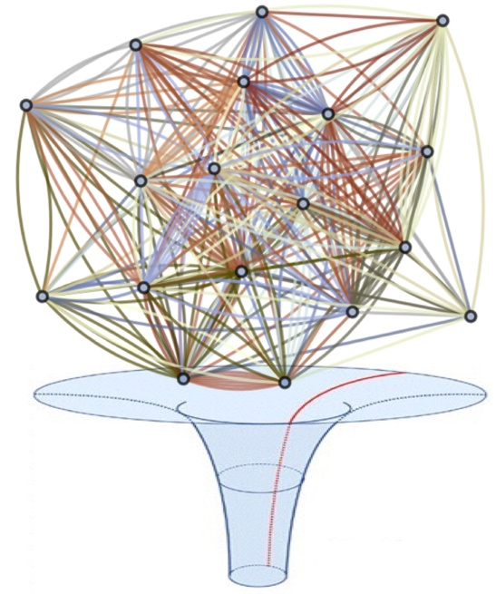
Overview on Sachdev-Ye-Kitaev model:
Quantum Heisenberg model with random exchanges:
Sachdev-Ye model (1993)
Two indices
Invent a small parameter !
PH symmetric
Gapless spin liquid phase
try to study High Temperature superconductors
S. Sachdev and J. Ye, Phys. Rev. Lett. 70 , 1993

Slide 11
In the Infra-red, we identify a Gapless,
conformal invariant QSL phase
Two point correlation functions of fermions in
Four point correlation functions:
Local dynamic spin susceptibility:
Quantum Spin glass (QSG) phase is the true ground state
at any finite
Claim: this QSL maybe relevant to Marginal Fermi Liquid
of high temperature superconductors

Slide 12
Sachdev-Ye-Kitaev (SYK) model:
q=4 Majorana
Fermions interaction
Four site indices:
Substantially simplified
the SY model
Analytically in 1/N expansion
Numerically at a large N
Its most remarkable property is:
It shows quantum chaos with the maximal
Lyapunov exponent
Try to study the classification of interacting topological superconductors
Kitaev, “A simple model of quantum holography,” KITP seminar, 2015 http://online.kitp. 42 ucsb.edu/online/entangled15/.

Slide 13
Several Remarkable properties of the SYK model
Gapless, conformal invariant QSL in the infra-red
2. Large N limit, solvable at large N by 1/N expansion
3. Maximally chaotic with
Saturate the upper bound !
Gravity dual:
No upper bound
for classical chaos !
Bekenstein-Hawking
Just like black holes which is the fastest quantum
information scrambling systems in the universe !
J. Maldacena, S. H. Shenker, and D. Stanford, arXiv:1503.01409 .
4. Entropy density
of SYK
=BH entropy
in dual gravity

Slide 14
Classical chaos: extremely sensitive dependence on
Initial conditions: Lyapunov exponent,
as
Operators in Heisenberg Picture
Trajectories
Wavefunctions, energy levels in
Schroidger picture
Two different or complementary ways
to study Quantum chaos in SYK models:
Early time: Evaluating Out of time ordered correlation(OTOC) Function of some operators
by 1/N expansion
Late times: Random matrix theory (RMT)
Energy level statistics (ELS)

Slide 15
A few basic features of a Quantum Black hole:
1.a closed ( or isolated ) system,
has a temperature
2. Quantum chaotic with the maximal Lyapunov exponent
Quantum Butterfly effects near its horizon
3. Satisfy Eigenstate Thermalization Hypothesis (ETH)
4. BH entropy can be interpreted as an EE:
Area of its horizon
5. Its energy levels can be described by RMT

Slide 16
II. Quantum information Scramblings by 1/N expansion
Classical: Poisson braket Quantum: Commutator
Quantum chaos:
Fermions: Anti-commutator
Taking two initially commuting operators
one can study how the commutator evolves as the time
applies when and are fermionic and bosonic operators

Slide 17
For two bosonic Hermitian operators
Time-ordered
Out of time ordered (OTOC)
a dissipation time
a scrambling time
For a quantum chaotic system, starts to decay exponentially between
The decay rate is the Lyapunov exponent
Quantum Butterfly effect
must be defined at a finite T !

Slide 18
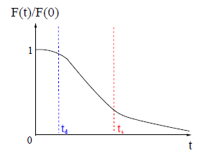
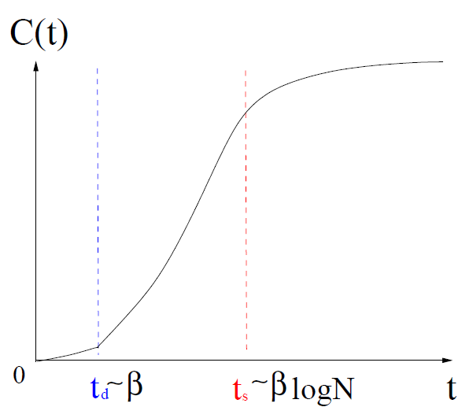
OTOC of SYK
Lyapunov exponent:
Caution: very difficult to see the in numerical
In sharp contrast to Classical chaos

Slide 19
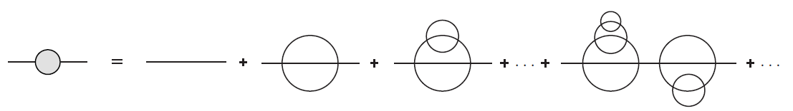
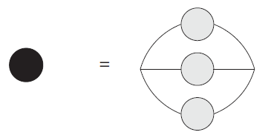

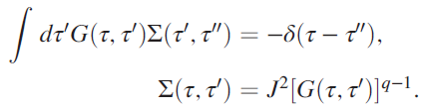

Two point correlation function is given by
the melon diagrams
Exactly the same as SY model
Reparametrization invariance:
J. Maldacena and D. Stanford (MS), Phys. Rev. D 94, 106002 (2016)

Slide 20
the saddle point solutions are identical to the SY model
Two point correlation functions in
the saddle point solution is invariant
Reparametrization invariance was spontaneously
broken down to leads to a Goldstone mode
Making an analogy to quantum AFM:
Hamiltonian is invariant
The ground state
invariant
Goldstone modes

Slide 21


The piece of the
Four point correlation function is given by
the ladder diagram for
Where the propagators are dressed ones
The kernel is:

Slide 22
It is eigen-value at the conformal limit has been worked out
for general . For it reduces to
To have a complete basis of eigenfuntions:
for the continuous series
for the discrete series
leads to the zero mode which must be treated away from the conformal limit,
One must put back the IR irrelevant term:
which explicitly breaks the re-parametrization symmetry
Making an analogy to quantum AFM: an external magnetic field breaks the symmetry explicitly

Slide 23
(1) The Schwarzian action:
The irrelevant time derivative term explicitly breaks the re-parametrization symmetry and lifts the Goldstone mode to a pseudo-Goldstone mode ( still gapless ! )
the Schwarzian is
is the reparametrization mode
It leads to
J. Maldacena and D. Stanford (MS), Phys. Rev. D 94, 106002 (2016)

Slide 24
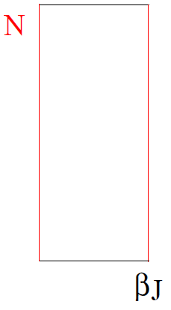
(2)
Plus One tower of massive operators with conformal dimension
leads to the operator dimensions:
It leads to a small correction:
J. Maldacena and D. Stanford (MS), Phys. Rev. D 94, 106002 (2016)

Slide 25
A brief summary on OTOC by 1/N expansion
SYK
Quantum AFM
1. Symmetry analysis
1. Symmetry analysis
Dropping term
No Zeeman
Reparametrization symmetry
2. Specific calculation by
1/S expansion
Zero ( Goldstone) mode
2. Specific calculation by
1/N expansion
2 Goldstone modes
Adding:
Pole of 4-point function
two gapped pseudo-Goldstone modes (gapped)
Putting back term
Gapless Pseudo-Goldstone
described by Schwarzian

Slide 26
Some Extensions of Sachdev-Ye-Kitaev
1. Multiple colors:
Colored SYK
D. J. Gross and V. Rosenhaus, arXiv:1610.01569, (2016),
The color degree of freedoms lead to new towers of operators
Classifications of quantum chaos in the colored Sachdev-Ye-Kitaev models, Fadi Sun，Yi-Xiang Yu, Jinwu Ye and W.M Liu，Phys. Rev. D 101, 026009 (2020).
2. Global symmetry:
A new sector describing quantum spin fluctuations
New gapless modes+ new towers of operators

Slide 27
The Simplest SYK with a global symmetry
Is the complex SYK model
Global symmetry
Complex fermions
Can add a chemical potential to tune the filling
Particle-hole symmetry at
A new sector describing quantum phase fluctuations
It is dual to a black hole carrying electric charge
(Reissner-Nordstrom black hole )
S. Sachdev, Bekenstein-Hawking Entropy and Strange Metals,
Phys. Rev. X 5, 041025 (2015)

Slide 28
3. Supersymmetric SYK: Witten index
SUSY breaking and its consequences
SUSY SYK
Majorana
fermions
Supercharge
Witten index
Complex
fermions
Extensive Ground state degeneracy
the equality holds for the SUSY SYK.
New towers of fermionic and bosonic operators
W. Fu, D. Gaiotto, J. Maldacena, and S. Sachdev, arXiv:1610.08917 .

Slide 29
4. Tensor model
:Gurau-Witten model
clean system !
Share the similar large N properties as SYK
Much harder to study by 1/N and
by Exact Diagonization (ED)
R. Gurau, arXiv:1611.04032,
E. Witten, arXiv:1610.09758
Igor R. Klebanov, G. Tarnopolsky,
arXiv:1611.08915
For a review: Igor R. Klebanov, Fedor Popov, Grigory Tarnopolsky, TASI Lectures on Large N Tensor Models, arXiv:1808.09434

Slide 30
5. Extended to higher spatial dimensions,
Quantum chaos in the time, diffusions in the space
Buttlefly (scrambling ) velocity versus entanglement
Entropy (EE) velocity
Inside the butterfly light-cone
and fail to commute
satisfy Lieb-Robsion bound
Exponential behaviors happen near the light cone
Y. Gu, X.-L. Qi, and D. Stanford, arXiv:1609.07832

Slide 31
6. Various 2d anaolg of SYK or SUSY SYK
Not maximal chaotic, higher spin ……
arXiv:1706.05362
J. Murugan, D. Stanford, E.Witten,
It is easy to find a gapless system which is
quantum chaotic ( such as any QCP ), but it is
Extremely rare to find one which is maximally
Chaotic ( which matches that of black hole )

Slide 32
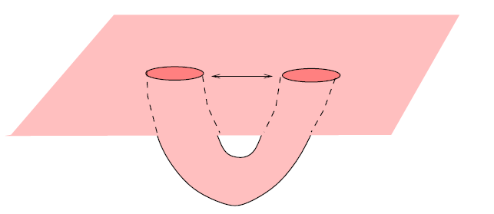
8. Transverse wormholes
Quantum effects of quantun tunnelings between
two black holes.
Two strongly coupled SYK to study warmholes…
Thermal field double (TFD) state
Maldacena and Qi, arXiv:1804.00491

Slide 33
8. Hybrid Sachdev-Ye-Kitaev models,
Quantum analog of Kolmogorov-Arnold-Moser (KAM) theorem in hybrid SYK models
Majorana
Complex
ArXiv:1809.07577, v2
Fadi Sun, Yi-Xiang Yu, Jinwu Ye and W.M. Liu,

Slide 34
After a time , the commutator becomes flat,
How to detect the quantum chaos at a later time ?
Random Matrix Theory (RMT)

Slide 35
III. Random matrix Theory (RMT) classification
Classical: Celestial chaotic (trajectory) dynamics
Quantum: Wavefunctions and energy levels
Nuclear physics,
large Z atom energy spectrum, hard to solve S-equation
F.J. Dyson gas
Statistical way to describe the energy level distributions
Energy level statistics:
3 Wigner-Dyson (WD) distributions
Global symmetries: GOE, GUE, GSE
E. Wigner, Math. Proc. Cam. Phil. Soc. 49, 790 (1951).
F. Dyson, J. Math. Phys. (N.Y.) 3, 140 (1962).
Quantum black hole is an Isolated system
If quantum mechanical, It should have energy levels similar to a large Z nuclei, ELS

Slide 36
Energy Level Statistics (ELS)
Let be an ordered set of energy levels and are the NN spacings.
the distribution function of the NN spacing
for GOE, GUE and GSE respectively.
Represents energy level repulsions !
Integrable system satisfies a Poisson distribution

Slide 37
Consider the GUE of Hermitian matrices of rank
where is the dimension of the Hilbert space.
For the Majorana fermion SYK model
The saddle point leads to Wigner semicircle DOS
The semi-circle DOS holds for any 10 fold way !

Slide 38
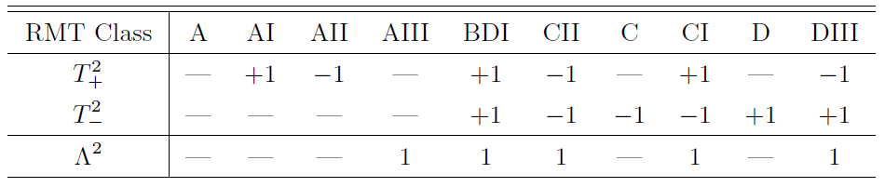
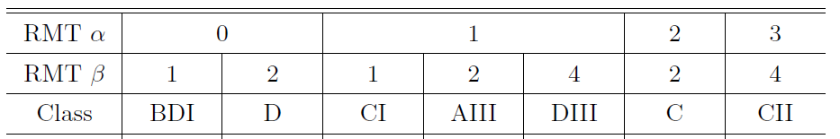
10 RM classifications ( Cartan labels )
3 Wigner-Dyson (WD) ensembles ( A, AI, AII); GUE, GOE and GSE
for GOE, GUE and GSE
3 chiral WD ensembles ( AIII, BDI, CII );
chiral ( GUE, GOE and GSE )
4 BdG ensembles ( C, CI, D, DIII )
For 7 classes with a mirror symmetry: edge exponent

Slide 39
Previous RMT classification of SYK model
8 fold way,
SUSY SYK
energy level statistics
at even
ch GOE (BDI)
GOE
GSE
GSE
GOE (AI)
GUE (A)
GSE (AII)
DIII
ch GSE (CII)
GOE
GUE (A)
CI
Wigner- Dyson (WD)
Chiral WD, BdG
Y.-Z. You, A. W. W. Ludwig, and C. Xu,
Phys. Rev. B 95, 115150 (2017)
Tianlin Li, et. al,
JHEP 1706 (2017) 111.
J. S. Cotler, S,H.Shenker ,et.al,
arXiv:1611.04650
T. Kanazawa, et.al,
arXiv:1706.03044
SUSY SYK, (clean) GW Tensor, (clean) Dicke models…..
All fit into RMT !!!!!

Slide 40
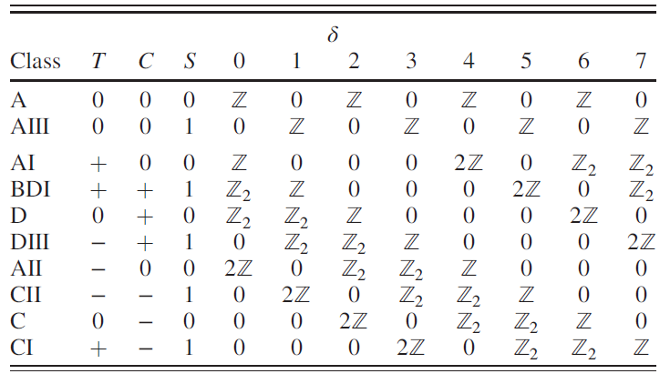
RMT classification of topological phases
10 RMT classifications by Altand-Zirnbauer (AZ)
based on discrete symmetries:
Time-Reversal, Particle-hole and Chiral symmetry
on dimension d ( mod 8 ) : Bott periodicity
Periodic Table of gapped TI and TSC
M. Z. Hasan and C. L. Kane, Rev. Mod. Phys. 82, 3045 (2010).
K-theory Classifications on TI and TS, Kitaev, 2009

Slide 41
For non-interacting electrons, Adding more symmetries such as translational symmetries, point group symmetries or non-isomorphic symmetries generate more rich periodic tables for topological crystalline symmetries.
********************
However, for interacting electron systems, the anti-unitary operators are not enough, the SPT or SET phases maybe classified by using more advanced mathematical tools such as co-homology, cobordism and Tensor categories which were already used in rational conformal field theory (RCFT) .
Potentially useful in topological quantum computing.

Slide 43
OTOC by 1/N expansion versus RMT
Complex SYK with
Half-filling
1/N exp.
Low
Bulk
RMT
High
Level repulsion
Many body energy
level spacing
No quasi-particle
1/N exp.
Complex SYK with
No Level repulsion
Quasi-particle
denser than

Slide 44
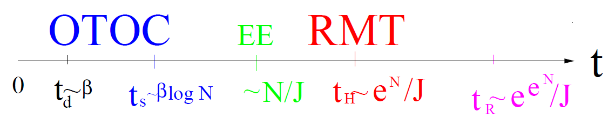
The time scale hierarchy in SYK models:
Volume law
Many body energy level spacing
RMT breaks down when
How to extend 1/N expansion to the ?

Slide 45
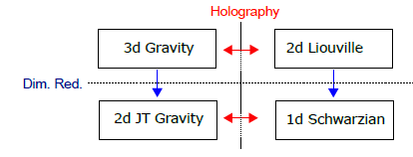




2D Jackiw-Teitelboim
Quantum (Dilaton)
gravity (1983)
SYK models
Provide UV finite microscopic models which have AdS gravity duals
Schwarzian
Quantum mechanics
Tensor models
Liouville CFT
Irrational CFT
RMT
Pure Mathematics:
Graph theory
Combinatorial

Slide 46
Iron Triangle
Quantum gravity, quantum black holes
3d gravity~
3d CS theory
Quantum information, computing
???
Topological phases
topological phase transitions

Slide 47
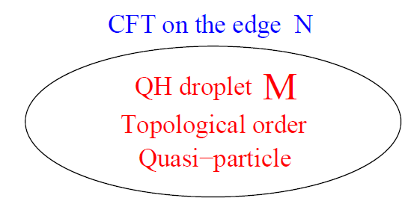
RMT
Classification of SPT
SYK models
1d CFT, 1/N expansion….
Classification of SET
Bulk-Edge correspondence
In topological phases
Bulk-Edge correspondence
Irrational (chaotic )CFT in flat space
Rational
TQFT, anyons
3d gravity~
3d CS theory

Slide 48
Three know universality classes:
1. Symmetry and symmetry breaking,
Renormalization group: low or high energies，
1/N expansions…..
Math: Calculus, differential geometry,…..
2. Topological equivalent classes
Symmetry protected topological (SPT) phases
Symmetry enriched topological (SET) phases
Topological invariants (numbers)
Math: Algebraic topology, Algebraic geometry,….
Quantum chaos by RMT.
Intermediate ( bulk ) energies
Math: RMT,……

Slide 49
Eigenstate Thermalization Hypothesis (ETH)
any excited state
with eigen-energy
For any operator :
The entanglement entropy of satisfies the volume law, while that of the ground state satisfies the more common area law
The quantum chaos imply the ETH or vice versa

Slide 50
Our recent works on SYK
1. Periodic Table of SYK and supersymmetric SYK，
Fadi Sun and Jinwu Ye, Phys. Rev. Lett. 124, 244101 (2020).
The Hamiltonian for even , supercharge for odd
where is real and satisfy the Gaussian distributions with mean and variance
for even
for odd

Slide 51
To get rid of the dependence on the local density of states, it is convenient to look at the distribution of the ratio of two adjacent energy level spacings
the Wigner-like surmises of the ratio of consecutive level spacings distribution
where and
for GOE, GUE and GSE respectively.

Slide 52
One may also compute the distribution of the logarithmic ratio:
Because is symmetric under ,one may confine and double the probability density
Four different expected values of
which is
for GOE,GUE and GSE respectively.
Y. Y. Atas, E. Bogomolny, O. Giraud, and G. Roux,
Phys. Rev. Lett. 110, 084101 (2013).

Slide 53
Clifford Algebra: There are ,
rank matrices with dimension
To perform ED in SYK, map the Majorana fermions to
the matrices
If odd, setting
with the Hilbert space , no conserved parity.
If even, setting
with the Hilbert space
a conserved parity

Slide 54


In the minimal classification scheme
One must choose with odd to be real and symmetric and with even to be pure imaginary and skew-symmetric
If using an alternative way to choose Majorana fermions:
For even , two schemes are equivalent,
but for odd , the latter can only be used in an enlarged Hilbert space by adding a Majorana fermion at

Slide 55
By collecting real and imaginary represented Majorana
Fermions at odd and even sites respectively, one can define two anti-unitary particle-hole symmetry operators:
ceiling
floor
They satisfy:
and their squared values
Nice symmetry between floor and ceiling
The chirality operator

Slide 56
The classification can directly leads to the
Bott periodicity:
Mirror ( reflection) symmetry:

Slide 57
Multiplying two equations leads to the following unified classification:
When is even, and either both commute with or both anti-commute with
,thus is a conserved quantity (fermion number parity) satisfying if is even, or an identity operator if is odd.
When is odd, one of , commutes with
and the other anti-commutes with
thus is a chirality operator satisfying
The classification can be systematically done by evaluating and their relations with .

Slide 58
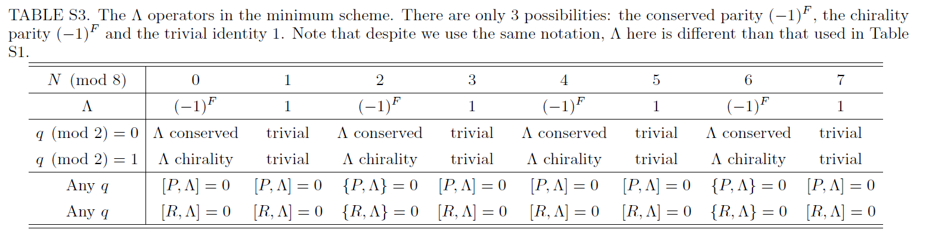

Slide 59
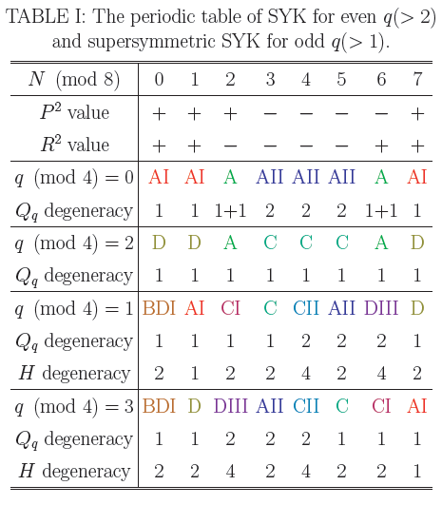
Periodic Table of SYK and supersymmetric SYK
in the minimum scheme
Bulk, edge
3 classes
3 classes
8 classes
8 classes
Two indices and the energy level deg

Slide 60
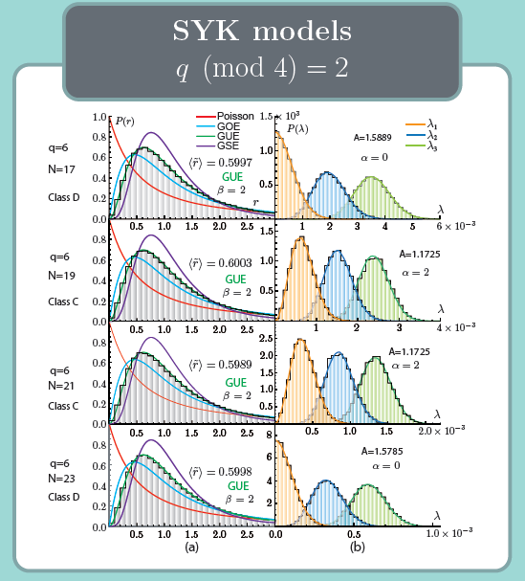

Slide 61
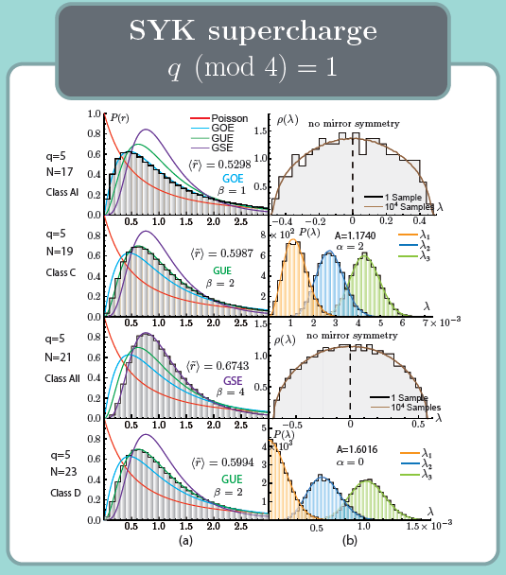

Slide 62
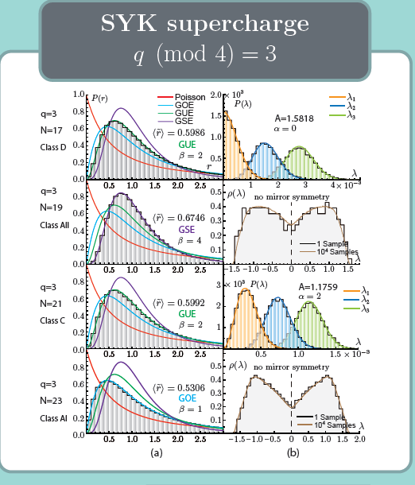

Slide 63
SYK models with .
All these results for both even and odd have been achieved before in
Y.-Z. You, A. W. W. Ludwig, and C. Xu, Phys. Rev. B 95, 115150 (2017)
Yi-Xiang Yu, Fadi Sun, Jinwu Ye and W.M. Liu, To appear in Phys. Rev. B
in the enlarged Hilbert space by adding an extra fermions at when is odd.
However, here we achieved the same results in the minimal Hilbert space in both even and odd in a unified scheme. Our new method maybe the most powerful and convenient way to achieve new results
in the other cases as shown in the following cases.

Slide 64
There is an evident dip at E=0 for the AI, AII class at N=23,19 respectively.
In fact, the dip always exists for q=3 at any
it disappears and gets back to the semi-circle law for q=7 at any
It was known that the DOS maybe
close to Gaussian when ,
close to be a semi-circle when
take a complicated form when
Many body DOS of SYK deviates from semi-circle law !
Or DOS of SYK deviates from RMT

Slide 65
Additional works ( SM in arXiv:1905.07694):
(B) Constructing the energy levels by anti-unitary operators in the minimum schem
(C) Classifying SYK models with odd N in enlarged
Hilbert space by adding a Majorana fermion at :
An alternative way to choose Majorana fermions:
(D) Counting the degeneracy of the supersymmetric SYK model in basis:
(E) It is tempting to put the complex SYK with even q and the SUSY SYK with odd q on the same periodic table

Slide 66
Short Summary:
We develop a systematic and unified random matrix theory to classify Sachdev-Ye-Kitaev (SYK) and
supersymmetric(SUSY) SYK models and also work out the structure of the energy levels in one periodic table.
The SYK with even q- and SUSY SYK with odd q- body interaction, N even or odd number of Majorana fermions are put on the same footing in the minimal Hilbert space, N mod 8 and q mod 4=0 double Bott periodicity are identified.

Slide 67
The most compact, systematic and complete classification method developed in this work can be applied to all kinds of generalizations of SYK models such as
Brownian SYK,
colored-SYK model,
two indices SYK model
SYK-like model with global symmetry.
colored (Gurau-Witten) Tensor model
uncolored (Klebanov-Tarnopolsky) tensor model
………
This is just putting more symmetries lead to more conserved quantities, also more operators, therefore generating more complicated periodic tables

Slide 68
Classical Black holes ( no hair theorem ) for asymptotically flat geometry
Classification of charge neutral quantum
black holes for asymptotically geometry ?
Hidden quantum numbers of black holes ???
************
The possible implications of our periodic table on the bulk gravity has been thoroughly presented in a very recent preprint
Douglas Stanford, Edward Witten, JT Gravity and the Ensembles of Random Matrix Theory， arXiv:1907.03363,
Witten’s talk in String 2019

Slide 69
1. The 3 distinct random matrix classes of the SYK models listed in Table 1 correspond to 3 variants of Jackiw-Teitelboim gravity theories in the bulk.
2. The 8 distinct random matrix classes of the supersymmetric SYK models listed in Table 1 correspond to 8 variants of Jackiw-Teitelboim supergravity theories in the bulk.
Douglas Stanford, Edward Witten, JT Gravity and the Ensembles of Random Matrix Theory， arXiv:1907.03363
Witten’s talk in String 2019

Slide 70
(1) Time-reversal symmetry P in the boundary theory means that unorientable spacetimes must be considered in the bulk. A new parameter " torsion " need to be introduced to compute the partition function.
(2) Presence of fermions in the boundary theory (and thus a symmetry ) means that the bulk has a spin or pin structure.
(3) The Supersymmetry in the boundary means that the bulk theory is associated to JT supergravity and is related to the volume of the moduli space of super Riemann surfaces rather than of ordinary Riemann surfaces.
Even or odd are discussed at the same footing in our periodic table. Its impacts in the bulk gravity side was also discussed in the Witten’s work.

Slide 73
2. Quantum analog of Kolmogorov-Arnold-Moser theorem and and bulk-edge correspondence in Fock space in hybrid Sachdev-Ye-Kitaev models,
ArXiv:1809.07577, v2
Fadi Sun, Yi-Xiang Yu, Jinwu Ye and W.M. Liu,
Quantum analog of KAM theorem in hybrid SYK models
Majorana
Complex
We also take the four site indices are all different to keep the PH symmetry explicit at

Slide 74
OTOC by 1/N expansion versus RMT
Complex SYK with
Half-filling
1/N exp.
Low
Bulk
RMT
High
Level repulsion
Many body energy
level spacing
No quasi-particle
1/N exp.
Complex SYK with
No Level repulsion
Quasi-particle
denser than

Slide 75
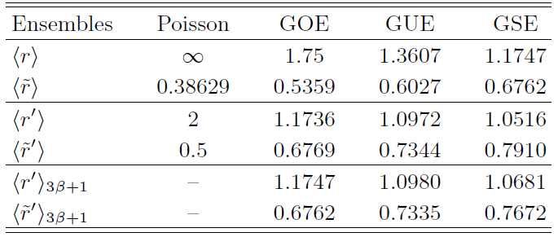
A new universal ratio in Random Matrix Theory
If there are nearly double degenerate energy levels, it is convenient to introduce next nearest-neighbor (NNN) spacings
An approximate but accurate relation:
For example,

Slide 76
The classical KAM theorem:
the classical Kolmogorov-Arnold-Moser (KAM) theorem states that
if an integrable Hamiltonian is disturbed by a small perturbation ,which makes the total Hamiltonian
non-integrable. If
(a) is sufficiently small
(b) the frequencies of are in-commensurate, then the system remains quasi-integrable.

Slide 77
We state the general form of a quantum KAM theorem from the RMT point of view:
Near the integrable limit of an incommensurate quantum many body system, when the energy level repulsion caused by a small chaotic perturbation is less than the average many-body energy spacing of the integrable system, the system remains quasi-integrable, so its ELS remains to be Possionian.
All the many-body energy levels in the integrable side are un-correlated.

Slide 78
Specifically, taking two nearest neighbour (NN) bulk energy states with the NN energy level spacing
One can write down the quantum chaotic matrix within the two NN energy levels subspace as
By a bulk energy level , we mean
the perturbed NN energy level spacing is:

Slide 79
is the diagonal energy shift
is the off-diagonal one
The diagonal shift does NOT change the ELS, only the off-diagonal does
Near any integral limit,
if one adds a conserved perturbation
the system remains integrable.
still induces a diagonal energy shift,
But not the off-diagonal one.

Slide 80
it is the off-diagonal one which introduces the level repulsion between the two NN levels, which, in turns, leads to the change of ELS to WD.
We conclude that when
the ELS stays Possionian, the quantum KAM applies.
We conjecture in most cases such as in SYK:

Slide 81
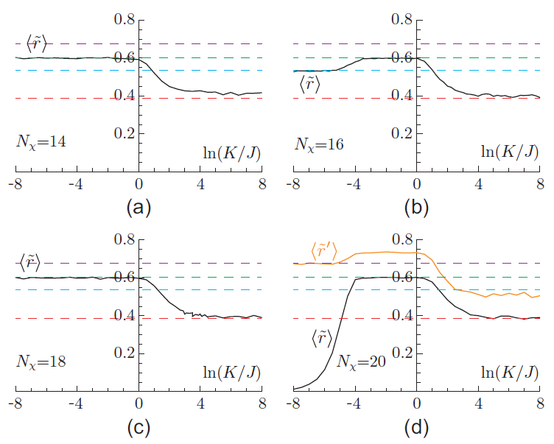
Chaotic to Integrable transition in hybrid Majorana SYK
Even N
GUE
GOE
GUE
GSE

Slide 82
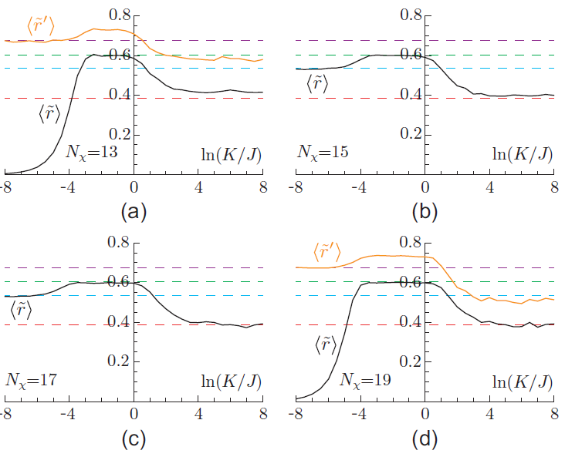
Odd N
GSE
GOE
GOE
GSE

Slide 83
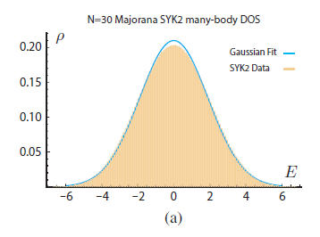
For the hybrid Majorana fermion SYK
the many body DOS satisfies a
Gaussian which has a variance
average bulk many body energy level spacing is
the naive quantum KAM theorem
This naive scaling matches well with the ED results

Slide 84
the dual KAM theorem
the stability of quantum chaos of the quantum chaotic q=4 SYK against an integrable perturbation
the bandwidth is where is the ground state energy per site in the unit of
the average many body energy level spacing is:
The naive lower bound of the dual form of the KAM takes
This naive lower bound could be made larger !

Slide 85
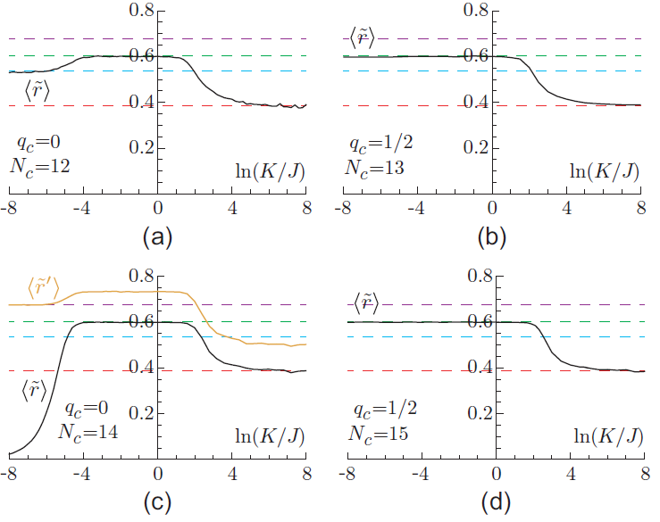
Chaotic to integrable transition in hybrid complex SYK
(CIT)
GUE
GOE
GSE
GUE

Slide 86
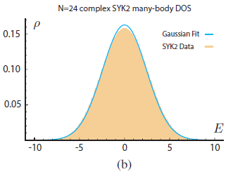
For the hybrid complex fermion SYK
at the half filling
the many body DOS satisfies a
Gaussian which has a variance
The size of the Hilbert space is
average bulk many body energy level spacing is
the naive quantum KAM theorem
This naive scaling matches well with the ED results

Slide 87
the dual KAM theorem
the stability of quantum chaos of the quantum chaotic q=4 complex SYK at half filling against an integrable perturbation
the bandwidth is where is the ground state energy per site in the unit of
the average many body energy level spacing is:
the naive lower bound of the dual form of the KAM takes
This naive lower bound can be made larger !

Slide 88
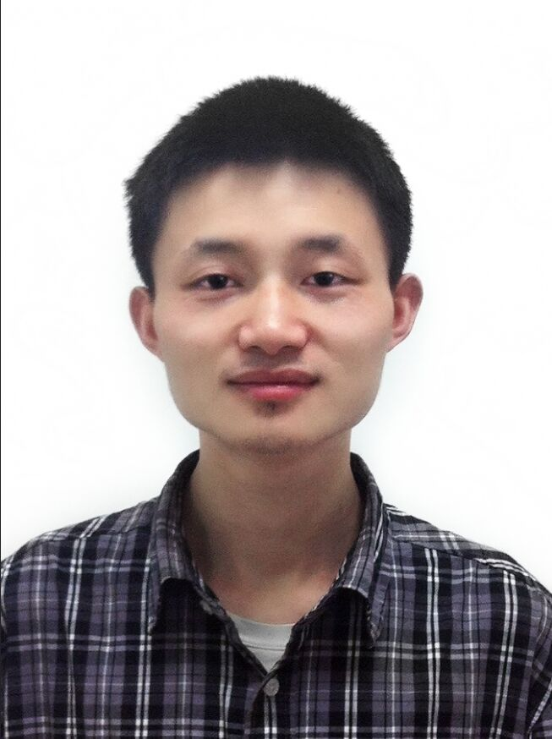
3. Classifications of quantum chaos in
colored Sachdev-Ye-Kitaev models,
Fadi Sun，Yi-Xiang Yu, Jinwu Ye and
W.M Liu，Phys. Rev. D 101, 026009 (2020).
Sun
Identify the maximal quantum numbers to characterize
the maximal symmetry is highly non-trivial !
Combining the 2- and 4-colored SYK models,
we find ( exhaust ) all ten symmetry classes.
K-theory Classifications on TI and TS, Kitaev, 2009

Slide 89
4. Quantum chaos and quantum information
scramblings In Cavity QED systems
Photon Berry phases, Instantons, Quantum chaos and quantum analog of Kolmogorov-Arnold-Moser (KAM) theorem in Dicke models
Yi-Xiang Yu, Jinwu Ye, Wuming Liu and CunLin Zhang,
arXiv:1903.02947
The Dicke model in cavity QED systems with N qubits:
A pure bosonic model
ELS stays Possion
There is a CNCT around
Possion
GOE
It is connected to transverse wormholes with a negative
Interaction !

Slide 90
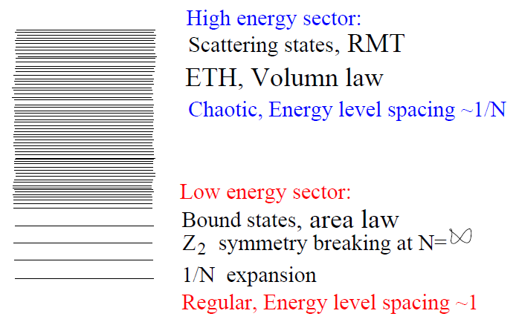
Energy levels at a given parity sector in the
Quantum Tunneling (QT) regime of the Dicke model
RMT
GOE
1/N exp.
Regular
High energy scattering states can be integrated out in finding these bounds states
Low energy bound states can be thrown away in
doing the ELS in the bulk !

Slide 91
In general,
the bulk energy levels have higher energies with small energy level spacings, while
the edge energy levels have lower energies with large energy level spacings.
This is indeed the case in the SYK and Dicke models
It is easy to find a gapless system which is
quantum chaotic ( such as any QCP ), but it is
Extremely rare to find one which is maximally
Chaotic ( which matches that of black hole )

Slide 92
The bulk edge correspondence in Fock space (BECFS)
Implications on:
1. CNCT versus QPT
2. Eigenstate Thermalization hypothesis (ETH)
3. Lyapunov exponents from OTOC

Slide 93
V. Possible Experimental realizations of SYK:
1.Danshita, M. Hanada, and M. Tezuka, Creating and probing the Sachdev-Ye
Kitaev model with ultracold gases: Towards experimental studies of
quantum gravity, Prog. Theor. Exp. Phys. 2017, 083I01 (2017).
2. D. I. Pikulin and M. Franz, Black Hole on a Chip: Proposal for a Physical Realization of the Sachdev-Ye-Kitaev Model in a Solid-State System, Phys. Rev. X 7, 031006 (2017).
3. A. Chew, A. Essin, and J. Alicea, Approximating the Sachdev-Ye-Kitaev model with Majorana wires, Phys. Rev. B 96, 121119 (2017).
,
In optical cavity
Photon Berry phases, Instantons, Quantum chaos and quantum analog of Kolmogorov-Arnold-Moser (KAM) theorem in the U(1)/Z_2 Dicke models
Yi-Xiang Yu, Jinwu Ye and CunLin Zhang, arXiv:1903.02947
Long-range quantum random Heisenberg model
Two indices Sachdev-Ye-Kitaev model
Jinwu Ye, ArXiv:1809.0667, substantailly revised version 2

Slide 94
Experimental measurements of OTOC and EE
Jun Li, et.al Jiangfeng Du,Measuring Out-of-Time-Order Correlators on a Nuclear Magnetic Resonance Quantum Simulator, Phys. Rev. X 7 031011 (2017).
Martin Grttner, at.al Measuring out-of-time-order correlations and multiple quantum spectra in a trapped ion quantum magnet, Nat Phys (2017).
Ken Xuan Wei, at.al , Exploring Localization in Nuclear Spin Chains, arXiv:1612.05249
M Cheneau, et.al, Light-cone-like spreading of correlations in a quantum many-body system, Nature (London) 481, 484 (2012);
Philip Richerme, et.al , Non-local propagation of correlations in quantum systems with long-range interactions, Nature (London) 511, 198 (2014);
P. Jurcevic, et.al,Quasiparticle engineering and entanglement propagation in a quantum many-body system, Nature (London) 511, 202 (2014).

Slide 95
Ordinary QCD instead of SUSY Yang-Millis
RMT: Lattice QCD/Nuclear Physics
S. M. Nishigaki, P. H. Damgaard, and T. Wettig,
Smallest Dirac eigenvalue distribution from random matrix theory,
Phys. Rev. D 58, 087704 (1998).
P. H. Damgaard and S. M. Nishigaki,
Distribution of the k-th smallest Dirac operator eigenvalue,
Phys. Rev. D 63, 045012 (2001
G. Akemann, E. Bittner, M. J. Phillips, and L. Shifrin,
Wigner surmise for Hermitian and non-Hermitian chiral random matrices,
Phys. Rev. E 80 065201 (2009).
RG, UV asymptotic freedom
What is the Lyapunov exponent
and butterfly velocity ?

Slide 96
Applied to many branches of physics:
String theory/quantum gravity/black holes
Lattice QCD/Nuclear Physics, AMO physics,
Condensed matter physics, topological phases
Eigenstate Thermalization Hyperthesis (ETH),
Tensor/Neutral networks
(DMRG/MPS)
AdS/CFT as a
Tensor network dS/Non-unitary CFT ?
Complexity, Deep Learning (DL)
AdS/DL
Other models in condensed matter systems, cold atoms and
quantum optical systems with maximally chaotic
Behaviors are absolutely welcome, but very difficult to realize
Thanks !

Slide 97
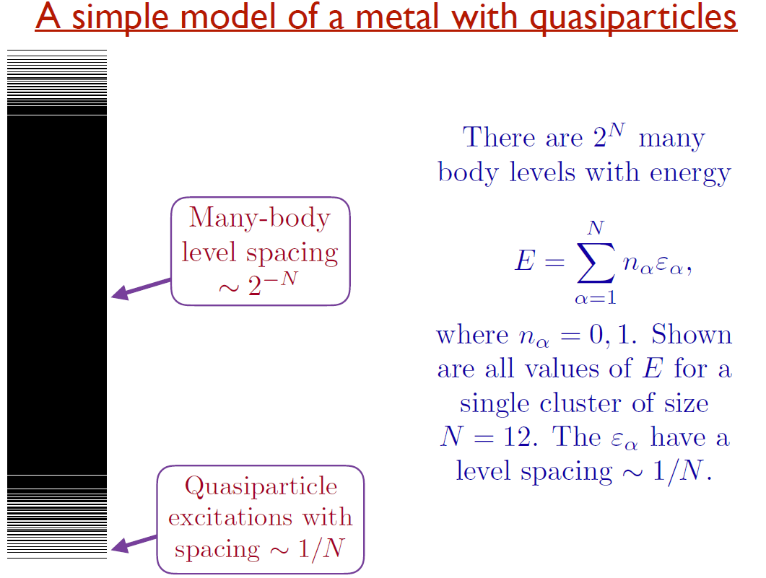
IV. Contrast 1/N with RMT
RMT
Chaotic
Half-filling
SYK
Exactly solvable
RMT
Integrable
RMT
Chaotic
Take from Sachdev’s ppt

Slide 98
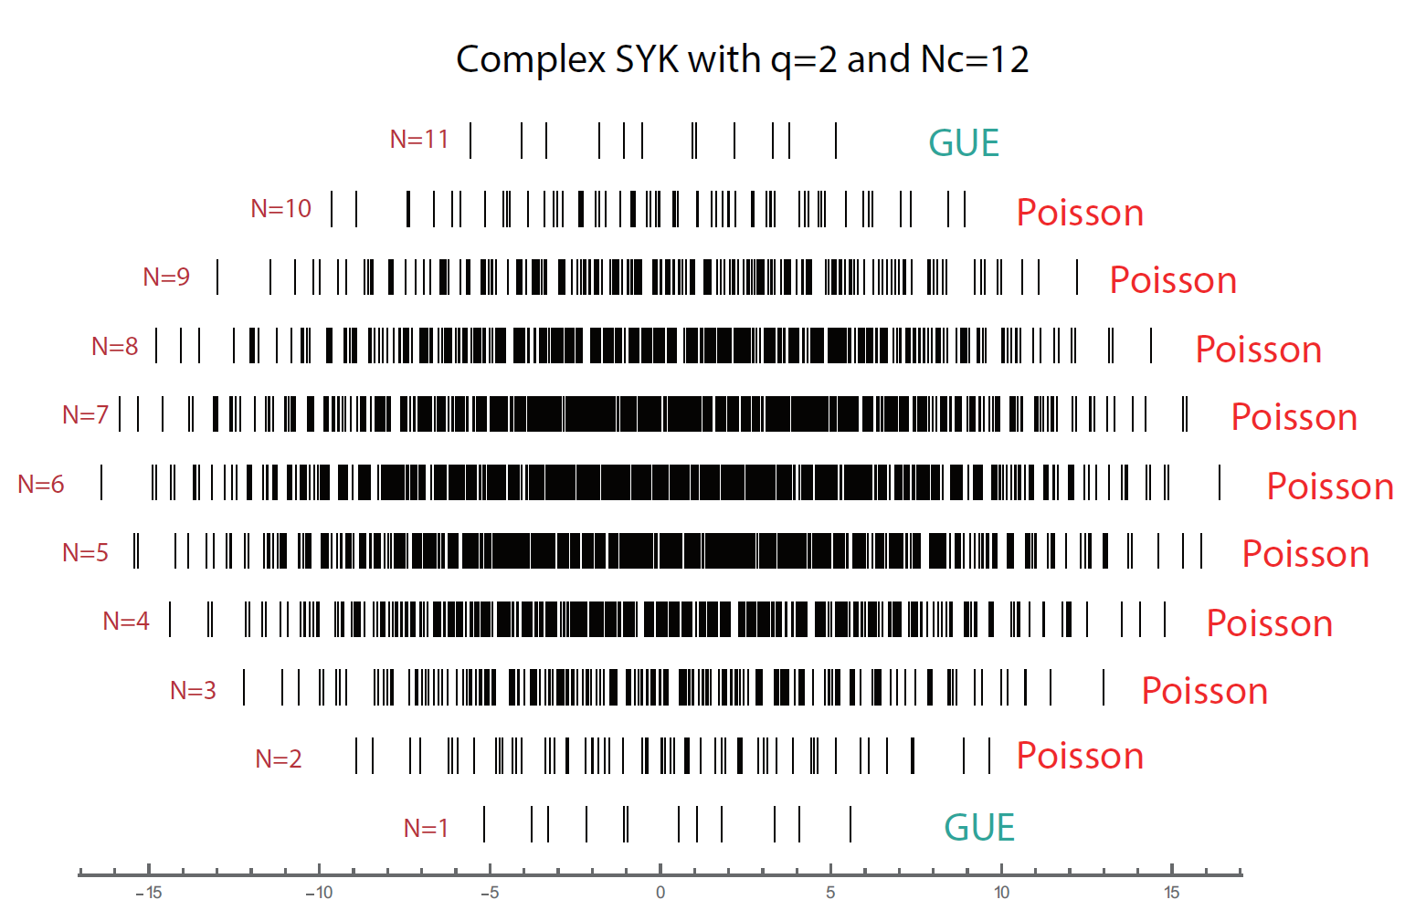
Exact Mirror symmetry at any given random realization

Slide 99
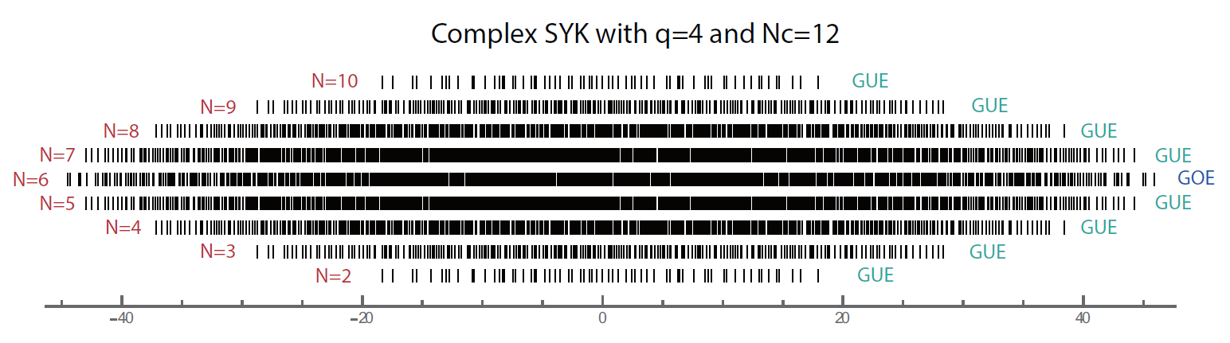
E=0, exact zero modes with degeneracy
At a large enough , it is self-averaging,
there is still an approximate mirror symmetry at any fillings

