Slide 1
T-invariant Decomposition and the Sign Problem in Quantum Monte Carlo Simulations
Congjun Wu
Kavli Institute for Theoretical Physics, UCSB
Reference: Phys. Rev. B 71, 155115(2005);
Phys. Rev. B 70, 220505(R) (2004);
Phys. Rev. Lett. 91, 186402 (2003).
Notes:
I am glad to take this opportunity to introduce our work on ‘A sufff’, by CW and SCZ, in collaboration with S. C.

Slide 2
Collaborators
S. Capponi, Université Paul Sabatier, Toulouse, France.
S. C. Zhang, Stanford.
Many thanks to D. Ceperley, D. Scalapino, J. Zaanen for helpful discussions.
Notes:
Let me thank my collaborators.

Slide 3

Overview of numeric methods
Quantum many-body problems are hard to solve analytically because Hilbert spaces grow exponentially with sample size. No systematic, non-perturbative methods are available at high dimensions.
Exact diagonalization: up to very small sample size.
Density matrix renormalization group: restricted one dimensional systems.
Quantum Monte-Carlo (QMC) is the only scalable method with sufficient accuracy at .
Notes:
1. QMC simulation plays an important role in studying the physics in strongly correlated systems.
However, in fermonic systems, QMC has the major difficulty of the sign problem.
When the sign problem appears, the statistical error scales exponentially as the inverse
of the temperature and the size of the sample. This makes the low T properties inaccessible.
2. Under some special conditions, the sign problem may disappear, such as in the
negative U Hubbard model, then MC can be preformed with high numerical accuracy.
In this talk, we will present a general criterion, a sufficient condition for absence of
the sign problem in the lattice auxiliary field QMC. This criterion is deeply related with the
T-reversal properties of the fermion determinant. We call it the time-reversal
invariant decomposition.
3. This criterion can be applied in a wide class of models at any doping level
and lattice geometry, including mutiband, and high spin Hubbard models.
In particular, we will use this method to show the existence of a 2D
staggered current phase in a bilayer model.

Slide 4
Outline
A sufficient condition for the absence of the sign problem.
The conclusive demonstration of a 2D staggered ground state current phase in a bilayer model.
Physics of the staggered current state.
Applications in spin 3/2 Hubbard model.
Notes:
We begin with the first part ‘ ……’
We first present the motivation of this project and show it is closely related He-B and ferro.

Slide 5
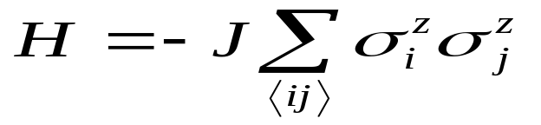

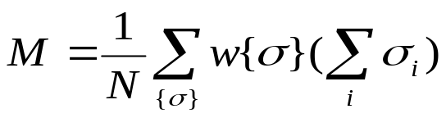
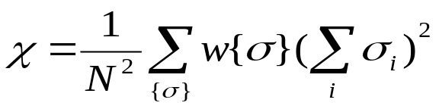

Classical Monte-Carlo: Ising model
Probability distribution:
Observables: magnetization and susceptibility.
Metropolis sampling:
Start from a configuration {s} with probability w({s}). Get a trial configuration by flipping a spin.
Calculate acceptance ratio: .
If r>1, accept it; If r<1, accept it wit the probability of r.
Notes:
1. QMC simulation plays an important role in studying the physics in strongly correlated systems.
However, in fermonic systems, QMC has the major difficulty of the sign problem.
When the sign problem appears, the statistical error scales exponentially as the inverse
of the temperature and the size of the sample. This makes the low T properties inaccessible.
2. Under some special conditions, the sign problem may disappear, such as in the
negative U Hubbard model, then MC can be preformed with high numerical accuracy.
In this talk, we will present a general criterion, a sufficient condition for absence of
the sign problem in the lattice auxiliary field QMC. This criterion is deeply related with the
T-reversal properties of the fermion determinant. We call it the time-reversal
invariant decomposition.
3. This criterion can be applied in a wide class of models at any doping level
and lattice geometry, including mutiband, and high spin Hubbard models.
In particular, we will use this method to show the existence of a 2D
staggered current phase in a bilayer model.

Slide 6
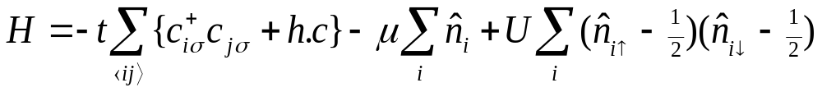
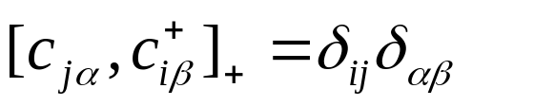
Fermionic systems
Strongly correlated fermionic systems: electrons in solids, cold atoms, nuclear physics, lattice gauge theory, QCD.
In particular, high T_{c} superconductivity: 2D Hubbard model in a square lattice.
How to sample fermionic fields, which satisfy the anti-commutation relation?
Notes:
1. QMC simulation plays an important role in studying the physics in strongly correlated systems.
However, in fermonic systems, QMC has the major difficulty of the sign problem.
When the sign problem appears, the statistical error scales exponentially as the inverse
of the temperature and the size of the sample. This makes the low T properties inaccessible.
2. Under some special conditions, the sign problem may disappear, such as in the
negative U Hubbard model, then MC can be preformed with high numerical accuracy.
In this talk, we will present a general criterion, a sufficient condition for absence of
the sign problem in the lattice auxiliary field QMC. This criterion is deeply related with the
T-reversal properties of the fermion determinant. We call it the time-reversal
invariant decomposition.
3. This criterion can be applied in a wide class of models at any doping level
and lattice geometry, including mutiband, and high spin Hubbard models.
In particular, we will use this method to show the existence of a 2D
staggered current phase in a bilayer model.

Slide 7
Auxiliary Field QMC
Blankenbecler, Scalapino, and Sugar. PRD 24, 2278 (1981)
Using path integral formalism, fermions are represented as Grassmann variables.
Transform Grassmann variables into probability.
Auxiliary field QMC
Probability:
positive number
Fermions:
Grassmann number
Decouple interaction terms using Hubbard-Stratonovich (H-S) bosonic fields.
Integrate out fermions and the resulting fermion functional determinants work as statistical weights.
Notes:
We first review the origin of the sign problem in the auxiliary field QMC algorithm.
The fermions are Grassmann variables which can not be directly sampled.
Instead, we decouple the interaction terms using H-S field …….
……….
This gives rise to the sign problem.

Slide 8
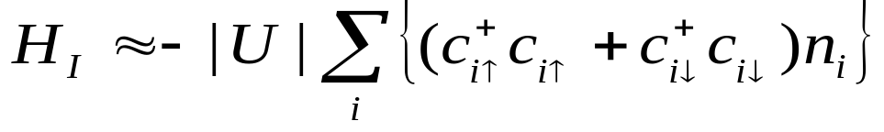
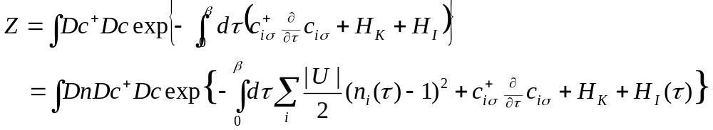
The Negative U Hubbard model(I)
H-S decoupling in the density channel: 4-fermion interaction→ quadratic terms.
H-S decoupling becomes exact by integrating over fluctuations.
Notes:
If we are lucky, the sign problem may disappear, such as in the negative U Hubbard model.
We decouple the interaction in the density channel, and integrate out the fermions.
I is the identity matrix, B is the imaginary time evolution operator.
Because the decoupling is performed in the density channel, the decoupled Hamiltonian
of the spin up and down parts are the same. As a result, the fermion determinant
can be factorized. As a square of a real number, the ferimon determinant is positive-definite.
However, generally, the fermion determinant may not be factorizable. Thus we need
a more general criterion to judge the disappearance of the sign problem.

Slide 9
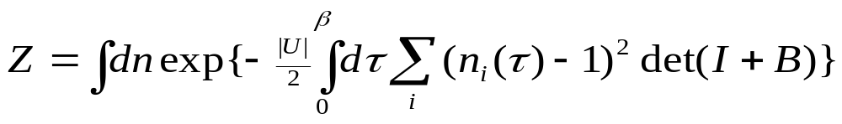
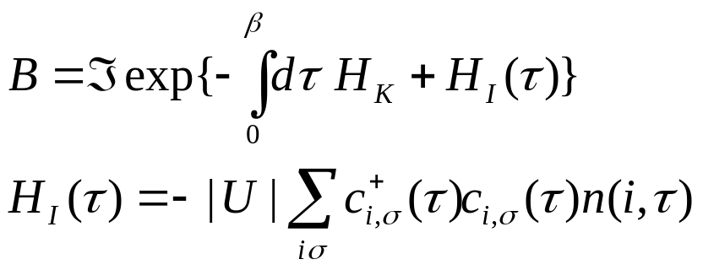
The Negative U Hubbard model(II)
Integrating out fermions: det(I+B) as statistical weight.
B is the imaginary time evolution operator.
Factorization of det(I+B): no sign problem.
Notes:
If we are lucky, the sign problem may disappear, such as in the negative U Hubbard model.
We decouple the interaction in the density channel, and integrate out the fermions.
I is the identity matrix, B is the imaginary time evolution operator.
Because the decoupling is performed in the density channel, the decoupled Hamiltonian
of the spin up and down parts are the same. As a result, the fermion determinant
can be factorized. As a square of a real number, the ferimon determinant is positive-definite.
However, generally, the fermion determinant may not be factorizable. Thus we need
a more general criterion to judge the disappearance of the sign problem.

Slide 10
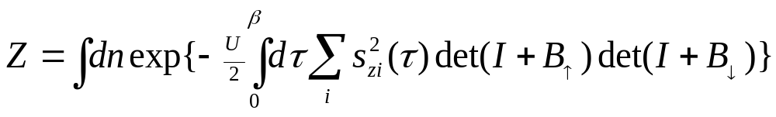
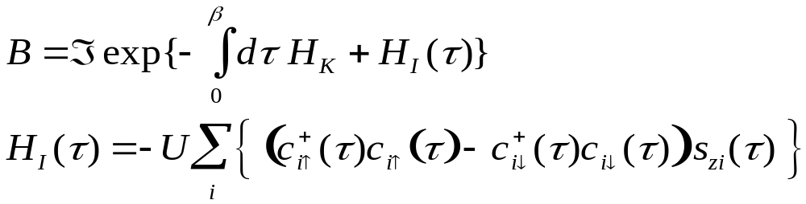


The Positive U Hubbard model
H-S decoupling in the spin channel.
Half-filling in a bipartite lattice (μ=0). Particle-hole transformation to spin down electron
no sign problem.
Notes:
If we are lucky, the sign problem may disappear, such as in the negative U Hubbard model.
We decouple the interaction in the density channel, and integrate out the fermions.
I is the identity matrix, B is the imaginary time evolution operator.
Because the decoupling is performed in the density channel, the decoupled Hamiltonian
of the spin up and down parts are the same. As a result, the fermion determinant
can be factorized. As a square of a real number, the ferimon determinant is positive-definite.
However, generally, the fermion determinant may not be factorizable. Thus we need
a more general criterion to judge the disappearance of the sign problem.

Slide 11
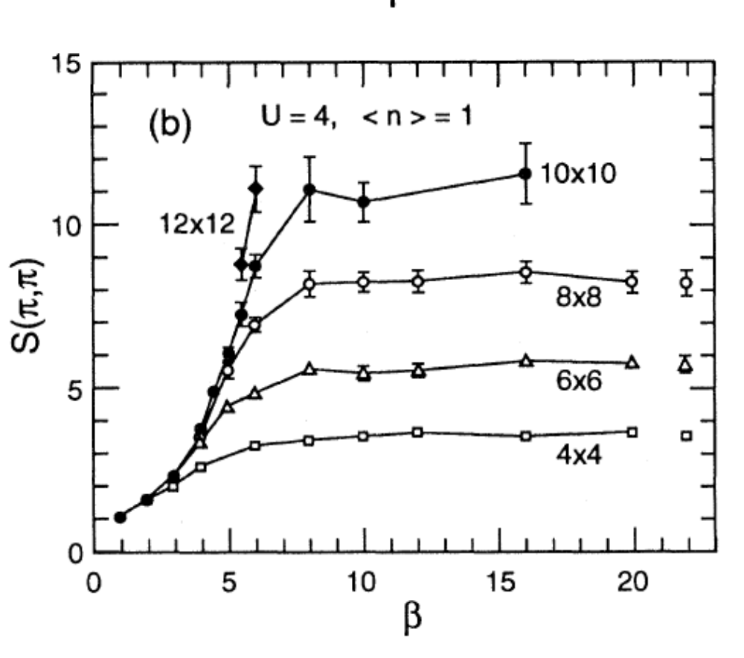
Antiferromagnetic Long Range Order at Half-filling
AF structure factor S(π,π) as a function of β=1/T for various lattice sizes. (White, Scalapino, et al, PRB 40, 506 (1989).
Notes:
If we are lucky, the sign problem may disappear, such as in the negative U Hubbard model.
We decouple the interaction in the density channel, and integrate out the fermions.
I is the identity matrix, B is the imaginary time evolution operator.
Because the decoupling is performed in the density channel, the decoupled Hamiltonian
of the spin up and down parts are the same. As a result, the fermion determinant
can be factorized. As a square of a real number, the ferimon determinant is positive-definite.
However, generally, the fermion determinant may not be factorizable. Thus we need
a more general criterion to judge the disappearance of the sign problem.

Slide 12
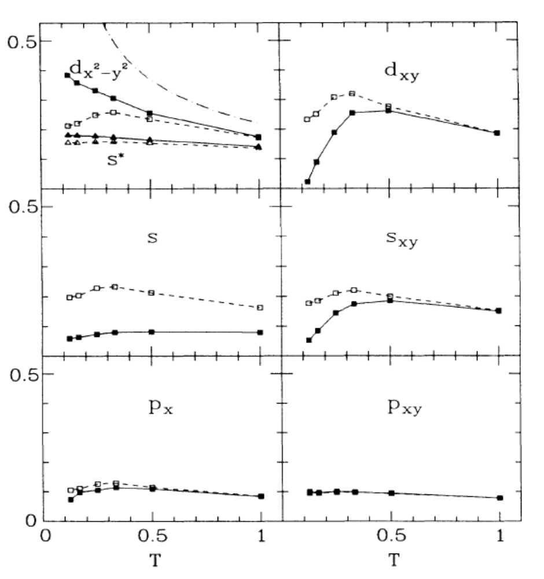
Pairing correlation at 1/8 filling
small size results:4*4 lattice
Pairing susceptibility in various channels.
Solid symbols are full pairing correlations.
Open symbols are RPA results.
(White, Scalapino, et al, PRB 39, 839 (1989).

Slide 13
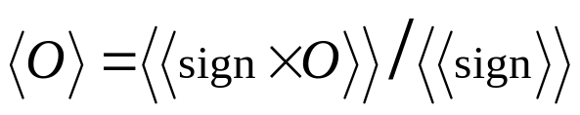
The sign (phase) problem!!!
Generally, the fermion functional determinants are not positive definite. Sampling with the absolute value of fermion functional determinants.
Huge cancellation in the average of signs.
Statistical errors scale exponentially with the inverse of temperatures and the size of samples.
Finite size scaling and low temperature physics inaccessible.
Notes:
1. QMC simulation plays an important role in studying the physics in strongly correlated systems.
However, in fermonic systems, QMC has the major difficulty of the sign problem.
When the sign problem appears, the statistical error scales exponentially as the inverse
of the temperature and the size of the sample. This makes the low T properties inaccessible.
2. Under some special conditions, the sign problem may disappear, such as in the
negative U Hubbard model, then MC can be preformed with high numerical accuracy.
In this talk, we will present a general criterion, a sufficient condition for absence of
the sign problem in the lattice auxiliary field QMC. This criterion is deeply related with the
T-reversal properties of the fermion determinant. We call it the time-reversal
invariant decomposition.
3. This criterion can be applied in a wide class of models at any doping level
and lattice geometry, including mutiband, and high spin Hubbard models.
In particular, we will use this method to show the existence of a 2D
staggered current phase in a bilayer model.

Slide 14
A general criterion: symmetry principle
Need a general criterion independent of factorizibility of fermion determinants.
The T (time-reversal) invariant decomposition.
Applicable in a wide class of multi-band and high models at any doping level and lattice geometry.
The bi-layer spin ½ models : staggered current phase
Reference: CW and S. C. Zhang cond-mat/0407272, to appear in Phys. Rev. B; C. Capponi, CW, and S. C. Zhang, Phys. Rev. B 70, 220505(R) (2004).
Notes:
1. QMC simulation plays an important role in studying the physics in strongly correlated systems.
However, in fermonic systems, QMC has the major difficulty of the sign problem.
When the sign problem appears, the statistical error scales exponentially as the inverse
of the temperature and the size of the sample. This makes the low T properties inaccessible.
2. Under some special conditions, the sign problem may disappear, such as in the
negative U Hubbard model, then MC can be preformed with high numerical accuracy.
In this talk, we will present a general criterion, a sufficient condition for absence of
the sign problem in the lattice auxiliary field QMC. This criterion is deeply related with the
T-reversal properties of the fermion determinant. We call it the time-reversal
invariant decomposition.
3. This criterion can be applied in a wide class of models at any doping level
and lattice geometry, including mutiband, and high spin Hubbard models.
In particular, we will use this method to show the existence of a 2D
staggered current phase in a bilayer model.

Slide 15
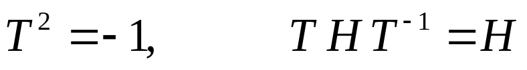
Digression: Time reversal symmetry
Kramers’ degeneracy in fermionic systems.
|f>, T|f> are degenerate Kramer doublets <f|T|f>=0.
Effects in condensed matter physics:
Anderson theorem for superconductivity;
Weak localization in disordered systems etc.
Notes:
1. QMC simulation plays an important role in studying the physics in strongly correlated systems.
However, in fermonic systems, QMC has the major difficulty of the sign problem.
When the sign problem appears, the statistical error scales exponentially as the inverse
of the temperature and the size of the sample. This makes the low T properties inaccessible.
2. Under some special conditions, the sign problem may disappear, such as in the
negative U Hubbard model, then MC can be preformed with high numerical accuracy.
In this talk, we will present a general criterion, a sufficient condition for absence of
the sign problem in the lattice auxiliary field QMC. This criterion is deeply related with the
T-reversal properties of the fermion determinant. We call it the time-reversal
invariant decomposition.
3. This criterion can be applied in a wide class of models at any doping level
and lattice geometry, including mutiband, and high spin Hubbard models.
In particular, we will use this method to show the existence of a 2D
staggered current phase in a bilayer model.

Slide 16

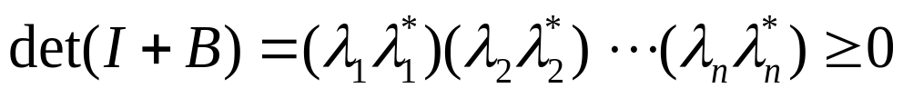
T-invariant decomposition
CW and S. C. Zhang, to appear in PRB, cond-mat/0407272; E. Koonin et. al., Phys. Rep. 278 1, (1997)
Theorem: If there exists an anti-unitary transformation T
for any H-S field configuration, then
Generalized Kramer’s degeneracy
I+B may not be Hermitian, and even not be diagonalizable.
Eigenvalues of I+B appear in complex conjugate pairs (λ, λ∗).
If λ is real, then it is doubly degenerate.
T may not be the physical time reversal operator.
Notes:
If the H-S decoupling can be performed in such a way, that there exists a anti-unitary
Transformation T. It satisfies T^2=-1, and it commutes with the decoupled Hamiltonian
for any configurations of HS fields. Then the determinant is positivie-definite.
This result is a generalized version of the Kramer’s degeneracy in quantum mechanics.
Because I+B involves the time-evolution operators, it may not be Hermitian, and even not
be diagonalizable at all. However, we still can show its eigenvalues appear in complex conjugate
Pairs. If lambda is its eigenvalue, then lambda star is also its eigenvalue. If lambda is real,
Then it is doubly degenerate.
As a product of all the eigenvalues, the fermion determinant is positive definite.
We also emphasize that T may not be the physical T operator at all.
As long as the above algebra is satisfied, it is fine.

Slide 17
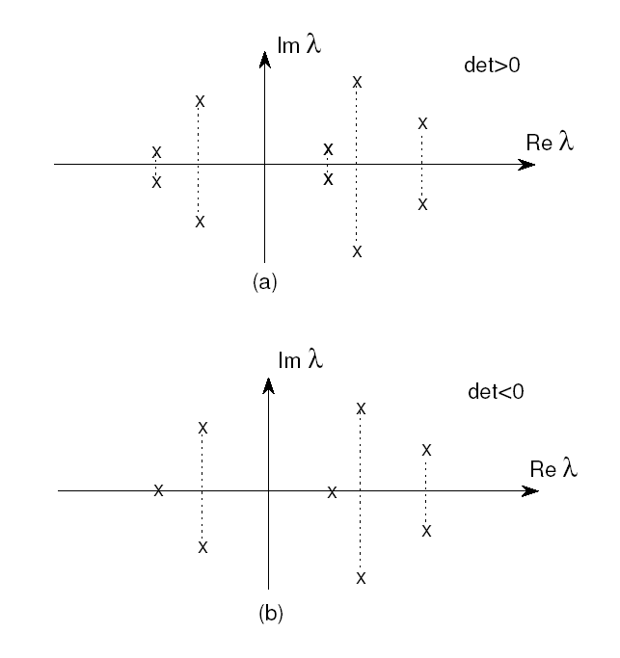
Distribution of eigenvalues

Slide 18
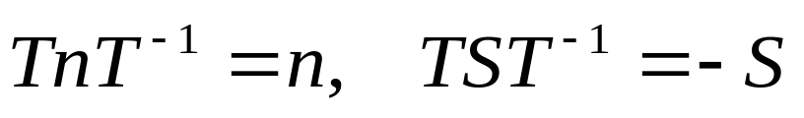
The sign problem in spin 1/2 Hubbard model
U<0: H-S decoupling in the density channel.
T-invariant decomposition → absence of the sign problem
U>0: H-S decoupling in the spin channel.
Generally speaking, the sign problem appears.
The factorizibility of fermion determinants is not required.
Validity at any doping level and lattice geometry.
Application in multi-band, high spin models.
Notes:
Now, we can look at the sign problem in the Hubbard model from this perspective.
In the U<0 case, the decoupling is performed in the density channel. Density is even
under T operation, thus the sign problem disappear.
In the U>0 case, the decoupling is performed in the spin channel. Spin is odd
Under T operation, thus generally speaking, the sign problem appears.
Although this criterion does not bring any new knowledge in the spin ½
case, it does not depend the factoriziability of the determinant, thus
can be applied a wide class of models, such as the multiband, high spin
models.

Slide 19
Outline
A sufficient condition for the absence of the sign problem.
The conclusive demonstration of a 2D staggered ground state current phase in a bilayer model.
Physics of the staggered current state.
Application in spin 3/2 Hubbard model.
Notes:
We begin with the first part ‘ ……’
We first present the motivation of this project and show it is closely related He-B and ferro.

Slide 20
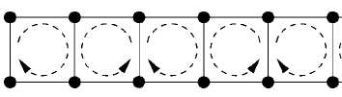
The ground state staggered current phase
D-density wave: mechanism of the pseudogap in high T_{c} superconductivity?
Chakravarty, et. al., PRB 63, 94503 (2000);
Affleck and Marston, PRB 37, 3774 (1988);
Lee and Wen, PRL 76, 503 (1996);
Staggered current phase in two-leg ladder systems.
Bosonization+renormalization group:
Lin, Balents and Fisher, PRB 58, (1998);
Fjarestad and Marston, PRB 65, (2002);
CW, Liu and Fradkin, PRB 68, (2003).
Numerical method: Density matrix renormalization group:
Marston et. al., PRL 89, 56404, (2002); U. Schollwöck et al., PRL 90, 186401, (2003).
Notes:
Recently, the staggered current phase has attracted much interest in strongly
correlated system.
In high Tc systems, the d-density wave scenario is proposed as the mechanism
for the pseudogap phenomenon.
%Another good example is the hidden order behavior in the heavy fermion compound URuSi.
%The mysterious transition at 17K has been interpreted as the incommensurate orbit current phase.
Due its relative simplicity , the quasi 1D two-leg ladder system provides an ideal test ground.
Both analytic bosonization method and numeric method of DMRG are available to show
the existence of such phase.

Slide 21
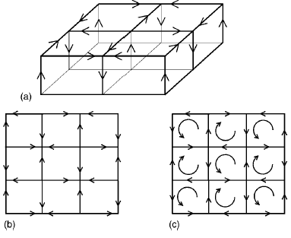
Application: staggered current phase in a bilayer model
Conclusive results: Fermionic QMC simulations without the sign problem.
2D staggered currents pattern: alternating sources and drains; curl free v.s. source free
T=Time reversal operation
*flipping two layers
top view d-density wave
S. Capponi, C. Wu and S. C. Zhang, PRB 70, 220505 (R) (2004).
Notes:
Now let’s see a concrete example. Using this criterion, we determine the parameter
Regime where the sign problem disappears in the bi-layer model. Furthermore, we
Conclusively demonstrate the existence of a staggered current phase in such model.
The current pattern looks like follows. On each rung, the current flow up, down alternatively.
For example, the current flows up, after reach the point, it flows outside, and then
the current converges at the neighboring site, and flows downward again.
If you look at it from the top, it has a s-wave pattern in contrast to the d-wave pattern of the DDW.
If you look at it from the side, it has the same pattern of the DDW.
This phase is invariant under the combined operation of the usual T and
the exchange of the two layers.

Slide 22







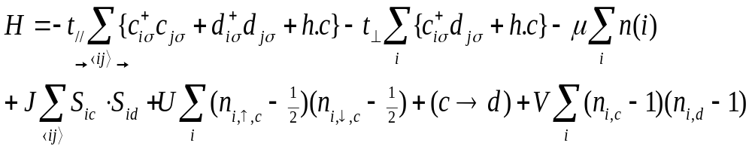
The bi-layer Scalapino-Zhang-Hanke Model D. Scalapino, S. C. Zhang, and W. Hanke, PRB 58, 443 (1998)
U, V, J are interactions within the rung.
No inter-rung interaction.
Notes:
The model we used is a bilayer generalization to the SZH model.
It is defined as follows: t//, tperp, U, V, J.
All the interactions are within the rung, there are no inter-rung interactions.

Slide 23




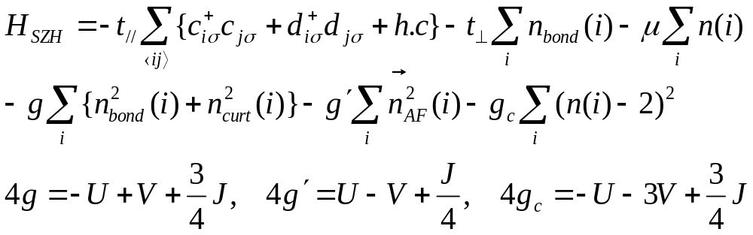
T-invariant decoupling (Time-reversal*flip two layers)
T-invariant operators: total density, total density;
bond AF, bond current.
When g, g’, g_{c}>0, T-invariant H-S decoupling→
absence of the sign problem.
.
Notes:
In order to do T-invariant decomposition, we first define the T operation as the product of the T and exchange
of two layers. We then construct the T-invariant operators within each rung.
They are rung bond strength, rung current, rung Neel order, the total charge density.
The bond strength and total charge density are even under both operations.
The bond Neel order and bond current operators are odd under both operations.
Thus all of them are even under the T operation.
Using these T-invariant operators, the SZH Hamiltonian can be rewritten as follows.
The coupling constants g, g’, gc are linear combinations of the U,V,J.
When g, g’, and gc are positive, the HS can be decoupled in a T-invariant way in
these channels, thus the sign problem disappears.

Slide 24
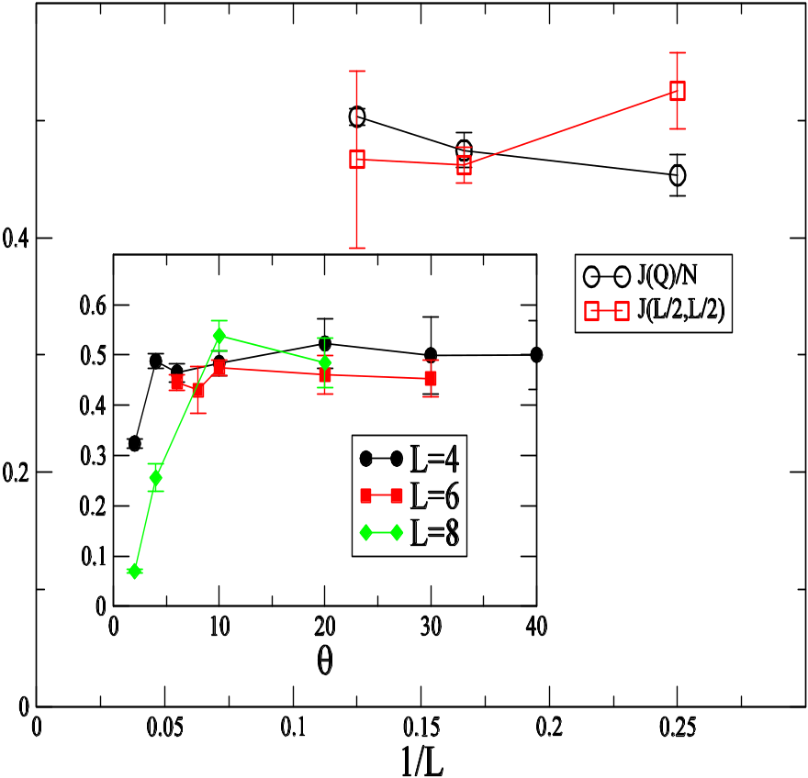
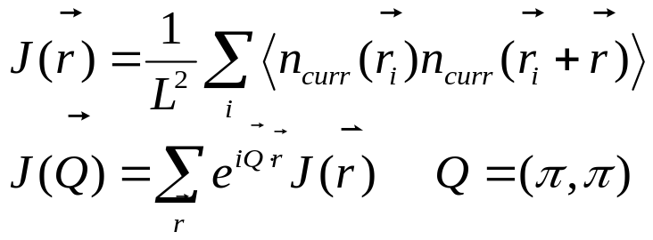
Fermionic auxiliary field QMC results at T=0K
The equal time staggered current-current correlations
Finite scaling of J(Q)/L² v.s. 1/L.
True long range order:
Ising-like order
S. Capponi, CW and S. C. Zhang, PRB 70, 220505 (R) (2004).
Notes:
Now we present the QMC field results. We defined the staggered rung current-current correlations as follows.
We simulate the model with this set of parameter values, and show the finite size scaling.
The simulations are done in a 4*4*2, 6*6*2, 8*8*2 size systems. You can see there is
almost no finite size effect. If we extrapolate the correlation function to the thermodynamic
limit, it saturates at a finite value, which means there exists a true long order.
It belongs to the Ising universal class.
The reason why the simulation can be performed at T=0K is the absence
Of the sign problem, which will be discussed in the next several slides.
We show the finite size scaling behavior of equal time
current-current correlation function v.s 1/L.
Simulations are done at 4*4, 6*6 and 8*8 systems. We can see the finite
size effect is negligible, which means a long range order at the thermodynamic
limit.
On the other hand, if we increases tperp=0.5, Deleta E, and introducing dopings.
The staggered current phase is suppressed.
All these results agree with the above strong coupling analysis.
Normalization J(Q), so if there is long rang order, it gives a const part.
Otherwise it gives 1/L decay part.

Slide 25
Outline
A sufficient condition for the absence of the sign problem.
The conclusive demonstration of a 2D staggered ground state current phase in a bilayer model.
Physics of the staggered current state.
Application in spin 3/2 Hubbard model.
Notes:
We begin with the first part ‘ ……’
We first present the motivation of this project and show it is closely related He-B and ferro.

Slide 26
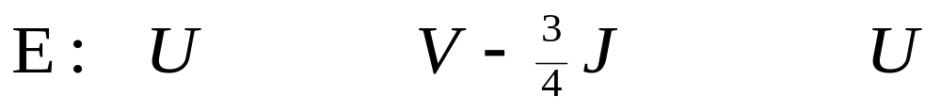
Strong coupling analysis at half-filling
The largest energy scale J>>U,V.
Project out the three rung triplet states.
+
Low energy singlet Hilbert space: doubly occupied states, rung singlet state.
=
-
Notes:
We first do the strong coupling analysis and assume the largest energy
scale is the Heisenberg exchange J. Although this assumption is a little
unphysical, it is the regime where we understand well and the staggered current exists.
We project out the three rung triplets and keep the three singlet states
as the low energy Hilbert space.
They doubly occupied states and the rung singlet state.

Slide 27
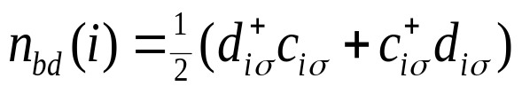







Pseudospin SU(2) algebra
The pseudospin SU(2) algebra v.s. the spin SU(2) algebra.
rung current
bond strength
cdw
Pseudospin-1 representation.
Rung current states
Notes:
6. We construct the psp algebra within each rung. It is formed by
the bond current, bond strength, cdw operators .
This psp algebra commutes with the usual spin SU(2) algebra.
These three singlets form the spin-1 Rep of this psp algebra,
Further they are eigenstates of the CDW operator.
The rung current current can be expressed as a superposition
of doubly occupied state and rung singlet state.

Slide 28
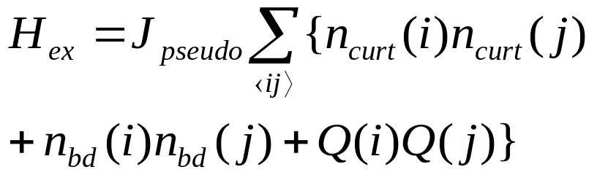
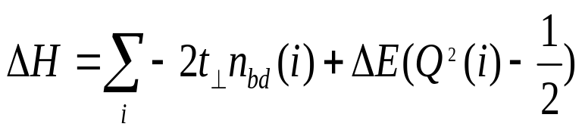


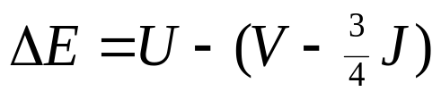

Pseudospin-1 AF Heisenberg Hamiltonian
t// induces pseudospin exchange.
Anisotropic terms break SU(2) down to Z₂ .
Notes:
The inter-rung hopping induces the super exchange process for the pseudospin.
The effective Hamiltonian can be described by the AF pseudo spin-1 Heisenberg
Model with anisotropic terms.
The intra-rung hopping behaves like uniform external B filed.
The delta E term is often called the ion-anisotropy term, which describes
the energy difference between the doubly occoupied state and rung singlet state.
We know the AF spin-1 model has the AF long-range order.
The intra-rung hopping term favors the easy plane of CDW and rung current.
A positive delta E favors the easy plane of bond order and rung current.
Consider these two factors together, we get an easy axis of staggered current.
The symmetry is reduced from SU(2) to Z_2.
However, the conditions for the staggered current phase is sutble.
tperp can not be too large, otherwise the system is polarized along tperp direction.
Delta E can not be two large either, otherwise the rung singlet state wins.

Slide 29
Competing phases
Neel order phases and rung singlet phases.
staggered current
staggered bond order
CDW
rung singlet
Notes:
Several phases compete within the above model, including the staggered
Current Phase, CDW and rung singlet.
We know the 2D AF spin-1 model has the long-range order.
The tperp term favors the easy plane of CDW and rung current.
A positive delta E favors the easy plane of bond order and rung current.
As a combined results, we get an easy axis of staggered current.
The symmetry is reduced from SU(2) to Z_2.
However, the conditions for the staggered current phase is very sutble.
tperp can not be too large, otherwise the pseudospin is polarized
along bond strength direction.
Delta E can not be two large either, otherwise the rung singlet state wins.

Slide 30


Competing phases
2D spin-1 AF Heisenberg model has long range Neel order.
favors the easy plane of staggered current and CDW.
favors the easy plane of staggered current and bond order.
SU(2)→Z₂
the easy axis of the staggered current
Subtle conditions for the staggered current phase.
is too large → polarized pseudospin along rung bond strength
is too large → rung singlet state
Notes:
Several phases compete within the above model, including the staggered
Current Phase, CDW and rung singlet.
We know the 2D AF spin-1 model has the long-range order.
The tperp term favors the easy plane of CDW and rung current.
A positive delta E favors the easy plane of bond order and rung current.
As a combined results, we get an easy axis of staggered current.
The symmetry is reduced from SU(2) to Z_2.
However, the conditions for the staggered current phase is very sutble.
tperp can not be too large, otherwise the pseudospin is polarized
along bond strength direction.
Delta E can not be two large either, otherwise the rung singlet state wins.

Slide 31
Fermionic auxiliary field QMC results at T=0K
The equal time staggered current-current correlations
Finite scaling of J(Q)/L² v.s. 1/L.
True long range order:
Ising-like order
S. Capponi, CW and S. C. Zhang, PRB 70, 220505 (R) (2004).
Notes:
Now we present the QMC field results. We defined the staggered rung current-current correlations as follows.
We simulate the model with this set of parameter values, and show the finite size scaling.
The simulations are done in a 4*4*2, 6*6*2, 8*8*2 size systems. You can see there is
almost no finite size effect. If we extrapolate the correlation function to the thermodynamic
limit, it saturates at a finite value, which means there exists a true long order.
It belongs to the Ising universal class.
The reason why the simulation can be performed at T=0K is the absence
Of the sign problem, which will be discussed in the next several slides.
We show the finite size scaling behavior of equal time
current-current correlation function v.s 1/L.
Simulations are done at 4*4, 6*6 and 8*8 systems. We can see the finite
size effect is negligible, which means a long range order at the thermodynamic
limit.
On the other hand, if we increases tperp=0.5, Deleta E, and introducing dopings.
The staggered current phase is suppressed.
All these results agree with the above strong coupling analysis.
Normalization J(Q), so if there is long rang order, it gives a const part.
Otherwise it gives 1/L decay part.

Slide 32
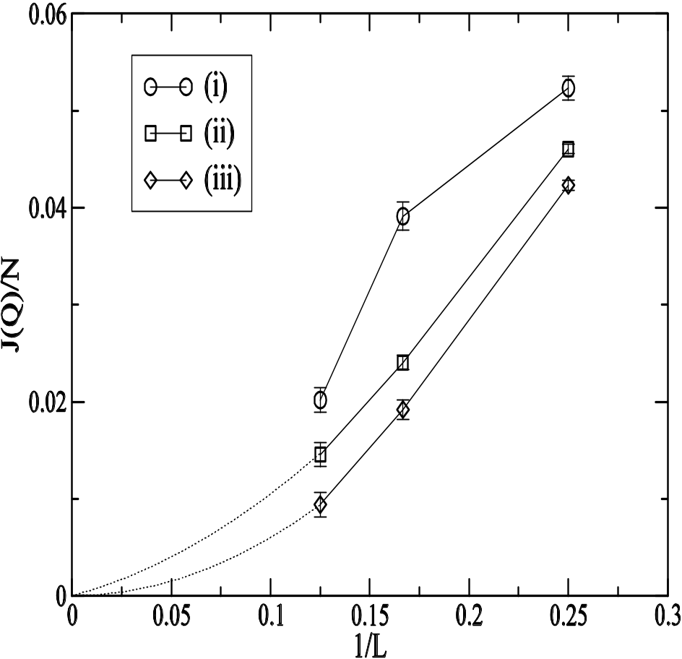
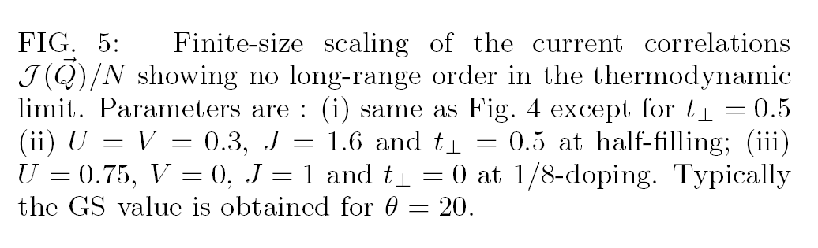
Disappearance of the staggered current phase
i) increase
ii) increase
iii) increase doping
Notes:
Now we present the QMC field result for the original fermionic model.
The reason why the simulation can be performed at T=0K is the absence
Of the sign problem, which will be discussed in the next several slides.
We show the finite size scaling behavior of equal time
current-current correlation function v.s 1/L.
Simulations are done at 4*4, 6*6 and 8*8 systems. We can see the finite
size effect is negligible, which means a long range order at the thermodynamic
limit.
On the other hand, if we increases tperp=0.5, Deleta E, and introducing dopings.
The staggered current phase is suppressed.
All these results agree with the above strong coupling analysis.
Normalization J(Q), so if there is long rang order, it gives a const part.
Otherwise it gives 1/L decay part.

Slide 33
Outline
A sufficient condition for the absence of the sign problem.
The conclusive demonstration of a 2D staggered ground state current phase in a bilayer model.
Physics of the staggered current state.
Application in spin 3/2 Hubbard model.
Notes:
We begin with the first part ‘ ……’
We first present the motivation of this project and show it is closely related He-B and ferro.

Slide 34
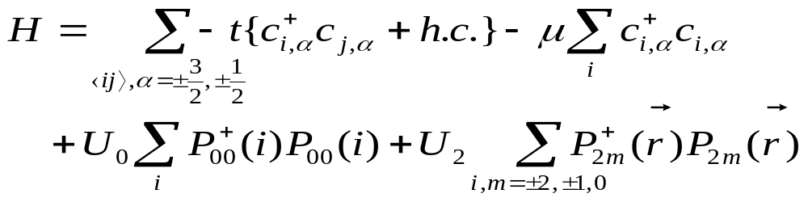
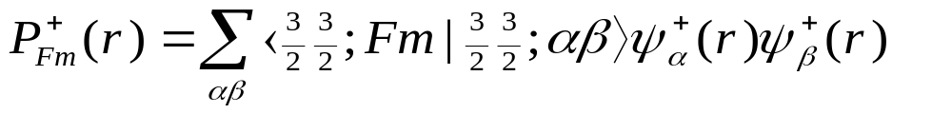
The spin 3/2 Hubbard model
The generic Hamiltonian with spin SU(2) symmetry.
F=0 (singlet), 2(quintet); m=-F,-F+1,…F.
Optical lattices with ultra-old atoms such as ¹³²Cs, ⁹Be, ¹³⁵Ba, ¹³⁷Ba.

Slide 35
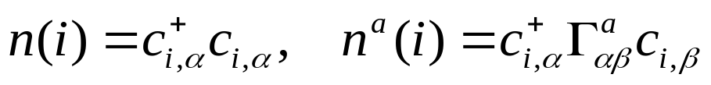
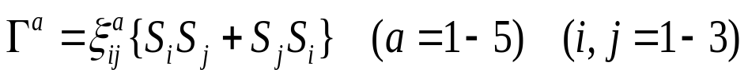

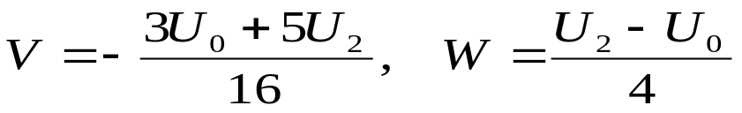
T-invariant decoupling in spin 3/2 model
T-invariant operators: density and spin nematics operators.
Five spin-nematics matrices = Dirac G matrices:
Explicit SO(5) symmetric form: Wu, Hu and Zhang, PRL91, 186402 (2003).
V, W>0→ absence of the sign problem.

Slide 36
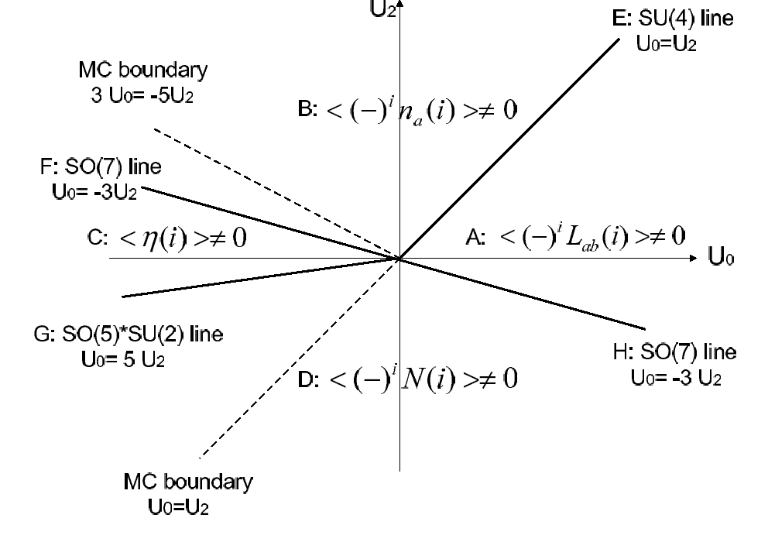
Application in spin 3/2 system

Slide 37
Summary
The “time-reversal” invariant decomposition criterion
for the absence of the sign problem.
Applications:
The bilayer spin 1/2 model→staggered current phase.
Other applications:
High spin Hubbard model;
Model with bond interactions: staggered spin flux phase
.

