Slide 1
Dissipationless quantum spin current
at room temperature
Shoucheng Zhang (Stanford University)
Collaborators:
Shuichi Murakami, Naoto Nagaosa
(University of Tokyo)
Science 301, 1348 (2003)
cond-mat/0310005
Funded by the NSF and DOE
PITP Meeting on Feb 1, 2004

Slide 2
Related refs:
J. Sinova et al, cond-mat/0307663.
D. Culcer et al, cond-mat/0309475.
S. Murakami, N. Nagaosa, and S.-C. Zhang, cond-mat/0310005.
J. Hu, B. A. Bernevig, and C. Wu, cond-mat/0310093.
J. Schliemann and D. Loss, cond-mat/0310108.
N. A. Sinitsyn et al, cond-mat/0310315.
Bernevig et al, cond-mat/0311024.
E. I. Rashba, cond-mat/0311110.
A.A. Burkov and A.H. MacDonald, cond-mat/0311328.
J. Inoue, G. Bauer and Molenkamp, to be posted.

Slide 3
Spintronics
The electron has both charge and spin.
Electronic logic devices today only used the charge property of the electron.
Energy scale for the charge interaction is high, of the order of eV, while the energy scale for the spin interaction is low, of the order of 10-100 meV.
Spin-based electronic promises a radical alternative, namely the possibility of logic operations with much lower power consumption than equivalent charge based logic operations.
Spin-based electronics also promises a greater integration between the logic and storage devices
Spintronics is also a field waiting for fundamental discoveries in new laws of physics!

Slide 4
Spintronic devices with semiconductors
spin injection into semiconductor
  Ohmic injection from ferromagnet Low efficiency
    (Difficulty):
    Ferromagnetic metal :
  conductivity mismatch
  → spin polarization is almost lost at interface.
    Ferromagnetic semiconductor (e.g. Ga_{1-x}Mn_{x}As) :
    Curie temperature much lower than room temp.
    Ferromagnetic tunnel junction.
spin detection by ferromagnet
spin transport in semiconductor
spin relaxation time
Optical pump and probe

Slide 5
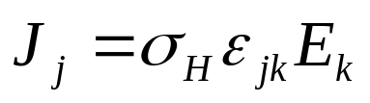
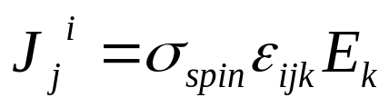
Quantum Hall effect in higher D?
Spin current generated by the electric field through the spin-orbit interaction
Since the spin is a vector, the spin current is a tensor. An electric field along the z direction can induce a spin current flowing along the x direction, where the spins are polarized along the y direction.
Murakami, Nagaosa and Zhang, Science, valence band
Sinova et al, cond-mat, conducting band

Slide 6
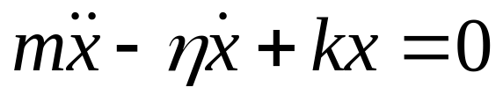
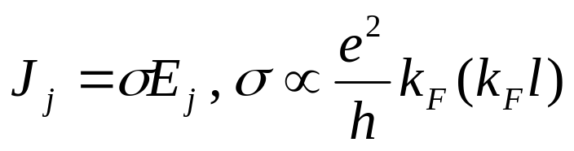
Time reversal symmetry and dissipative transport
Microscopic laws physics are T invariant.
Almost all transport processes in solids break T invariance due to dissipative coupling to the environment.
Damped harmonic oscillator:
Electric field=even under T, charge current=odd under T.
  Ohmic conductivity is dissipative!
Only states close to the fermi energy contribute to the dissipative transport processes.

Slide 7
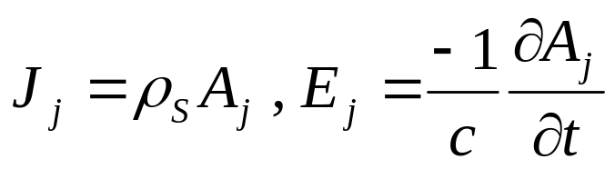
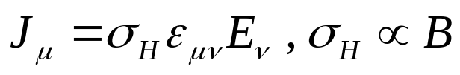
Only two known examples of dissipationless transport in solids!
Supercurrent in a superconductor is dissipationless, since London equation related J to A, not to E!
  Vector potential=odd under T, charge current=odd under T.
In the QHE, the Hall conductivity is proportional to the magnetic field B, which is odd under T.
  Laughlin argument: all states below the fermi energy contribute to the Hall conductance.
  Streda formula, TKNN formula relates the Hall conductance to the 1st Chern number.

Slide 8
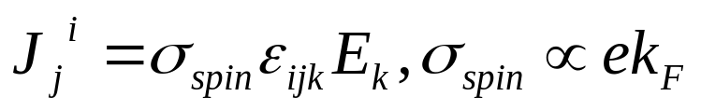
Dissipationless transport at room temperature?
Room temperature superconductivity?
QHE at room temperature would require a very high magnetic field!
The achieve dissipationless quantum transport at room temperature is the main objective of condensed matter physics!
Spin current=even under T.
  spin transport can be non-dissipative!
It works because of spin-orbit coupling, which can be large even at room temperature.
In fact, the spin conductivity is entirely topological, can be expressed as the integral of a gauge curvature in momentum space.
  Similar to Streda, or TKNN formula in QHE.

Slide 9
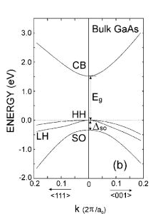
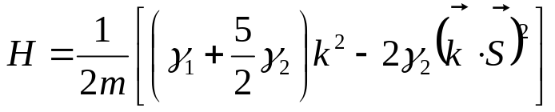

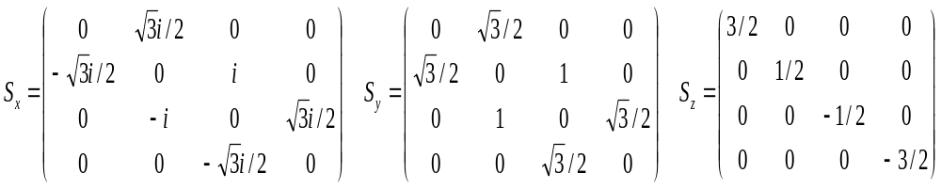
Valence band of GaAs
p-orbit (x,y,z)× spin ↑,↓= 6 states
split-off band (SO)
heavy-hole band (HH) doubly degenerate
light-hole band (LH) (Kramers)
+ spin-orbit coupling
Luttinger Hamiltonian
( : spin-3/2 matrix, describing the P_{3/2} band)

Slide 10
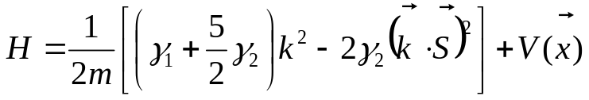



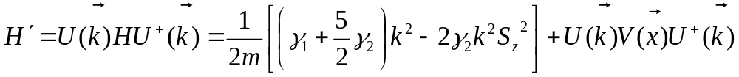

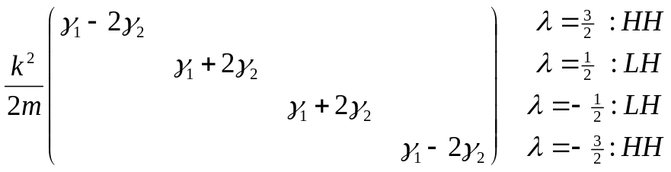
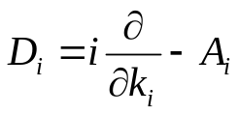
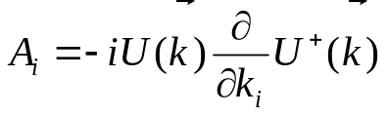
Unitary transformation
Diagonalize the first term with a local unitary transformation
Helicity basis
: gauge field in k!

Slide 11
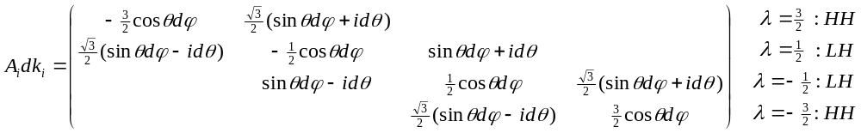

Local gauge field in k space
Adiabatic transport = potential V does not cause inter-band transitions
→ only retain the intra-band matrix elements
Abelian approximation = retain only the intra-helicity matrix elements

Slide 12
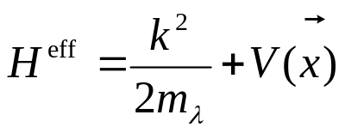
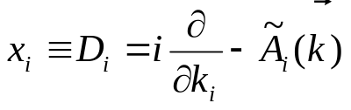
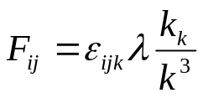
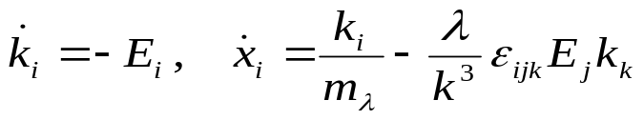
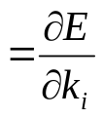
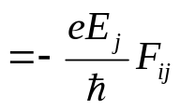
Effective Hamiltonian for adiabatic transport
Nontrivial spin dynamics comes from the
Dirac monopole at the center of k space, with
eg=λ:
(Dirac monopole)
Eq. of motion
Drift velocity
Topological term

Slide 13
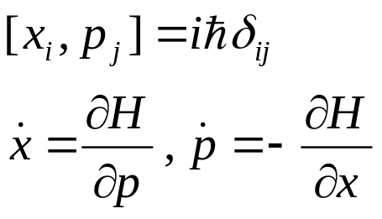
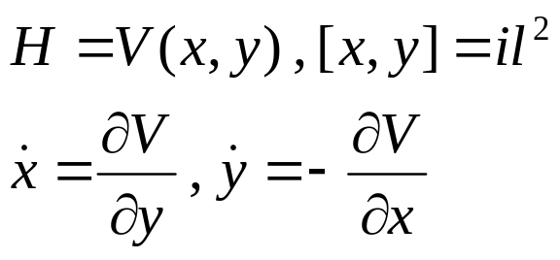
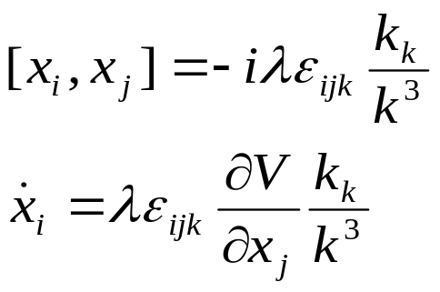
Non-commutative geometry
Heisenberg uncertainty principle:
Non-commutativity in phase space
2D QHE:
Non-commutativity in real space
3D spin current:
Non-commutativity in
Real/momentum space

Slide 14



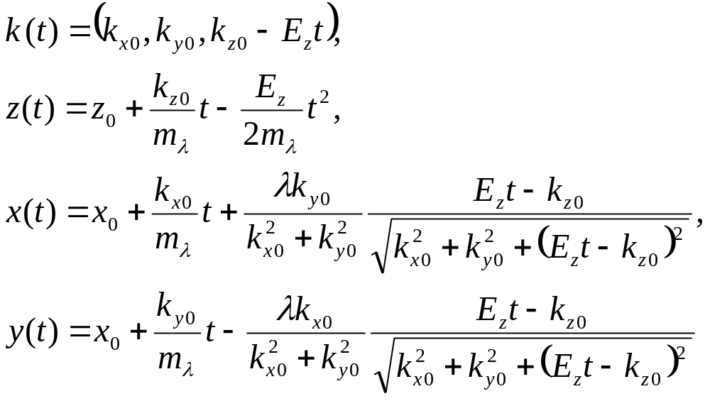




Real-space trajectory within Abelian approximation
Eq. of motion:
It can be integrated:
Hole spin

Slide 15





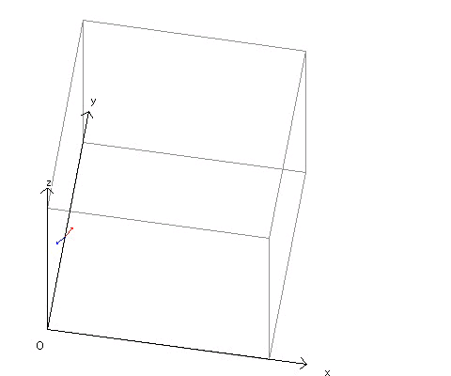
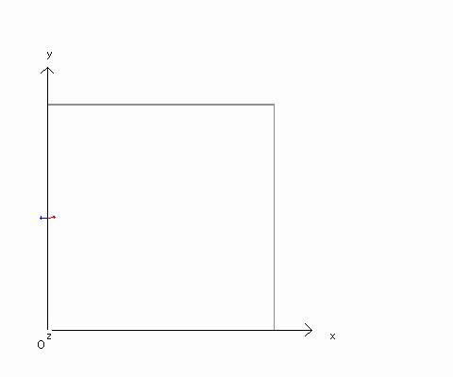

Real-Space trajectory for the HH band
Spin direction
( and : parallel)
( and : antiparallel)
3D motion
projection onto xy plane
: side-jump perpendicular to and

Slide 16
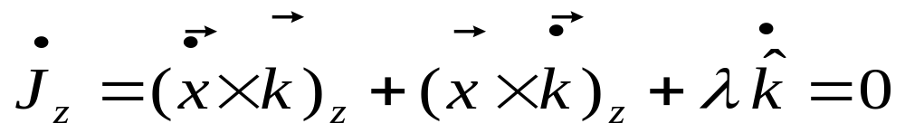
Conservation of total angular momentum
Total angular momentum:
In the presence of the E field, J_{z} is conserved.
The first term is the spin current, while the last term is proportional to the electric field. The spin current is therefore induced by the E field.

Slide 17
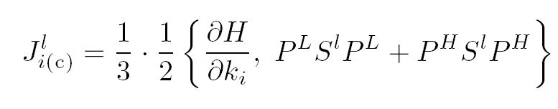
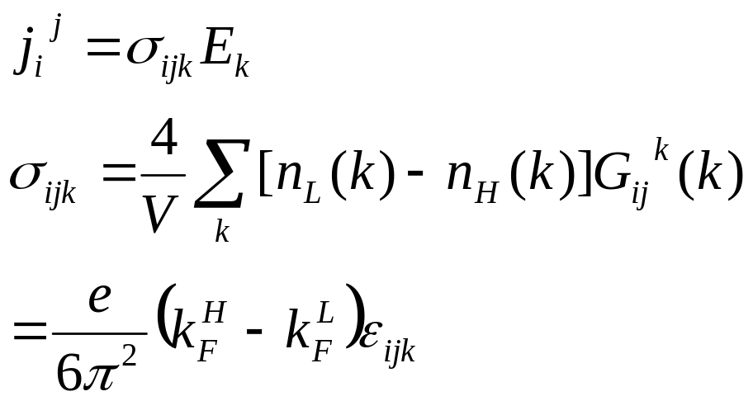
Full quantum calculation of the spin current based on Kubo formula
Definition of the conserved spin current in the presence of the spin orbit coupling:
Final result for the spin conductivity: (Similar to the TKNN formula for the QHE. Note also that it vanishes in the limit of vanishing spin-orbit coupling).

Slide 18
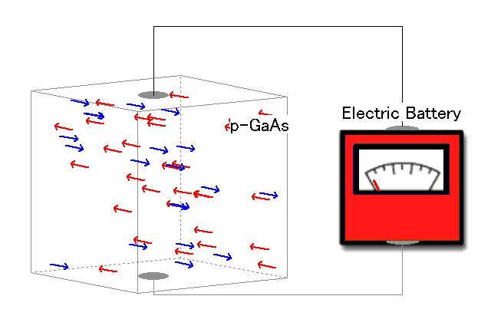
Dissipationless spin current induced by the electric field

Slide 19


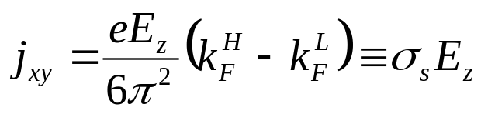


Spin current induced by an electric field
x: current direction
y: spin direction
z: electric field
GaAs
Direct Kubo formula calculation yields
essentially the same result.
SU(2) analog of the QHE
topological origin
dissipationless
All occupied states in the valence band contribute.
External electric field does not break time-reversal symmetry.
Spin current is allowed in this system with time-reversal symmetry

Slide 20
Application in spintronics : Effective source of spin currents
  At present, efficiency of spin injection is still very low.
  Electric-field-induced spin currents can overcome this difficulty!
Example:
Depending on the direction of magnetization of the ferromagnet, the voltage drop will change.
p-GaAs
Ferro.
V

Slide 21




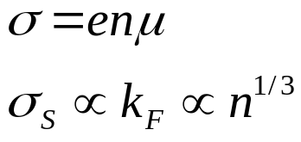


Order of magnitude estimate (at room temperature)
carrier density | mobility | Charge conductivity | Spin (Hall) conductivity
10¹⁹ | 50 | 80 | 73
10¹⁸ | 150 | 24 | 34
10¹⁷ | 350 | 5.6 | 16
10¹⁶ | 400 | 0.64 | 7.3
As the hole density decreases, both and decrease.
decreases faster than .

Slide 22


Spin accumulation and the rapid relaxation of hole spins
Spin relaxation time at RT:
hole : momentum relaxation
electron:
Because of strong spin-orbit coupling in the valence band, deviation of spin/momentum distribution away from equilibrium relaxes rapidly for holes.
Our spin current is free from this rapid relaxation, because
the spin/momentum distribution is in equilibrium.
(The spin current originates from anomalous velocity.)

Slide 23



Detection of spin current
(b) Measuring the circular polarization of emitted light by
attaching n-GaAs
Measuring the conductance difference by attaching ferromagnetic electrode
p-GaAs
GaAs
p-GaAs
(In,Ga)As
GaAs
ferro.
n-GaAs
I

Slide 24
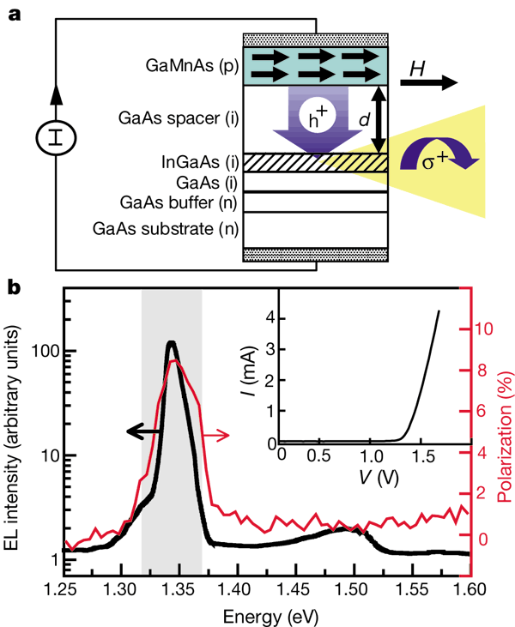
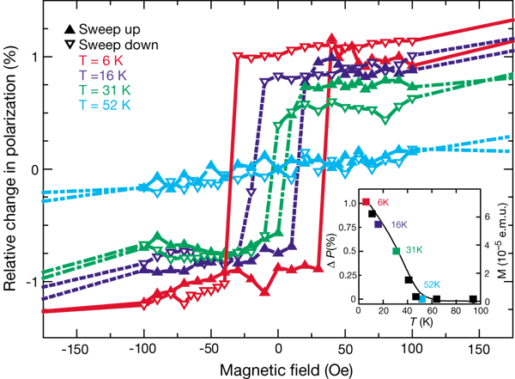
Spin injection by ferromagnetic semiconductor Ga_{1-x}Mn_{x}As
Ohno et al., Nature 402,790 (1999)

Slide 25





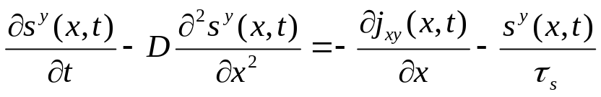
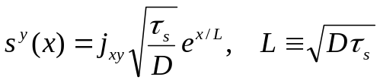



Spin accumulation at the boundary
p-GaAs
p-GaAs :
Spin current :
Diffusion eq.
Steady-state solution:
Total accumulated spins:

Slide 26









Detection of spin current by measuring accumulated spins
(c) Accumulation of hole spins
(d) Convert hole spins
into electron spins
p-GaAs
n-GaAs
p-GaAs
Charge current :
At room temperature:
At room temperature :
At 30K :

Slide 27
Conclusion & Discussion
A new type of dissipationless quantum spin transport, realizable at room temperature.
  Similar to the edge transport of the QHE. Can be viewed as the 3D edge transport of the 4D QHE.
  Topological origin, spin conductivity is an integral over the monopole field strength, over all states below the fermi energy.
Instrinsic spin injection in spintronics devices.
  Spin injection without magnetic field or ferromagnet.
  Spins created inside the semiconductor, no issues with the interface.
  Room temperature injection.
  Source of polarized LED.
Reversible quantum computation.

