Slide 1
Berry Phase Effects on Electronic Properties
Qian Niu
University of Texas at Austin
Collaborators:
D. Xiao, W. Yao, C.P. Chuu,
D. Culcer, J.R.Shi, Y.G. Yao, G. Sundaram, M.C. Chang,
T. Jungwirth, A.H.MacDonald, J. Sinova, C.G.Zeng, H. Weitering
Supported by : DOE, NSF, Welch Foundation

Slide 2
Outline
Berry phase and its applications
Anomalous velocity
Anomalous density of states
Graphene without inversion symmetry
Nonabelian extension
Polarization and Chern-Simons forms
Conclusion

Slide 3

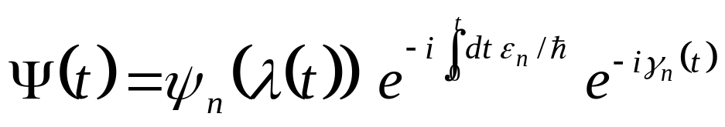
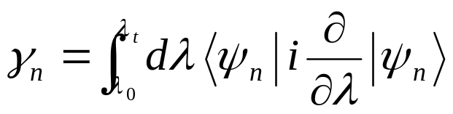




Berry Phase
In the adiabatic limit:
Geometric phase:

Slide 4
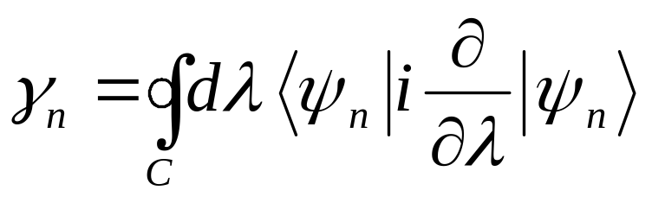
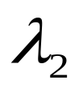

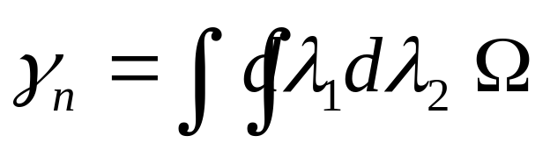

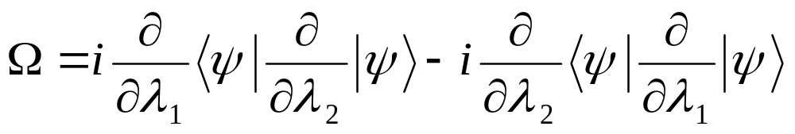
Well defined for a closed path
Stokes theorem
Berry Curvature

Slide 5


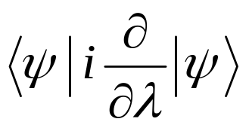

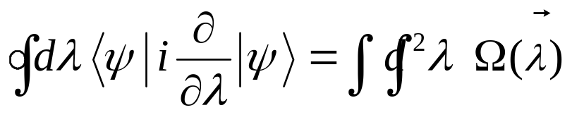
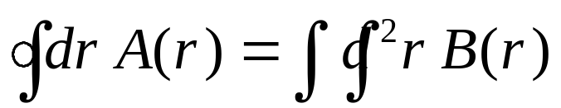
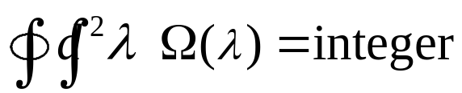
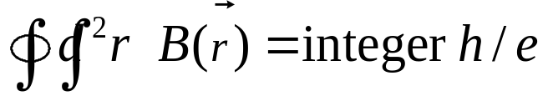
Analogies
Berry curvature Magnetic field
Berry connection Vector potential
Geometric phase Aharonov-Bohm phase
Chern number Dirac monopole

Slide 6
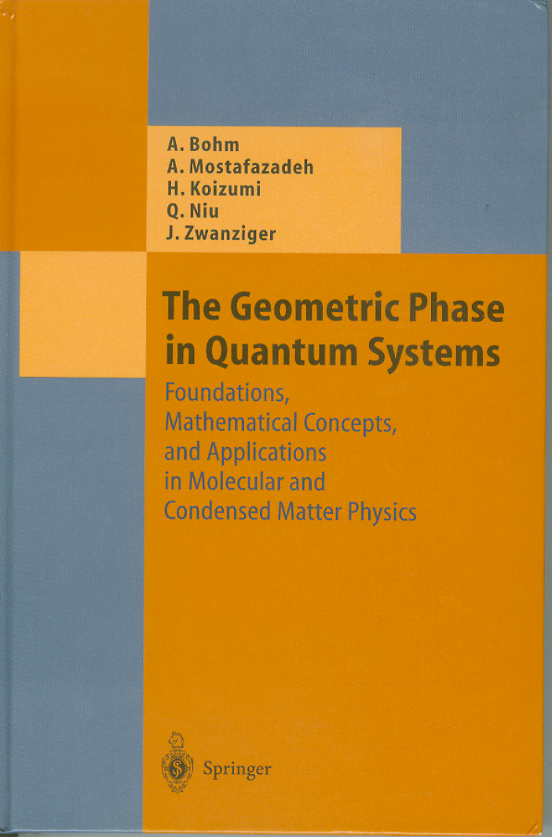
Applications
Berry phase
    interference,
    energy levels,
    polarization in crystals
Berry curvature
    spin dynamics,
    electron dynamics in Bloch bands
Chern number
    quantum Hall effect,
    quantum charge pump

Slide 7
Outline
Berry phase and its applications
Anomalous velocity
Anomalous density of states
Graphene without inversion symmetry
Nonabelian extension
Polarization and Chern-Simons forms
Conclusion

Slide 8
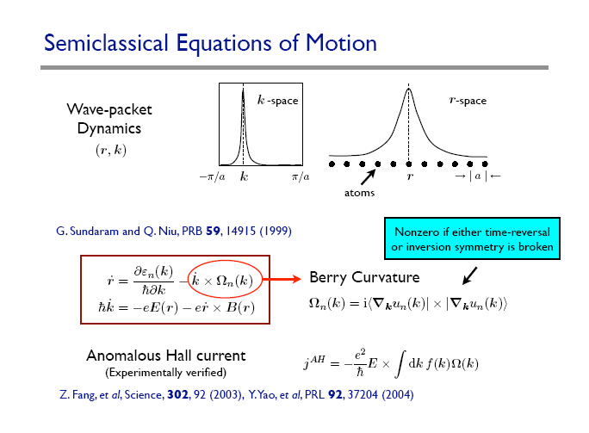

Slide 9

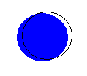
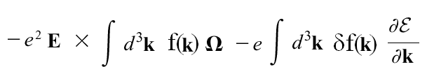
Anomalous Hall effect
velocity
distribution g( ) = f( ) + δf( )
current
Intrinsic

Slide 10
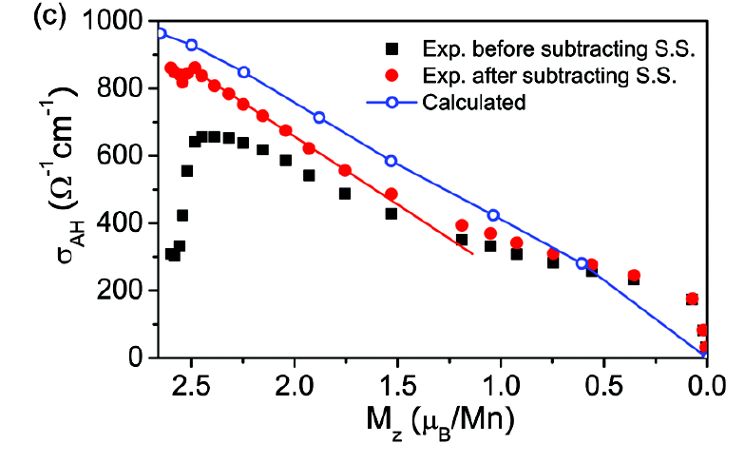
Recent experiment
Mn5Ge3 : Zeng, Yao, Niu & Weitering, PRL 2006

Slide 11
Intrinsic AHE in other ferromagnets
Semiconductors, Mn_{x}Ga_{1-x}As
  Jungwirth, Niu, MacDonald , PRL (2002)
Oxides, SrRuO₃
  Fang et al, Science , (2003).
Transition metals, Fe
  Yao et al, PRL (2004)
  Wang et al, PRB (2006)
Spinel, CuCr₂Se_{4-x}Br_{x}
  Lee et al, Science, (2004)

Slide 12
Outline
Berry phase and its applications
Anomalous velocity
Anomalous density of states
Graphene without inversion symmetry
Nonabelian extension
Polarization and Chern-Simons forms
Conclusion

Slide 13
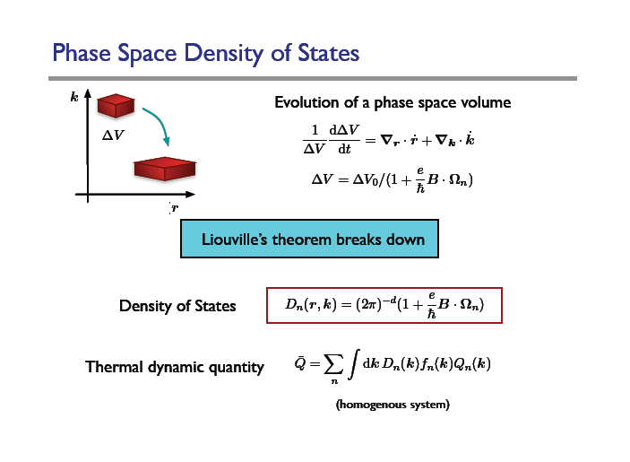

Slide 14

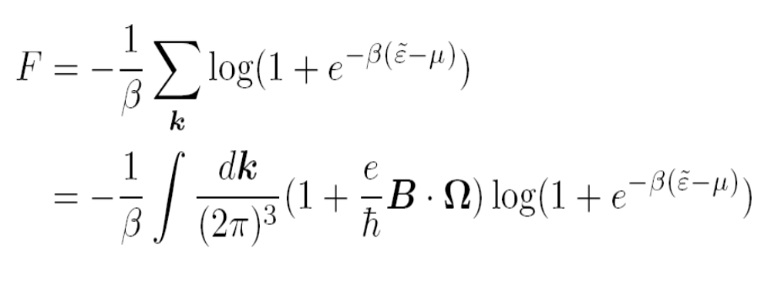
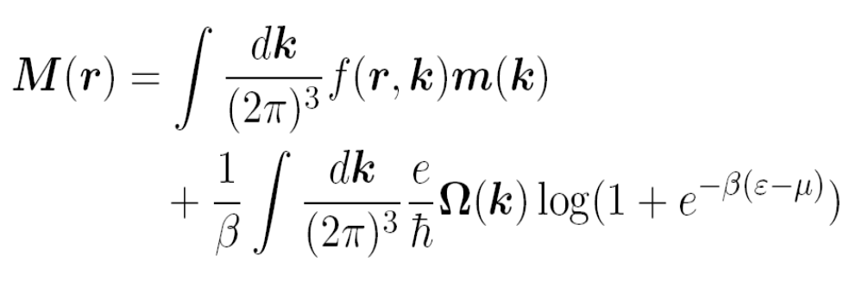
Orbital magnetization
Xiao et al, PRL 2005, 2006
Definition:
Free energy:
Our Formula:

Slide 15
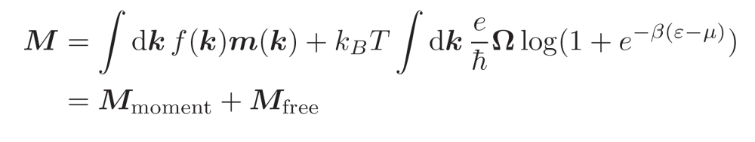
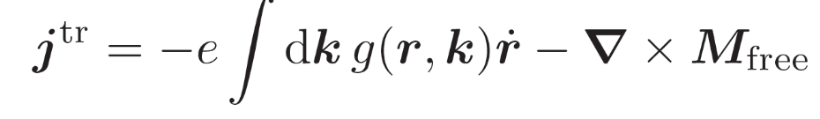
Anomalous Thermoelectric Transport
Berry phase correction to magnetization
Thermoelectric transport

Slide 16
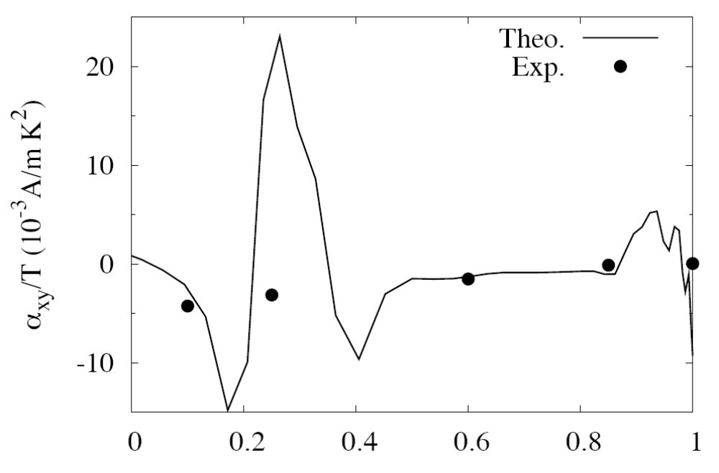
Anomalous Nernst Effect in CuCr₂Se_{4-x}Br_{x}
Lee, et al, Science 2004; PRL 2004, Xiao et al, PRL 2006

Slide 17
Outline
Berry phase and its applications
Anomalous velocity
Anomalous density of states
Graphene without inversion symmetry
Nonabelian extension
Polarization and Chern-Simons forms
Conclusion

Slide 18
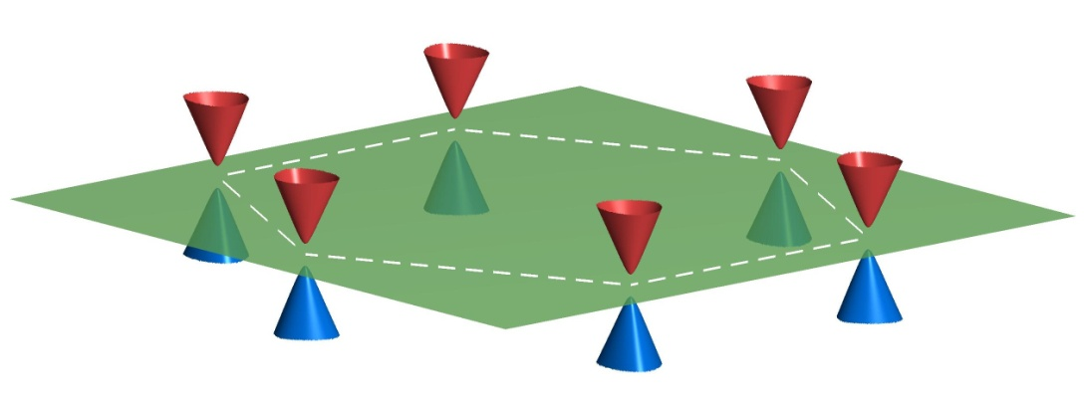
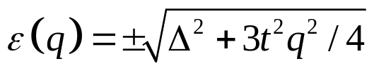
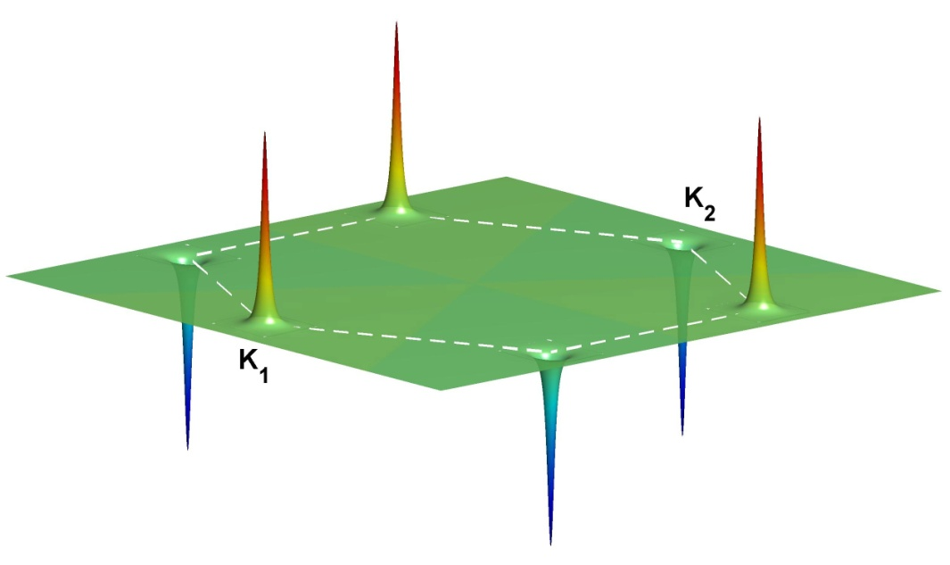
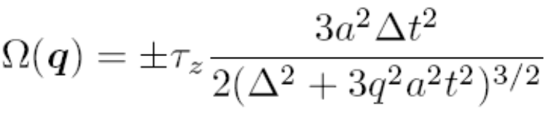
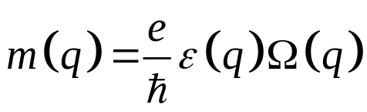
Graphene without inversion symmetry
Graphene on SiC: Dirac gap 0.28 eV
Energy bands
Berry curvature
Orbital moment

Slide 19




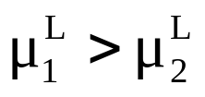
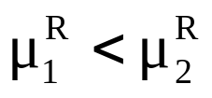
Valley Hall Effect
And edge magnetization
Left edge
Right edge
Valley polarization induced on side edges
Edge magnetization:

Slide 20
Outline
Berry phase and its applications
Anomalous velocity
Anomalous density of states
Graphene without inversion symmetry
Nonabelian extension
Quantization of semiclassical dynamics
Conclusion

Slide 21
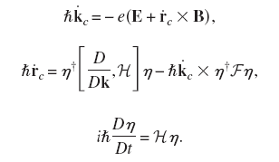

Degenerate bands
Internal degree of freedom:
Non-abelian Berry curvature:
Useful for spin transport studies
Cucler, Yao & Niu, PRB, 2005
Shindou & Imura, Nucl. Phys. B, 2005
Chuu, Chang & Niu, 2006

Slide 22
Outline
Berry phase and its applications
Anomalous velocity
Anomalous density of states
Graphene without inversion symmetry
Nonabelian extension: spin transport
Polarization and Chern-Simons forms
Conclusion

Slide 23
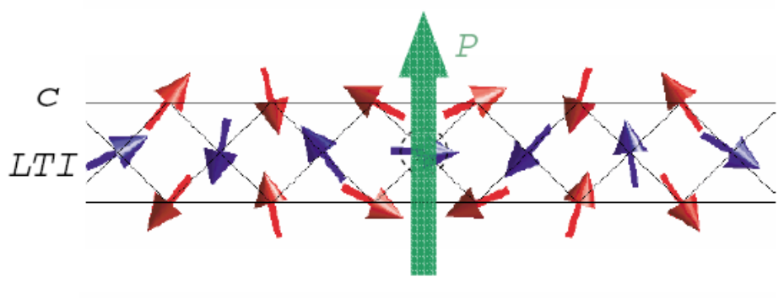
Electrical Polarization
A basic materials property of dielectrics
  To keep track of bound charges
  Order parameter of ferroelectricity
  Characterization of piezoelectric effects, etc.
A multiferroic problem: electric polarization induced by inhomogeneous magnetic ordering
G. Lawes et al, PRL (2005)

Slide 24
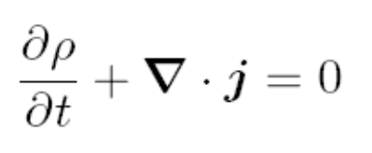
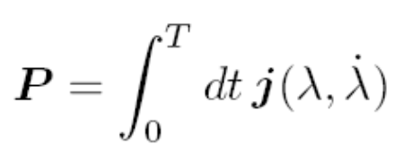


Polarization as a Berry phase
Thouless (1983): found adiabatic current in a crystal in terms of a Berry curvature in (k,t) space.
King-Smith and Vanderbilt (1993):
Led to great success in first principles calculations

Slide 25



Inhomogeneous order parameter
Make a local approximation and calculate Bloch states
A perturbative correction to the KS-V formula
A topological contribution (Chern-Simons)
|u>= |u(m,k)>, m = order parameter
Perturbation from the gradient

Slide 26
Conclusion
Berry phase
A unifying concept with many applications
Anomalous velocity
Hall effect from a ‘magnetic field’ in k space.
Anomalous density of states
Berry phase correction to orbital magnetization
anomalous thermoelectric transport
Graphene without inversion symmetry
valley dependent orbital moment
valley Hall effect
Nonabelian extension for degenerate bands
Polarization and Chern-Simons forms

