Slide 1
The Persistent Spin Helix
Shou-Cheng Zhang, Stanford University
Banff, Aug 2006

Slide 2
Credits
Collaborators:
B. Andrei Bernevig (Stanford)
Joe Orenstein (Lawrence Berkeley Lab)
Chris Weber (Lawrence Berkeley Lab)

Slide 3
Outline
Mechanisms of spin relaxation in solids
Exact SU(2) symmetry of spin-orbit coupling models
The Persistent Spin Helix (PSH)
Boltzmann equations
Optical spin grating experiments

Slide 4
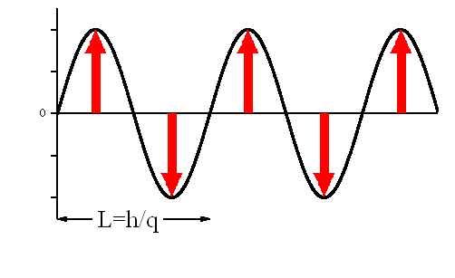
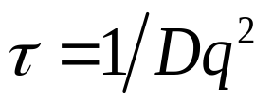
Spin Relaxation in Solids
Without SO coupling, particle diffusion is the only mechanism to relax the spin.

Slide 5


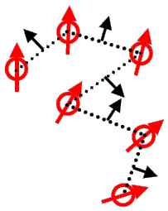



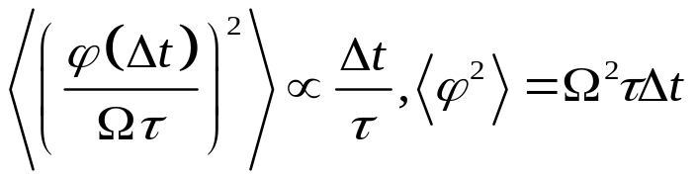
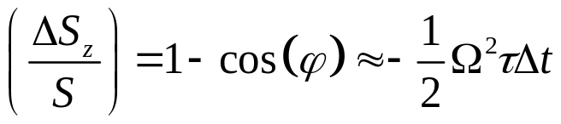
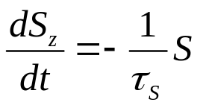
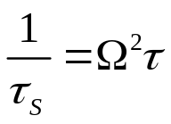
Spin Relaxation in Solids
With SO coupling, the dominant mechanism is the DP relaxation.
The spin-orbit field
Momentum relaxation time
The 2D random walk problem:
The effective reduction of Sz:

Slide 6
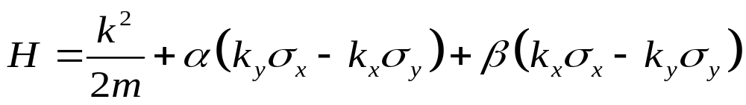
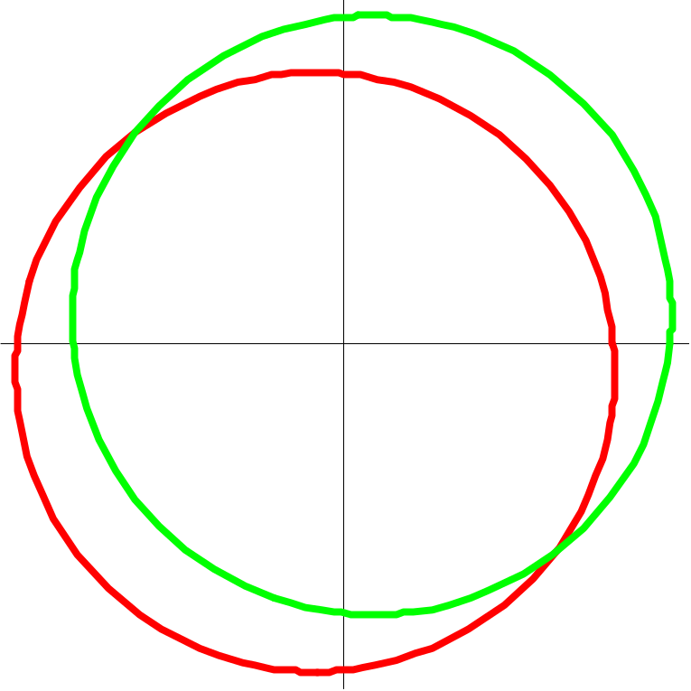
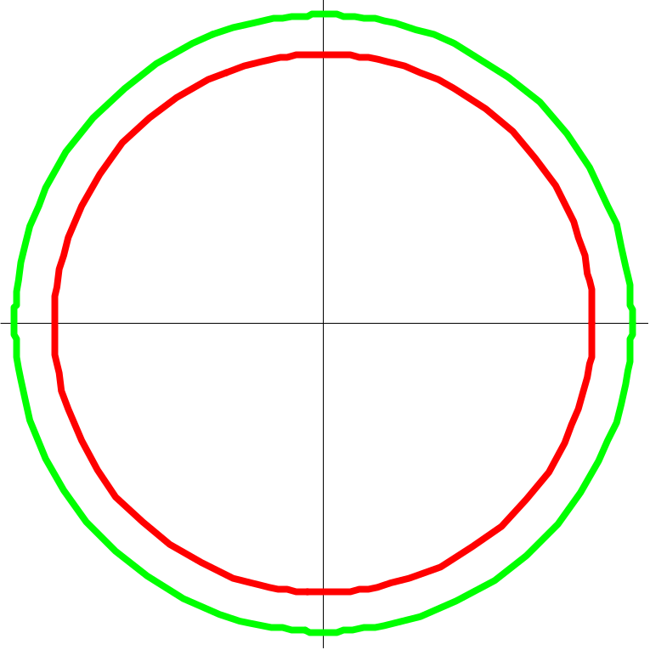
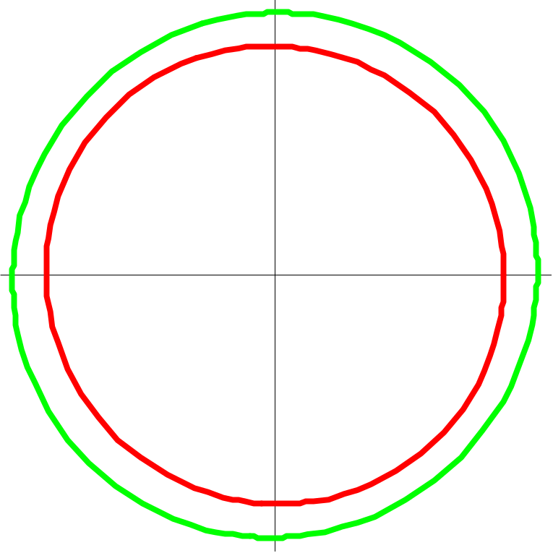
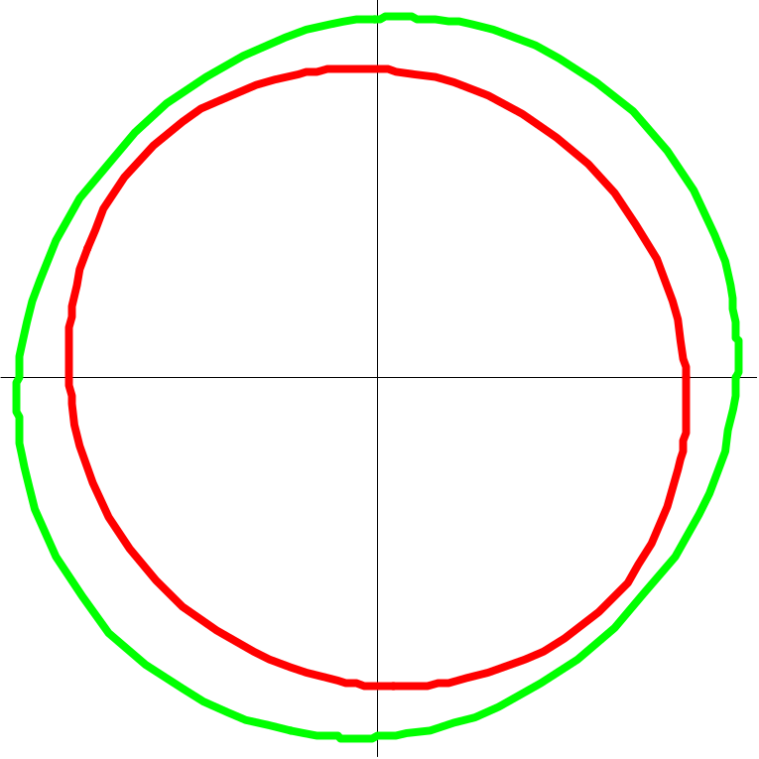
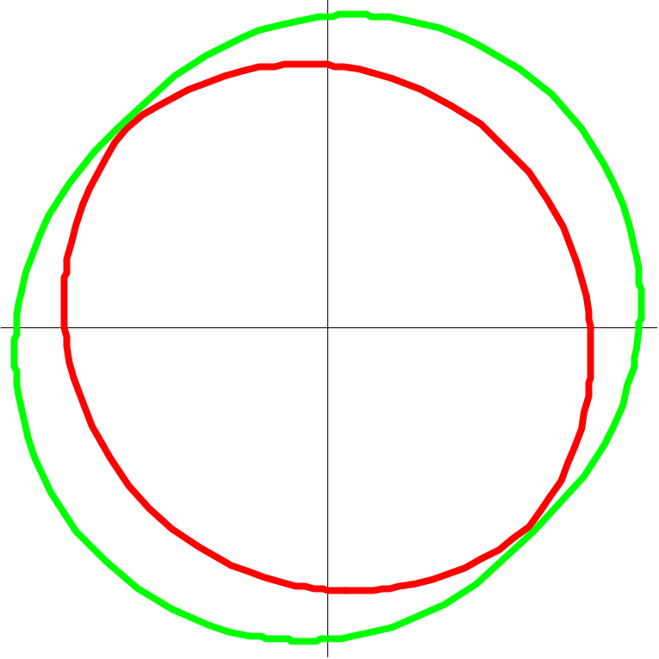
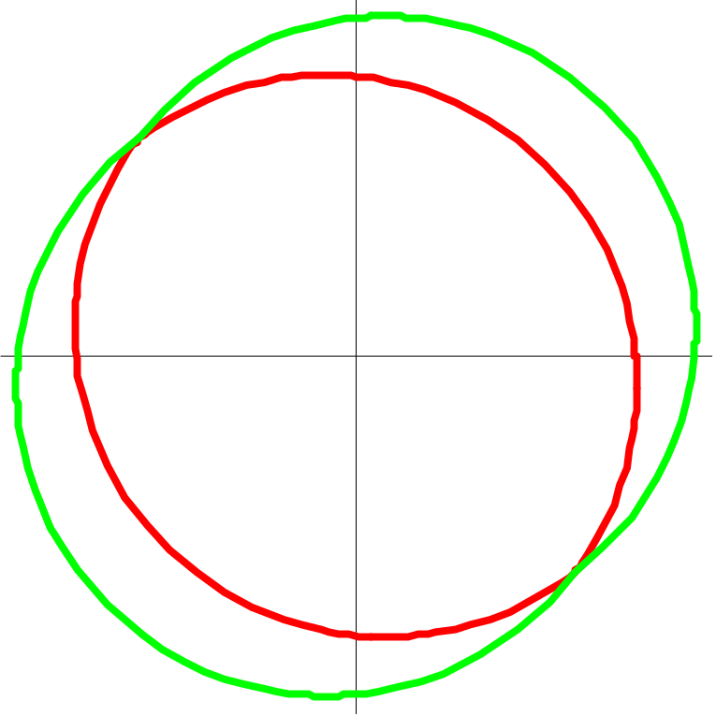
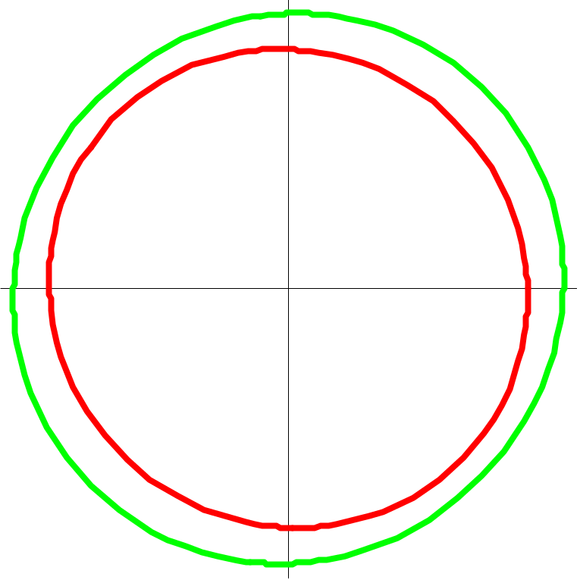
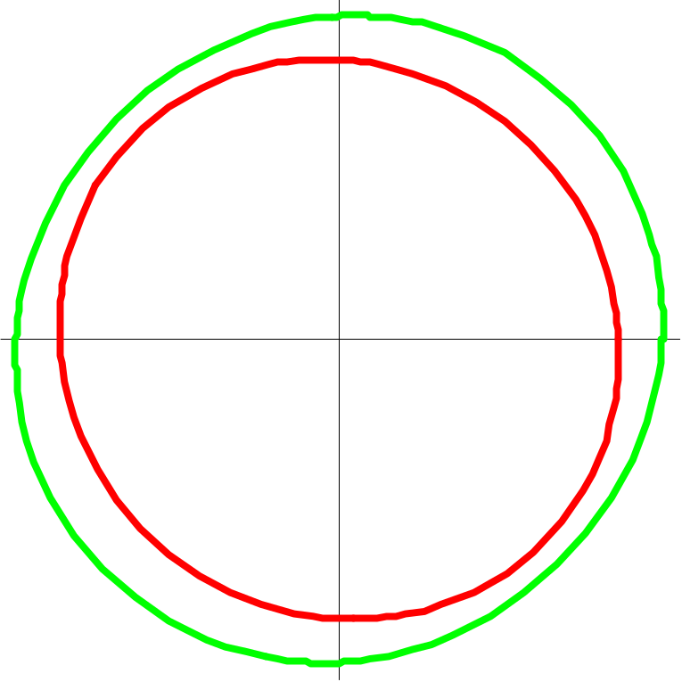
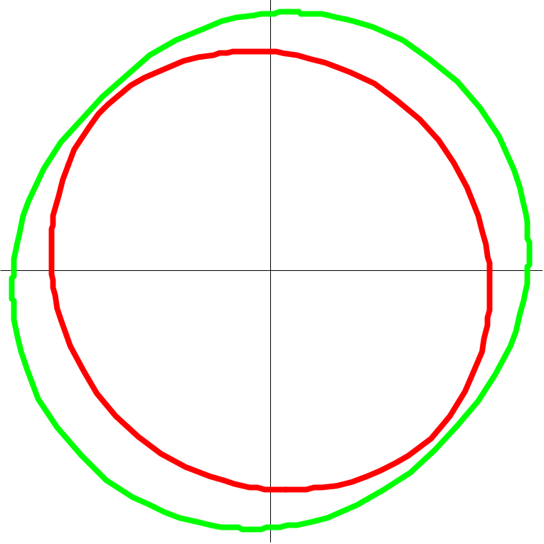
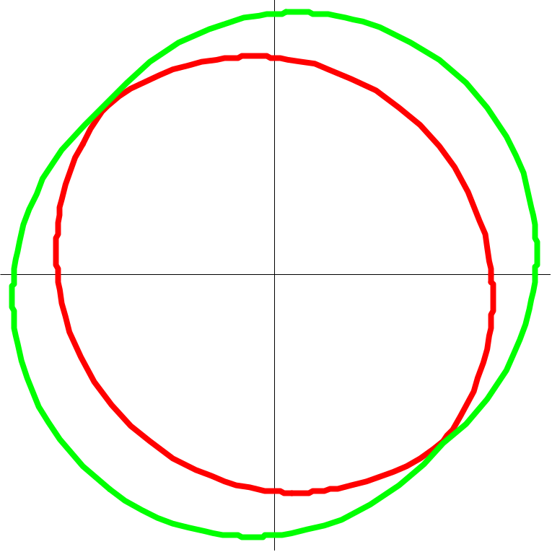
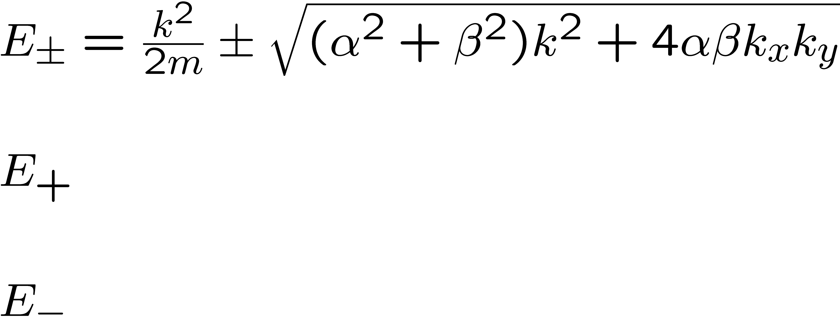
The Rashba+Dresselhaus Model
The Rashba spin-orbit coupling.
Can be experimentally tuned via proper gating.
The Dresselhauss spin-orbit
coupling.
Increase Dresselhauss

Slide 7
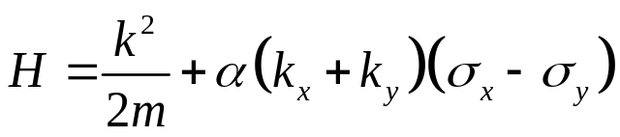
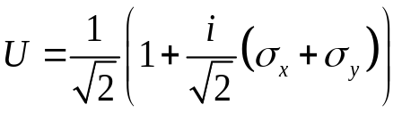
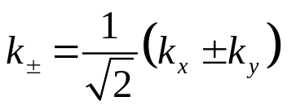
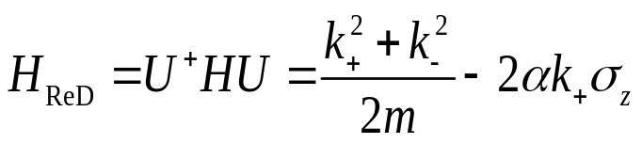
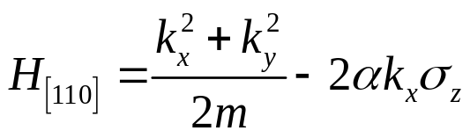
The Rashba+Dresselhaus Model
For α=β
Global spin
rotation
Coordinate change
The Dresselhaus [110] Model
Symmetric Quantum wells grown along the [110] direction:

Slide 8
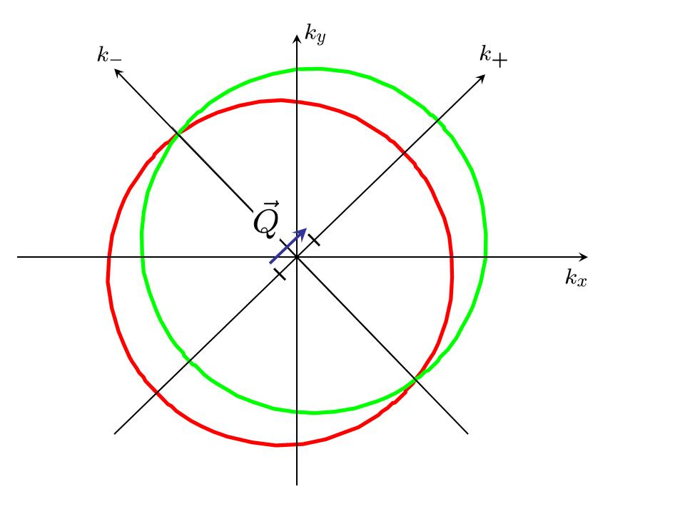
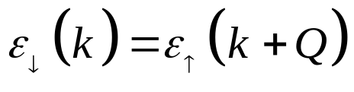


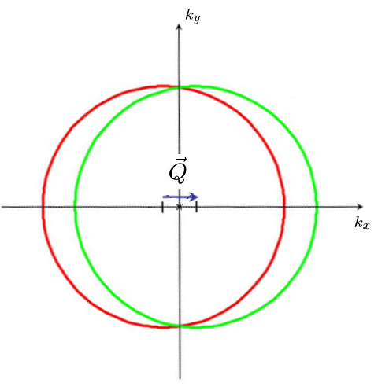



Fermi Surface and the Shifting Property
The shifting property:
For the
model
For the
model

Slide 9
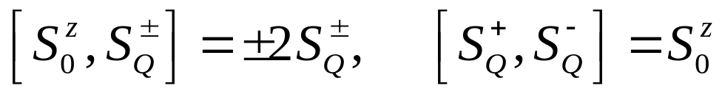
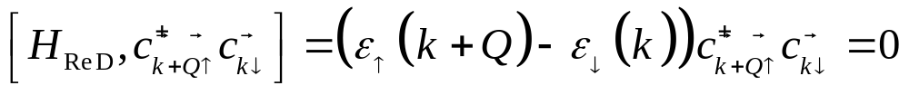
The Exact SU(2) Symmetry
Finite wavevector spin components
Shifting property essential
An exact SU(2) symmetry
Only Sz, zero wavevector U(1) symmetry previously known:
J. Schliemann, J. C. Egues, and D. Loss, Phys. Rev. Lett. 90, 146801 (2003).
K. C. Hall et. al., Appl. Phys. Lett 83, 2937 (2003).

Slide 10
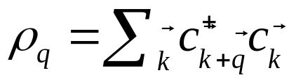
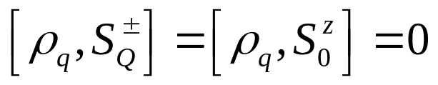
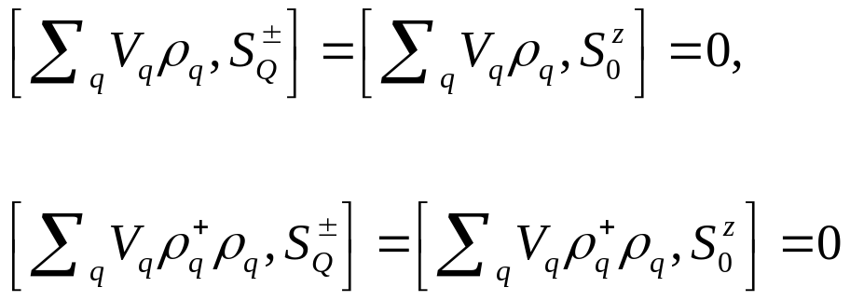


The Exact SU(2) Symmetry
The SU(2) symmetry is robust against spin-independent disorder and Coulomb (or other many-body) interactions.
A spin helix with wave vector has infinite life time
Persistent Spin Helix

Slide 11


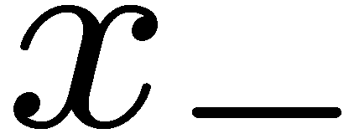

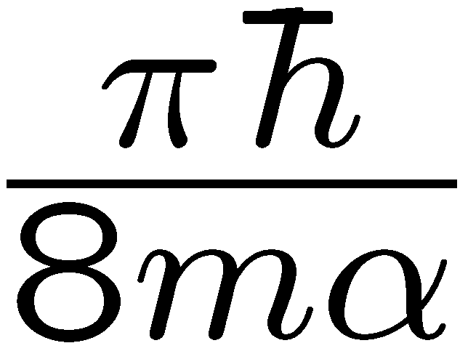
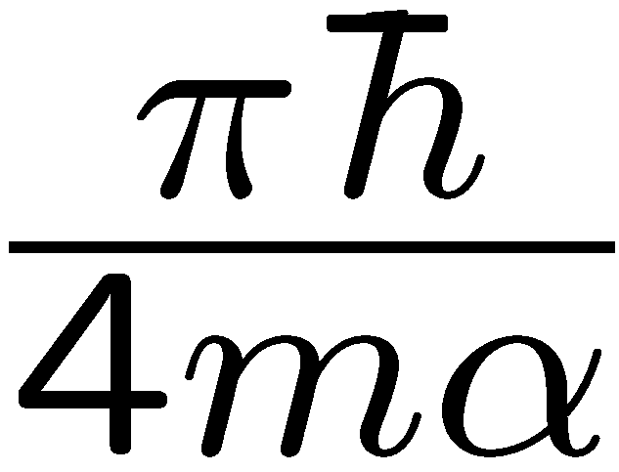
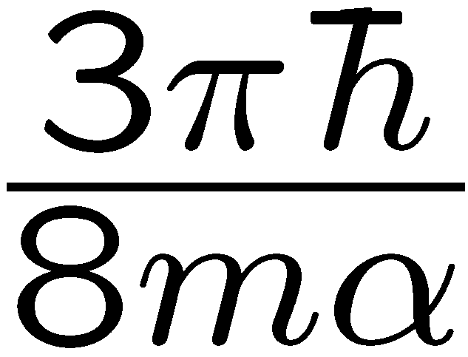
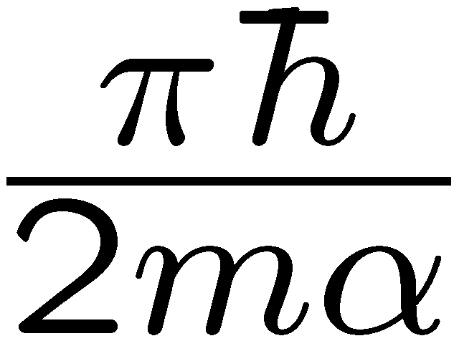
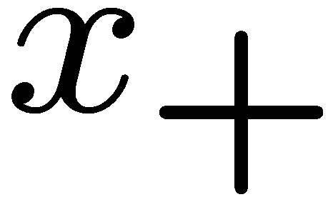
Physical Picture: Persistent Spin Helix
Spin configurations do not depend on the particle initial momenta.
For the same distance traveled, the spin precesses by exactly the same angle.
After a length the spins all return exactly to the original configuration.

Slide 12
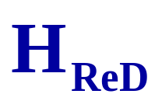
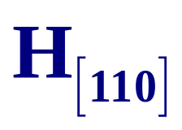
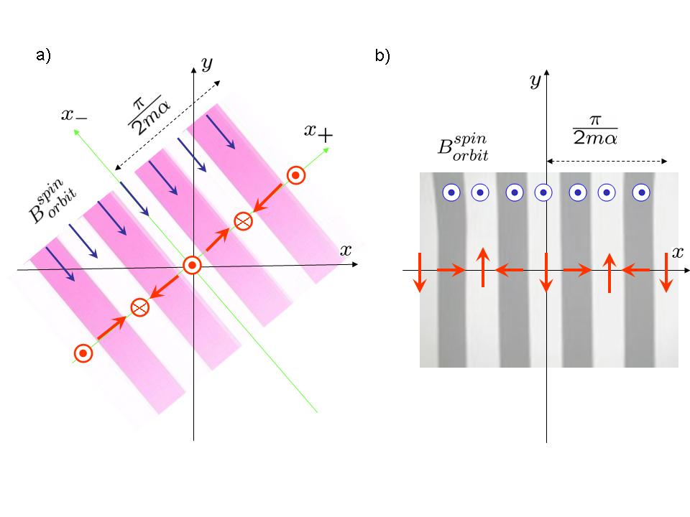




PSH for the Model and the Model
(a) PSH for the model. The spin-orbit magnetic field is in-plane (blue), where as the spin helix is in the plane. (b) PSH for the model. The spin-orbit magnetic field , in blue, is out of plane, whereas the spin helix, in red, is in-plane.

Slide 13
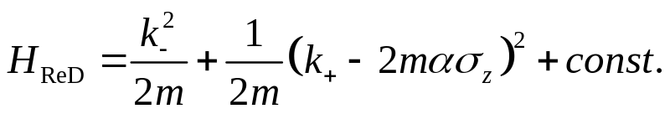
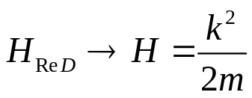
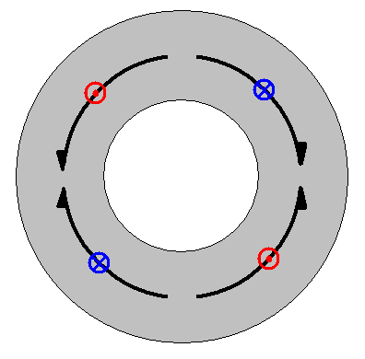

The Non-Abelian Gauge Transformation
in the form of a background non-abelian gauge potential
P. Q. Jin, Y. Q. Li, and F. C. Zhang, J. Phys. A 39, 7115 (2006)
Field strength vanishes; eliminate the vector potential by non-abelian gauge transf
Mathematically, the PSH is a direct manifestation of a non-abelian flux in the ground state of the models.

Slide 14
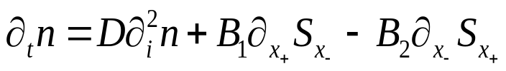
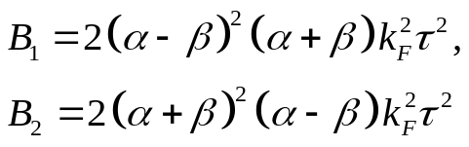
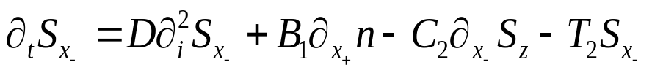
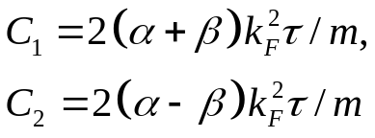
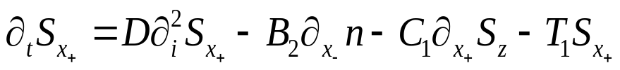
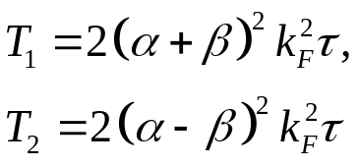
The Boltzmann Transport Equations
For arbitrary α,β spin-charge transport equation is obtained for diffusive regime
For propagation on [110], the equations decouple two by two
For Dresselhauss = 0, the equations reduce to Burkov, Nunez and MacDonald, PRB 70, 155308 (2004);
Mishchenko, Shytov, Halperin, PRL 93, 226602 (2004)

Slide 15








The Boltzmann Transport Equations
For α=β :
(Free Fermi gas)
Gauge
transformation
Simple diffusion equation

Slide 16









The Boltzmann Transport Equations
Along special directions the four equations decoupled to two by two blocks
Propagation on [1ῑ0]
Propagation on [110]
At α=β
At α=β
The behavior of Sz is diffusive and exponentially decaying; this is the passive direction
At the shifting wave-vector Q
An infinite spin life-time of the Persistent Spin Helix; this is the active direction

Slide 17



The Optical Spin Grating Experiment
C. P. Weber et. al., Nature 437, 1330 (2005)
Interference of two orthogonally polarized beams
An optical helicity wave generates an electron spin polarization wave
The pump-probe technique:
The spatially modulation of spin or charge is first introduced by the ‘pump’ laser pulse.
The time evolution of the modulation is measured by the diffraction of a probe beam.
Spin transport and relaxation properties are probed.

Slide 18

The Optical Spin Grating Experiment
Measurements of the decay, at q close to the ‘magic’ shifting vector, at Rashba close, but not equal to Dresselhauss. Black is the active direction, red the passive.

Slide 19

The Optical Spin Grating Experiment
Fitting of experimental data to Boltzman transport equations, for Rashba/Dresselhauss ~ 0.2 - 0.3. Even though the Rashba and Dresselhauss are not yet equal, large enhancement of spin-lifetime for the spin helix is observed

Slide 20


Generation of the PSH Current
PSH associated with SU(2) charge – PSH current
FM2 pulse delayed from FM1 pulse
FM1
FM2
[110] GaAs
Two consecutive FM1 pulses delayed by

Slide 21
Generation of the PSH Current
Optical detection of oscillating spin at given spatial point. Dresselhauss [110]
For Rashba equal Dresselhauss:
Optical
detection
Decay component:
FM1
FM2
ReD GaAs

Slide 22
Conclusions
Minimize spin-decoherence while keeping strong spin-orbit coupling
Shifted Fermi Surfaces: Fundamental property of some cond-mat
systems, similar to nesting
Exact SU(2) symmetry of systems with Rashba equal to Dresselhauss
or Dresselhauss [110]; finite wave-vector generators
Persistent Spin Helix
Experimental discovery

