Slide 1
The spin Hall effect
Shoucheng Zhang (Stanford University)
Collaborators:
Shuichi Murakami, Naoto Nagaosa (University of Tokyo)
Andrei Bernevig, Taylor Hughes (Stanford University)
Xiaoliang Qi (Tsinghua), Yongshi Wu (Utah)
Science 301, 1348 (2003)
PRB 69, 235206 (2004), PRL93, 156804 (2004)
cond-mat/0504147, cond-mat/0505308
PITP 2005/05

Slide 2
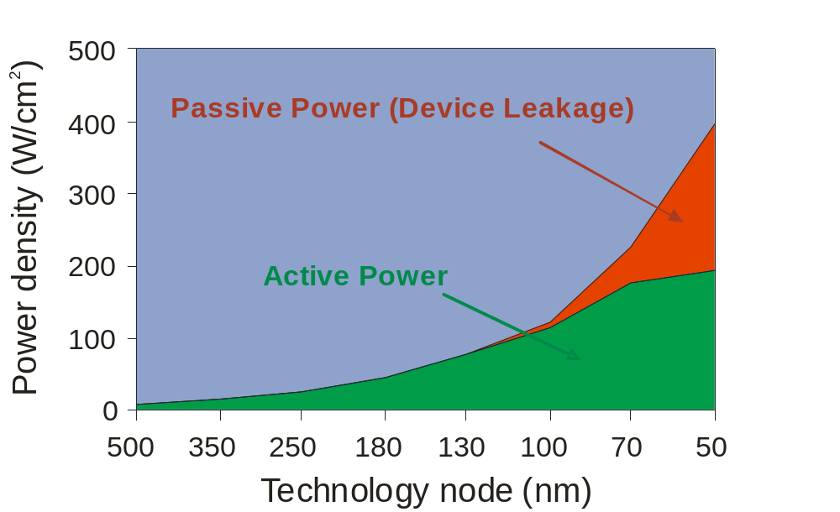
Can Moore’s law keep going?
Power dissipation=greatest obstacle for Moore’s law!
Modern processor chips consume ~100W of power of which about 20% is wasted in leakage through the transistor gates.
The traditional means of coping with increased power per generation has been to scale down the operating voltage of the chip but voltages are reaching limits due to thermal fluctuation effects.

Slide 3
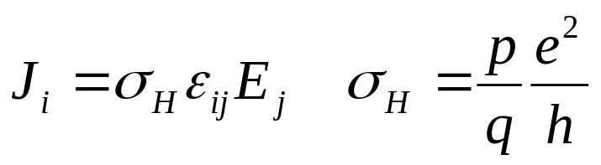
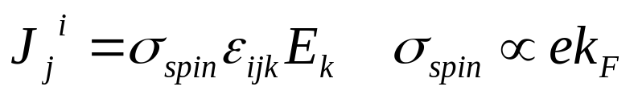
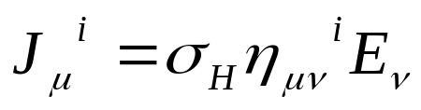
Generalization of the quantum Hall effect
Quantum Hall effect exists in D=2, due to Lorentz force.
Natural generalization to D=3, due to spin-orbit force:
3D hole systems (Murakami, Nagaosa and Zhang, Science 2003)
2D electron systems (Sinova et al, PRL 2004)
Quantum Hall effect in D=4 (Zhang and Hu):

Slide 4
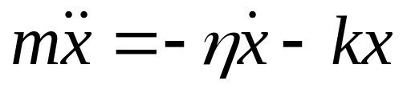
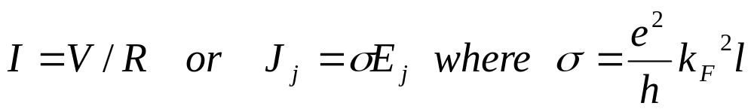
Time reversal symmetry and dissipative transport
Microscopic laws physics are T invariant.
Almost all transport processes in solids break T invariance due to dissipative coupling to the environment.
Damped harmonic oscillator:
Electric field=even under T, charge current=odd under T.
  Ohmic conductivity is dissipative!
Only states close to the fermi energy contribute to the dissipative transport processes.

Slide 5
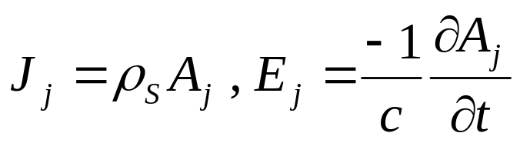
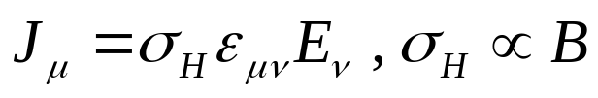
Only two known examples of dissipationless transport in solids!
Supercurrent in a superconductor is dissipationless, since London equation related J to A, not to E!
  Vector potential=odd under T, charge current=odd under T.
In the QHE, the Hall conductivity is proportional to the magnetic field B, which is odd under T.

Slide 6
Time reversal and the dissipationless spin current
-
v
T
v
-
-
v
T
v
-
v
-
-
v

Slide 7
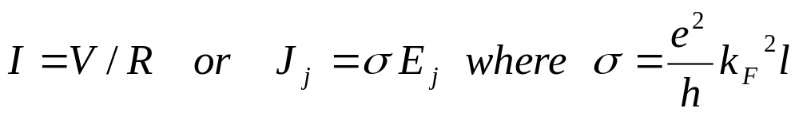
The intrinsic spin Hall effect
Key advantage:
  electric field manipulation, rather than magnetic field.
  dissipationless response, since both spin current and the electric field are even under time reversal.
  Topological origin, due to Berry’s phase in momentum space similar to the QHE.
  Contrast between the spin current and the Ohm’s law:

Slide 8
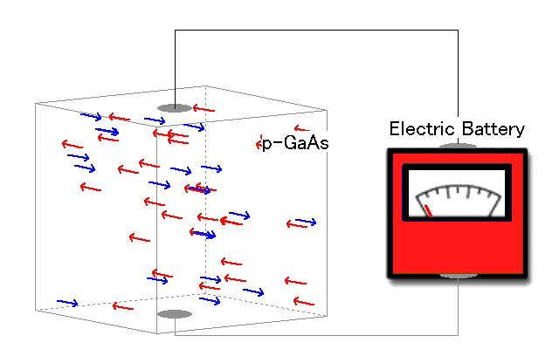
Dissipationless spin current induced by the electric field

Slide 9

Mott scattering or the extrinsic Spin Hall effect
Electric field induces a transverse spin current.
Extrinsic spin Hall effect
Mott (1929), D’yakonov and Perel’ (1971)
Hirsch (1999), Zhang (2000)
impurity scattering = spin dependent (skew-scattering)
Spin-orbit couping
up-spin
down-spin
impurity
Cf. Mott scattering
Intrinsic spin Hall effect Berry phase in momentum space
Independent of impurities !

Slide 10
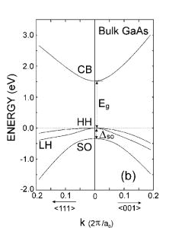
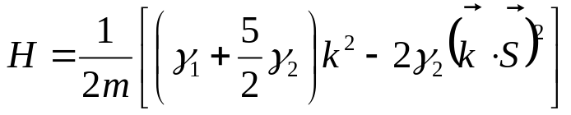

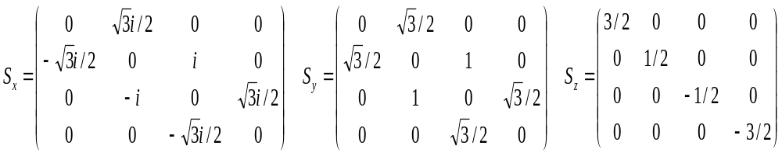
Valence band of GaAs
S
S
P_{3/2}
P
P_{1/2}
Luttinger Hamiltonian
( : spin-3/2 matrix, describing the P_{3/2} band)

Slide 11
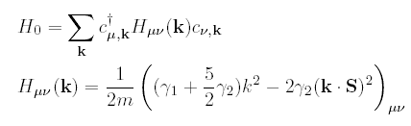

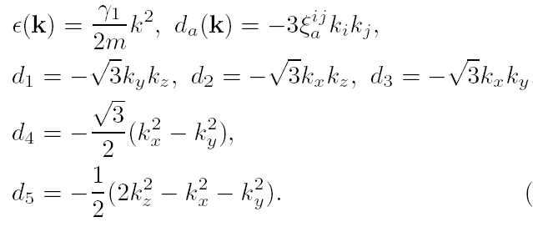

Luttinger model
Expressed in terms of the Dirac Gamma matrices.

Slide 12
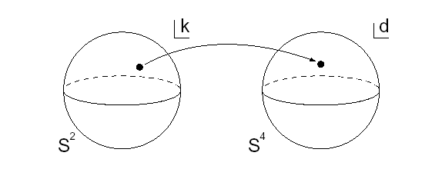
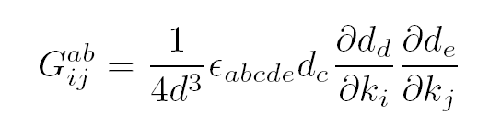
Non-abelian gauge field in k and d space
Gauge field in the 3D k space is induced from the SU(2) monopole gauge field in the 5D d space. The gauge field on S⁴ is exactly the Yang-Mills instanton solution!

Slide 13
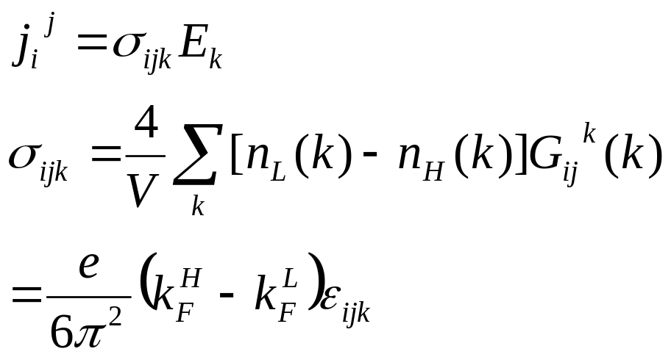


Full quantum calculation of the spin current based on Kubo formula
Final result for the spin conductivity: (Similar to the TKNN formula for the QHE. Note also that it vanishes in the limit of vanishing spin-orbit coupling).

Slide 14

Topological structure of the intrinsic SHE
Wigner-Von Neumann classes for level crossing:
 | Co-dimension | symmetry | systems
orthogonal | 2 | Time-reversal invariant, no Krammer degeneracy. | bosons
unitary | 3 | Time-reversal breaking | SO(3) spinor
symplectic | 5 | Time-reversal invariant, with Krammer degeneracy. | SO(5) spinor
U(1) Dirac monopole in D=3. First Chern class. Haldane sphere for the QHE.
SU(2) Yang monopole in D=5, related to the Yang-Mills instanton in D=4. Second Chern class. 4DQHE of Zhang and Hu.

Slide 15
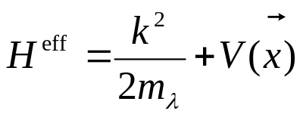
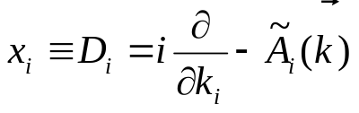
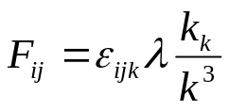
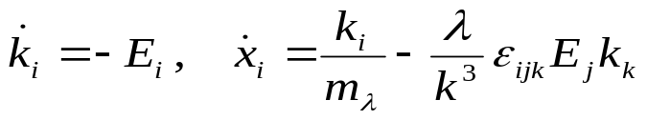
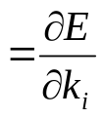
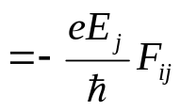
Effective Hamiltonian for adiabatic transport
Nontrivial spin dynamics comes from the
Dirac monopole at the center of k space, with
eg=λ:
(Dirac monopole)
Eq. of motion
Drift velocity
Topological term

Slide 16
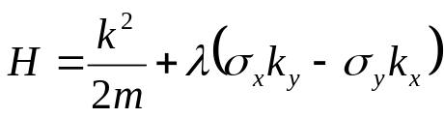

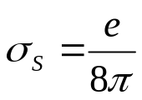
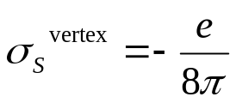



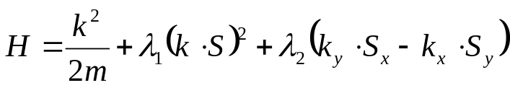
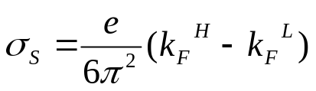

Effect due to disorder
Green’s function method
Rashba model:
Intrinsic spin Hall conductivity (Sinova et al.(2004))
+ spinless impurities ( -function pot.)
+ Vertex correction in the clean limit
(Inoue et al (2003), Mishchenko et al,
Sheng et al (2005))
Luttinger model:
Intrinsic spin Hall conductivity (Murakami et al.(2003))
+ spinless impurities ( -function pot.)
Vertex correction vanishes identically!
(Murakami (2004), Bernevig+Zhang (2004)

Slide 17




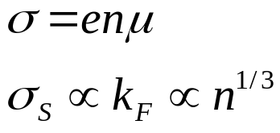


Order of magnitude estimate (at room temperature)
carrier density | mobility | Charge conductivity | Spin (Hall) conductivity
10¹⁹ | 50 | 80 | 73
10¹⁸ | 150 | 24 | 34
10¹⁷ | 350 | 5.6 | 16
10¹⁶ | 400 | 0.64 | 7.3
As the hole density decreases, both and decrease.
decreases faster than .

Slide 18





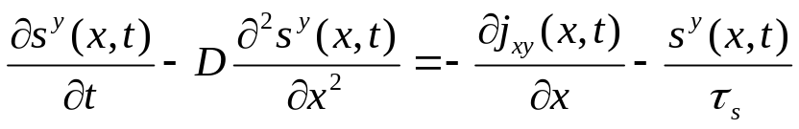
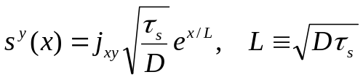



Spin accumulation at the boundary
p-GaAs
p-GaAs :
Spin current :
Diffusion eq.
Steady-state solution:
Total accumulated spins:

Slide 19
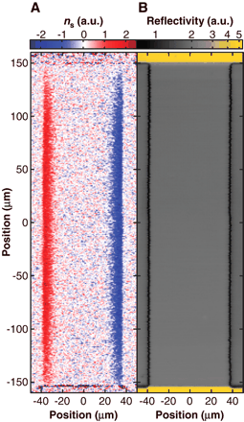


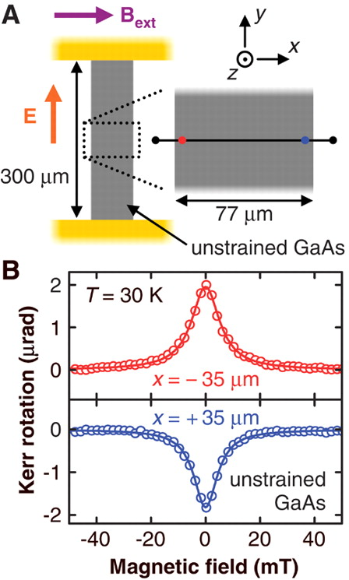
Experiment -- Spin Hall effect in a 3D electron film
Y.K.Kato, R.C.Myers, A.C.Gossard, D.D. Awschalom, Science 306, 1910 (2004)
(i) Unstrained n-GaAs
(ii) Strained n-In_{0.07}Ga_{0.93}As
T=30K, Hole density:
: measured by Kerr rotation

Slide 20

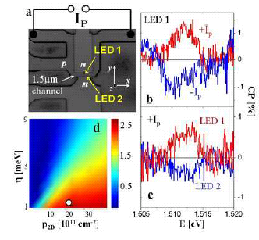

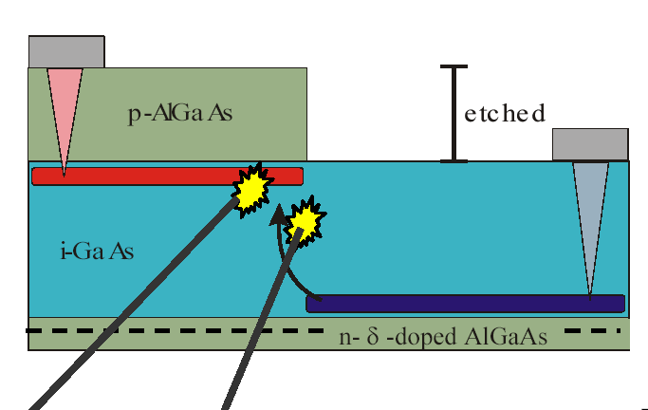
Experiment -- Spin Hall effect in a 2D hole gas --
J. Wunderlich, B. Kästner, J. Sinova, T. Jungwirth, PRL (2005)
LED geometry
Circular polarization
Clean limit :
much smaller than spin splitting
vertex correction =0
(Bernevig, Zhang (2004))
It should be intrinsic!

Slide 21

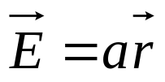

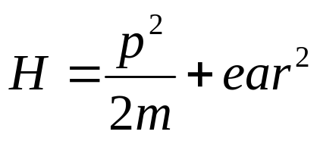
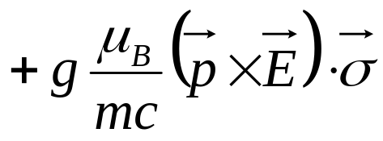
Quantum Spin Hall
2D electron motion in radial electric field which increases with the distance from the center.
GaAs
Example of such a field: inside a uniformly charged cylinder
Hamiltonian for electrons with large g-factor:

Slide 22
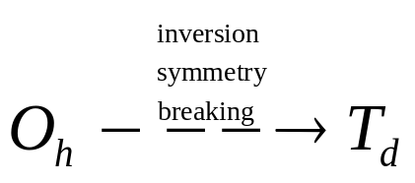

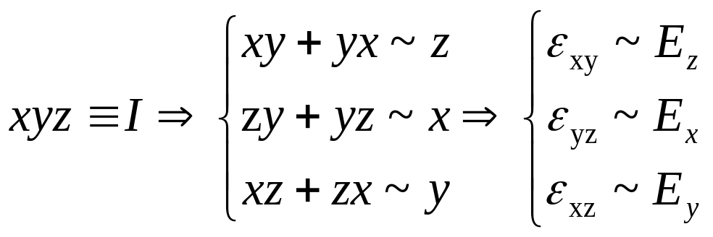
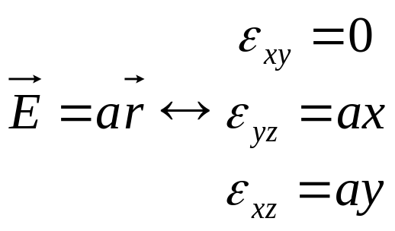
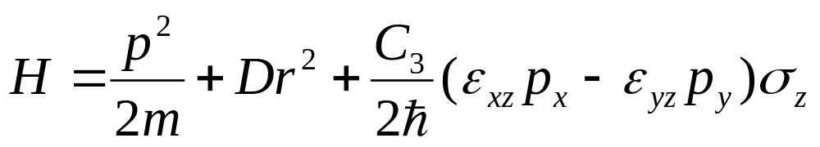
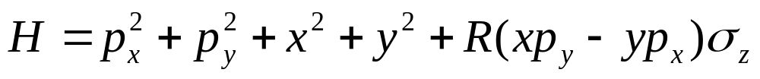
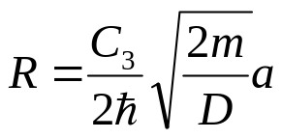
Quantum Spin Hall
In semiconductors without inversion symmetry, shear strain is like an electric field in terms of the SO coupling term
cubic gp
symm gp:
(rotation part only, inversion not a symmetry)
(shear strain gradient creates the same SO coupling situation as a radialy increasing electric field)
(up to a coordinate re--scaling)

Slide 23
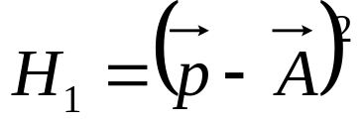
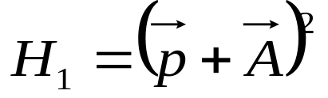
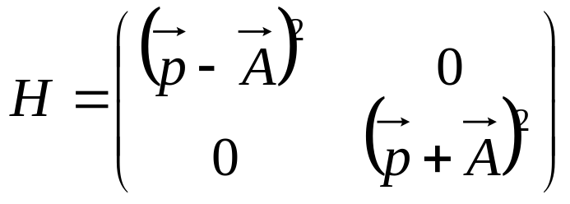
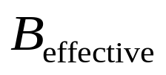
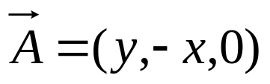
Quantum Spin Hall
GaAs
Hamiltonian for electrons:
Tune to R=2
Spin up
Spin down

Slide 24






Quantum Spin Hall
Spin up
Spin down
P,T-invariant system
Halperin-like wavefunction

Slide 25











Quantum Spin Hall
Purely electrical detection measurement, measure
Landau Gap and Strain Gradient
strain gradient
More effort to directly measure , open question.

Slide 26




Topological Quantization of Spin Hall
Topological Quantization in Conserved Spin Hall Conductivity
Inverse band: insulator case
LH
Conserved spin Hall conductivity in Luttinger model
HH
topological quantized to be n/2π

Slide 27

Topological Quantization of Spin Hall
Physical Understanding: Edge states
In a finite spin Hall insulator system, mid-gap edge states emerge and the spin transport is carried by edge states.
Laughlin’s Gauge Argument:
When turning on a flux threading a cylinder system, the edge states will transfer from one edge to another
Energy spectrum on stripe geometry.

Slide 28






Topological Quantization of Spin Hall
Physical Understanding: Edge states
When an electric field is applied, n edge states with Γ¹²=+1(−1) transfer from left (right) to right (left).
Γ¹² accumulation → Spin accumulation
Conserved
Non-conserved
=
+

Slide 29
Conclusion & Discussion
A new type of dissipationless quantum spin transport, realizable at room temperature.
  Natural generalization of the quantum Hall effect.
  Lorentz force and spin-orbit forces are both velocity dependent.
  U(1) to SU(2), 2D to 3D.
Instrinsic spin injection in spintronics devices.
  Spin injection without magnetic field or ferromagnet.
  Spins created inside the semiconductor, no issues with the interface.
  Room temperature injection.
  Source of polarized LED.
Reversible quantum computation?

Slide 30


Physics behind the semi-conductor revolution
Quantum mechanics: invented in 1920, lead to the invention of the transistor in 1947
Relativity: invented in 1905, no applications yet in electronics?

