Slide 1
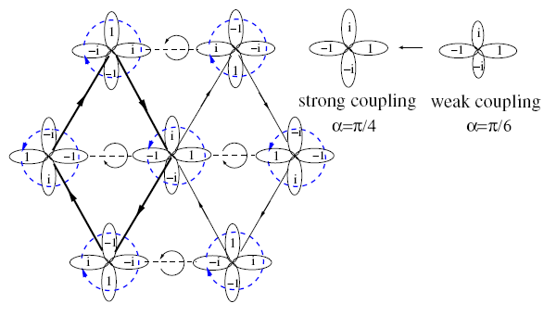


Frustrated superconductivity and superfluidity
Congjun Wu
Department of Physics, School of Science, Westlake University
$${−t}_{⊥}$$
$$t_{//}$$
WTQI workshop, Shanghai Tech, 12/15/2022
Notes:
It is my great pleasure to attend this wonderful workshop. I thank the organizers for the kind invitation. Today I will talk about how to generalize frustration, a concept typically studied in magnetism, to the field of superfluidity and superconductivity, then I will connect these ideas to the current experimental studies in ultra-cold atom physics and the Kagome superconductivity.

Slide 2
Collaborators:
Zhiming Pan, Chen Lu Westlake University
Fan Yang Beijing Institute of Technology
Zhifang Xu SUST
Early collaborations with W. V. Liu, J. Moore, S. Das Sarma, W. C. Lee, H. H. Hung, Gia-Wei Chern
Refs.
Zhiming Pan, Chen Lu, Fan Yang, CW, arXiv:2209.13745
Chao Xu, Wang Yang,CW, arXiv:2010.05362 .
Zhifang Xu, et al, submitted.
CW, W. Vincent Liu, Joel Moore, and Sankar Das Sarma , PRL 97, 190406 (2006).
Hsiang-hsuan Hung, Wei-Cheng Lee, CW, Phys. Rev. B 83, 144506 (2011)
G. W. Chern, CW, PRL 112, 020601 (2011).

Slide 3
P-orbital BEC
beyond “no-node” theorem
Condensations at non-zero
momenta
Frustrated SF(SC)
Charge “6e” SC
3-color model
Inter-orbital
f-wave pair density wave
Notes:
This is the outline. I will first explain why frustration is not often met in studies of superfluidity and superconductivity. In order to generate frustrations, the key idea is “condensations at non-zero momenta” to create sign changes. We will then explore frustrations in various context including unconventional BECs beyond the no-node theorem, charge 6e superconductivity, and f-wave pair density wave states.

Slide 4
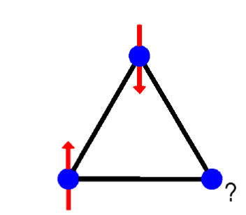
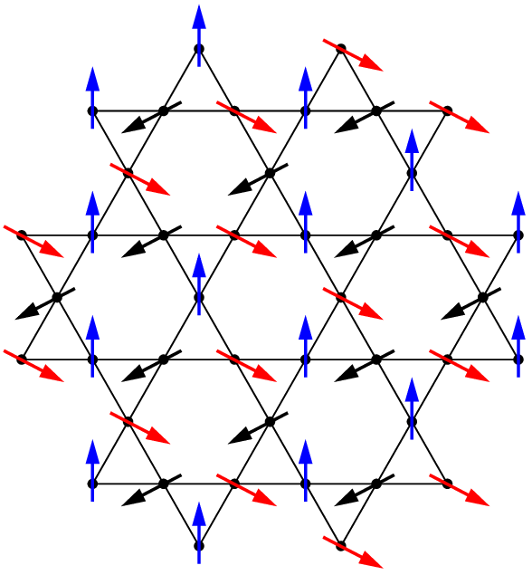
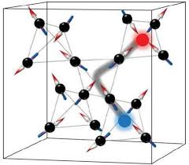
Frustrated magnets
AFM on non-bipartite lattices
triangular, Kagome, pyrochlore lattices
Ground state degeneracies (classical).
Exotic properties
fluctuations induced ordering → “order from disorder”
Coulomb phase, spin liquid.
C. L. Henley, Annu. Rev. Cond. Matt. Phys. 1, 179 (2010).
Notes:
Frustration typically refers to antiferromagnetism on non-bipartite lattices, say, triangular, Kagome, and pyrocholre lattices, in which the antiferromagnetic exchange cannot be simultaneously satisfied on all the bonds. The ground states often exhibit a macroscopic level of degeneracies. Then physics is highly non-perturbative leading to exotic phenomena including order from disorder, Coulomb phase with power law correlations, and even quantum spin liquids.

Slide 5
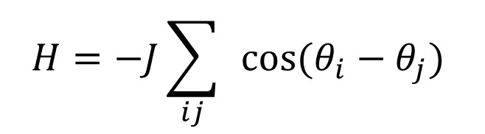
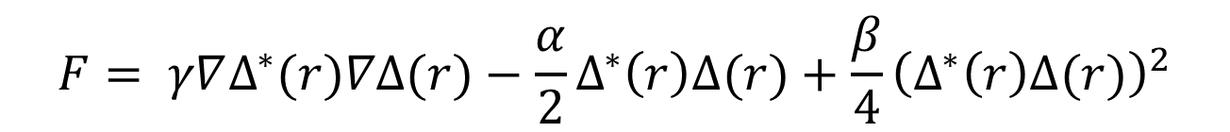
Phase coherence -- superconductivity
Analogy to ferromagnetism → no frustration
$$H=−J\sum_{ij}{ }cos(θ_{i}−θ_{j})$$
$$F= γ∇Δ^{∗}(r)∇Δ(r)−\frac{α}{2}Δ^{∗}\left(r\right)Δ(r)+\frac{β}{4}{\left(Δ^{∗}\left(r\right)Δ(r)\right)}^{2}$$
Notes:
However, as for superconductivity, which is another important topic in condensed matter physics, frustration in general does not occur. Superconducting phases tend to be uniform across the system, which is an analogy to ferromagnetism, hence, no frustration.

Slide 6
“No-node” theorem – boson superfluidity
Positive-definite ground-state wavefunctions.
Feynman’s textbook “Statistical Mechanics”
Notes:
Similar story occurs in the boson superfluidity, such as superfluid He, and cold atom BECs, which are constrained by the no-node theorem. It states that the many-body ground state wavefunctions of bosons under very general conditions are positive-definite. There is no sign change, not even mention complex phases, hence, no frustration either. An intuitive proof was presented in Feynman’s “statistical Mechanics”, which shows that we can always transform a sign-change wavefunction to a positive-definite one to save some energy.

Slide 7
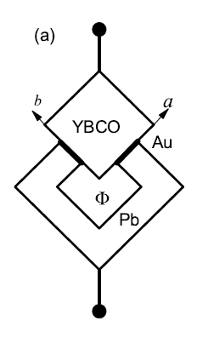
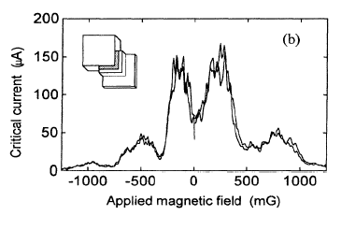
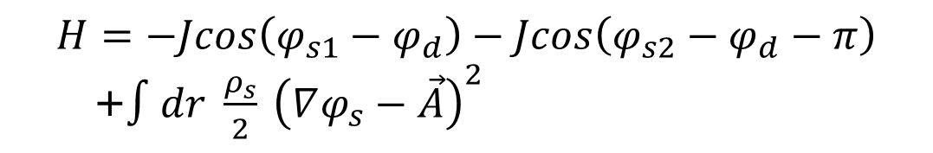
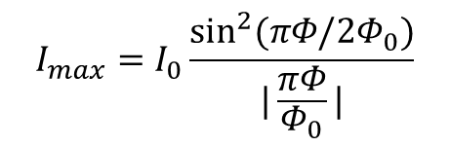
$π$-junction: unconventional superconductivity
$$I_{max}=I_{0}\frac{\sin^{2}(πΦ/2Φ_{0})}{|\frac{πΦ}{Φ_{0}}|}$$
-
+
YBaCuO
+
Quantum interference
-
D. Van Harlingen, RMP (1995)
$$H=−Jcos\left({φ_{s1}−φ}_{d}\right)−Jcos\left(φ_{s2}−φ_{d}−π\right)$$
+$∫dr {\frac{ρ_{s}}{2}}_{ }{\left(∇φ_{s}−\vec{A}\right)}^{2}$
Analogy to the AFM coupling
Notes:
Nevertheless, for superconductivity with a unconventional symmetry, the phase coherence problem can indeed exhibit an antiferromagnetic-like feature. For example, the corner junction experiment by Van Harlingen. The circuit consists of two Josephson junctions between YBCO, which is a d-wave superconductor, and Pb, an s-wave superconductor. The two junctions are on two adjacent edges, hence, their couplings exhibit a pi-phase difference due to the d-wave symmetry. Hence, the supercurrents interfere destructively. This pi-phase mismatch can be offset by an external pi-flux, and then the maximal critical current appears.

Slide 8
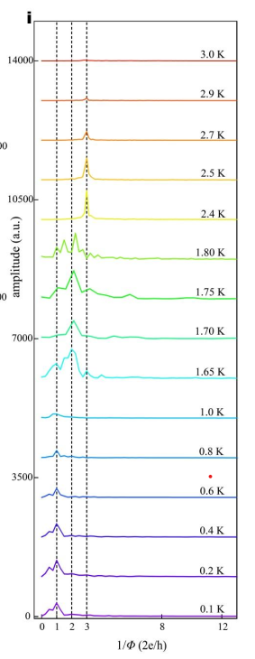
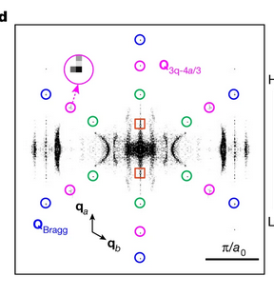
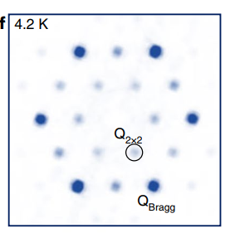
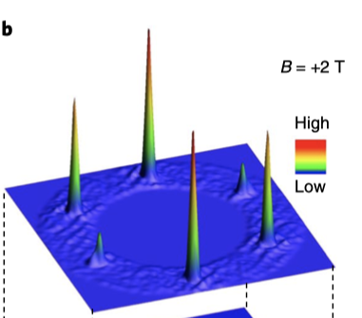


Kagome superconductor CsV3Sb5
Superconductivity $T_{c}≈2.5K.$
Ortiz et al, PRL. 125, 247002 (2020)
Chiral CDW $≈80K$, 2*2 supercell
Pair-density-wave Q=3/4 B.
X. H. Chen, et al. PRX 11, 031026 (2021);
Tao Wu, X. H. Chen, Nature 604, 59–64 (2022).
J. P. Hu et al, Sci. Bullitin 66, 1384(2021)
6e
Charge “6e” oscillations (?) – signature of frustration(?)
4e
2e
e?
Hasan’s group, Nat. Mat. (2021)
H.J. Gao’s group, Nature 599, 222 (2021)
Wang Jian’s group. arxiv:2201.10352
Notes:
Recently, the Kagome superconductor of CsV3Sb5 aroused a great deal of research interests. Many groups in China made important contributions. This will be talked by Dr. Tao Wu, the next speaker. I will be very brief here. It undergoes a chiral CDW transition with a supercell structure of 2*2 around 80K. In the superconducting state, a new modulation at 3/4 of the reciprocal lattice vectors is found, which could be understood as a pair-density-wave state. Recently, Wang Jian’s group measured the magneto-resistance oscillation. They discovered both charge-4e and 6e oscillations above Tc. The charge 6e one is more robust. Later we will try to understand the charge-6e state as a consequence of frustration of superconductivity arising from pair-density waves.
**********************************************
1 . CDW Experiments: Ortiz et al, PRL. 125, 247002 (2020), Jiang et al, Nat.Mater 20, 1353 (2021), Wang et al, Adv.Mat, 33(42), 2102813., Yu et al, arxiv:2107.10714, Yu et al, PRB 104,L041103(2021) , Mu et al, CPL 38, 077402 (2021). Wang et al, PRB 104, 075148(2021) , Liang et al. PRX 11.3 (2021): 031026, ........
2 . CDW theory: Tan, Liu, Wang, and Yan, PRL. 127, 046401 (2021). Feng, Jiang, Wang, and Hu, Sci.Bull 66, 1384 (2021) and PRB 104,165136 (2021) ……
3. PDW Experiments Jiang et al, Nat.Mater 20, 1353 (2021) ,Chen et al, Nature 599, 222 (2021)
4. PDW theory
5. Charge 4e/6e experiments Ge et al. arxiv:2201.10352
6. Charge 4e/64 theory Zhou and Wang, arXiv:2110.06266, Zhang, Wang, Hu, arXiv:2205.08732, Yu, arXiv:2210.00023

Slide 9
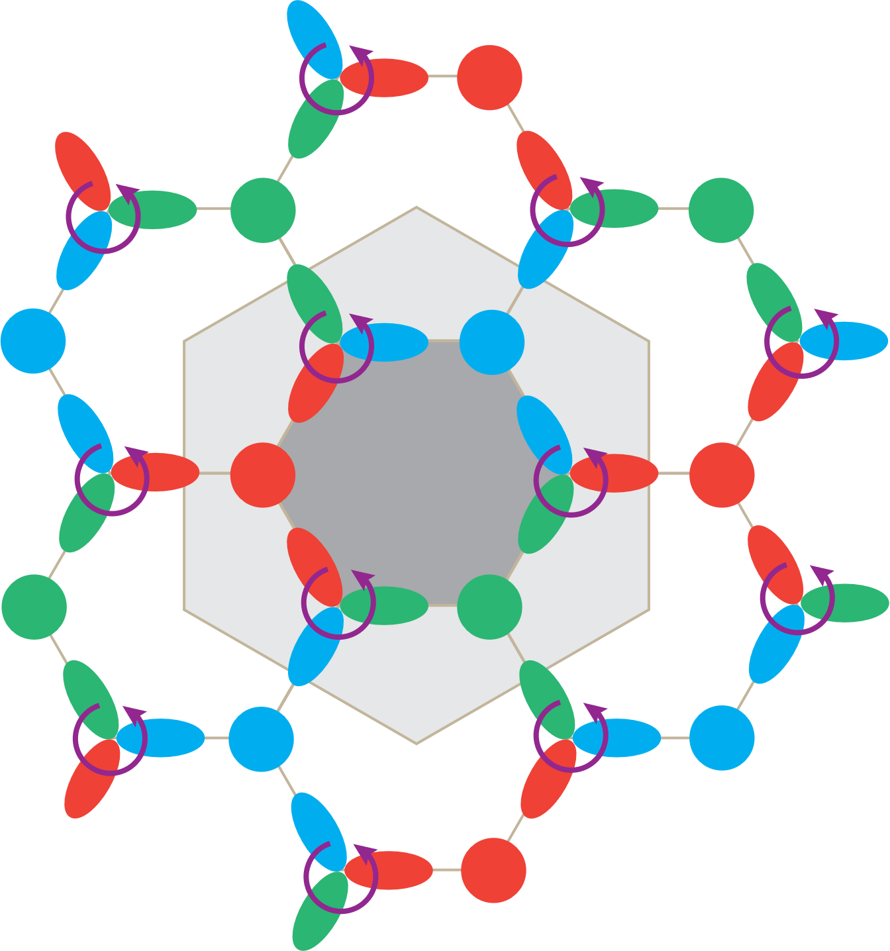
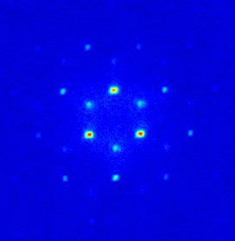
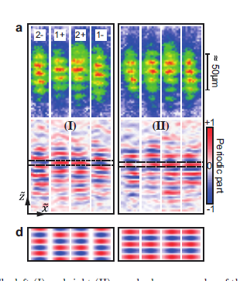


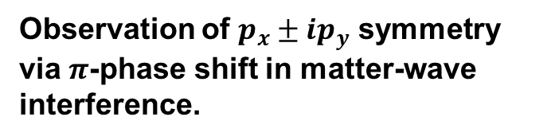
Complex BECs at non-zero momenta in high-orbital bands
Meta-stable excited states
Complex-valued wavefunction and
time-reversal symmetry breaking
C. Wu, Mod. Phys. Lett. 23, 1 (2009) (brief review).
Observation of $p_{x}±ip_{y}$ symmetry via $π$-phase shift in matter-wave interference.
Time-reversal symm. breaking
$$p_{x}^{ }$$
$$p_{y}^{ }$$
Hemmerich group Nature Physics 7, 147 (2011); PRL 114, 115301 (2015).
Xiao-Qiong Wang et al., Nature 596, 227 (2021)
Notes:
On the other hand, considerable progress has been achieved in cold atom optical lattices. More than 15 years ago, my collaborators and I proposed to pump bosons into the high-orbital bands. They are excited states of bosons and form meta-stable BECs, hence, they are no longer constrained by the no-node theorem. We predicted that condensations occur at non-zero momentum, and they become complex-valued, say, p+ip type.
Excitingly, this unconventional symmetry has been observed in Hemmerich’s group at Hamburg via matter-wave interference. Furthermore, recently, Zhifang Xu’s group at SUST created chiral condensates. Their time-of-flight spectra shows condensation momenta are asymmetric under time-reversal transformation, exhibiting time-reversal symmetry spontaneous breaking.
We will see how to arrive at frustration in this kind of systems.

Slide 10
P-orbital BEC
beyond no-node theorem
Condensations at non-zero
momenta
Frustrated SF/SC
Charge “6e” SC
3-color model
Inter-orbital
f-wave pair density wave
Notes:
Next we start from the unconventional BEC in the p-orbital bands beyond the no-node theorem.

Slide 11
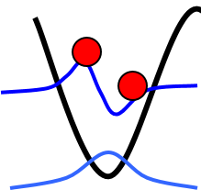
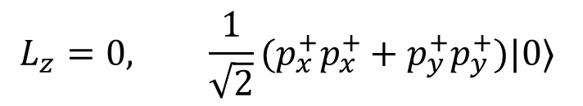
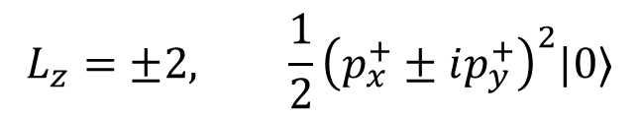
Ferro-orbital interaction
Filling the shell structure with bosons – boson orbital physics
Metastable states of bosons
real
$$L_{z}^{ }=0, \frac{1}{\sqrt{2}}(p_{x}^{+}p_{x}^{+}+p_{y}^{+}p_{y}^{+})|0〉$$
$$L_{z}=±2, \frac{1}{2}{\left(p_{x}^{+}±ip_{y}^{+}\right)}^{2}|0〉$$
complex
Notes:
Consider a single site: Put two bosons in a pair of degenerate p-orbitals, and study its orbital configuration. This is the analogy of filling atomic shells, but now with bosons instead of electrons. Since Pauli’s exclusion principle does not apply here, the s-orbital can hold as many bosons as you would like, then the p-orbital bosons are in excited states. They either go to the real orbitals px and py and total angular momentum is zero, or, they aggregate to the complex orbitals p+ip, or, p-ip, maximizing their orbital angular momentum. It is easy to show that the state with orbital angular momentum has less energy.

Slide 12

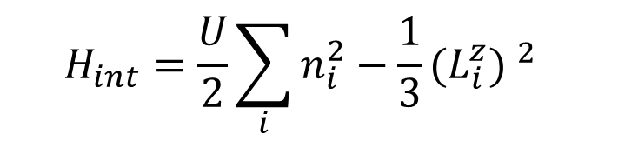
Orbital Hund’s rule for bosons
$$H_{int}=\frac{U}{2}\sum_{i}{n_{i}^{2}−\frac{1}{3}(L_{i}^{z}}) ^{2}$$
C. Wu, Mod. Phys. Lett. 23, 1(2009).
W. V. Liu and C. Wu, PRA 2006.
$$L_{z}=−i(p_{x}^{+}p_{y}−p_{y}^{+}p_{x})$$
Bosons aggregate into the same single-particle state.
Complex state (e.g. p+ip) is favored to minimize repulsion.
Orbital angular momentum moments (OAM) - vorticity
Complex states are spatially more extended!
Notes:
To capture this ferro-orbital feature, we write down a multi-orbital Hubbard model for bosons. In addition to the usual n-square term, orbital angular momentum Lz-square also shows up. Please pay attention that the sign is negative. The physics here is similar to that of the 2nd Hund’s rule: The complex orbitals p+ip are uniform in terms of the angular distribution, which are spatially more extended than real orbitals px and py. If we put many bosons into a single site, they condense into complex orbitals to save interaction energy, hence the orbital angular momentum is maximized. They behave like a local vortex.

Slide 13
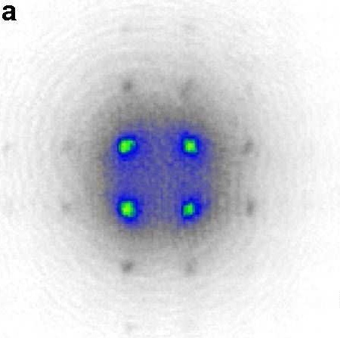
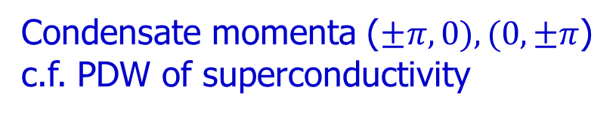
Neel ordering and non-zero momentum condensations
Condensate momenta ($±π,0), (0,±π$)
c.f. PDW of superconductivity
$$p_{x}^{ }$$
$$p_{y}^{ }$$
C. Wu, Mod. Phys. Lett. 23, 1(2009).
W. V. Liu and C. Wu, PRA 2006.
Hemmerich group PRL 114, 115301 (2015).
Notes:
Now put many sites together and consider phase coherence among them. Look at the sigma bonding, due to the odd parity of p-orbitals, two px orbitals are actually with a pi-phase difference, i.e., here is 1 and here is -1. In contrast, the pi-bonding locks the two py-orbitals with the same phase. Hence, the neighboring sites are coupled antiferomagnetically. For a square lattice, the Neel type ordering develops.
Experimentally, p-orbital condensates have been realized with a slightly different design by Hemmerich’s group, but the essential physics is the same. If transformed to momentum space, the condensate momenta are non-zero, similar to the pair-density-wave of superconductivity. Furthermore, the matter-wave interference measurement shows a pi-phase mismatch between px and py orbitals, which manifests the complex factor of i. This is very similar to Dal Van-Harlingen’s corner junction experiment testing the d-wave symmetry.

Slide 14
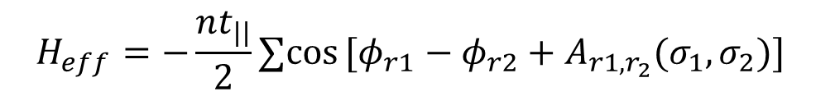
Vector potential from the p-orbital symmetry
Onsite U(1) phase and Ising variable.
the phase of the right lobe.
direction of the Lz.
Inter-site Josephson coupling.
$$H_{eff}=−\frac{nt_{||}}{2}∑cos[φ_{r1}−φ_{r2}+A_{r1,r_{2}}(σ_{1},σ_{2})]{ }$$
J. Moore and D. H. Lee, PRB, 2004.
Notes:
Now consider a general bond orientation. Since each site is a local vortex, an Ising variable sigma is used to represent its vorticity, and a U(1) variable to denote its phase in a particular direction, say, along the x-direction. The tunneling term contains the phase difference along the bond direction, including not only the U(1) phase difference, but also a vector potential, which arises from the p-orbital symmetry.

Slide 15




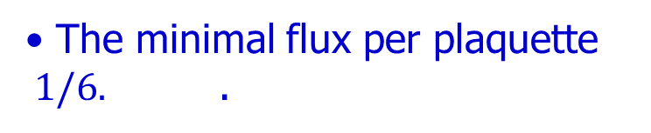
P-orbital BEC in a triangular lattice
The minimal flux per plaquette $1/6.$ .
$$−\frac{1}{3}$$
The stripe pattern minimizes the ground state vorticity.
$$\frac{1}{3}$$
$$\frac{1}{3}$$
The same analysis also applies to p+ip Josephson junction array.
$$−\frac{1}{3}$$
Notes:
For a triangular lattice, the total vorticity around the a plaquette is simply the sum of the total vorticity divided by 6 since each site is shared by 6 triangles. The minimal vorticity per plaquette is 1/6. Two triangles from a rhombohedral exhibiting the vorticity of 1/3. Then this pattern with staggered 1/3 and -1/3 vorticies can be straightforwardly scaled up to the entire 2D plane, which become the striped pattern of angular momentua. One entire row exhibits with p+ip, and another entire row with p-ip, minimizing the ground state vorticity.

Slide 16
Stripe ordering of orbital angular momentum
Rotational symmetries broken.
CW, W. Vincent Liu, J. Moore, and S. Das Sarma , PRL 97, 190406 (2006)
Observed experimentally in Zhifang Xu’s (SUST) group.
Plaquette loop current
cf. Current loop states in high Tc cuprate:
C. M. Varma, Phys. Rev. B 55, 14554 (1997).
S. Chakravarty, R. B. Laughlin, Dirk K. Morr, and Chetan Nayak, Phys. Rev. B 63, 094503 (2001)
Notes:
This striped pattern of orbital angular momentum breaks rotational symmetry. Zhifang Xu’s group is doing this experiment, and has already realized p-orbital BEC in the triangular optical lattice. They have observed rotational symmetry breaking, and I am also collaborating with his group. Around the rhombohedral plaquette, the theory further predicted the plaquette loop current, which is similar to the loop-current state studied in high Tc and other strongly correlated electron systems.

Slide 17
P-orbital BEC
beyond no-node theorem
Condensations at non-zero
momenta
Frustrated SF/SC
Charge “6e” SC
3-color model
Inter-orbital
f-wave pair density wave
Notes:
Next we consider the charge 6e superconductivity as a frustration problem based on Baxter’s 3-color problem.

Slide 18



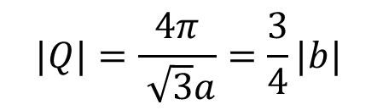

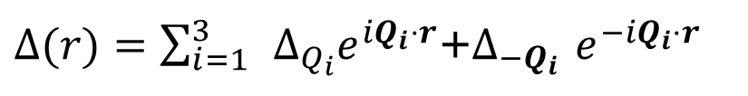




Unconventional Superconductivity in $CsV_{3}Sb_{5}$
$$K$$
$$b_{1}$$
$$b_{3}$$
$$Q_{3}$$
$$Q_{1}$$
$$Γ$$
$$Q_{2}$$
$$b_{2}$$
$$|Q|=\frac{4π}{ \sqrt{3}a}=\frac{3}{4}|b|$$
CDW 2*2 supercell (normal state)
Z. Q. Wang et al, arxiv:2110.06266.
X. Hu, arxiv:2205.08732
H Yao and Y. Zhou, PRL 129, 167001 (2022).
Y. Yu arxiv:2210.00023.
Pair density wave 4*4 supercell
$Δ(r)=\sum_{i=1}^{3}{ }{Δ_{Q_{i}}e}^{iQ_{i}⋅r}$+$Δ_{−Q_{i}}$ $e^{−iQ_{i}⋅r}$
Notes:
In the Kagome superconductors, STM experiment shows a modulation at the wavevector of ¾ of the reciprocal lattice vectors. This was interpreted by Z. Q. Wang’s as the pair-density-wave state with 3 pairs of pairing wave vectors Q1,2,3 and their negatives. Their superposition gives rise to the PDW pattern.

Slide 19
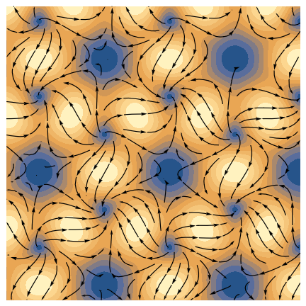

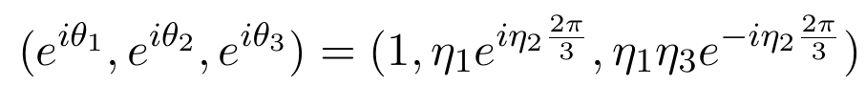



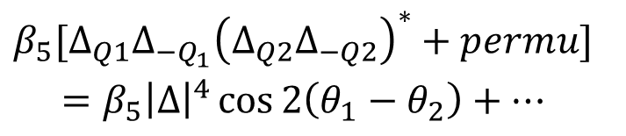

Vortex-anti vortex lattice
Phase lock: $β_{5}>0$
$${\begin{aligned}β_{5}[Δ_{Q1}Δ_{−Q_{1}}{\left(Δ_{Q2}Δ_{−Q2}\right)}^{∗}+permu] \\ =β_{5}{\left|Δ\right|}^{4}\cos{2\left(θ_{1}−θ_{2}\right)}+…\end{aligned}}_{ }$$
Xu, Yang, CW, arxiv arXiv:2010.05362
H. Yao, Y. Zhou, PRL2022
Z. Q. Wang et al, arxiv:2110.06266.
8-fold degeneracies:
time reversal symmetry: ${ η}_{2}=±1$
$η_{2}=−1 η_{1,3}=−1$
$π$-phase shift: $η_{1,3}=±1$
Half-period shift with respect to 4*4 PDW pattern
Notes:
Further analyses show that this problem can be mapped to a three-band superconductor with positive quadratic Josephson couplings. It exhibits 8 different patterns as characterized by 3 Ising variables, eta1,2, and 3. A typical PDW configuration exhibits a vortex lattice configuration. Flipping the value of eta2 corresponds to a time-reversal transformation, and flipping the values of eta1 and eta2 corresponds to translating the vortex lattice with the half periodicity of the 4*4 PDW pattern.

Slide 20
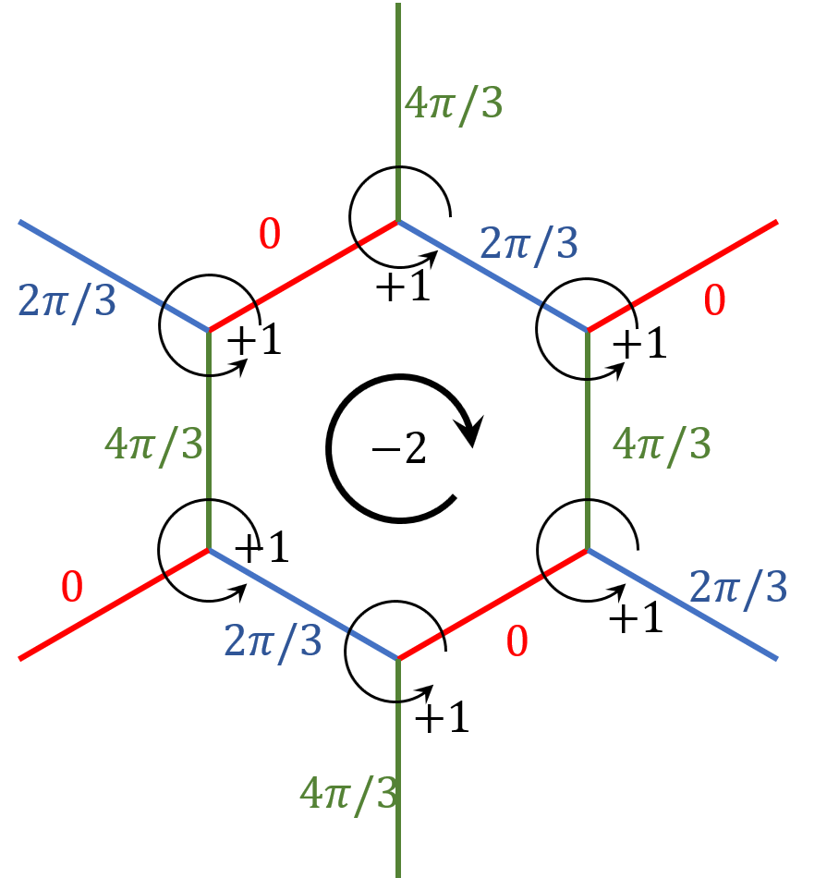


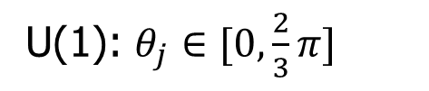



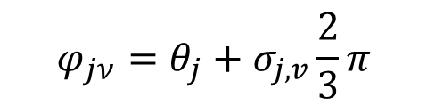


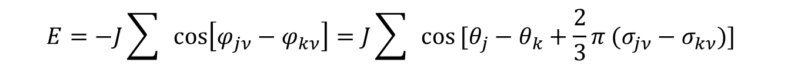


Map to p-orbital honeycomb lattice
Single vortices as lattice sites.
$$φ_{jν}=θ_{j}+σ_{j,v}\frac{2}{3}π$$
$$4π/3$$
$$0$$
$$σ_{j,v}=0, 1, 2→R, G, B$$
$$2π/3$$
$$−1$$
U(1): $θ_{j}∈[0,\frac{2}{3}π]$
$$2π/3$$
$$0$$
$$+1$$
$$4π/3$$
$$E=−J\sum{ }cos\left[φ_{jν}−φ_{kν}\right]=J\sum_{ }{ }cos[θ_{j}−θ_{k}+\frac{2}{3}π (σ_{jν}−σ_{kν})]{ }$$
Z. M. Pan, Lu, Yang, CW, arXiv:2209.13745
Notes:
We switch to the real space to examine the phase coherence problem. The single-vortices form a honeycomb lattice, then from the symmetry aspect, it is the same as the p-orbital BEC problem in a honeycomb lattice. Along the three bonds from each vortex to its three neighboring vortices, the phase difference is 120 degree. We map them to the colors of R, G, B. We also need a continuous U(1) variable on each site taking values from 0 to 120 degree.

Slide 21
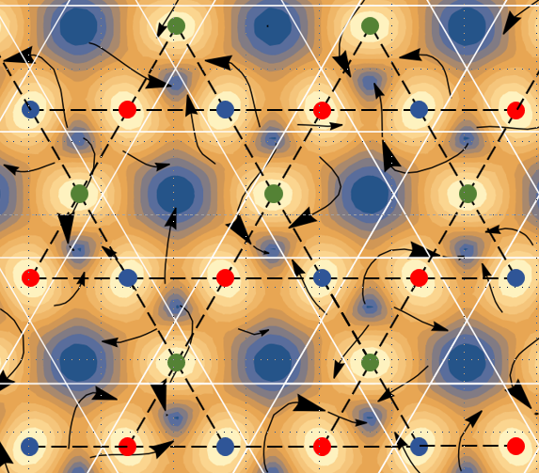

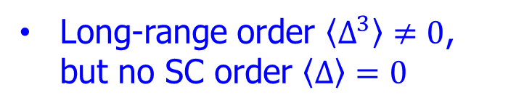

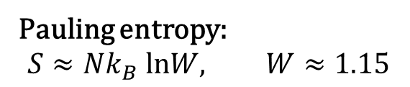
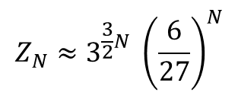
3-coloring problem (Baxter 1970) → charge 6e
Bond color ($Z_{3}$ variable)
Dual Kagome lattice 4/3*4/3
6 coloring patterns → two vorticities
Extensive entropy favored by temperature
$$Z_{N}≈3^{\frac{3}{2}N} {\left(\frac{6}{27}\right)}^{N}$$
Long-range order $〈Δ^{3}〉≠0$, but no SC order $〈Δ〉=0$
Pauling entropy:
$$S≈Nk_{B} lnW, W≈1.15$$
$$1 \left(R\right),e^{\frac{i2}{3}π}\left(G\right), e^{i\frac{4}{3}π}(B)$$
Notes:
Now focus on the color variables. If a bond is painted with the same color, it means phase coherence. This is the celebrated Baxter’s 3 coloring problem. 6 coloring patterns around a vertex corresponds to two opposite vorticites, and each vorticity is associated with three rotations. The allowed configuration numbers scale exponentially as system size, hence, the entropy is extensive, and hence is favorable by temperature. The Pauling-like entropy is estimated as ln1.15.
Such a state does not exhibit long-range order of superconductivity, but since the cubic of the colors are the same, hence, they do exhibit long-range order in terms of \Delta^3. In this sense, they could be called charge 6e state.

Slide 22



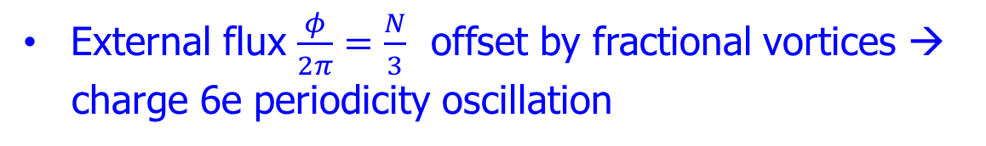





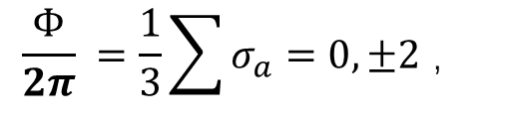
Fractional vortices
$$σ_{6}$$
Domain wall
$$σ_{1}$$
$$+1$$
$$σ_{5}$$
$$σ_{2}$$
$$−1$$
$$σ_{4}$$
$$σ_{3}$$
Color constraint satisfied:
Fractional vortices
J. Moore and D. H. Lee, PRB, 2004.
$${\frac{Φ}{2π}}_{ }=\frac{1}{3}\sum{σ_{a}}=0,±2 ，$$
(5+, 1-) mod 1 → 1/3
Z. M. Pan, Lu, Yang, CW, arXiv:2209.13745
External flux $\frac{φ}{2π}=\frac{N}{3}$ offset by fractional vortices →
charge 6e periodicity oscillation
Notes:
So far we only consider the constrained coloring configurations, which could give rise to integer vortices around each plaquette. On the other hand, if a plaquette breaks the coloring rule, say, with 5 vortices and one antivortex, then the plaquette vorticity is 1/3, which gives rise to a domain wall of mismatch colored bonds. Hence, the global vorticity is quantized in terms of N/3. Hence, the Little-Parks type experiments should exhibit 6e oscillations.

Slide 23
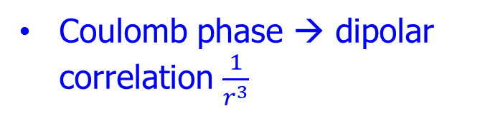

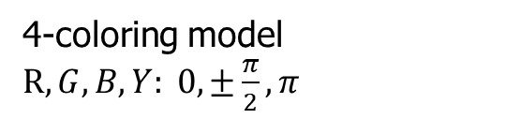
4-boson superfluidity – diamond lattice
P-orbital BEC with cubic anisotropy.
4-coloring model $R, G, B, Y: 0,±\frac{π}{2}, π$
$$4!=24, \vec{L}||±\hat{x},±\hat{y},±\hat{z}$$
Coulomb phase → dipolar correlation $\frac{1}{r^{3}}$
G. W. Chern, CW, PRL 112, 020601 (2011).
Notes:
We have also generalized the 3-coloring problem to the diamond lattice, the 4-coloring problem. Its physical background is the p-orbital BEC with the cubic anisotropy. Each color corresponds to the superfluid phases of 0, 90, 180, 270 degrees. The coloring pattern can be divided by 6 chiralities representing the angular momentum directions long the major axes. Monte Carlo simulations show that the superfluid phase correlations decay as 1/r^3, which is a signature of a Coulumb phase.

Slide 24
P-orbital BEC
beyond no-node theorem
Condensations at non-zero
momenta
Frustrated SF/SC
Charge “6e” SC
3-color model
Inter-orbital
f-wave pair density
Notes:
Next we consider the f-wave pair density as a consequence of frustration from inter-orbital pairing.

Slide 25
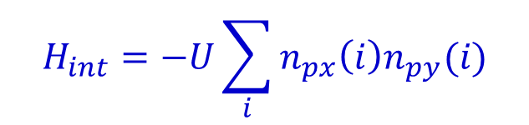
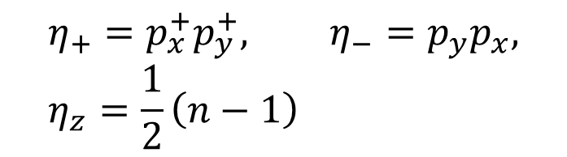


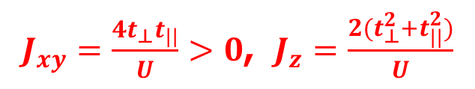
Frustrated Cooper pair hopping
Spinless fermion pairing (inter-orbital)
$${−t}_{⊥}$$
$$H_{int}=−U\sum_{i}{n_{px}\left(i\right)n_{py}(i)}$$
$$η_{+}=p_{x}^{+}p_{y}^{+}, η_{−}=p_{y}p_{x}, η_{z}=\frac{1}{2}\left(n−1\right)$$
$$t_{//}$$
$J_{xy}=\frac{4t_{⊥}t_{||}}{U}>0$, $J_{z}=\frac{2(t_{⊥}^{2}{+t}_{||}^{2})}{U}$
Frustrated pair hopping
$$H_{eff}=\frac{J_{xy}}{2}∑\left(η_{+}\left(i\right)η_{−}\left(j\right)+η_{−}\left(i\right)η_{+}\left(j\right)\right)+J_{z}∑η_{z}\left(i\right)η_{z}\left(j\right)$$
H.H. Hung, W. C.Lee, CW, PRB 83, 144506 (2011)
Notes:
We consider the p-orbital problem in the triangular lattice, but now switch to fermions. Spinless fermions are considered with an inter-orbital attraction. In the strong coupling limit, on-site pairing is expected, and the Copper pair hopping problem can be mapped to a pseudo-spin SU(2) exchange model. Since the sigma and pi-bondings exhibit opposite signs, the pair hopping Jxy integral is positive. This is antiferromagnetic like, leading to frustration in the triangle lattice.

Slide 26


Umbrella configuration of CDW and gap function
A
BCS results – 3-site supercell
$$〈G\left|η_{x}(i)\right|G〉=ReΔ_{i},$$
$〈G\left|η_{y}\right|G〉=ImΔ_{i}, 〈G\left|η_{z}\right|G〉=\frac{1}{2}(n$-1)
C
B
$$\frac{t_{⊥}}{t_{||}}=0.2,\frac{U}{t_{||}}=6$$
Notes:
Guided by the above picture, we performed the BCS mean-field theory solution allowing a 3-site supercell structure. The pseudo-spin configurations are plotted as 3-vector, whose xy-component represents Cooper pairing and z-component represents density. These pictures show as varying filling number, the order parameter exhibits a umbrella configuration, and the pairing gap function switch signs in real space.

Slide 27




F-wave pair density wave
Real space gap function – sign change
$${Δ(\vec{r})}_{ }=\sin{{\vec{G}}_{1}⋅\vec{r}+\sin{ {\vec{G_{ }}}_{2}⋅\vec{r}+sin{\vec{G}}_{3}⋅\vec{r} }}$$
$${\vec{G}}_{1}=(\frac{4π}{3a},0)$$
$${\vec{G}}_{2}=(−\frac{2π}{3a},\frac{2π}{\sqrt{3}a},)$$
$${\vec{G}}_{3}=(−\frac{2π}{3a},−\frac{2π}{\sqrt{3}a},)$$
$$n_{A}=n_{B}=1.54, n_{C}=0.15$$
H.H. Hung, W. C.Lee, CW, PRB 83, 144506 (2011)
Notes:
At certain fillings, the mixing between the PDW and CDW is found, which can be unified by the pseudospin SU(2) algebra. The PDW is non-zero on two of the three sublattices exhibiting with staggered signs as a mixture of three wavevectors G1, G2, G3. In real space, they exhibit a F-wave structure.

Slide 28






Weak coupling picture
Inter-orbital pairing → patches on the Fermi surface → non-zero momentum pairing
$${\vec{G}}_{2}$$
$$−{\vec{k}+{\vec{G}}_{2}}_{ }$$
$${\vec{k}}_{ }$$
$${\vec{G}}_{1}=(\frac{4π}{3a},0)$$
$${\vec{G}}_{3}$$
Brillouin zone and the reduced one
f-wave symmetry
Notes:
We can understand the PDW structure from momentum space. Usual pairing occurs between momentum k and –k, but they are with the same orbitals. Here, pairing interaction takes place between different orbitals, then their corresponding Fermi surface patches are not related by time-reversal symmetry. For example, the red and the yellow spots, the pairing between them gives rise to the pairing wave vector G2.

Slide 29


Condensation at non-zero momentum
P-orbital BEC
beyond no-node theorem
$${−t}_{⊥}$$
$$t_{//}$$
Frustrated SF/SC
Charge “6e” SC
3-color model
Inter-orbital
f-wave PDW
Notes:
In summary, I have presented a concept of frustrated superfluidty or superconductivity. The key idea is the condensation at non-zero momentum, such that they can exhibit sign change and generate frustrations. They can exhibit in the meta-stable excited condensate, and pair-density-wave states, and also provide a possible mechanism for the charge 6e state.

Slide 30
Back up

Slide 31

p-orbital Bose-Hubbard model (2D square lattice)
Anisotropic hopping and odd parity:
σ-bond
π-bond
On-site interaction → the orbital version of “Hund’s rule”.
are spatially more extended than polar states
Notes:
Next I will first prove this symmetry and present its physical consequences.

Slide 32
p-band Bose-Hubbard model in triangular lattice
Interactions select the condensate as (weak coupling analysis):
CW, W. V. Liu, J. Moore, and S. Das Sarma, Phys. Rev. Lett. (2006).

Slide 33

6e
4e
2e
e?

