Slide 1
Jordan-Wigner Transformation and Topological characterization of quantum phase transitions in the Kitaev model
Guang-Ming Zhang (Tsinghua Univ)
Xiaoyong Feng (ITP, CAS)
T. Xiang (ITP, CAS)
Cond-mat/0610626

Slide 2
Outline
Brief introduction to the Kitaev model
Jordan-Wigner transformation and a novel Majorana fermion representation of spins
Topological characterization of quantum phase transitions in the Kitaev model

Slide 3
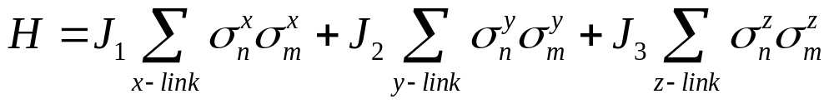
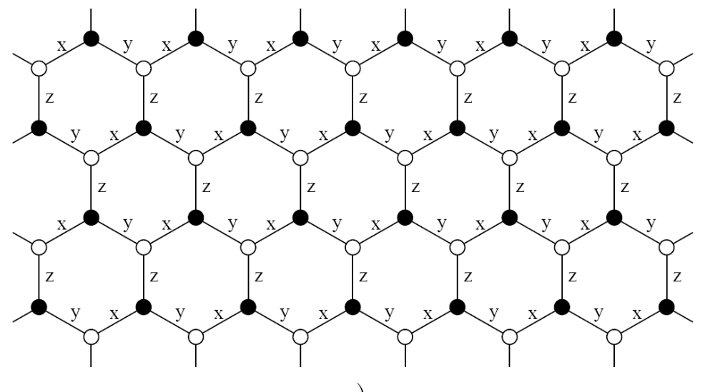
Kitaev Model
Ground state can be rigorously solved
A. Kitaev, Ann Phys 321, 2 (2006)

Slide 4
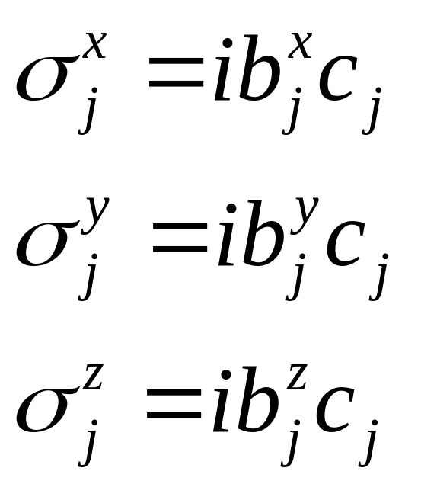
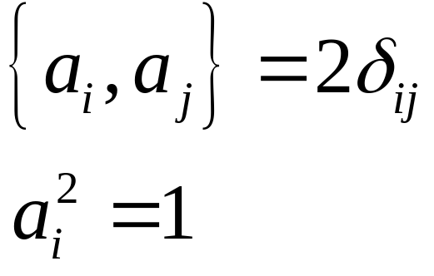
4 Majorana Fermion Representation of Pauli Matrices
c_{j}, b_{j}^{x}, b_{j}^{y}, b_{j}^{z} are Majorana fermion operators
Physical spin: 2 degrees of freedom per spin
Each Majorana fermion has 2^{1/2} degree of freedom
4 Majorana fermions have totally 4 degrees of freedom

Slide 5
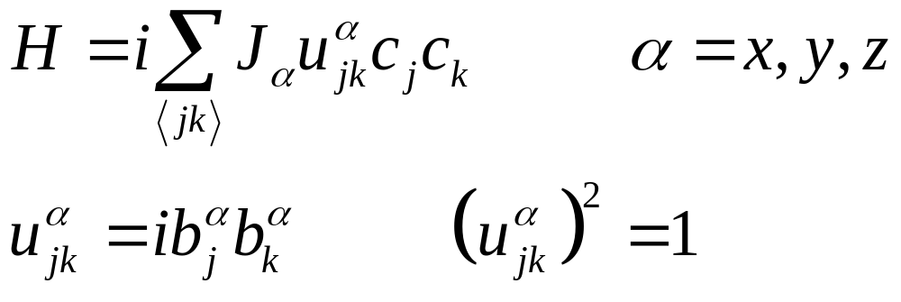
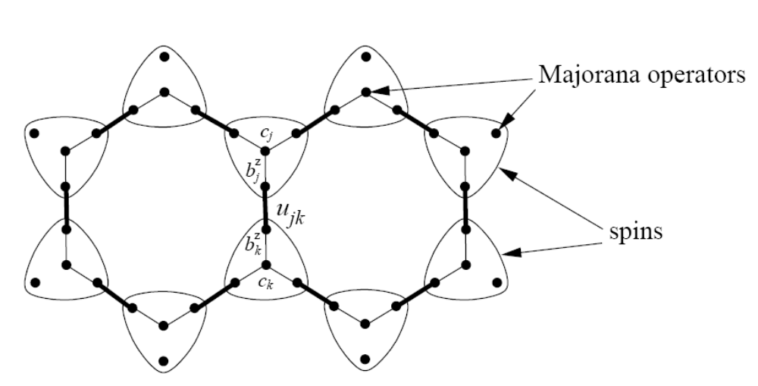
4 Majorana Fermion Representation of Kitaev Model
Good quantum number
y
x
z
x
y

Slide 6
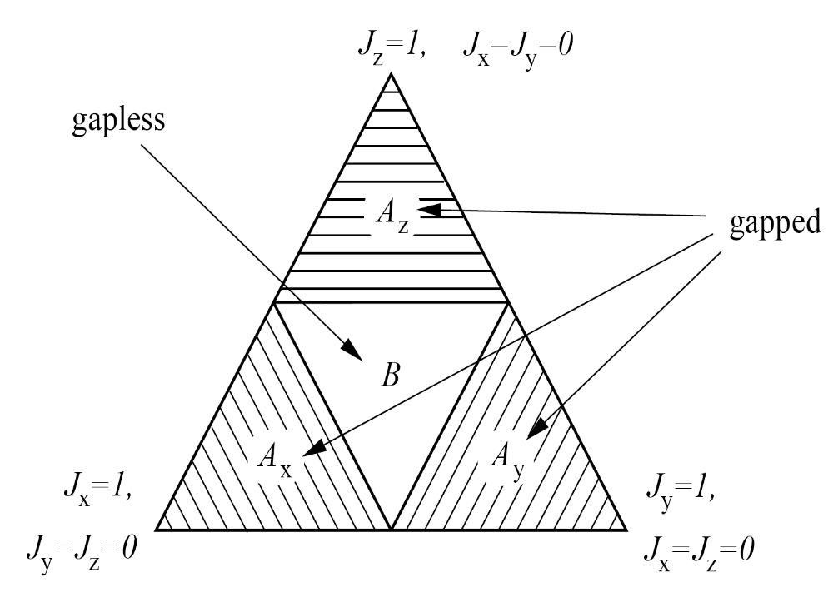
2D Ground State Phase Diagram
The ground state is in a zero-flux phase (highly degenerate, u_{jk} = 1), the Hamiltonian can be rigorously diagonalized
non-Abelian anyons in this phase can be used as elementary “qubits” to build up fault-tolerant or topological quantum computer

Slide 7
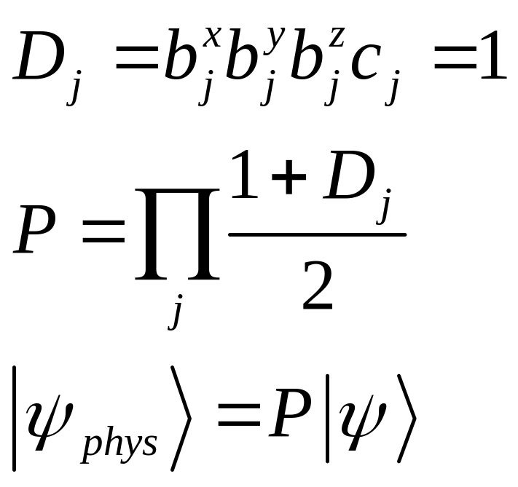
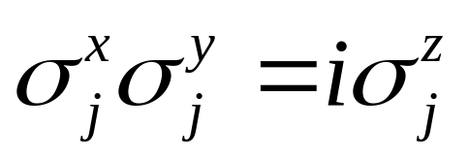
4 Majorana Fermion Representation: constraint
Eigen-function in the extended Hilbert space

Slide 8
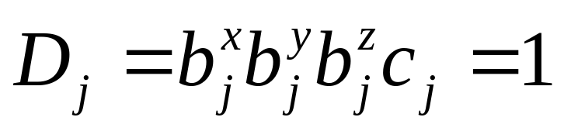
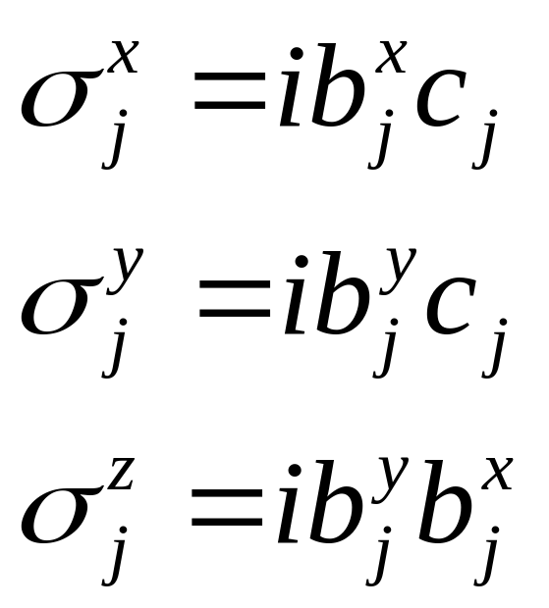
3 Majorana Fermion Representation of Pauli Matrices
Totally 2^{3/2} degrees of freedom, still has a hidden 2^{1/2} redundant degree of freedom

Slide 9
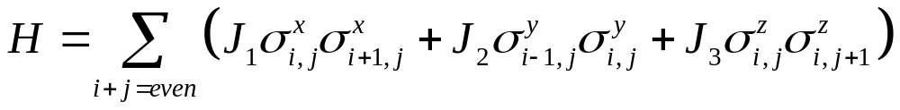
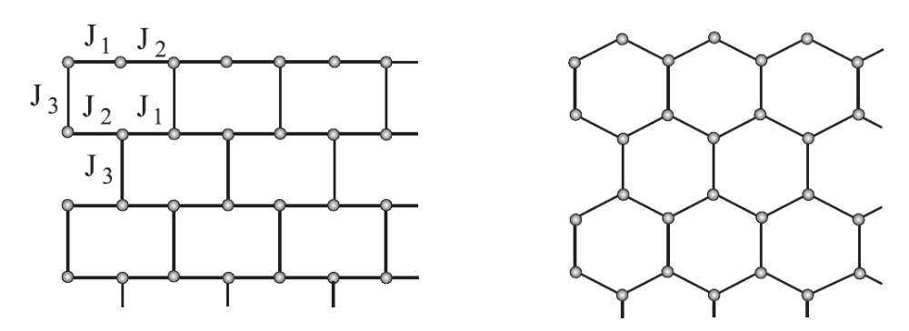
Kitaev Model on a Brick-Wall Lattice
x y x y
x y x y x y
z z z z
y x y x
y x y x y x
z z z
Brick-Wall Lattice honeycomb Lattice

Slide 10
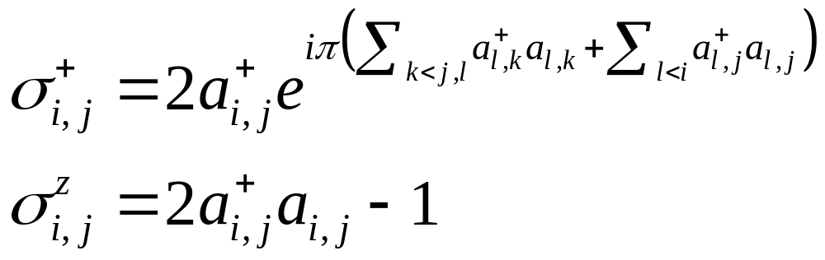
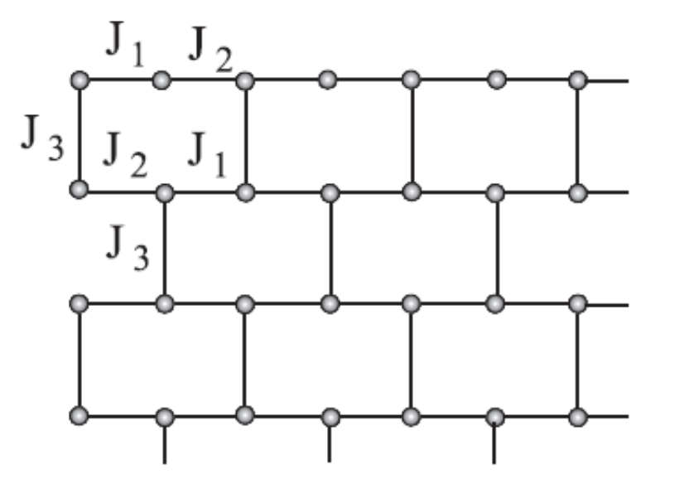
Jordan-Wigner Transformation
Represent spin operators by spinless fermion operators

Slide 11
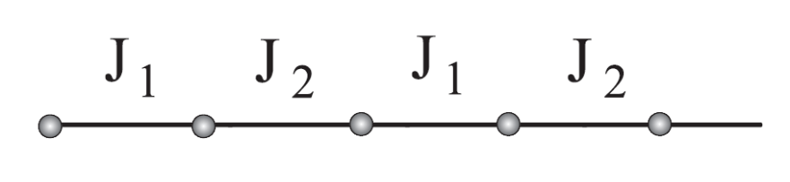
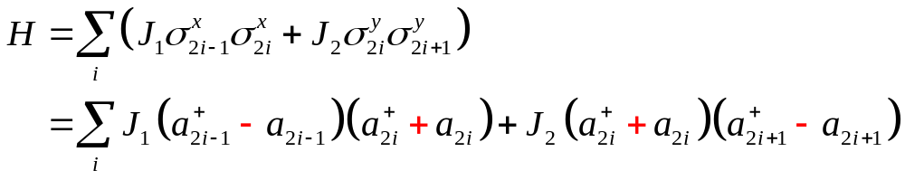
Along Each Horizontal Chain
x y x y

Slide 12
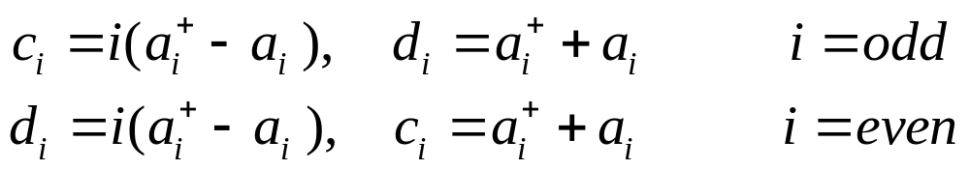
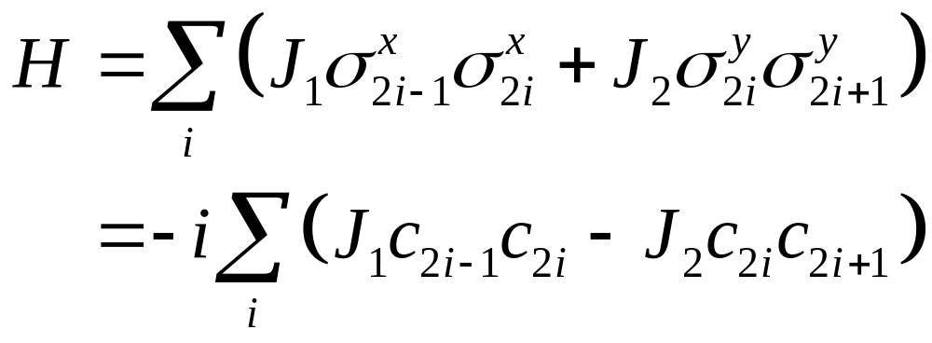
Two Majorana Fermion Representation
Onle c_{i}-type Majorana fermion operators appear!

Slide 13
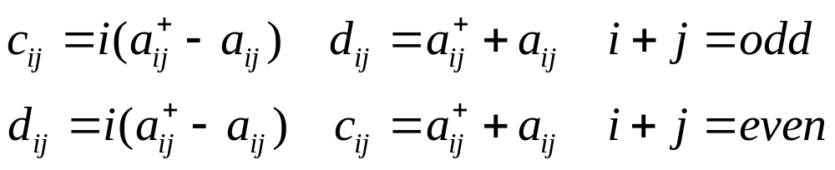
Two Majorana Fermion Representation
c_{i} and d_{i} are Majorana fermion operators
A conjugate pair of fermion operators is represented by two Majorana fermion operators
No redundant degrees of freedom!

Slide 14
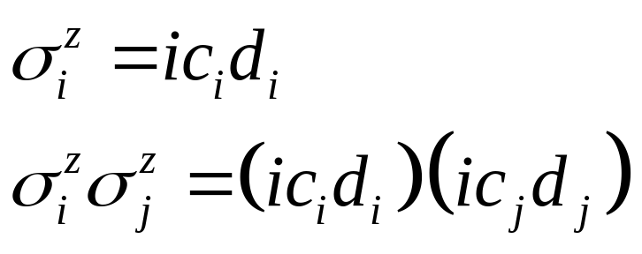
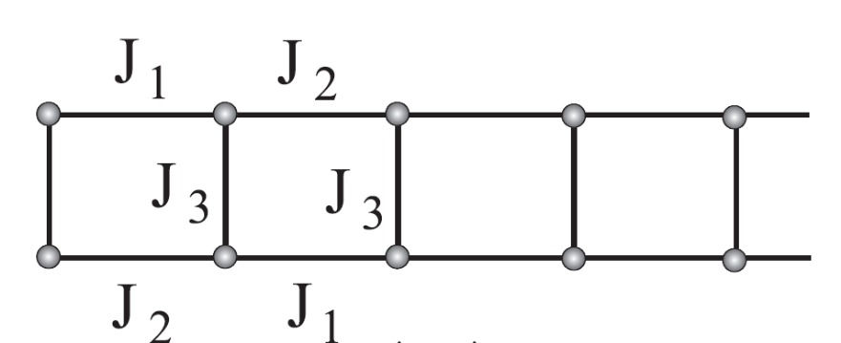
Vertical Bond
No Phase String

Slide 15
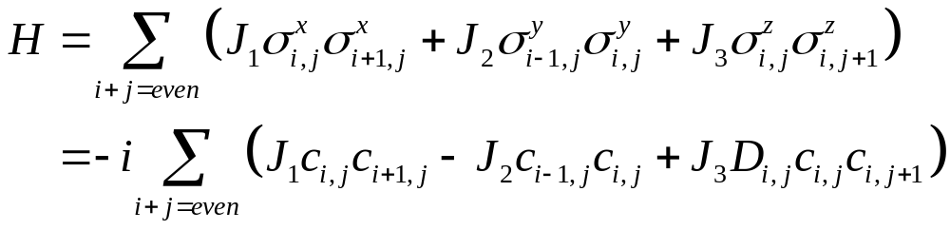
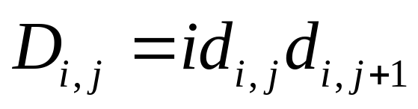
2 Majorana Representation of Kitaev Model
good quantum numbers
Ground state is in a zero-flux phase D_{i,j} = D_{0,j}

Slide 16
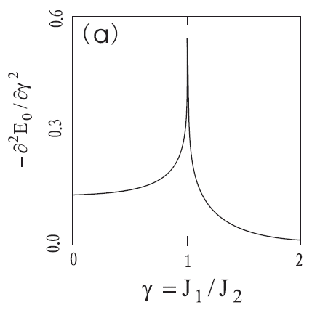
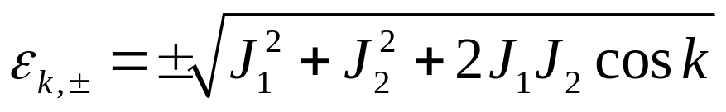
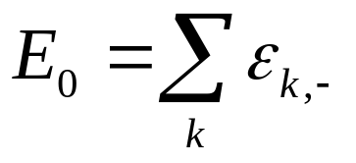
Phase Diagram
Single chain
x y x y
0 1 J₁/J₂
Critical point
Quasiparticle excitation:
Ground state energy

Slide 17
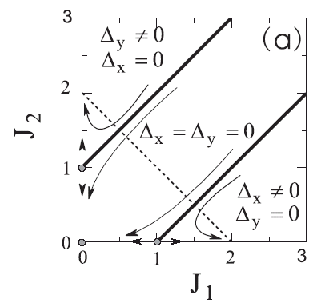
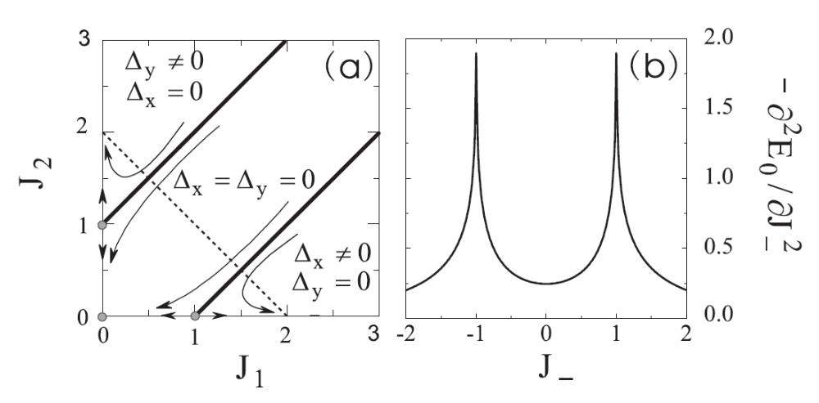
Phase Diagram
J₃=1
Critical lines
Two-leg ladder
= J₁ – J₂

Slide 18
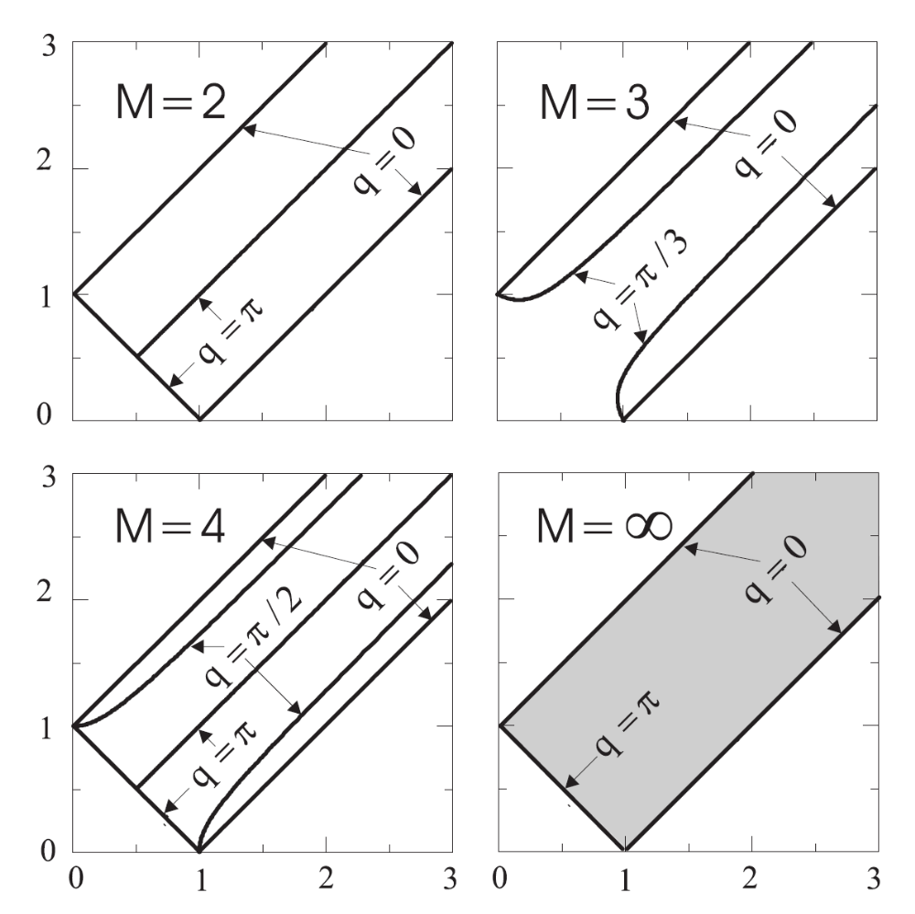
Multi-Chain System
J₃=1
Chain number = 2 M
Thick Solid Lines:
Critical lines
How to characterize these quantum phase transitions?

Slide 19
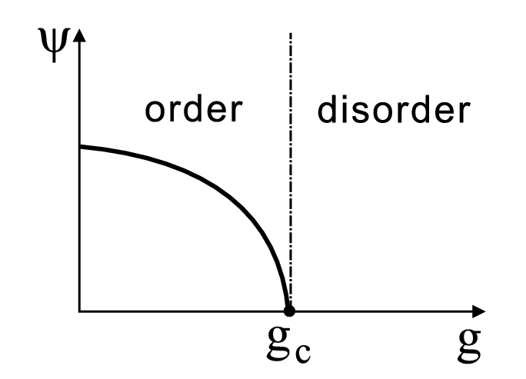
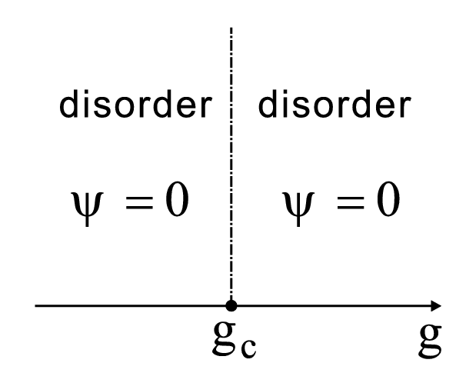
Classifications of continuous phase transitions
Conventional: Landau-type
  Symmetry breaking
  Local order parameters
Topological:
  Both phases are gapped
  No symmetry breaking
  No local order parameters

Slide 20
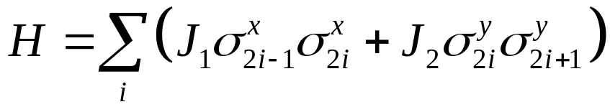
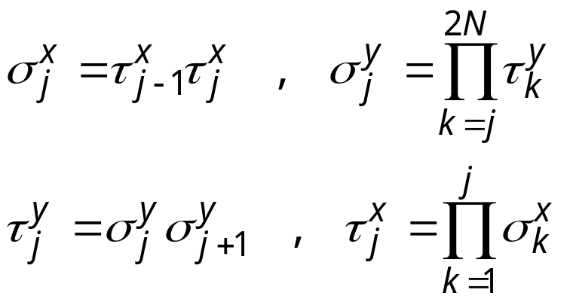
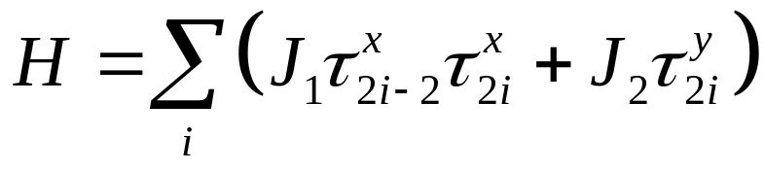
QPT: Single Chain
x y x y
Duality Transformation

Slide 21
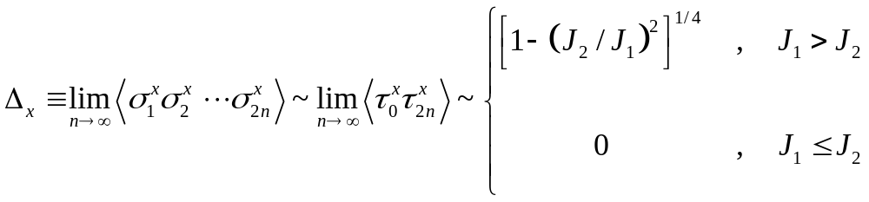
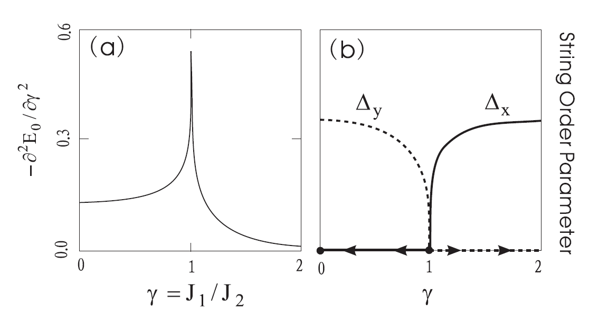
Non-local String Order Parameter

Slide 22
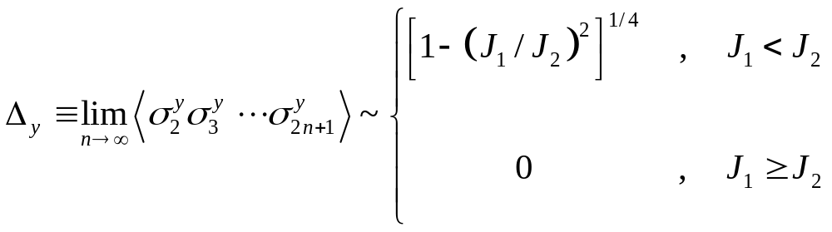
Another String Order Parameter

Slide 23
Two-leg ladder
J₃ = 1
= J₁ – J₂

Slide 24
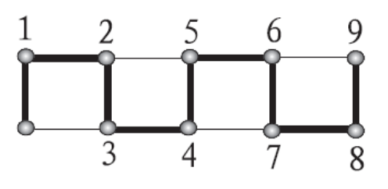
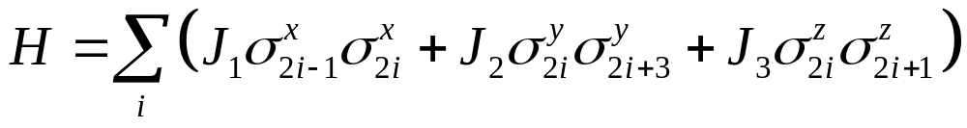
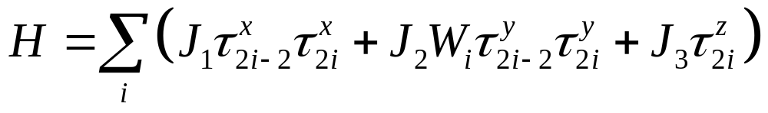
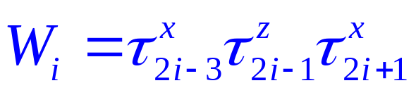
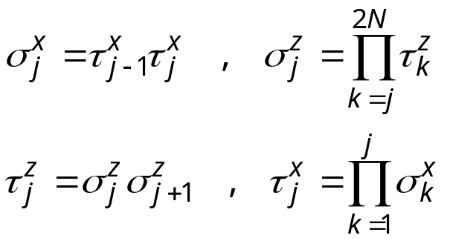
Phase I: J₁ > J₂ + J₃
In the dual space:
W₁ = -1 in the ground state

Slide 25
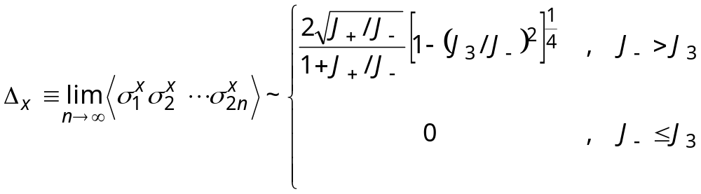
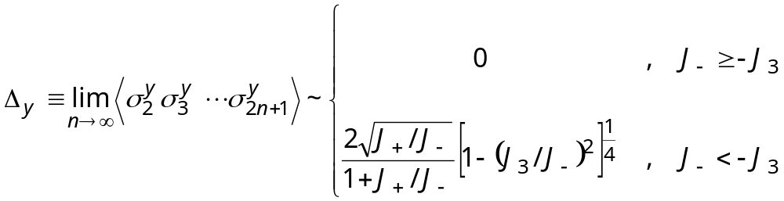
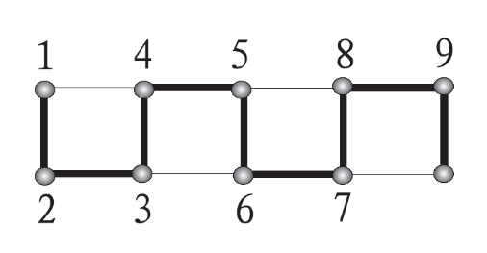
String Order Parameters

Slide 26
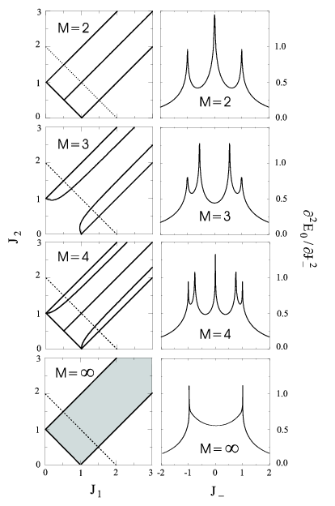
QPT: multi chains
Chain number = 2 M

Slide 27
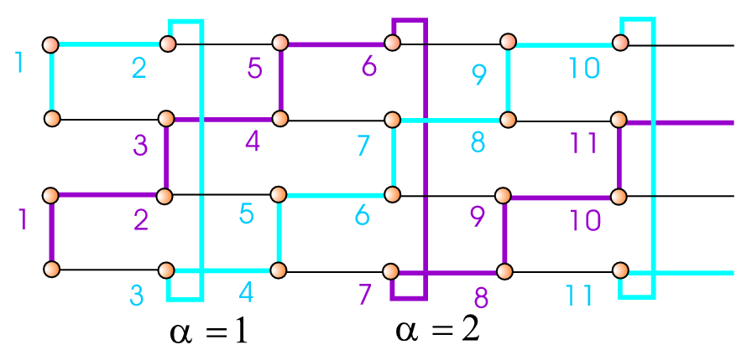
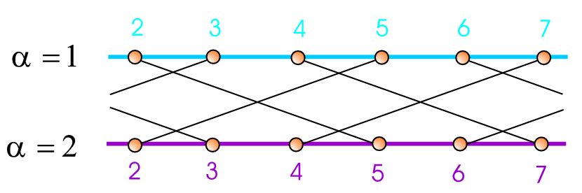
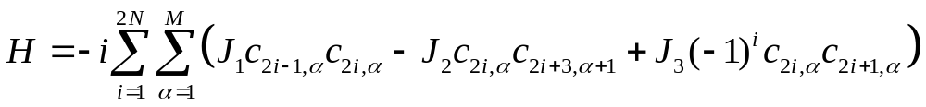
QPT in a multi-chain system
4-chain ladder M = 2

Slide 28



Fourier Transformation

Slide 29

q = 0
c_{i,0} is still a Majorana fermion operator
H_{q=0} is exactly same as the Hamiltonian of a two-leg ladder

Slide 30

String Order Parameter

Slide 31

q = π
c_{i,π} is also a Majorana fermion operator
H_{q=π} is also the same as the Hamiltonian of a two-leg ladder, only J₂ changes sign

Slide 32

String Order Parameter

Slide 33
Summary
Kitaev model = free Majorana fermion model with local Ising field without redundant degrees of freedom
Topological quantum phase transitions can be characterized by non-local string order parameters
In the dual space, these string order parameters become local
The low-energy critical modes are Majorana fermions, not Goldstone bosons

