Slide 1
The Physics of the Perfect Curve
Modeling Soccer Ball Spin Velocity & Speed from Kicking Force Vectors

Slide 2
00 // fundamental physics
When Kick force vector pass the center of the ball
F x T = M x V
F - the kick force (newton)
T – duration of the force exerted on the ball (second)
M – ball mass (kg)
V – ball launching speed after the kick (meter/second)
ball travels without spin
kick force

Slide 3
01 // Core Kinematics & Mechanics
Off-Center Contact Point: Striking converts translation force into angular momentum.
Vector Splitting: Impact splits into orthogonal pairs: Normal and Tangential.
Frictional Coefficient: Bound interfaces dictate energy transfer efficiency.
kick force
Normal
Tangential
kick force

Slide 4
02 // Governing Mathematical Framework
Torque Equation:
τ = F_tangential * r // Twisting moment at ball radius boundary
Rotational Inertia (Sphere):
I = (2/3) * m * r^2 // Resistance profile to angular spin
Angular Velocity Matrix:
ω = (τ * Δt) / I // Final systemic rotational velocity
r
Torgue
F
F_Normal
F_Tangential
kick force

Slide 5
03 // Test Environment Constants
- m (Ball Mass) = 0.43 kg # Official Size 5
- r (Ball Radius) = 0.11 m # 11 cm exact radius
- F (Impact Force) = 1000.0 N # Raw force vector
- θ (Off-Axis Angle)= 15.0 deg # Offset delta
- Δt (Dwell Time) = 0.01 s # 10ms contact window
[CONSOLE_LOG]
> INITIALIZING ENVIRONMENT...
> MASS BALANCED
> CODES ACTIVE
> SYSTEM STATUS: STABLE

Slide 6
04 // Execution Blueprint: Translation Vector
[Step 1] Project directional force vectors:
F_normal = 1000 * cos(15°) = 965.93 N
F_tangential = 1000 * sin(15°) = 258.82 N
[Step 2] Solve for linear velocity (v):
v = (F_normal * Δt) / m = (965.93 * 0.01) / 0.43
--> [Result Speed: 22.46 m/s (80.85 km/h)]

Slide 7
05 // Execution Blueprint: Rotation Vector
[Step 3] Compute rotational inertia (I):
I = (2/3) * m * r^2 = 0.00347 kg·m²
[Step 4] Extract Torque output (τ):
τ = F_tangential * r = 28.47 N·m
[Step 5] Compute terminal spin output (ω):
ω = (τ * Δt) / I = 82.08 rad/s
--> [Result Spin Velocity: ~783.79 RPM]

Slide 8
06 // Runtime Mechanics: The Magnus Effect
Boundary Layer Friction: Spinning hulls drag fluid layers, creating asymmetry.
Pressure Field Instability: High local speed generates low static pressure drop (Bernoulli).
Deflection Force Matrix: Net structural delta forces vector push toward low-pressure.

Slide 9
07 // System Optimization & Takeaways
Trade-off Matrix: Increasing θ yields more spin but drops forward efficiency at 1-cos(θ).
Maximize Contact Frame (Δt): Dragging or warping contact maximizes physical energy delivery.
Surface Roughness Bounds: Textures prevent boundary slip, aligning flights directly to code.

Slide 10
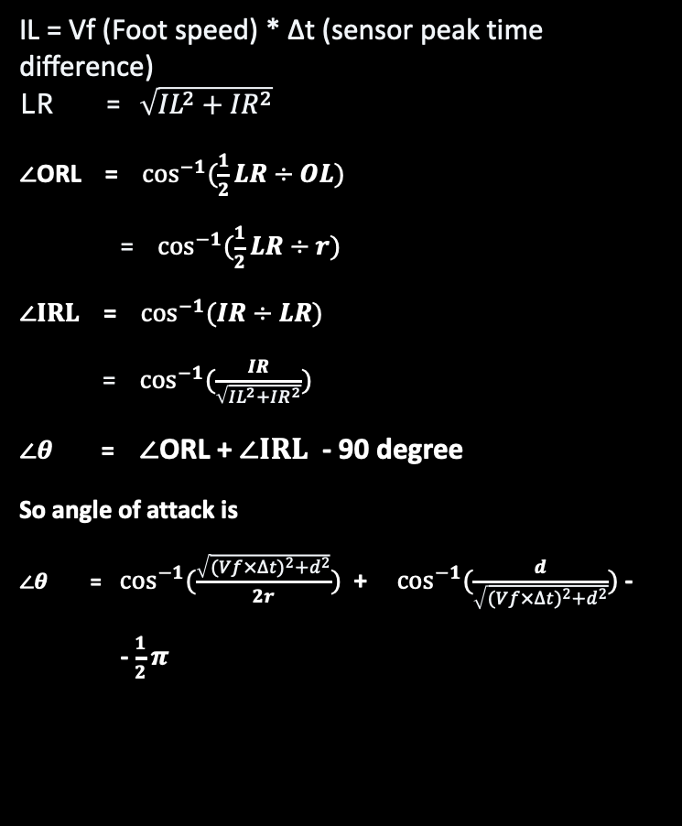
∠ABC=90∘
∠ABC=90∘
∠ABC=90∘
02 // using Force sensor peak time difference
IL = Vf (Foot speed) * Δt (sensor peak time difference)
LR = $\sqrt{{IL}^{2}+{IR}^{2}}$
$∠$ORL = $\cos^{−1}{(\frac{1}{2}LR÷OL)}$
= $\cos^{−1}{(\frac{1}{2}LR÷r)}$
$∠IRL$ = $\cos^{−1}{(IR÷LR)}$
= $\cos^{−1}{(\frac{IR}{\sqrt{{IL}^{2}+{IR}^{2}}})}$
$∠θ$ = $∠$ORL + $∠IRL$ - 90 degree
So angle of attack is
$∠θ$ =$\cos^{−1}{(\frac{\sqrt{{(Vf×∆t)}^{2}+d^{2}}}{2r})}$ + $\cos^{−1}{(\frac{d}{\sqrt{{(Vf×∆t)}^{2}+d^{2}}})}$ -
- $\frac{1}{2}π$
L: contact point of left sensor on the ball
R: contact point of right sensor on the ball
O: center of the ball
R: contact point of right sensor on the ball
I: initial position of left sensor when right sensor touch the ball
r: ball radius
O: center of the ball
R: contact point of right sensor on the ball
r
O
L
θ
Foot speed * Δt
I
R
d (sensor distance)
Cleat left sensor
Cleat right sensor

Slide 11

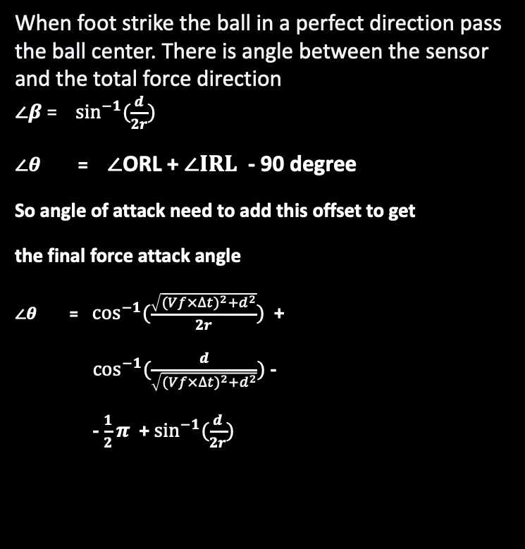
∠ABC=90∘
∠ABC=90∘
∠ABC=90∘
02 // using Force sensor peak time difference
When foot strike the ball in a perfect direction pass the ball center. There is angle between the sensor and the total force direction
$∠β$ = $\sin^{−1}{(\frac{d}{2r})}$
$∠θ$ = $∠$ORL + $∠IRL$ - 90 degree
So angle of attack need to add this offset to get
the final force attack angle
$∠θ$ =$\cos^{−1}{(\frac{\sqrt{{(Vf×∆t)}^{2}+d^{2}}}{2r})}$ +
$\cos^{−1}{(\frac{d}{\sqrt{{(Vf×∆t)}^{2}+d^{2}}})}$ -
- $\frac{1}{2}π$ + $\sin^{−1}{(\frac{d}{2r})}$
L: contact point of left sensor on the ball
R: contact point of right sensor on the ball
O: center of the ball
R: contact point of right sensor on the ball
I: initial position of left sensor when right sensor touch the ball
r: ball radius
O: center of the ball
R: contact point of right sensor on the ball
r
O
$$β$$
Cleat left sensor
d (sensor distance)
Cleat right sensor

