Slide 1
Detecting selection in protein-coding sequences
Stephanie J. Spielman, PhD
stephanie.spielman@temple.edu

Slide 2
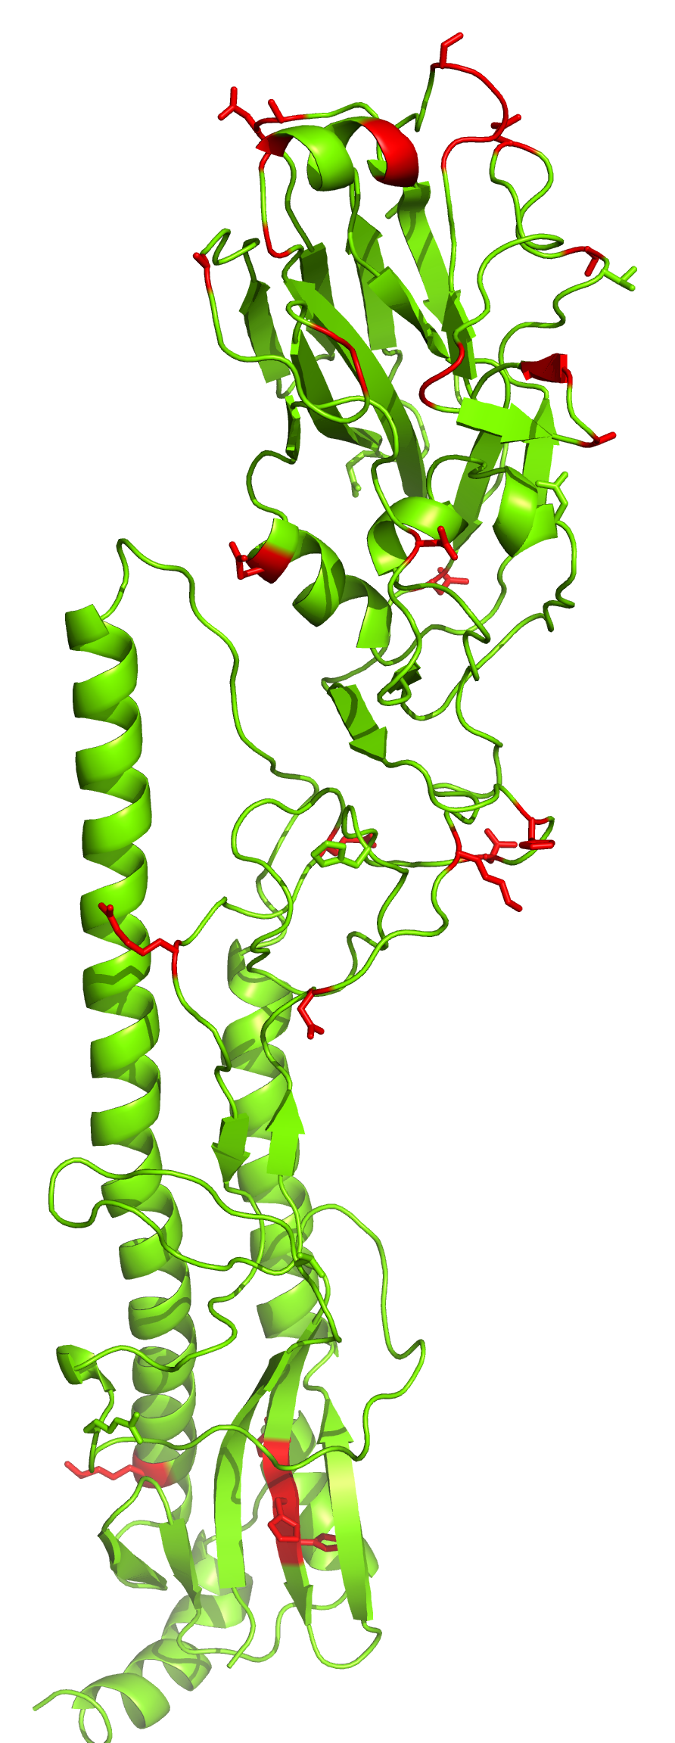
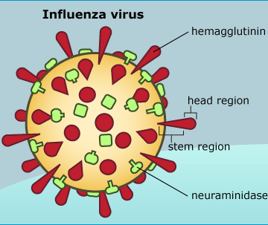
Natural selection leaves signatures of its activity in DNA
Modified from Meyer and Wilke
Mol. Biol. Evol. 30: 36-44 (2013)
Wertheim et al. Mol. Biol. Evol. 32:820-832 (2015)
Notes:
We study this information to gain insight into the biological and evolutionary processes that shape the natural world.
Hemagglutinin sequences have been studied to identify regions that are rapidly evolving, adaptive immune escape.
Shown in red. Identifying these sites contributes to rationale vaccine design so that antibodies can target the rapidly evolving regions.
Transition marked by several evolutionary patterns, such as genome reduction and reduced efficacy of NS.
Analysis here shows strength of NS is relaxed along bluer lineages, more stringent along red.
Consistent pattern where relaxed selection is commonly associated with endosymbiotic lineages.
How do we get this information? models.

Slide 3
We fit models using a multiple sequence alignment and a corresponding phylogeny
301 298
D6TVM5 DGTRLFYEDW G-----QGAP VVFVSSWALN ADMWEYQIPT
A6E8N4 --VNIFYEDL G-----AGKP VILIHGWPVS HEMWEYQVSS
C6RPU3 DGTYLYYKDW G-----EGLP IIFLHGWPLS SDAFEDQMLF
D4Z431 DGTAIFYRDF G-----QGQP VVFAHGWPLN ADAWDGQMLF
D2BAE6 DDTQIFFYEW G-----SGPP VLFIHGWPLN ADAWHDQMKA
D7AWN1 DGVEIFYKDW G-----SGRP VVFIHGWPLN ADAWEDQMKW
B1VU88 DGVDIFYKDW G-----RGRP VVFIHGWPLN GDAWQDQLKA
E4N663 DGVEIFYKDW G-----SGRP VVFIHGWPLN GDAWQDQLKA
E9UV19 DGTDIYYTDW G-----TGKP VVLSHGWPLS SDAWAAVAKL
A2QT50 DGAELFYKDW GNP---RGPI ITFSHGWPLS SDNWENQMMF
B6H7R1 DGAELYYKDW GNP---EGAI VTFSHGWPLS SDNWENQMIY
Q2UD06 DGAELFYKDW GNP---DGEI VTFSHGWPLS SDNWENQMFF
E9EM31 DGAELFYKDW GNP---KGPI VTFSHGWPLS SDNWENQMVF
Q89D86 DGVSIFYKDW G-----SGQP IVFSHGWPLT ADDWDAQMMF

Slide 4
Sequence evolution is modeled as a Markov process
A Markov Process has a specified set of states
Nucleotide: A C G T
Amino acid: A C D E F G H I K L M N P Q R S T V W Y
Codon: AAA, AAC, AAG, ..., TTT
Markov processes are memory-less
Transitions between states occur with a probability that depends only on the current state
Evolution acts on current genotype/phenotype, not on ancestral or future
Notes:
say time-reversible

Slide 5
From populations to Markov chains
time
Assumption that differences among sequences are fixed differences, i.e. substitutions

Slide 6
Sequence evolution is modeled as a Markov process
A Markov Process has a specified set of states.
Nucleotide: A C G T
Amino acid: A C D E F G H I K L M N P Q R S T V W Y
Codon: AAA, AAC, AAG, ..., TTT
Markov processes are memory-less
Transitions between states occur with a probability that depends only on the current state.
... T → A → G → T → C → A → G → ...
Time
Notes:
say time-reversible

Slide 7
Sequence evolution is modeled as a Markov process
A Markov Process has a specified set of states.
Nucleotide: A C G T
Amino acid: A C D E F G H I K L M N P Q R S T V W Y
Codon: AAA, AAC, AAG, ..., TTT
Markov processes are memory-less
Transitions between states occur with a probability that depends only on the current state.
P(G|A)
P(G|A)
... T → A → G → T → C → A → G → ...
Time
Notes:
say time-reversible

Slide 8
We generally use dN/dS models to infer selection
dN = nonsynonymous substitution rate
dS = synonymous substitution rate
AGT → CGT
M R
CGC → CGT
R R
dN/dS < 1 | Purifying selection
dN/dS ~ 1 | Neutral evolution
dN/dS > 1 | Positive selection

Slide 9
We will focus on dN/dS models

Slide 10
Using HyPhy to detect selection
Homepage: http://hyphy.org
Datamonkey webserver: http://datamonkey.org
New Datamonkey webserver: http://test.datamonkey.org

