Slide 1
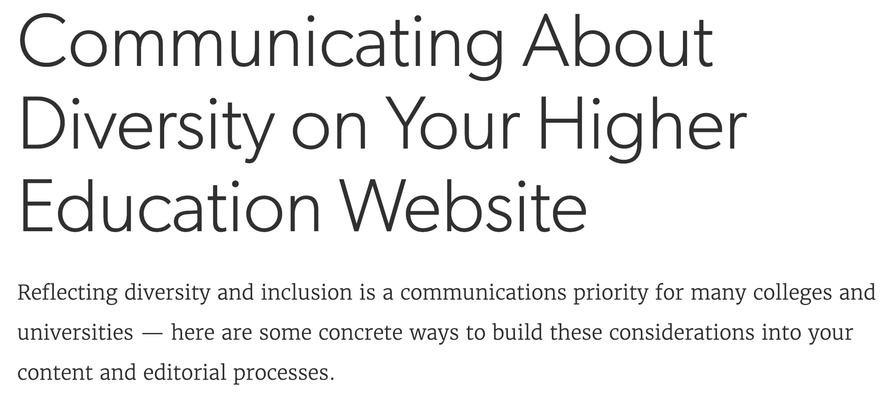
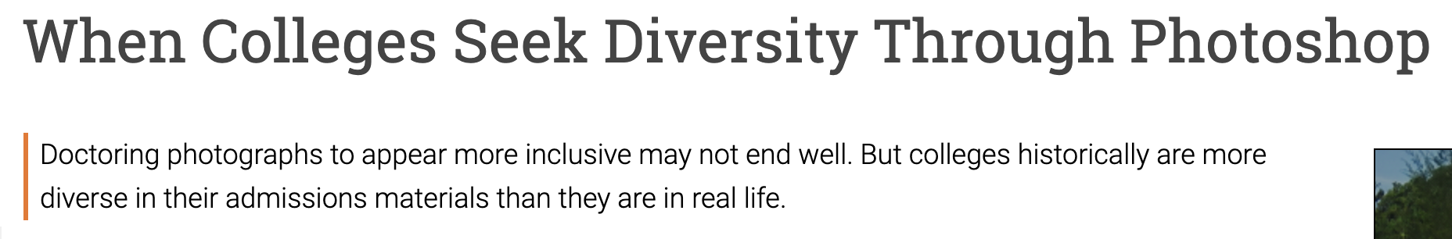
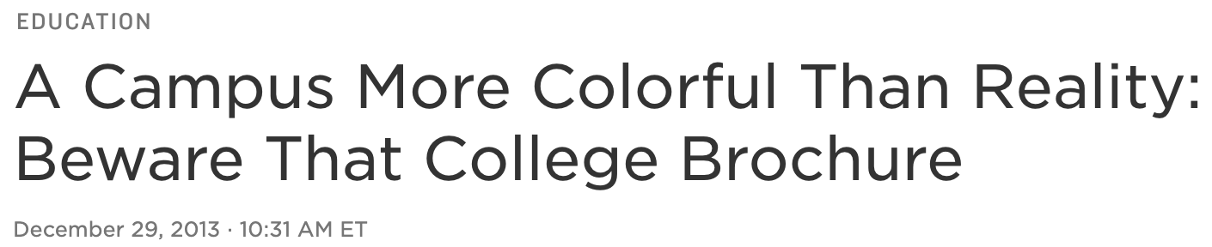
Diversity on College Websites vs. College Campuses

Slide 2
Let’s find out! What is our problem to solve?
What do college and university websites say about diversity?
How accurate is that portrayal?

Slide 3
Why should we care?
Diversity is a big draw that prospective students and prospective professors look for
However, if we are inaccurately displaying a certain diversity when there is less, students or faculty could be disappointed, which could result in them leaving the Davidson community
We should strive to build a diverse community, not just online

Slide 4

Implementation Ideas
beautifulSoup: Scrape images from college and university websites
01
face_recognition package: crop images to be just one face in tight frame
02
Ran into importing problems but just need proper permissions and it should work
Skin Extraction from Image and Finding Dominant Color: Mask for skin on cropped images and output classification data using openCV
03
We will need to fiddle with this to classify skin colors as different races

