Slide 1

Classification Project Term Deposit Subscription
Elyas Maghrabi
Notes:
Starting
Hello tankyou for being here today and we would like me elyas maghrabi and tia to welcome you all .
So today we want to talk about modeling where is term deposit subscription data

Slide 2
Abstract
The data is related with direct marketing campaigns (phone calls) of a Portuguese banking institution.
Classification goal
The classification goal is to predict if the client will subscribe a term deposit (variable y).
Notes:
So today we want to talk about modeling where is term deposit subscription data
Abstract :
The data is related with direct marketing campaigns(phone calls) of Portuguese banking institution .
Goal:
The classification goal is to predict if the client will subscribe term deposit (variable y).

Slide 3
Objective The objective is to analyze dataset based on several variables and create a classification algorithm.
Dataset
The dataset was collected from UCI Machine Learning Repository:
http://archive.ics.uci.edu/ml/datasets/Bank+Marketing#
EDA Phase:
Pandas
Matplotlib
NumPy
Machine Learning Phase:
Sklearn
Notes:
Objective :
The objective is to analyze dataset based on several variables and create a classification algorithm.
Dataset:
The dataset was collected from UCI Machine Learning Repository:
http://archive.ics.uci.edu/ml/datasets/Bank+Marketing#
EDA Phase:
Pandas
Matplotlib
NumPy
Machine Learning Phase:
Sklearn

Slide 4
UCI - Bank Marketing Data Set
Dataset contains:
We have 41188 instances and 21 features..
y - has the client subscribed a term deposit (yes, no) target.
Bank Client Data:
Age, Job, Marital, Education, Default, Housing, Loan
Last contact / Campaign:
Contact, Month, Day_of_week, Duration, Campaign, Pdays, Previous, Poutcome
Social and economics:
Emp.Var.Rate, Cons.Price.Idx, Cons.Conf.Idx, Euribor3m, Nr.Employed
Target outcome:
Y - Subscribe term deposit or not
Notes:
So the dataset about client subscription on term deposit is from UCI Machine Learning
The data itself mainly contain four components
The first component is the basic bank client data which is does something like education level and whether the client own a house or whether client have loan before
And next component about last contact we made between the client and us.
about the campaign . And it has a variable about like when is the last time we contacted client and what is the outcome of the contact
And the third component is Social and economics component it has variables such as employment variation rate , consuming price index and consuming confidence index and number of employees
Last component is our target y which is whether a client subscribed to term deposit or not so it binary column

Slide 5
The problem
Preprocessing
What features?
Prediction Model
What features are important to get customers subscribe in the term deposit.
Try to build a model to predict whether customers will subscribe for term deposit.
How to deal with missing values
How to encode categorical variables
Imbalance Target
Notes:
The problem we’re trying to solve with this data how we should per-process the data for example how we can deal with the missing values and how to encode the categorical variables and how to deal with a imbalanced together
and also, we are wondering what futures are important to get customers subscribed to the term deposit
and at last, we would like to have a prediction model that can predict whether customers will subscribe for term deposit or not and
hopefully we’ll be with high generality

Slide 6
Exploratory Data Analysis
Notes:
So tia will talk about EDA phase

Slide 7
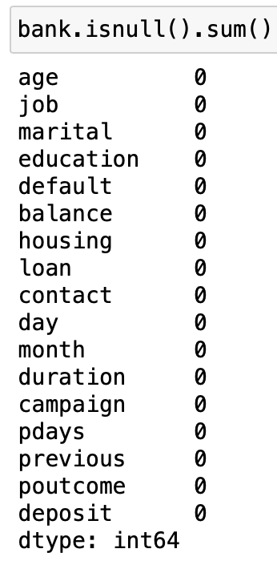
Check for null values
Fortunately, there are no missing values. If there were missing values, we will have to fill them with the median, mean or mode.

Slide 8
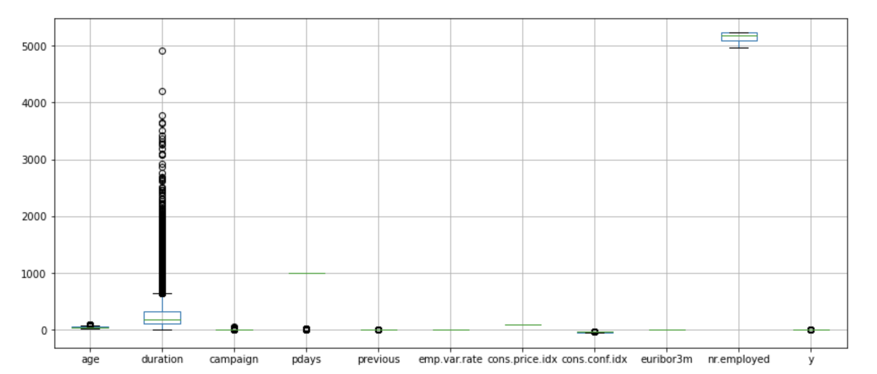
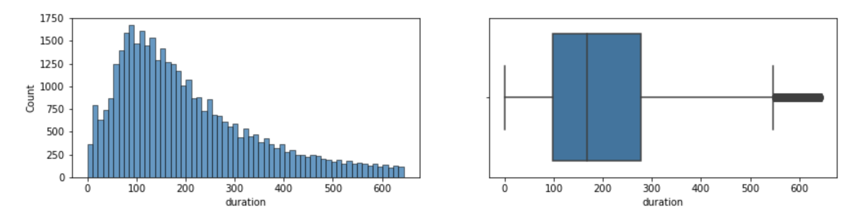
Removing outliers
Notes:
In order to remove outliers from this skewed distribution, we will define a function to get the upper and lower limits based on the IQR

Slide 9
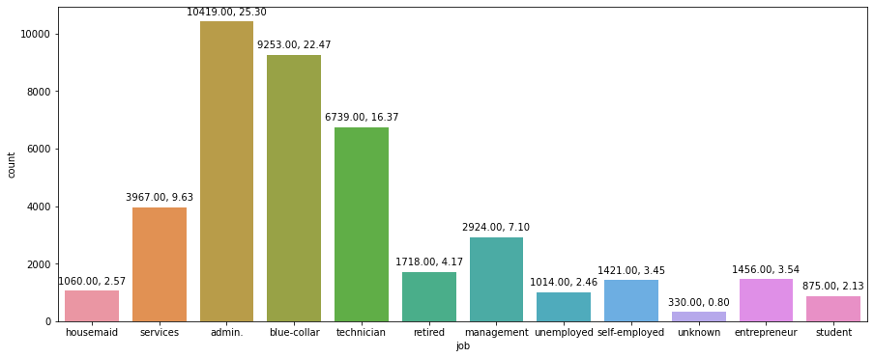
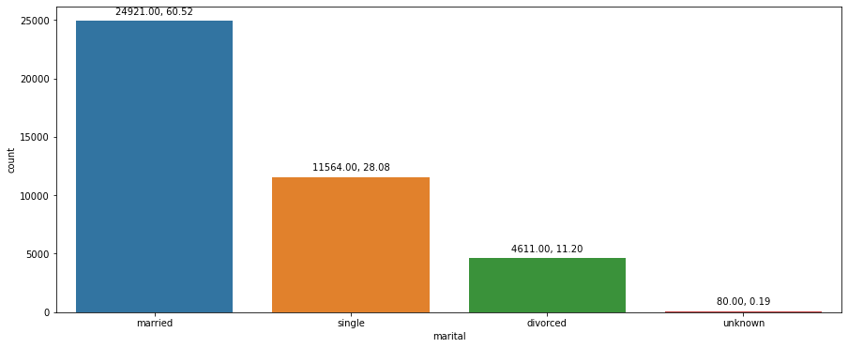
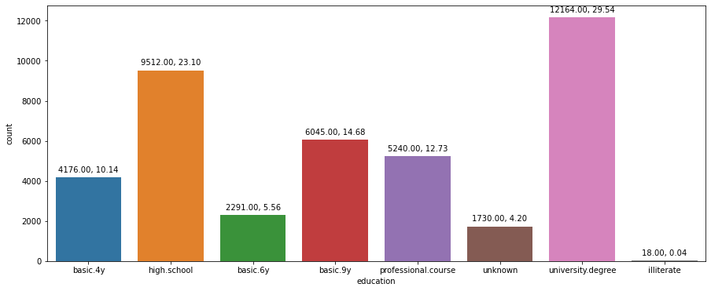
Data Analysis: Job, Marital
Notes:
Job: Highest Number (around 25%) of application are from admin type of job.
#Default: Default variable has no impact on the client subscribing for term deposit. As we can see with no as input client took the term deposit and client having credit are not taking term deposit. So we will drop this feature.
Marital: Around 60% of client were approached were married.
Education: Client with university degree and high school were approached more as compared to other and they have higher success rate as well. (in terms of term deposit number)

Slide 10
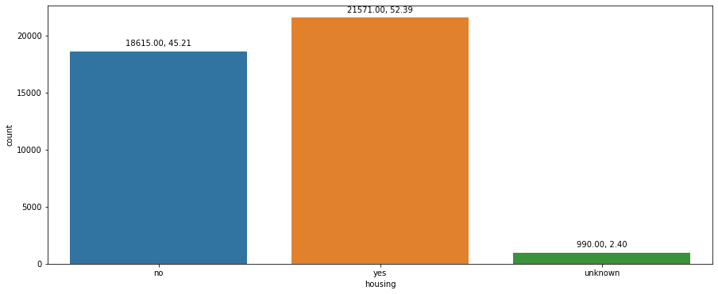
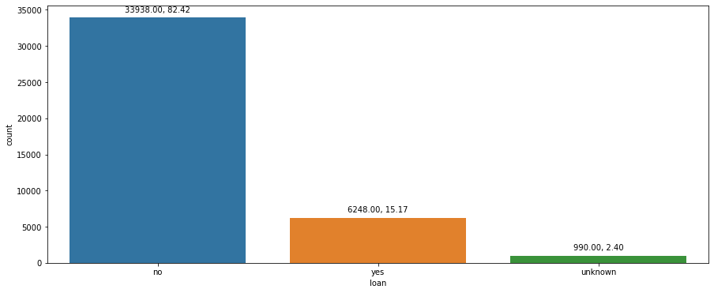
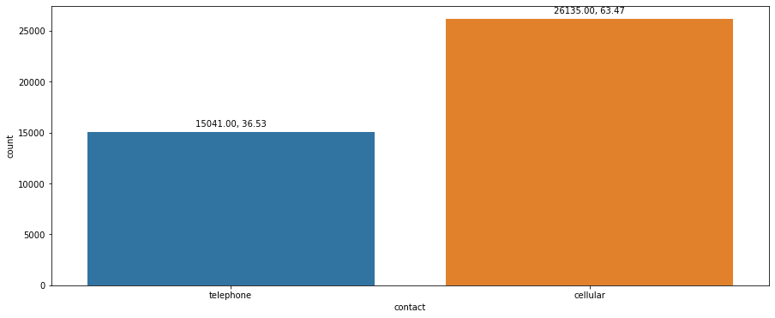
Data Analysis: Housing, Loan, Contact
Notes:
Housing: Housing loan does not have much effect on the number of term deposit purchased.
Loan: We approach around 84% of client with not having personal loan.
Contact: Around 64% calls are from cellular.

Slide 11
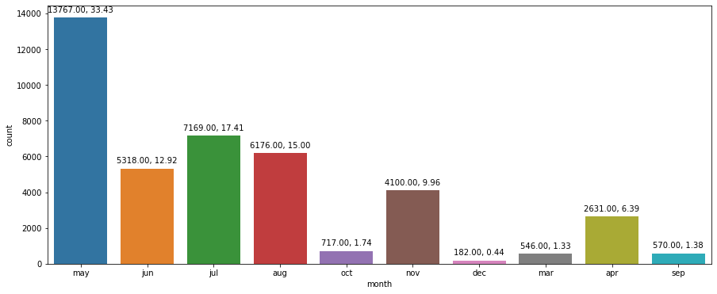
Data Analysis Month
Notes:
Month: Around 33% were approached in may and in January, Febuary we don't have data or no one was approached.
Success rate was almost same in june, july and August.

Slide 12
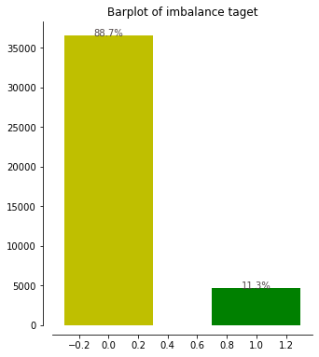
Imbalance
Target
11% to 88%
(User class_weight = “balanced”)
Notes:
from this visualization plot of target variable we can tell that our target variable is very imbalance
We have 11% of yes we have 88% of no
So that is very imbalance, and which mean the majority of people will not subscribe to term deposit so when we’re training our data we need to make class weights equals balanced so that the model will balance the imbalanced data somehow and

Slide 13
Preprocessing
Categorical
By description, all the unknown or missing values are represented as “unknown” in all the categorical values. And since most of them are not ordinal(nominal), therefore we would like to oneHotEncode them.
Numerical
There are almost no missing value in the numerical columns, but one weird columns “pdays”, which is the number of days since last reach out, indicate no call before as 999. Therefore, we need to replace 999 with 0.
Notes:
When it comes to preprocessed data our categorical variables is given in the data description that all the unknown and missing values are represented as unknown as we see in EDA part so and most of them are not ordinal so we can basically just simply them use one hot encoder to encode them
And our numerical columns or variables they’re mostly fine there’s no missing values but one column called p days which is the number of days since last reach out to client that column indicates no call as 999 so we need to replace this 999 with 0 so that it doesn’t cause any confusion to the model

Slide 14
Modelling

Slide 15
Three Models
Logistic Regression
Random Forest
Ensemble model
Baseline
The logistic regression performance is not very well, but its simplicity make it work very well as the baseline.
RandomizedSearchCV
Using random grid search , we can search for the best hyperparameters that goes into the model.
Voting Classifier
With ensemble model of knn, decision tree, and svc, find the best combination of the model with their vote.
Notes:
For modelling part there are threes models total that we fit
The first one is Logistics regression.
The Logistics regression model even though it doesn’t perform very well since it’s the simplest model we can use it , and it works very well as the baseline of the score
and second model is the random forest we created a grid or a list of the candidates for hyper parameters we continue and throw it into the random forest cv our cross validation to get the best hyper parameters that can go into the random forest model
and Third model we use is ensemble model using the voting classifier with different model for example model of knn , decision tree and svc classifier “support vector classification” to find the best combination of the model with their vote
So now let’s interpret the outcome of the model

Slide 16
Metrics
Models
Validation score
F1 Score
Confusion Matrix
1
Logistic Regression
[[5838 1006]
[ 100 777]]
0.85
0.88
What features?
Prediction Model
2
Random Forest
[[6773, 71],
[666, 211]]
0.90
0.88
3
Ensemble model
[[6642, 202],
[482, 395]]
0.91
0.90
Notes:
So here are the metrics we used for the there models the first one is validation score which is just default score between predictions and the validation set second column is f1 score and third matrix we use is confusing matrix
From the first column we can tell that ensemble model works the best will perform the best on among the two
and first two perform pretty much the same but when we look at the confusion matrix
We can tell that random forest and ensemble model works really well on predicting True positive but they’re not very good at predicting false negative
but if you look at logistic regression is very balanced on predicting the true positive and false negative
So by things we’re trying to pick the best performances overall so we decided to use ensemble model as our final model and it has the highest generality

Slide 17
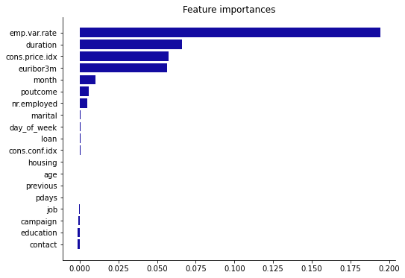
Most important features:
Employment variation rate
Duration
Consumer price index
Euribor 3 month rate
They are all social and economics and campaign related features.
Notes:
And when it comes to deciding which feature are most important, we visualize this feature importance plot using the import mean importance attributes and most of the model agrees that these four columns
•Employment variation rate
•Duration
•Consumer price index
•Euribor 3 month rate
Are the most important features to the model and
As we can tell they are all social and economics and campaign related features so maybe we can conclude that whether a client will subscribe to the term deposit it’s also very highly closely related to the current social and economics and campaign situations
So that all from our presentation and thank you for lessening

Slide 18
Thank You

