Slide 1


Slide 2
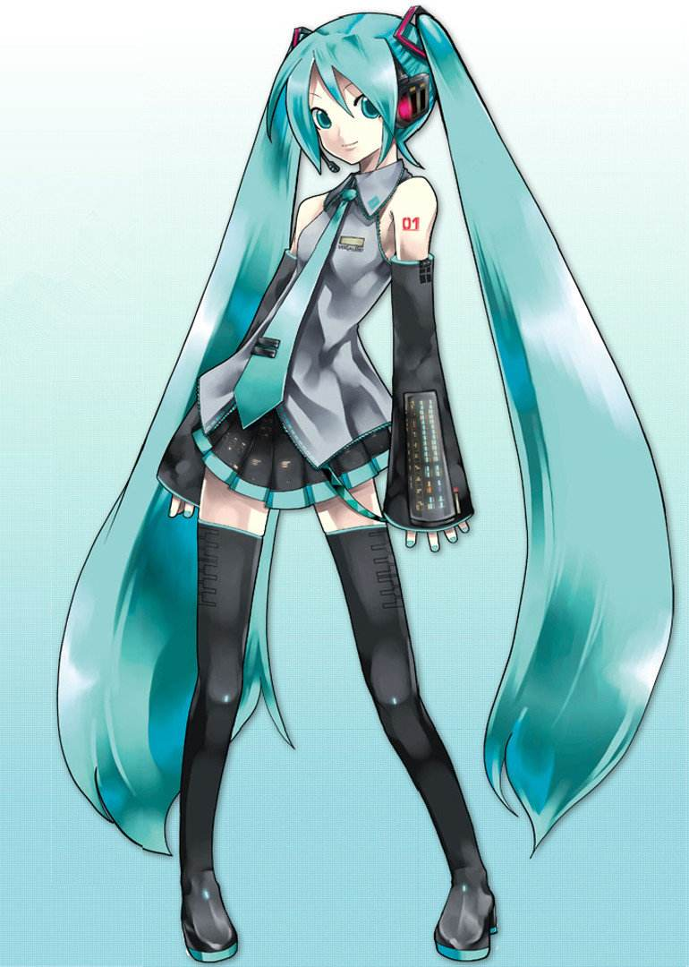


History
Founded on 6.26,2009,as MikuFans.
Renamed on 1.24,2010,as bilibili
Run as a corporation in 2014
Listed on NASDAQ in 2018
我永远喜欢初音未来
御坂美琴

Slide 3
Why you may like bilibili?

Slide 4
No ads

Slide 5
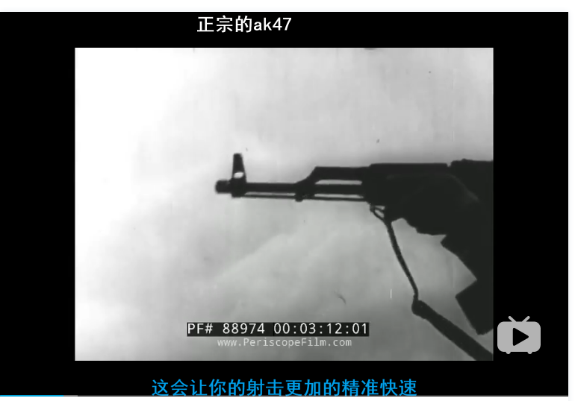
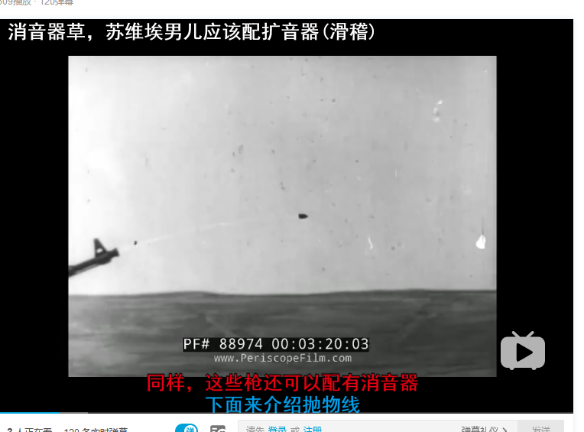
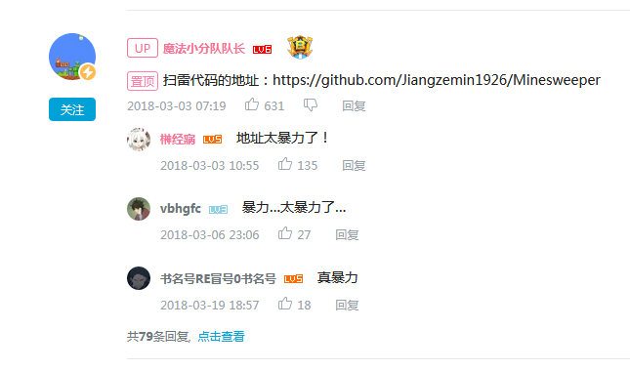

Nice people

Slide 6
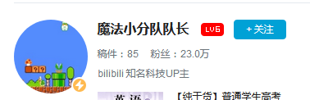
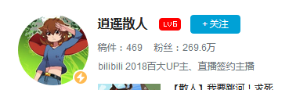
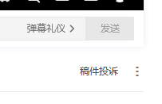

Why are people nice here?
Youth is the majority
Dr. of CAS
Master Candidate of NKU
Bilibili takes a lot of measures

