Slide 1
ORMLite for Android

Slide 2
Overview
ORM (Object relational mapping)
ORMLite
ORMLite for Android
Example in Android

Slide 3

Object relational mapping
Programming technique
Converts data between incompatible data representations
  object oriented data presentation ↔ relational oriented data presentation

Slide 4
Object relational mapper
Well known in the java world:
  JDO – Java Data Objects
    JSR243 (JDO2.0)
    Release 2006
    Reference implementation: DataNucleus AccessPlatform
  JPA 2.0 – Java Persistence API
    JSR317
    Release 2009
    Reference implementations: EclipseLink

Slide 5
ORMLite
ORM framework
  Open source
  Small footprint
    Core ~300kb
    Android ~50kb
    JPA2 ~150kb
  Supports subset of JPA2.0
Website: ormlite.com
  Examples, JavaDoc, source code, libraries

Slide 6
ORMLite Feature
Annotation driven, but works without too
Supports: MySQL, Postgres, MS SQL Server, H2, Derby, HSQLDB, Sqlite
QueryBuilder
„Foreign“ object support
Basic transaction support
Spring configuration support
Maven

Slide 7
ORMLite for android
HowTo:
  You need: ormlite-core
  For JPA support: javax.persistance
  For android: ormlite-android
How does it work
  Uses reflection to map data form/to DB to java objects (DB cursor to Pojo, Pojo to SQL)
  NO byte code enhancement

Slide 8
ORMLite for Android
POJOs resp. Entity Objects
  No arg constructor, due to reflection
DAO
  Either predefined class or selfmade
SQLiteHelper
  Android specific SQLite accessor

Slide 9
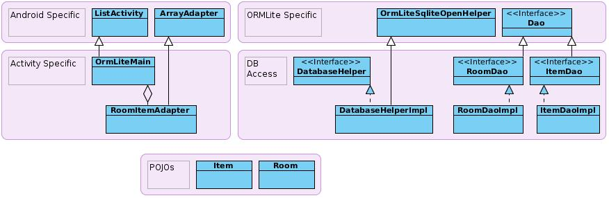
ORMlite for android
Code example
on github:
https://github.com/magiclands-com/ormlitedemo

Slide 10
Questions
Thank you
Questions
Contact
t.kudla@tarent.de
magic@magiclands.de

