Slide 1

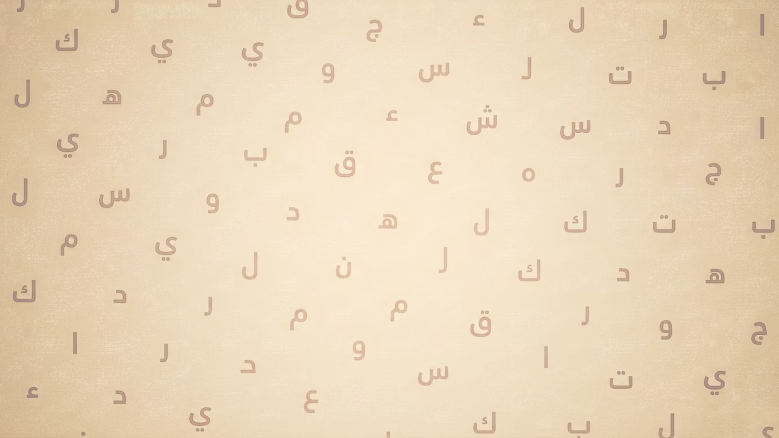


Notes:
1

Slide 2


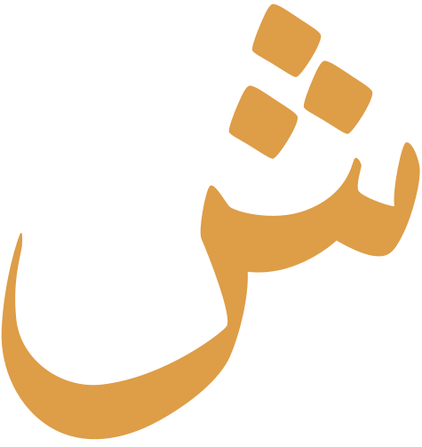




Jawhar
Arabic at its Core
Presented by: Meher Ali
AI/ML Fellowship 2026
Notes:
2

Slide 3

Introduction
The Problem no app has solved
1.8 Billion Muslims. One Language. No Grammer App
For 14+ centuries, Classical Arabic grammar was taught through the ijazah system, scholar to student, in mosques and madrassas. Access required physical proximity to a qualified teacher, years of commitment, and financial means. For Muslims across South Asia, Africa, and Southeast Asia, structured Sarf and Nahw education was effectively unreachable.
Technology began closing this gap gradually, cassette tapes in the 1970s, digital Quran databases in the 1990s, web platforms in the 2000s, and smartphone apps that now reach hundreds of millions. Yet through every wave of innovation, Arabic grammar was left behind. Apps teach vocabulary, not structure. Research tools like corpus.quran.com provide world-class annotation but are built for graduate linguists, not everyday learners. Teacher-led platforms exist but are paid, synchronous, and unscalable.
The result: millions of motivated learners can recognise Quranic words but cannot parse a single sentence, because no accessible, self-paced, grammar-complete digital tool has ever existed for them.
Notes:
3

Slide 4


Literature Review
Foundation
Source
Role in Jawhar
Quranic Arabic Corpus
Dukes & Habash, LREC 2010
Primary Linguistic dataset (77,430 words)
1
2
CAMel Tools
Obeid et al, NYU Abu Dhabi 2020
Powers the Sarf Engine
3
Farasa NLP
ABdelali et al, QCRI 2016
Powers the Nahw Parser
Spaced Practice Meta Analysis
Kim & Webb, 2022 (63 studies
Vocabulary SRS retention approach
4
5
LLM Chatbot in Language Learning
Zhang & Huang, Heliyon 2024
Validates AI Tutor as learning intervention
6
Gamification Review
Hamari et al, HICSS 2014
Validates streaks, badges, leaderboards
Notes:
4

Slide 5

The Problem
Existing Tools
Duolingo, Rosetta Stone — designed for conversational modern languages
CAMeL Tools, Farasa, Anki — powerful but siloed and not integrated into a unified learning experience
Insufficient coverage
Global comprehension gap
Classical and Quranic Arabic differ considerably from Modern Standard Arabic and are not supported by mainstream language-learning tools.
Over 1.8 billion Muslims worldwide lack access to tools that enable understanding of the Quran in its original language.
Tool mismatch
Fragmented capabilities
Platforms such as Duolingo and Rosetta Stone target conversational modern languages and do not address Quranic grammar depth (sarf, nahw).
No single platform currently unifies NLP morphological analysis, syntactic parsing, AI tutoring and spaced repetition into one cohesive Quranic learning experience.
Notes:
3

Slide 6

Our Solution
One unified platform purpose-built for Quranic Arabic comprehension.
Delivered as a cross-platform application on Android and iOS via Kotlin Multiplatform.
NLP-Powered Analysis
AI Conversational Tutor
Adaptive Vocabulary & Paths
A Gemini Flash-powered tutor that answers learner questions about grammar, meaning, and structure in real time.
A spaced repetition system for Quranic vocabulary combined with learning paths that adjust based on individual performance.
Automatic morphological breakdown (Sarf) via CAMeL Tools.
Notes:
3

Slide 7

Core Modules
1
Cross‑platform application
Build a Kotlin Multiplatform app for Android and iOS to ensure broad accessibility.
2
Morphological analysis (Sarf)
Deliver root extraction and verb‑conjugation analysis using CAMeL Tools.
3
Syntactic analysis (Nahw)
Provide grammatical parsing and i'rab using Farasa's syntactic modules.
4
AI conversational tutor
Integrate Gemini Flash to provide interactive tutoring, explanations and targeted feedback.
5
Spaced Repetition System
Implement SRS to optimise vocabulary and morphology retention across study sessions.
6
Adaptive learning paths
Personalise curricula dynamically according to learner performance and diagnostics.
Notes:
4

Slide 8
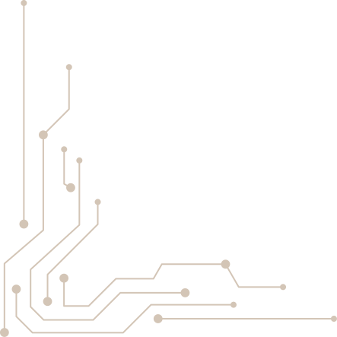
Technology Stack
Component
Technology
Frontend
Kotlin Multiplatform (Android, iOS)
NLP — Morphology
CAMeL Tools (Python)
NLP — Syntax
Gemini + RAG
Quranic Corpus Microservice
corpus.quran.com API (Java)
AI Model
Gemini Flash (interactive tutoring)
Database
PostgreSQL
Cache
Redis
Infrastructure
Docker, Nginx, GitHub Actions
Notes:
8

Slide 9



Questions & Discussion
Notes:
10

Slide 10
Thanks You!
Presented by: Meher Ali & Hammad Ali
Notes:
11

