Slide 1
Weakly progresS
Jing Mai
Peking University
02/28/2020

Slide 2

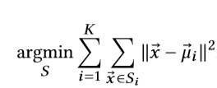

- K-means algorithm
sample vector $\vec{x}$ : low and arbitrary bit-width eg. $b_{l}=3$
cluster vector $\vec{u_{i}}$ : high bit-width eg. $b_{h}=32$

Slide 3
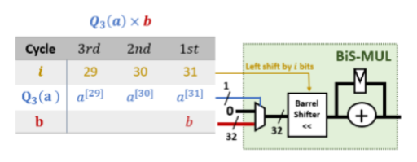

Q: How to multiply any low precision by high precision?
- bit-serial
BiS-MUL
Function: multiply any low precision by high precision
Delay: bit number of low precision $b_{l}$

Slide 4
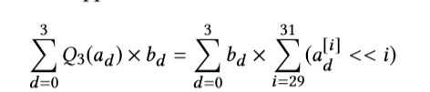
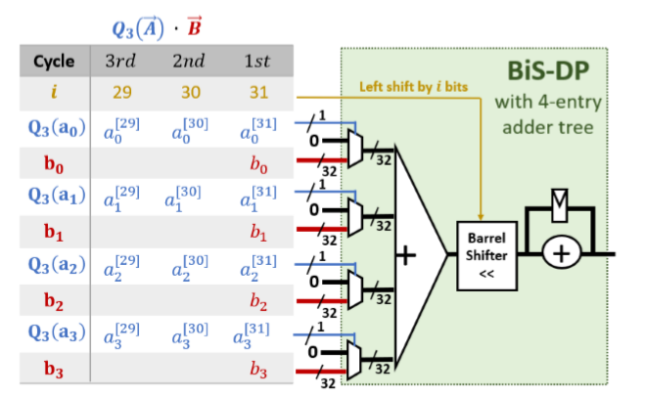

Q: How can an arbitrary low precision vector do point product with a high precision vector?
- bit-serial
- adder tree + multiple Bis-MUL?
adder tree low utilization….
solution?
BiS-DP

Slide 5

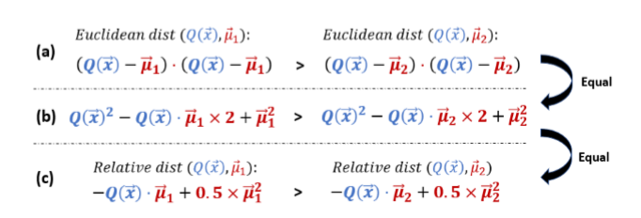
Q: Is it cost-effective to use European distance? Is the resource utilization rate high?
-
- 我们只关心最值, 实际上只关心点积.

Slide 6
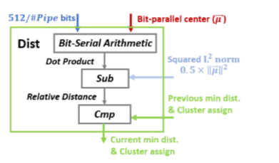
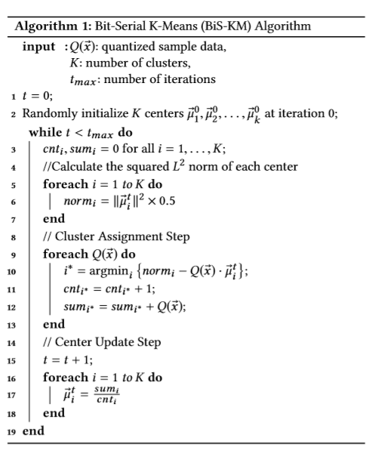
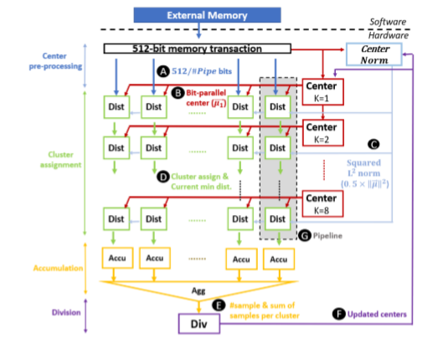
Overview

Slide 7
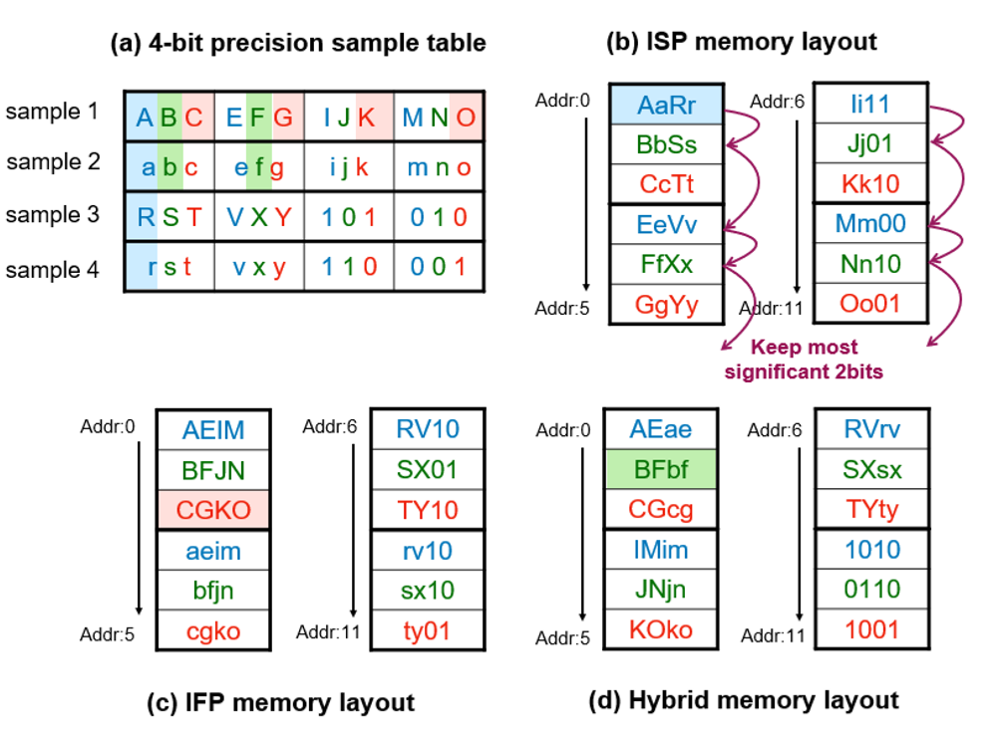
两种并行方式: 样本间并行和特征间并行

Slide 8
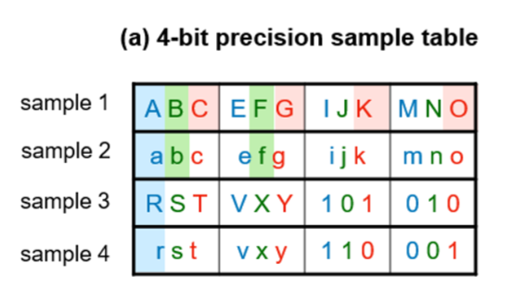
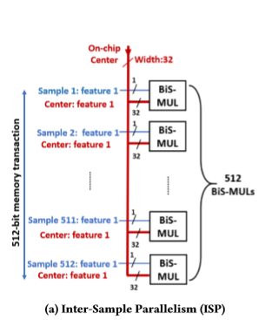
-样本间并行:
使用BiS-MUL
Cons: 资源消耗多 M * K = 4096个BiS-MLU

Slide 9
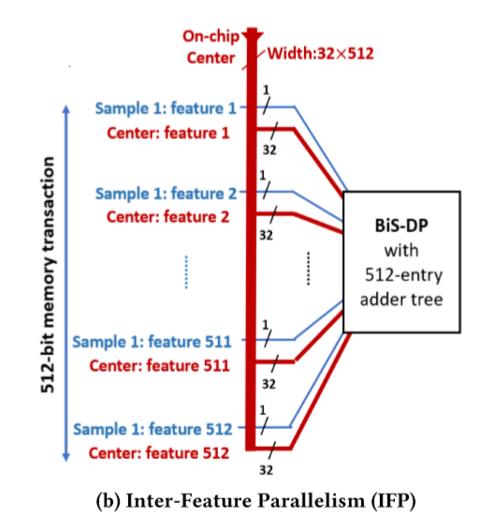
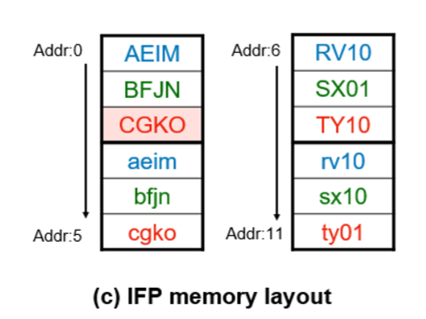
特征间并行:
使用BiS-DP
Cons:
片上带宽需求大
特征数必须是512的倍数

Slide 10
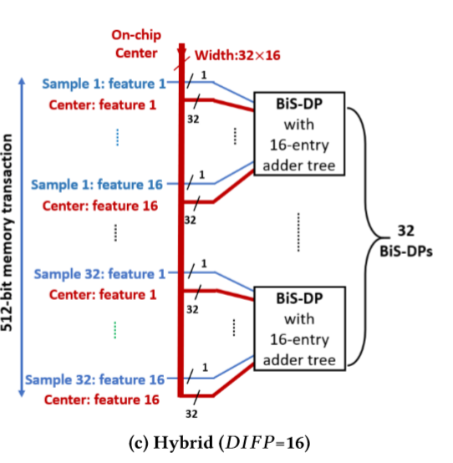
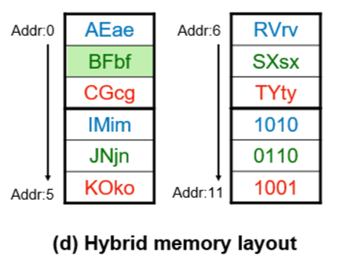
Solution: Hybrid

Slide 11
Personal Insight
- hybrid solution
- bit-serial
- multiply any low precision by high precision
relative paper: BISMO: A Scalable Bit-Serial Matrix Multiplication Overlay for Reconfigurable Computing, FPL 2018
Large scale matrix multiplication with variable bit width

